Slide 1
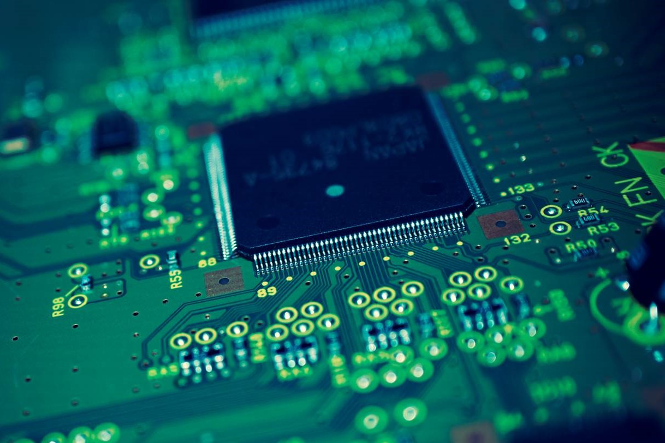
From The Garden To The City: Redemption
Levi Douglas & Joshua Rohrer
CPS 105 FGC Presentation IV
https://www.photohdx.com/pic-2609/electronic-circuit-motherboard-cpu-background

Slide 2
Redemption
Blueprints
Social Networking
Three Ideas Around Technology
Notes:
This section from chapter 7 is broken down into three different ideas around technology:
Redemption
Blueprints
Social Networking

Slide 3
Redemption
Technology has a certain redemptive capacity in the right situation
A buzzer was used to encourage a Pastor diagnosed with cancer and even created opportunities to share the gospel
Notes:
The book gave a short story of how a church congregation used a buzzer to let their pastor, who was diagnosed with cancer, know they were praying for him. In 2 years, God miraculously healed him. This example illustrates how something normally distracting and annoying can be used for good. Creative use of the buzzer transformed its sound into an encouragement that illustrated the power and faithfulness of God.

Slide 4
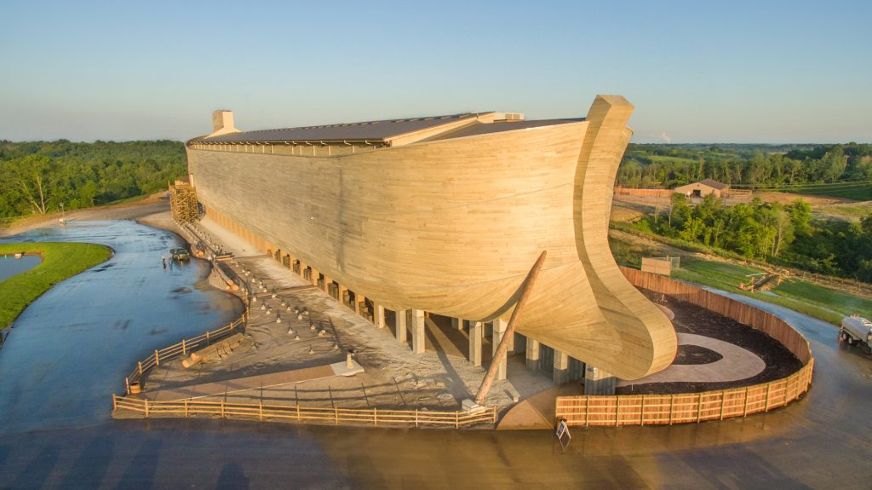
Blueprints
Although technology can save temporarily, as in the case of Noah’s ark, only God can save us eternally from our sin (Jesus Christ’s death on the cross).
https://www.archdaily.com/794940/ark-encounter-leroy-troyer
Notes:
Worldly influences of today want us to believe that advances in technology and science will save humanity or somehow bring us utopia.
As Christians, it is important that we recognize that Jesus created technology to further His redemptive purposes. While technology helps relieve us from suffering and “nurtures us along” in a cursed world, Jesus Christ is the only one who offers salvation from sin and eternal life (John 14:6). What’s more is that He offers it freely to all who believe, not according to our works (Romans 6:23). We don’t have to worry about evolving or inventing a means to immortality through technology. Instead of idolizing technology, we should allow its amazing potential to point us to trust in Jesus Christ, the ultimate reality.

Slide 5
Social Networking
Advances in technology can turn man’s heart away from God
The tower of Babel was used as a substitute (anti-garden) for God

Slide 6
Technology only changes the choices people can make
Technology change in culture results in a change of that culture
While technology impacts culture, culture can also impact technology
Notes:
Technology only changes the choices people can make
For example: guns
Technology change in culture results in a change of that culture
For example: cars
While technology impacts culture, culture can also impact technology
“Each new tool [technology] has a series of strengths and weaknesses and a unique set of values and these factors work in concert to shape our world and influence our choices.”

Slide 7
Conclusion
Balance
God shows us His desire as the creator of technology for balance and discernment in our use of it
Notes:
Thus, we can look to Him to see when it’s time for outside intervention to eradicate a certain technology and when a technological solution to a problem would bring glory to God.
Example: Recording sermons and posting them on a website.

