Slide 1
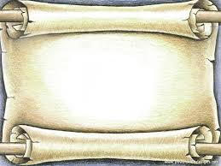
From the Garden to the City Ch. 7: Redemption
By: Zachary Tapp and Jessie Heath

Slide 2
Theme
God uses technology to redeem his people
“Noah made all that God had commanded” (Gen. 6:22)

Slide 3
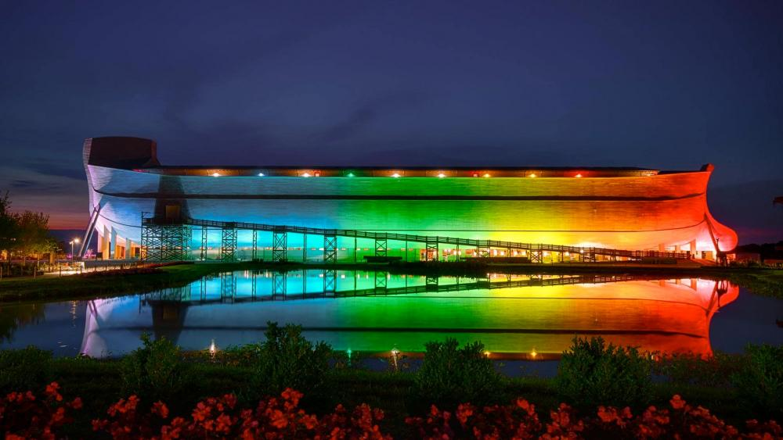
Noah’s Ark
God commissions technology to save his people and further his plan
The redemptive property is only temporary
God is pleased when he uses our creations to further his redemptive work
http://www1.cbn.com/cbnnews/us/2017/july/new-noahs-ark-lights-christians-need-to-take-back-the-rainbow

Slide 4
Tower of Babel
God uses technology to hinder our wicked desires and preserve his plan
The people of Babel threatened his plan
Technology doesn’t force action but changes our options

Slide 5
Modern Examples
Medicine
Encouraging Emails
Evangelism

Slide 6
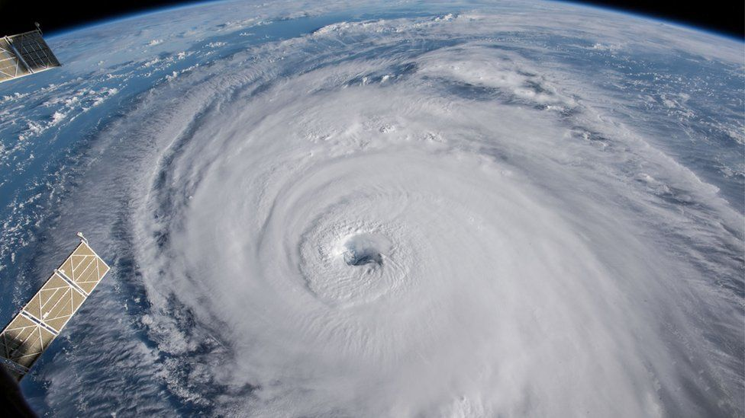
Personal Application
Filters on the internet
The Creation Museum
Hurricane Relief
https://www.bbc.com/news/world-us-canada-45532679

Slide 7
Proper usage of the tools for God
Advancement of technology
Misusage
“The buzzes from Andy’s beeper distracted him (and the people in the waiting room) from the idea that there was no hope, that people didn’t really care, and that God wasn’t there with him.”

