Slide 1
From the garden to the city Chapter 6: Approach
By Nathaniel Colegrove and Julianna King

Slide 2
Application of Technology
Technology can be used for good
Encouraging people
Communication
Business affairs
Technology can be used for evil
Pornography
Cyber crime
Black-market
Improper business practices

Slide 3

Views of technology
Instrumentalism
Technology is just a tool and does not influence our actions
“Guns don’t kill, people do”
Technological determinism
Technology drives societies
Karl Marx and the use of technology to level the social status of men
Blaming tactic

Slide 4
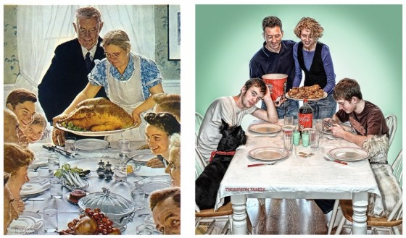
“The more its around the more we use”
Technology can be used to magnify, extend, eliminate, and amputate certain practices of the past.
Fast food
Its easy to get and helps us save time but it isn’t healthy and takes away normal family time around the table.
https://humor.gunaxin.com/rockwells-thanksgiving-parodies/178165
Notes:
Phones are now used to communicate which is good but can be used to also seclude yourself from real life human interaction
Calculaors can help solve math problems but it inhibilitates memory skills

Slide 5
Media Ecology
The way of life with technology
Music: new ways of advertising, selling, producing…
E books: Easier way to get books, read them, and store them.

Slide 6
What to do with technology
There is always a cost to every benefit…there are always trade offs
Making bad decision and following the sinful nature
Making good decisions and using technology for God’s glory (hint: what the next chapter is about).
“The most accurate observation to be made about the philosophy of technology is that there really isn’t one”—Langdon Winner

