Slide 1
Chapter V
Rebelion
Yoseph Lee
CPS 105
Oct 5, 2018

Slide 2
STEAL
Mutant Ninja Turtle. Figure
It was enjoyable
Later feeling guilty
Have you ever stole something in the past?

Slide 3
Sin – enjoy – regret - result

Slide 4
Adam & eve
Ate forbidden fruit
Was good at first time
Realized what is good and evil

Slide 5
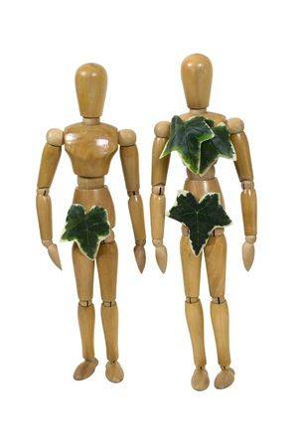
World’s first technology
They made clothes with fig leaves.
Hiding behind the fig leaves is never enough
https://www.123rf.com/photo_6432444_wooden-models-wearing-leaves-as-clothes-to-represent-adam-and-eve.html

Slide 6
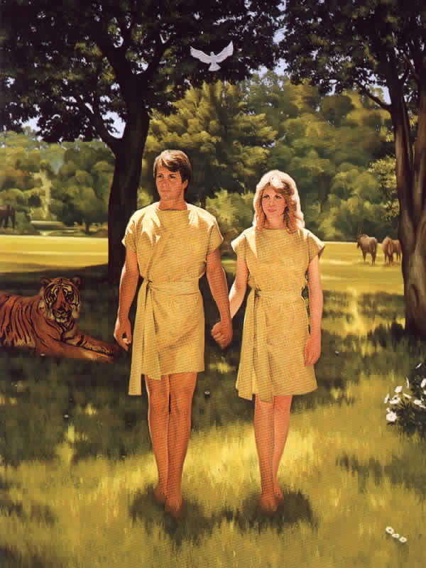
World’s first upgrade
Begin with fig leave clothes
Upgrade to brand new arrival skin clothes
https://www.deilataylor.com/the-lord-made-garments-of-skin/

Slide 7
Cain & abel
God rejected Cain’s offspring
Killed his brother
God cast him out to the far east of Eden

Slide 8
rebellion
Cain built city (isolated from God)
Need technology
not for God
but for rebellion against God

Slide 9
Technology
Enhance quality of your life
Attempt human without God
Messenger of Gospel
vs
Tools for sin

