Slide 1
Rebellion
Technology in Genesis

Slide 2

The First Technology and Upgrade
Fig leaves into something with practical purpose (clothes)
Shift in relationship with God

Slide 3


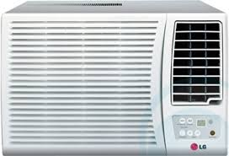


The First Technology and Upgrade
Technology is our attempts to overcome the effects of the fall
Ex. Lightbulbs, air-conditioner, shovels
Technology temporarily eases pain.

Slide 4
Anti-Gardener and Anti-Garden
Cain Kills Abel
Ignores God’s Warning
Task description
God Curses Him
From the Ground
Cain Builds a City
Alternative to Eden
Task description
Rebellion Against God

Slide 5

Man’s attempts to cover the effects of the fall
Picture of New York City - https://www.newszii.com/technologically-advanced-cities/

Slide 6
The First Technological Revolution
Strands of Human society
Contrasts
Agriculture
Art
Technology
Line of Cain vs Seth
Pagan vs Christians
God-inclusive vs God-exclusive

Slide 7
Summary
First Technology and Upgrade
Even after the fall, God encourages creativity with technology.
Anti-Gardener and Anti-Garden
Technology can be our best attempts to create a world independent of God.
The First Technological Revolution
We must not be people with a lot of technology, but no faith(reliance on God)

Slide 8
Thank you!!!
Thank you!!!
Thank you!!!
Thank you!!!
Thank you!!!

