Slide 1
Imagination
From the Garden to the City: Chapter 2

Slide 2
Isaac Abrahamson
Classification: Freshman
Major: Computer Science, Business
Dream: Start my own business, possibly in a foreign country doing missionary entrepreneurship
Cool fact: I’ve performed a solo piano concert and had a newspaper article written about it.
CPS 105 FGC Presentation

Slide 3
Will Pham
Classification: Freshman
Major: Computer Science
Dream: to become a successful computer programmer
Cool fact: I’ve gone with four hours of sleep a night for about 3 years or so now
CPS 105 FGC Presentation
Notes:
I am Will Pham but most of my friends just call me Pham. I am a Freshman majoring in Computer Science, dream is… cool fact...

Slide 4
Imagination
Kids naturally have a strong imagination
However, adults seem to have lost this ability
Technology awakens this ability and three stories unfold
Notes:
This chapter was all about imagination (do the spongebob thing) it starts off talking about how kids have a very interesting imagination for lack of a better word. As we get older that imaginative spark seems to fizzle out but with technology that imagination slowly seeps it way back into our lives

Slide 5


1. How we shape the world
Imagine you have some new technology. The technology we use whether simple or complex allows us to change the world.
It is a bridge From imagination to reality.
It is transformative Promises a better reality
Notes:
There were three sections to this chapter, it starts off with how we shape the world around us with the technology that we have. The technology we use, whether simple like a shovel or complex like a book. These tools are used as a bridge to help us further our imagination. Using them also promises a better reality in that we can change how we see and think of the world

Slide 6
2. How the tools shape us
Our world isn’t the only thing changed by technology. Technology has the ability to change us..
It is separative Removes us from direct interaction.
It is transformative Changes us physically and mentally
Notes:
Moving on to the second point, we talk about how the tools shape us. Our world isn’t the only thing changed by technology. It helps us get away from all the stress of the world and put us in our happy place which nicely segways into how it changes us physically and mentally. Technology such as say a bench press changes us physically in that we develop more muscle mass or a book which helps us mentally letting us learn more about certain topics

Slide 7
3. Why are we doing this
Why do we use technology? Why are we innovating and changing the world and where are we going?
Reduce suffering Technology improves life.
Redeem Plays a role in changing people.
Notes:
Onto the third and final point in this presentation. Why are we innovating and changing the world and where are we going? As technology keeps evolving our lives get easier and easier. It also plays a role in changing people, you could be living some sort of lifestyle and then one day a new product comes out that changes your life forever. I spent probably half an hour trying to figure out an example for this but couldn’t so i quit but i bet that one of you could figure one out. Done

Slide 8
is technology
the savior of life?

Slide 9
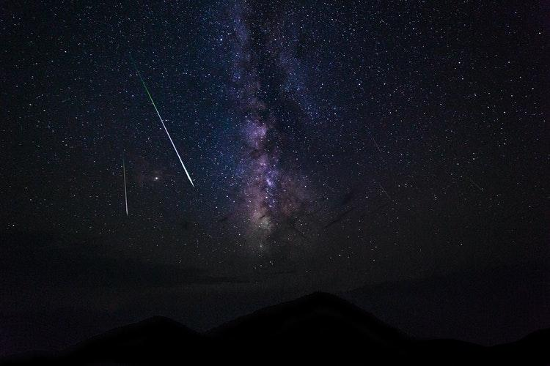
https://unsplash.com/@xohumanox

Slide 10
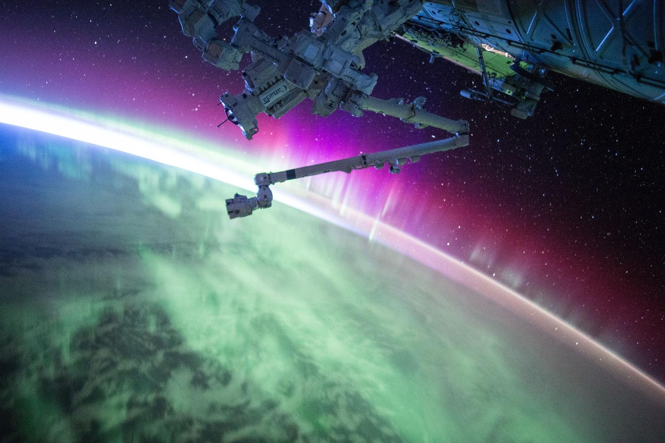
https://unsplash.com/@nasa

Slide 11
“There’s nothing we can do to prevent this cataclysm. Yet according to scientists who study the far future, including Yale University astronomer Gregory Laughlin, the prospect for life is, oddly, rather bright. Given technological advances and the continuing evolution of our species, humans should be able to survive — in some form — long after Earth has ceased to exist.”
Source: https://www.nbcnews.com/mach/science/how-humans-might-outlive-earth-sun-even-universe-ncna831291

Slide 12
“Still, even this near-eternity is not the same as eternity.
At some point, life runs into the physical limits of matter itself.”
Source: https://www.nbcnews.com/mach/science/how-humans-might-outlive-earth-sun-even-universe-ncna831291

Slide 13
“At 10^100 years — 10 duotrigintillion years A.D. — even black holes will evaporate...
...a new Big Bang would wipe away all traces of this universe — unless we can find a way to leapfrog into the next cosmic cycle.”
Source: https://www.nbcnews.com/mach/science/how-humans-might-outlive-earth-sun-even-universe-ncna831291

Slide 14
2 Peter 3:11-13
Since all these things are thus to be dissolved, what sort of people ought you to be in lives of holiness and godliness, waiting for and hastening the coming of the day of God, because of which the heavens will be set on fire and dissolved, and the heavenly bodies will melt as they burn! But according to his promise we are waiting for new heavens and a new earth in which righteousness dwells.
The Holy Bible, English Standard Version. ESV® Text Edition: 2016. Copyright © 2001 by Crossway Bibles, a publishing ministry of Good News Publishers.
Notes:
This chapter was all about imagination (do the spongebob thing) it starts off talking about how kids have a very interesting imagination for lack of a better word. As we get older that imaginative spark seems to fizzle out but with technology that imagination slowly seeps it way back into our lives

