Slide 1

Student Information Management System
Team Members:
Parteek Saini (300323311)
Jagseer Singh (300323885)
Shubam Kalra (300323868)

Slide 2
Introduction
AIM: To manage, access and update student's information in a college/university in a separate portal.
Below are the categories of the students whose data will be maintained through this application:
Currently enrolled students
Alumni’s

Slide 3
Database Architecture
There are different tables maintained for currently enrolled students and graduate students(Alumni’s).
For current students , a table named “Student” and for Alumni’s, a table “alumniStudent” and , both of which have the following columns:
1. Id(Primary key): Identity(1,1)
2.StudentID
3.FirstName
4.LastName
5.emailID

Slide 4
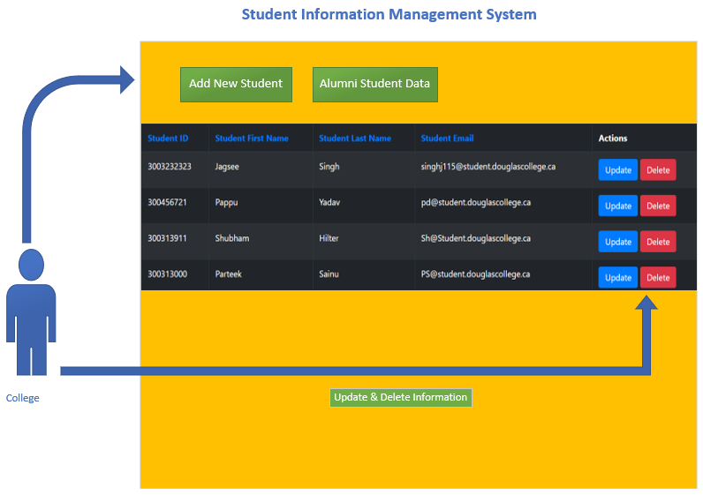
Landing page - design
The main page of this application shows us the data already present in the Student database table
Each row has an update and delete button.
On clicking update button, the user is redirected to a new page where it can update the existing values and the changes will reflect in the database.
On clicking delete button, the selected entry will be deleted from the student database.

Slide 5

Landing page – design (CONTINUED)
On the top of the display table, the design has two buttons as shown above.
Add New Student: redirects user to a new page where he/she can enter the details of a new student and add a new entry to the database
Alumni Student Data: redirects the user to list of alumni’s data where again the user has the option to add/ update and delete existing data.

Slide 6
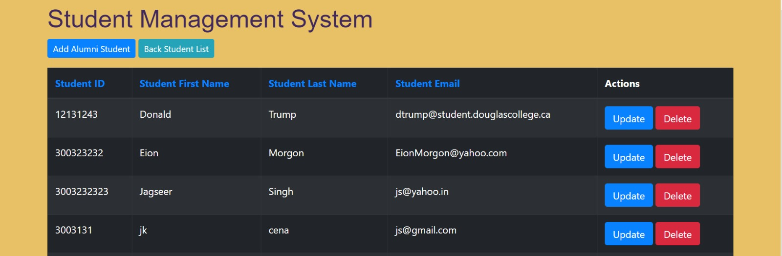
Alumni’s List
On going to Alumni’s page, data shown is from studentAlumni’s table in the database. Similar to student’s page, it has update and delete button and changes will reflect in the studentAlumni’s table.
By clicking on “Back Student List”, it redirects back to student’s list where the data is fetched from student table

Slide 7
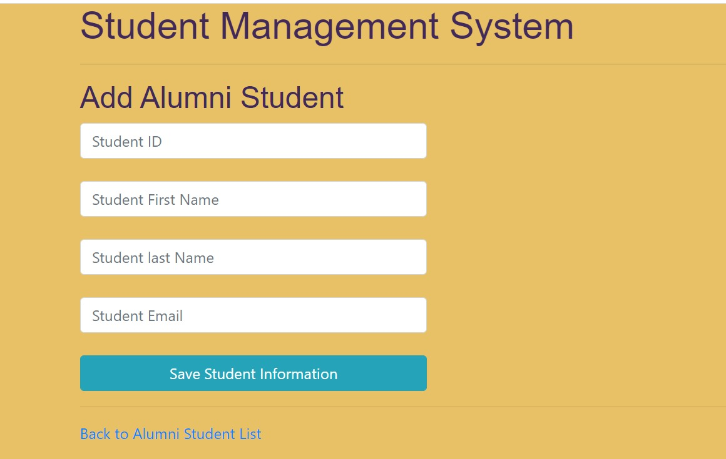
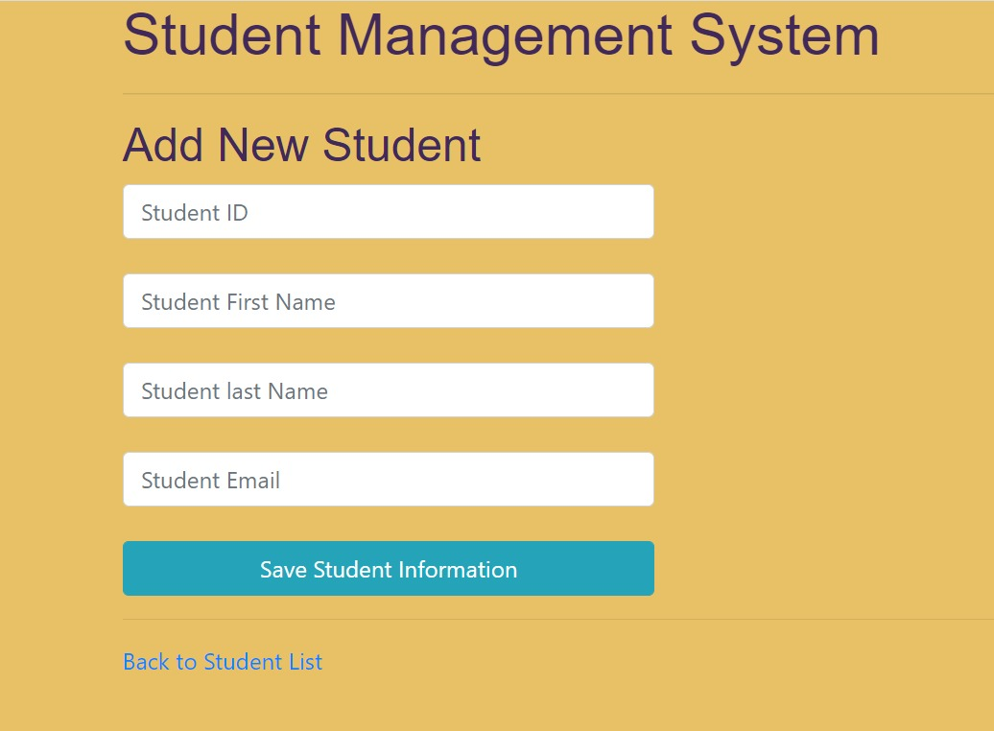
Adding Student and Alumni’s GUI

Slide 8
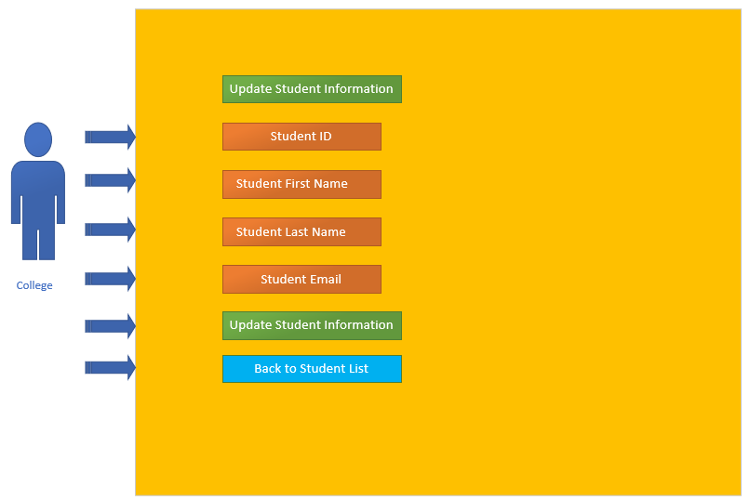
List of actions by college
As seen in the figure, these are the features which the user(College) has the option to access by using this application.

Slide 9
challenges
Below are the list of challenges faced by us while making the project:
On click of Update button, displaying existing data in the textbox which can be edited later by the user.However, it was figured out by fetching it from database.
Another challenge we faced was in the testing of project with test cases on live database. After doing some research then we able to implement tests case on live database in both tables, which we have implemented in our project.

Slide 10
Future enhancements
Below are the following enhancements will we as a group plan to append to the existing's project:
1. Sorting Student based on year by adding a dropdown list which when selected displays data of the students in a particular year.
2. Searching students by studentID or email which will make easier to access
3.Adding respective Professors of a student and all other details of students like grades, Unofficial and Official transcripts
Online PDF Downloadable degree/diploma certificate.

Slide 11


