Slide 1
ENGI 301 BeagleCNC 1.0 Proposal
10/5/2021
Douglas Hebda

Slide 2
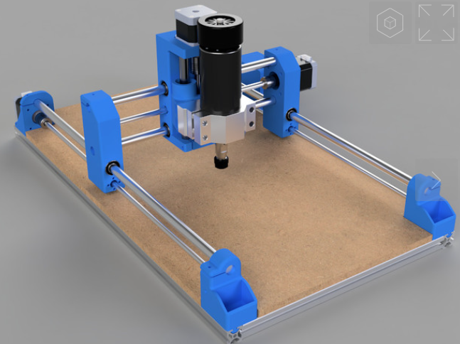
Background Information
For my ENGI301 project I want to build a PocketBeagle powered CNC router. The machine should take g-code as an input and perform a prescribed toolpath. It will use stepper motors and lead screws to achieve linear motion in 3 directions.
Opensource designs will reduce the amount of Mech design needed.
Arduino support exists, but I hope to take advantage of LinuxCNC to parse the g-code and control my machine.
Source Projects:
https://www.thingiverse.com/thing:3004773
http://linuxcnc.org/
Improvements
The primary improvement will come by way of using a superior driving system (PocketBeagle 🐶)
I also want to incorporate a physical Cancel/abort button on the device for safety

Slide 3
System Block Diagram
12V
Power
3.3V
Ground
GPIO 3
GPIO 4
GPIO 5
GPIO 13
GPIO 14
GPIO 15
GPIO 23
GPIO 26
GPIO 27
GPIO 28
3.3V Ref
Ground
Step X
Step Y
Step Z
Dir X
Dir Y
Dir Z
Limit X
Limit Y
Limit Z
Motor Enable
Stepper Motor
Stepper Motor
Pocket Beagle
CNC
Shield
Stepper Motor
Stepper Motor
USB

Slide 4
Power Block Diagram
12V
Power
3.3V
Ground
3.3V Ref
Ground
Stepper Motor
Stepper Motor
Pocket Beagle
CNC
Shield
Stepper Motor
Stepper Motor
USB
5V In

Slide 5
Components / Budget
Component | Need to Buy | Cost (each)
Stepper Motor | 4* | $13.99
Power Supply | 1* | $10.99
Stepper Drivers (pack of 5) | 1* | $9.29
CNC Shield | 1* | $8.78
Spindle or Dremel | 1 | $80-100
A bunch of 3d printed parts |  | Free 99
DC Connector (OEDK has)
Misc mech components that I can provide
Need all components to be purchased by instructor listed; additional components may be purchased by student

Slide 6
Datasheets
Component | Datasheet
Stepper Motor | here
Power Supply | n/a
Stepper Drivers (pack of 5) | here
CNC Shield | Here or here
 | 1
Spindle or Dremel | n/a
DC Connector (OEDK has)
A bunch of 3d printed parts
Need all components to be purchased by instructor listed; additional components may be purchased by student

Slide 7
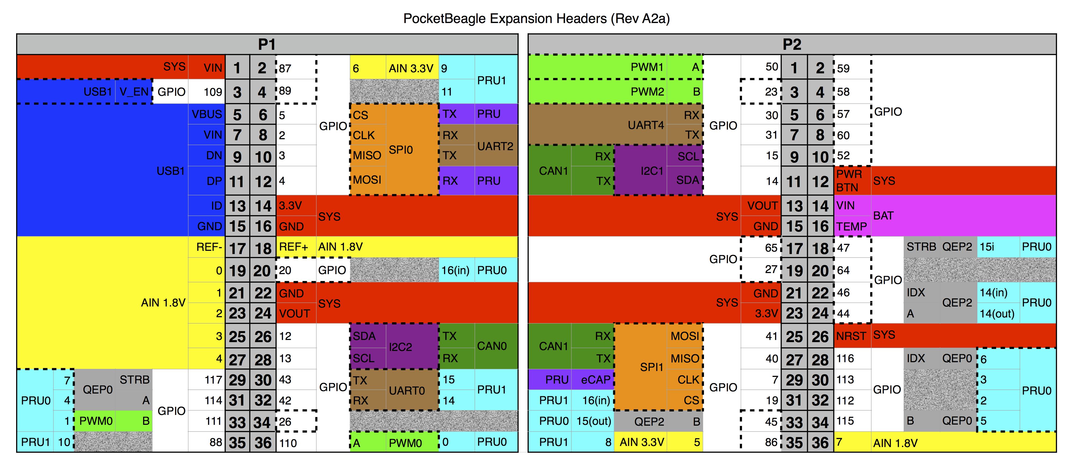
PocketBeagle Pinout for Reference

Slide 8
LinuxCNC/Shield Resources
https://forum.linuxcnc.org/38-general-linuxcnc-questions/39698-linuxcnc-and-arduino-with-cnc-shield
https://forum.v1engineering.com/t/inexpensive-linuxcnc-interface-for-mpcnc/9718/35
https://forum.linuxcnc.org/18-computer/36879-raspberry-pi-4-mmap?start=20
https://www.buildlog.net/blog/2013/09/cnc-translator-for-beaglebone/
http://blog.machinekit.io/2019/02/using-machinekit-on-bbb-hands-on-log-of.html
https://machinekit.narkive.com/Som7G3f8/pocketbeagle-bbb-custom-overlays-at-boot
https://machinekoder.com/machinekit-debian-stretch-beaglebone-black/

Slide 9
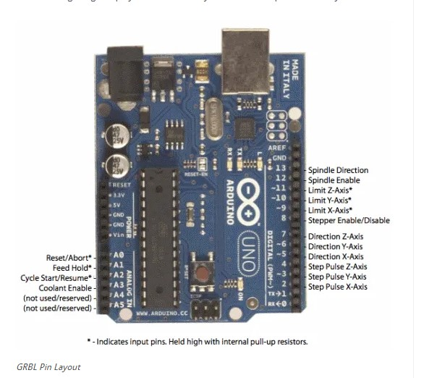
Arduino Pinout for Use with GRBL CNC Firmware
GRBL is an open source CNC software written for Arduino, that utilizes the pinout displayed in the figure
6 Analog Inputs (2 of which are unused, and 1 of which is unnecessary for my application)
12 Digital inputs

