Slide 1
95
How might we boost financial inclusion for low to medium income families through comprehensive solutions (e.g., micro-finance, micro-payments, micro-pension, micro-insurance, micro-savings and micro-investment) that enable them to be have better access to financial services?

Slide 2
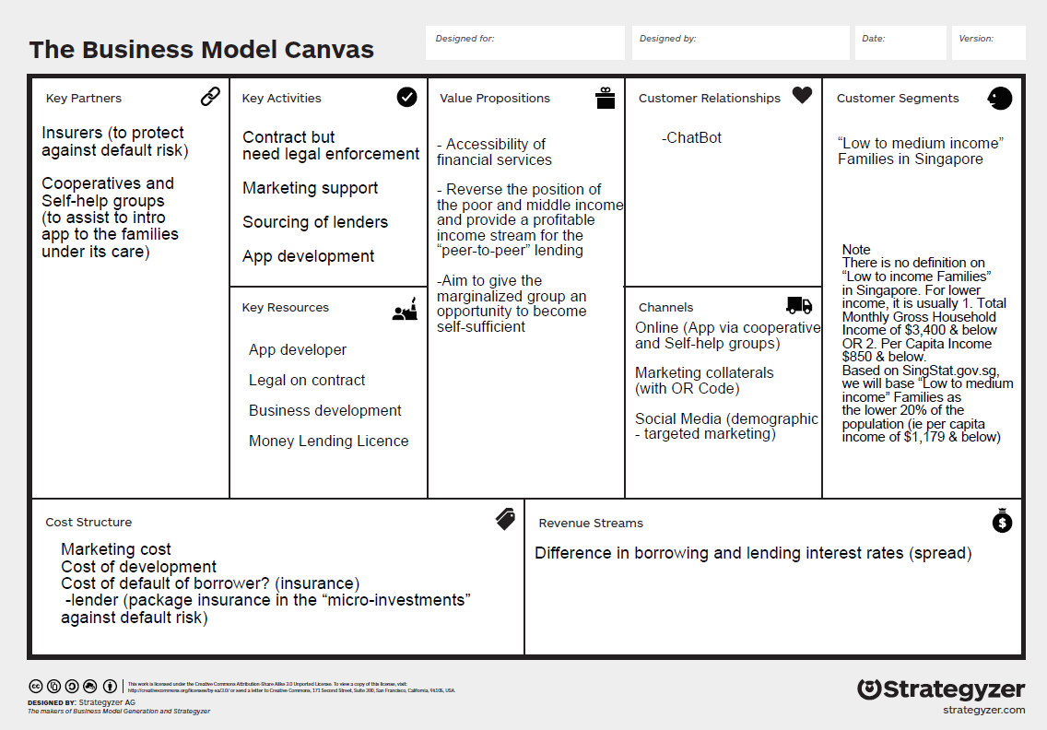
Notes:
Douglas –BMC+To-Be Strategy + Slide 3 to 8
Catherine – Slide 9 – 17
Chee Hoi – Slide 18 – 21
Herry – Slide 22 (Demo) – 24 (end of presentation)

Slide 3
PROBLEM STATEMENT
Strive to boost financial inclusion for low to medium income families through comprehensive solutions (micro-finance), that enable them to be have better access to financial services

Slide 4
OUR SOLUTION
A one stop virtual application towards providing accessibility of micro-finance to the poor
A platform to guide peer-to-peer lending towards a profitable income stream
Give the marginalized segment of society an opportunity to become self-sufficient

Slide 5
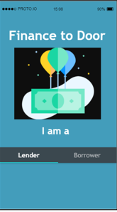



BUSINESS MODEL
Platform is the middleman Supply Side → Lenders Demand Side → Borrowers
Investors & Private Lenders
Borrowers
Lender Borrower smart application to be marketed through to Co-operatives and Self- Help Groups

Slide 6
BUSINESS MODEL

Slide 7
BUSINESS MODEL

Slide 8
BUSINESS MODEL
Most
Favourable

Slide 9
MARKET SIZE
Population of Singapore (Singaporeans & PRs)
4.03m
The lower 20%* percentile of the Singapore Population
20% of them will take Micro-loans at least twice per year
242k
48k
806k
30% of “Low to Medium” income will tap into Micro-loans (once per year)
*There is no definition on “Low to income Families” in Singapore. For lower income, it is usually 1. Total Monthly Gross Household Income of $3,400 & below OR 2. Per Capita Income $850 & below. Based on SingStat.gov.sg, we will base “Low to medium income” Families as the lower 20% percentile of the population (ie per capita income of $1,179 & below)

Slide 10
POTENTIAL MARKET REVENUE
40%
60%
2,000
By Potential Users
MAXIMUM SPEND PER CUSTOMER
30% of “Low to Medium” income to tap micro-financing (once per year)
$2,285,507
20 - 60
AGE
20% of them will take Micro-loans and Micro-Financing at least twice per year
$457,101
m³Loan Inc Annual Revenue
$2,742,608

Slide 11
TRACTION
$2.7m
$0.62
$7.39
300k
242k
Expected Gross revenues in 2021
ADDITIONAL earning per $1000 lender per month
ADDITIONAL savings per $1000 borrower per month
Registered Lenders
Potential Registered Borrowers

Slide 12

FUNDING
30% = $258k
40%= $344k
Enterprise Singapore
Angel Round
30% = $258k
Total Initial Outlay
$860k
Independent Investor

Slide 13



COMPETITORS
DBS Bank
(Cashline Solution)
m³Loan Inc
One-Hour Loan
Notes:
TCC - https://www.tcc.org.sg/
1 to 5 years
Interest Rate: 6.99% p.a. flat rate basis
Eligibility Criteria
Main and Joint Applicant:
Singapore Citizen or Singapore Permanent Resident
Age between 21 and 60 years old
Must be a TCC Ltd’s member, membership is FREE
Earning a minimum monthly basic salary of $1,200
Should not be existing surety for any other loans from TCC

Slide 14
CUSTOMER JOURNEY
Taking a $500 loan
Register as a borrower with necessary information
Download Finance-To-Door App
A Cleaner
27 years old, hawker centre cleaner. Need extra money to pay clinic bills.
1
Confirmation to borrow
Select $500 to borrow and 1-week loan tenure
2
Scenario
Trying to get a loan by approaching a Self-Help group in the neighbourhood.
3
Repayment via auto deduction from bank
Goals & Expectations
Keen to take a loan with no hassle. Wants a loan with low interest rate but with short tenure.
4
Get the money directly credited to her bank account
5

Slide 15
Borrowers’ Eligibility Criteria
Singapore Citizen or Singapore Permanent Resident
Age between 21 and 60 years old
Earning a minimum monthly basic salary of $800
Preference given to referrals from CDAC,
Sinda, Mendaki and Co-operatives

Slide 16











ADOPTION STRATEGY
COOPERATIVES & ASSOCIATIONS
SELF-HELP GROUPS
SOCIAL MEDIA

Slide 17
PREDICTED GROWTH
Stage 3 : Expand to regional markets (Malaysia, Indonesia, etc)
Stage 2 : Expand apps to target mass market and add more micro- financing products
Stage 1 : Bring out Finance-to-door app to all cooperatives' and self help groups' members and their referrals

Slide 18
Five-Years Forecast

Slide 19





State Diagram
Borrowers
5. Login
Private Lenders
Borrowers
Private Lenders
10a. Monthly deduction
4. SMS + Email
9a. Loan dispersed
1. register
11a. Deduction failed. Trigger claims
3. Passed
Registration
5. Enrolment
Loan and Deposit
9b. Deposit from Private Lenders
8. Validate & Confirm Enrolment
2. Checked
Credit Bureau
12a. Defaulter (Blacklist)
10b. Principal + Interest dispersed
Membership
Stage 1
Stage 2
Stage 3
Stage 4

