Slide 1
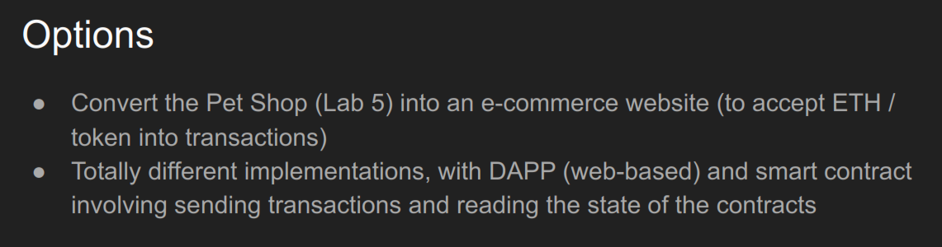

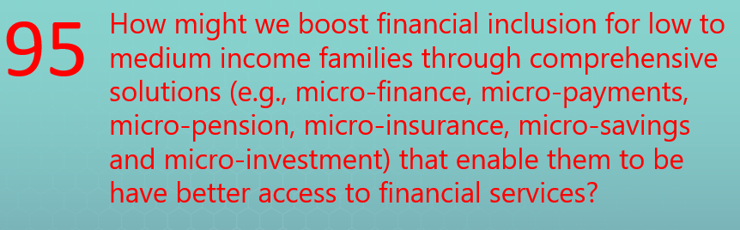

Slide 2
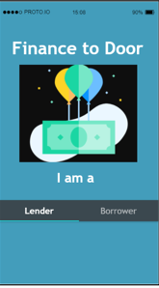
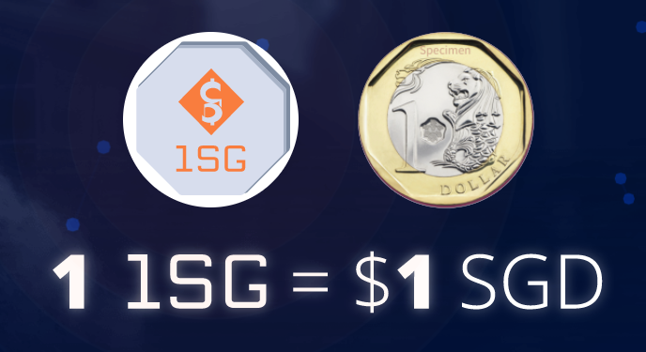






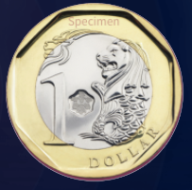
Private Lenders
Borrowers
https://1.sg/
DApp Token
Interest

Slide 3
Demo + Disclosure

Slide 4

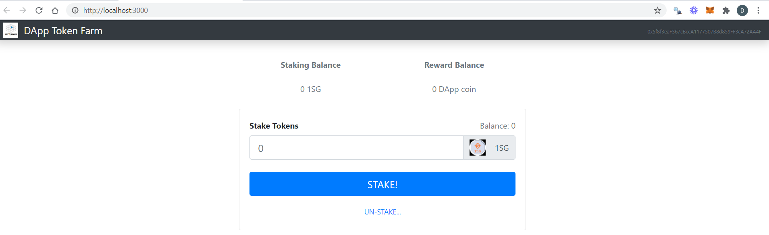
DAppToken.sol & 1SGToken.sol
Private Lenders
event Transfer(address indexed _from, address indexed _to, uint256 _value
event Approval(address indexed _owner, address indexed _spender, uint256 _value);
function transfer(address _to, uint256 _value) public returns (bool success)
function approve(address _spender, uint256 _value) public returns (bool success)
function transferFrom(address _from, address _to, uint256 _value) public returns (bool success)
1SG
DApp Token
TokenFarm.sol
function stakeTokens(uint _amount) public
function unstakeTokens() public
function issueTokens() public
React js
React JS
Main.js
Navbar.js
App.js
web3js
DApp Token Farm
TokenFarm.sol
Ganache
1SGToken.sol
DAppToken.sol

Slide 5
References …
1. Main
https://docs.soliditylang.org/en/v0.7.5/contracts.html
https://web3js.readthedocs.io/en/v1.3.0/
https://eips.ethereum.org/EIPS/eip-20
https://reactjs.org/
2. Others
https://medium.com/metamask/https-medium-com-metamask-breaking-change-injecting-web3-7722797916a8
GitHub
StackOverflow
3. Videos & Website …
DappUniversity/Bootcamp (React js, Smart Contract)
Eat The Block (Openzeppelin, Truffle, Ganache, Web3, Smart Contract)
Will It Scale (Solidity for Beginner)
Shlomi Zeltsinger (Truffle)
Filip Martinsson (Truffle & Web3)
Tutorialslum (DApp for Beginner)
Giveth (DApp Step by Step)

Slide 6
Demo steps ..
Compile:
In VSCode, run Terminal
Truffle compile
Deploy:
In Windows, run ganache
In VSCode, run Terminal
Truffle migrate --reset
nmp run start
Goto Metamask login and select account
Goto website and stake
In VSCode, run another Terminal
Truffle exec scripts/issue-token.js
Goto website to confirm payout & unstake
Test:
Truffle test

Slide 7
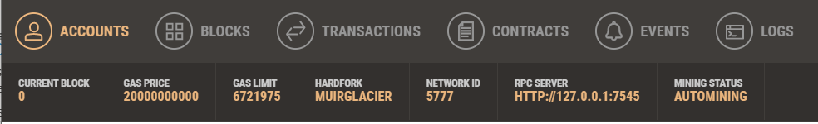
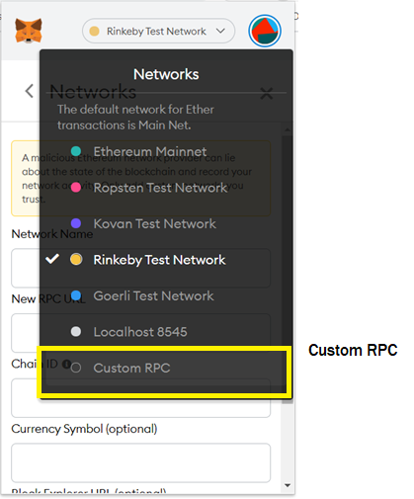
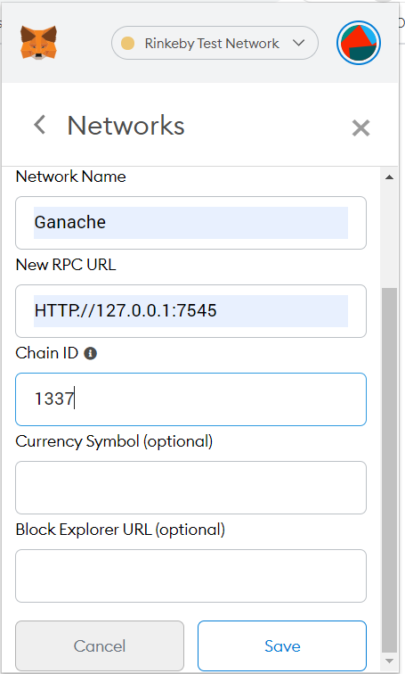
Metamask setup

