Slide 1
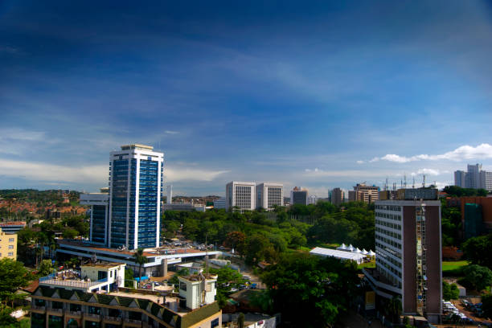






Home
Services
FAQs
Login
Register
Are you an investor, a businessman, or just the daily Ugandan tired of the daily uncertainties and the many LAND WRANGLES and looking to SECURE YOUR LAND and property?
LandWatch got you covered!, SECURE YOUR LAND and PROPERTY today!
Landwatch256
@Landwatch256
@Landwatch256
@Landwatch256
@Landwatch256

Slide 2
Home
Services
FAQs
Login
Register
Land Survey
Are you an investor, a businessman, or just the daily Ugandan tired of the daily uncertainties and the many LAND WRANGLES and looking to SECURE YOUR LAND and property?
LandWatch got you covered!, SECURE YOUR LAND and PROPERTY today!
What is LandWatch?
Boundary Stone
How do I register on LandWatch
Land Title Assistance
What is the Boundary Stone?
Land Court Issues
Questions about property appraisal
Property Appraisal
Questions about Land Survey
Landwatch256
@Landwatch256
@Landwatch256
@Landwatch256
@Landwatch256

Slide 3


National ID
Password
Request OTP
OTP
Login
Forgot password

Slide 4
New Password
Re-enter Password
Name
National ID
Request OTP
Phone Number
OTP
Email
Register

Slide 5

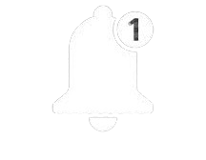
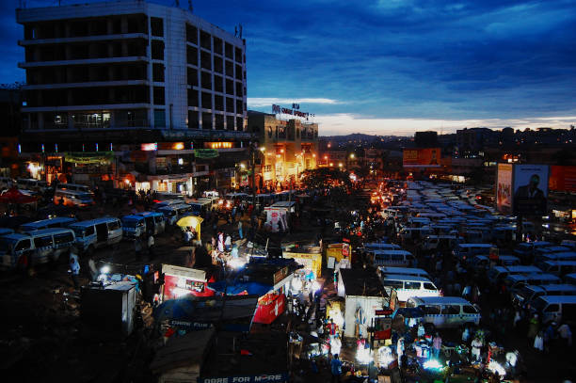


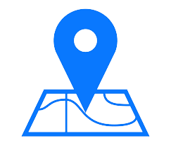



Home
Services
About Us
FAQs
Contact Us
Douglas Onencan
LandWatch is making investing in real estate and the property market of Kampala much more easier and secure. Experts projects that it will ….Read more
Sell
My Subscription
My Land Title
My Land Boundary
Hamis Kigundu in search for land around Naguru to establish his Ham Hospital, envisioned to be Africa’s biggest hosp……..Read more
Hi, I am here for you 24/7, ask me anything
Report Land Fraud

Slide 6
Home
Services
About Us
FAQs
Contact Us
Douglas Onencan
Land Survey and Mapping. LandWatch has a team of expert surveyors with a state of the art technologies for the most accurate data collection
Sell
My Subscription
My Land Title
The Boundary Stone. LandWatch provides digitalized boundary stone devices that store the most accurate information about your land right at your premises
My Land Boundary
Report Land Fraud
Property appraisal. LandWatch evaluates and prices your propetry so no body cheats you

Slide 7
Home
Services
About Us
FAQs
Contact Us
Douglas Onencan
LandWatch is an online platform that offers the most accurate and up-to-date property information, we offer the safest place to safe your property information, join us today
Our Team
Sell
My Subscription
My Land Title
My Land Boundary
Hi, I am here for you 24/7, ask me anything
CEO Co-founder
Mr. Jaramogi Odhiambo
Previously served as legal advisor to the Ugan
CEO Co-founder
Mr. Benon Kwikiriza
20 years experience in land survey………
Report Land Fraud

Slide 8

Home
Services
About Us
FAQs
Contact Us
Douglas Onencan
Email Us Now
Sell
My Subscription
My Land Title
Send
My Land Boundary
You can also contact us by clicking any of the bellow
Report Land Fraud

