Slide 1


Creation of AI for En Garde !

Slide 2
Summary
GIFU KOSEN (NIT)
EN GARDE !
  BOARD GAME
  JAVA VERSION
AIs
  RANDOM
  STATIC
  MINIMAX
  QLEARNING
FIGHT !
CONCLUSION

Slide 3
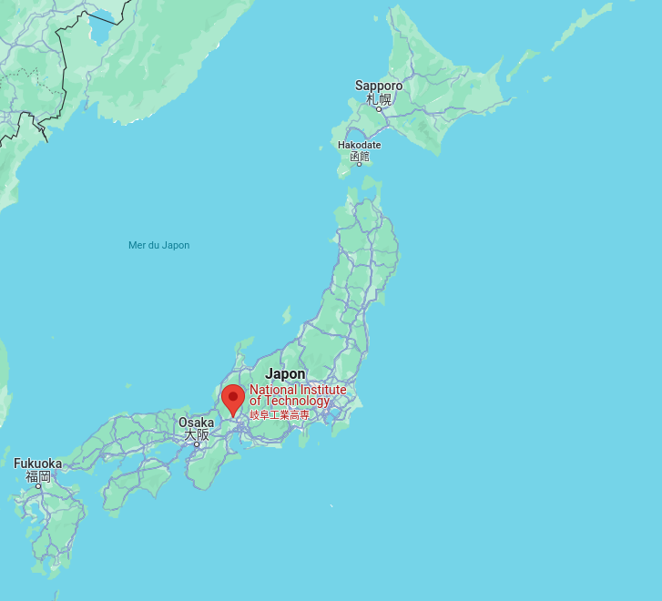
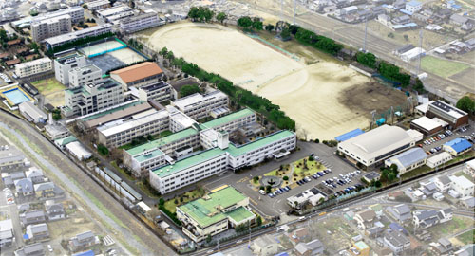
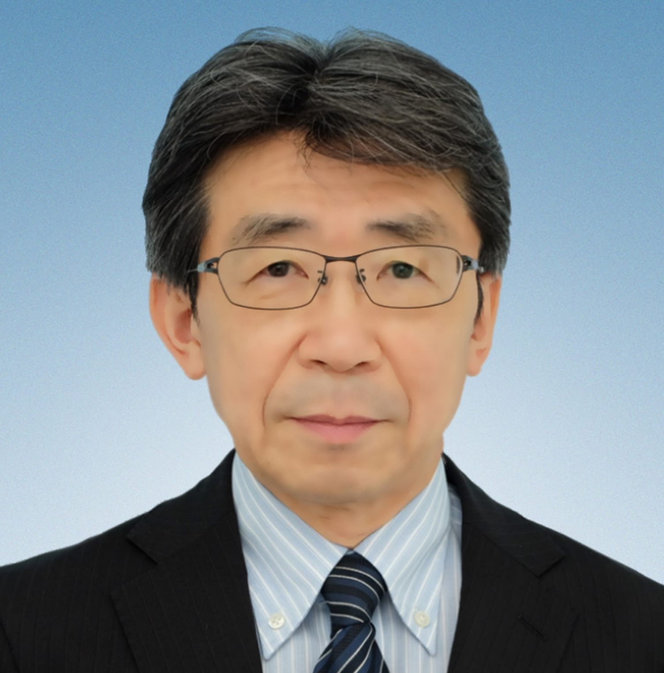
National Institute of Technology
Mechanical Engineer
Electrical and Computer Engineer
Electronic Control Engineer
Civil Engineer
Architecture

Slide 4
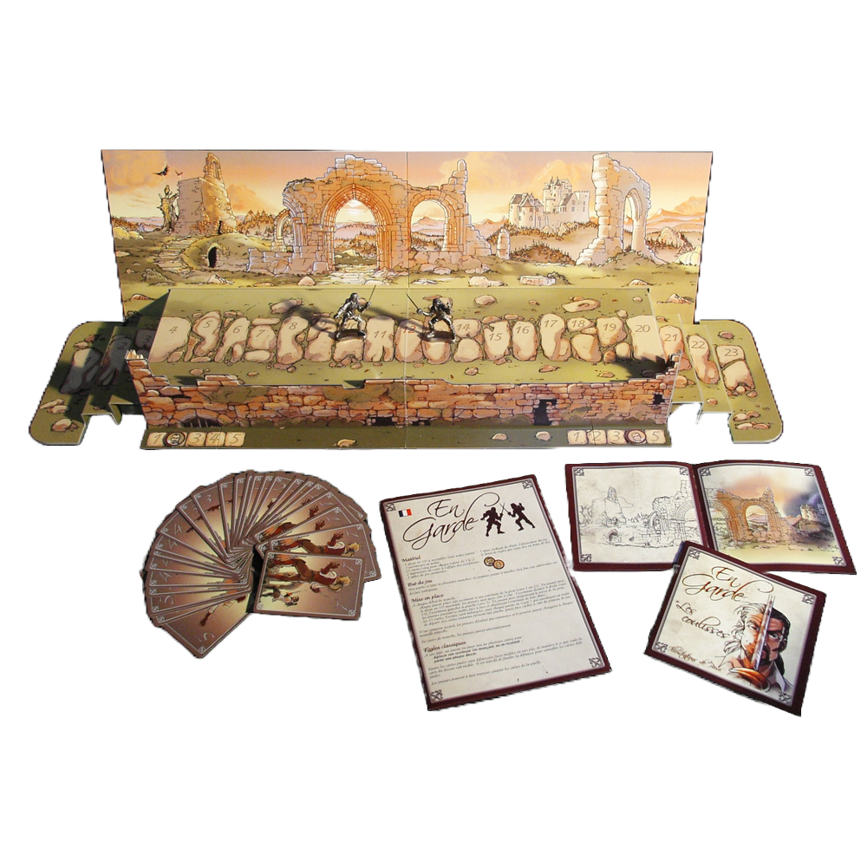

En Garde !

Slide 5
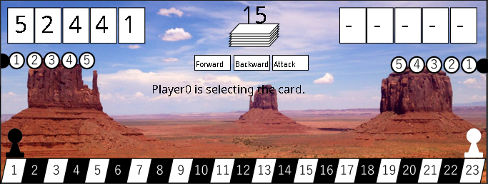
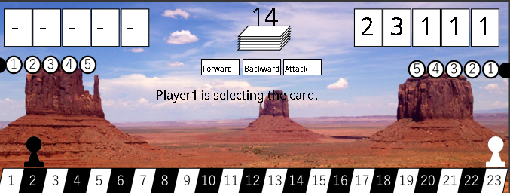
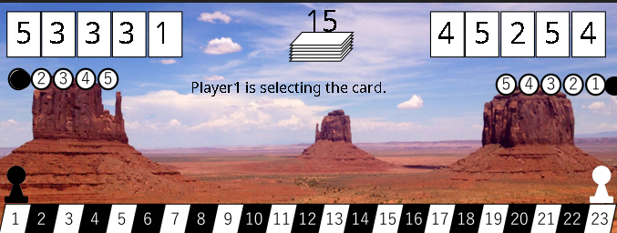
Java Version

Slide 6
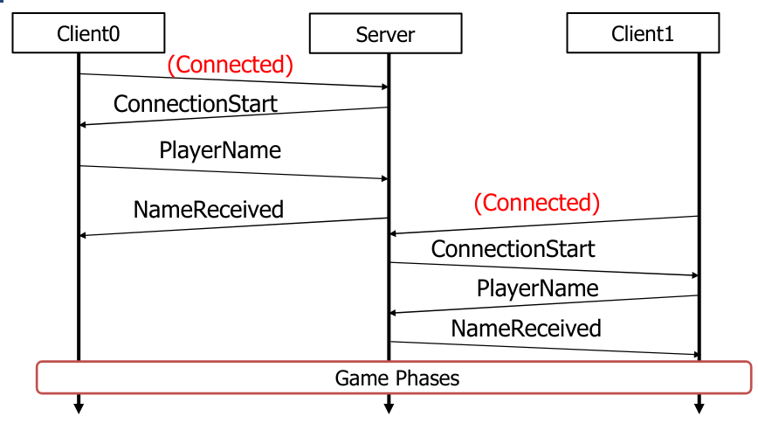
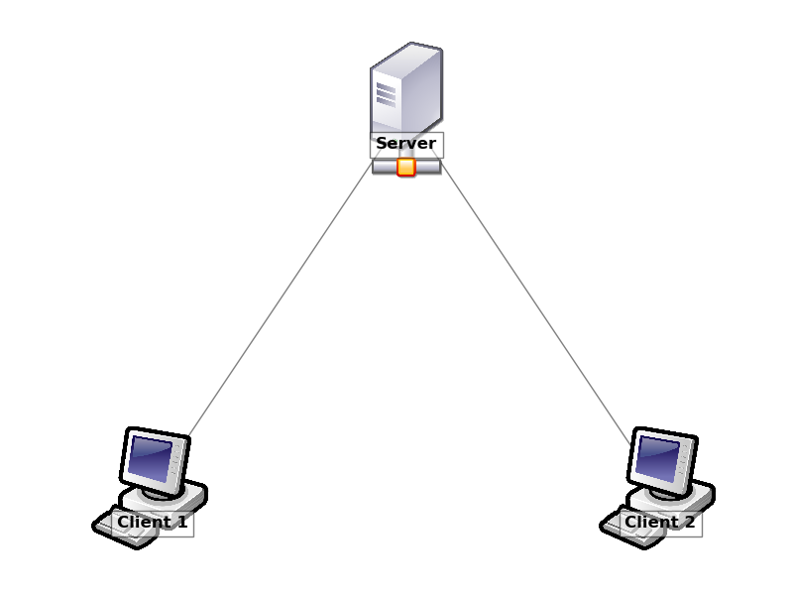



Slide 7
AI

Slide 8
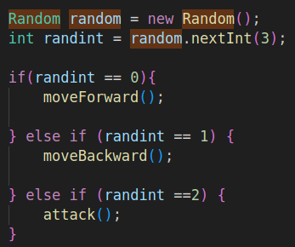
AI-RANDOM

Slide 9
AI-STATIC
Forward
Attack
Backward
| 2 | 2 | 2 | 5 | 3 |
| 5 | 5 | 2 | 5 | 3 |
| 5 | 2 | 2 | 5 | 3 |
| 2 | 2 | 2 | 5 | 3 |
| 5 | 5 | 2 | 5 | 3 |
| 5 | 2 | 2 | 5 | 3 |
| 2 | 2 | 2 | 5 | 3 |
| 5 | 5 | 2 | 5 | 3 |
| 5 | 2 | 2 | 5 | 3 |

Slide 10
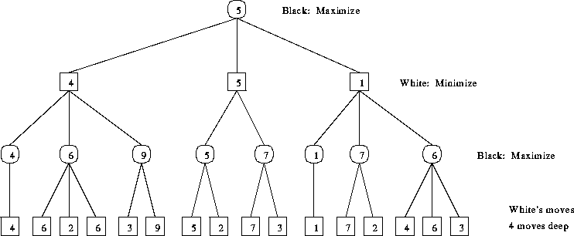
AI-MINIMAX

Slide 11
Can We Do Better ?

Slide 12
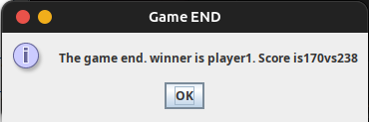
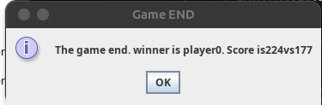
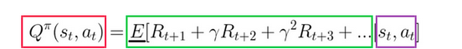
AI-Q Learning

Slide 13
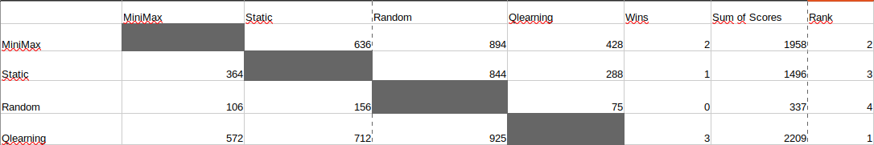
FIGHT !!!

Slide 14
Conclusion

Slide 15
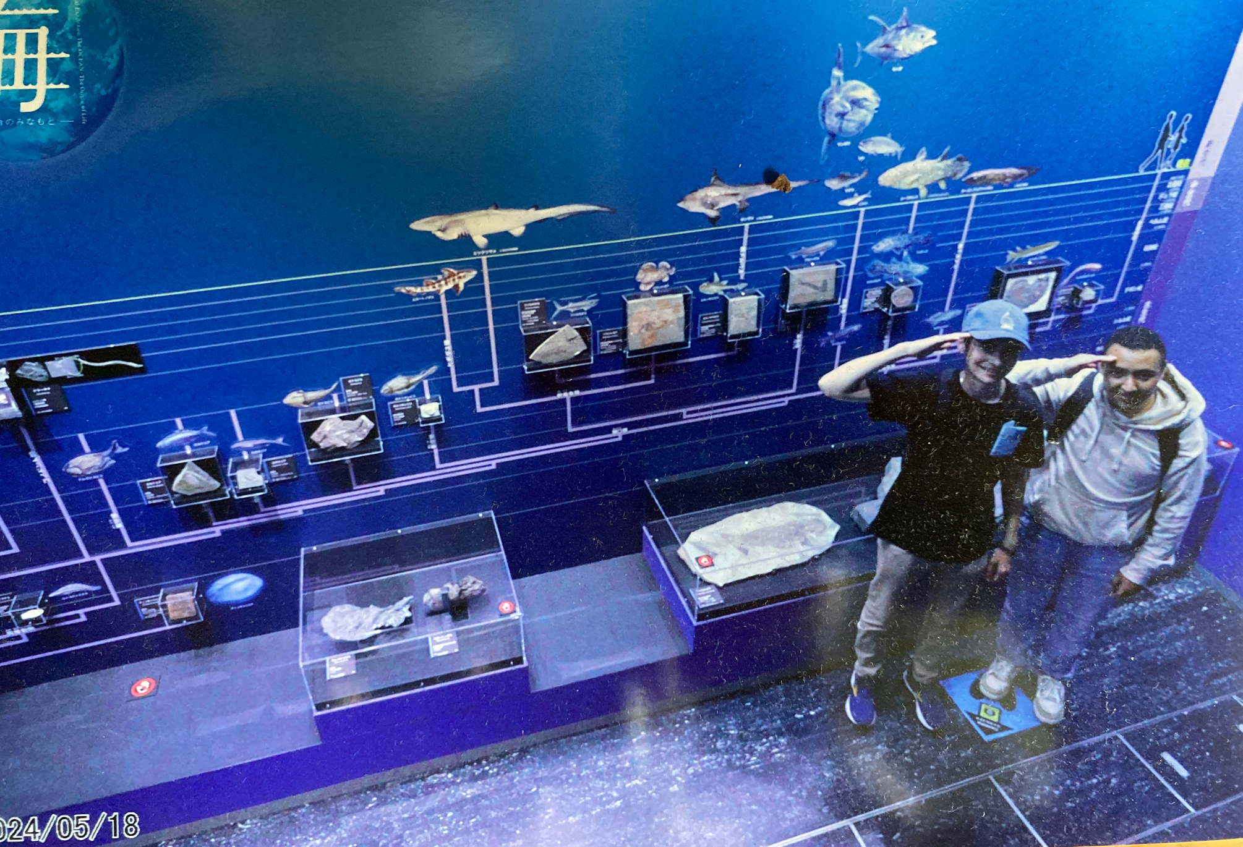
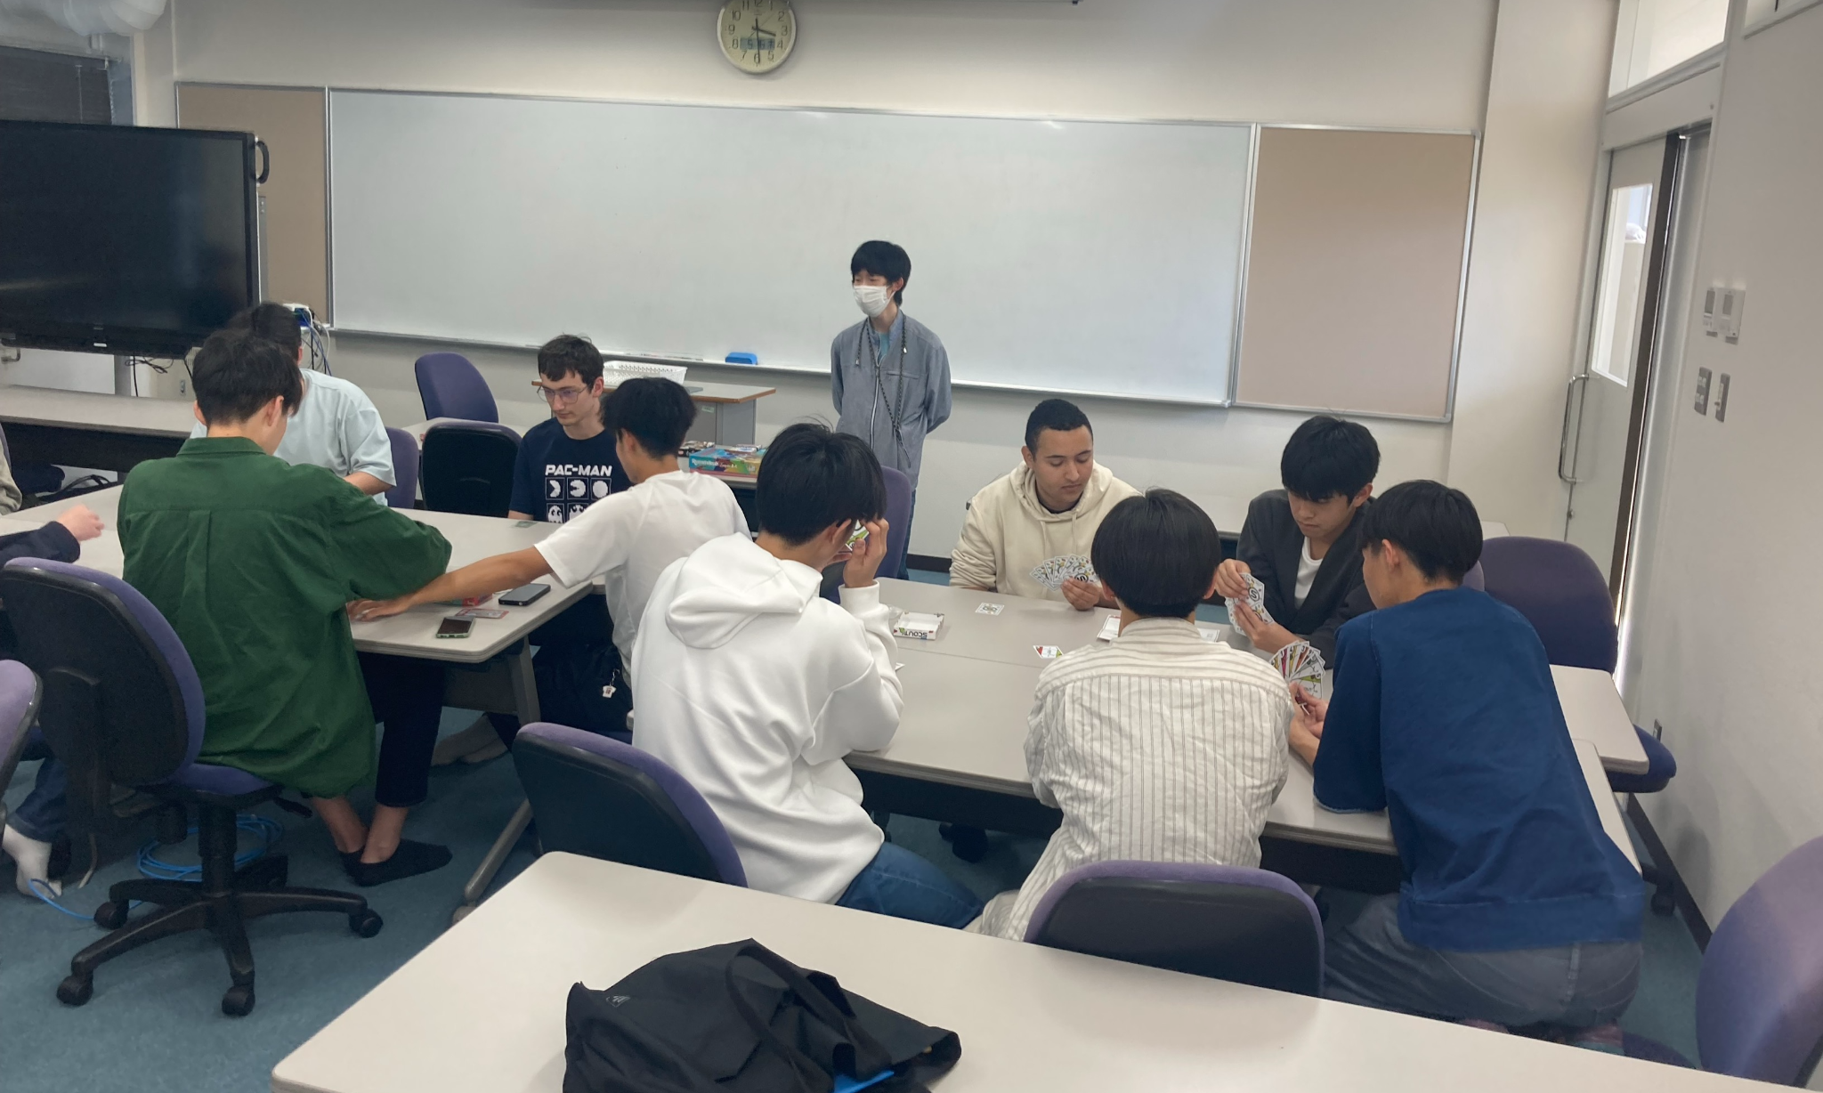
Thanks

