Slide 1
CS 7370 Project Presentation
Joseph Hendrix

Slide 2
Algorithm
Linear Search
Java 8 Stream API
Parallel vs Non-parallel (i.e. serial)
Local file system

Slide 3
Linear Search
Used to search unordered data
Normal search complexity O(n)
Worst case n
Have to search every item (possibly no item found).
Average case n/2
Best case 1
The first item examined is the item searched for.

Slide 4
Linear Search where multiple items may exist
Searching unordered data
May return 0, 1, or multiple items.
Must examine every item.
No way to know if unsearched data fits criteria.
Best, average, and worst case is n
Every case is n.

Slide 5
What
Local file system
Directory and subdirectories
Image file.
Extension is one of jpg, jpeg, gif, or png.
File size is less than 3,000,000 bytes.
Reasoning:
Returns about 50% of the files searched in this particular experiment.

Slide 6
Implementation
ImageFileSearch
-List<String> IMAGE_EXTENSIONS
-String[] PATHS
+abstract List<Path> search(String)
+test()
+boolean filter(Path)
ParallelImageFileSearch
+List<Path> search(String)
SerialImageFileSearch
+List<Path> search(String)

Slide 7
ImageFileSearch::filter
try {
String pathString = path.toString();
int dot = pathString.lastIndexOf(".");
if(dot > 0) {
String extension = pathString.substring(dot).toLowerCase();
if(IMAGE_EXTENSIONS.contains(extension)) {
BasicFileAttributes attr = Files.readAttributes(path, BasicFileAttributes.class);
return attr.size() < 3_000_000;
}
}
} catch(IOException e) {
e.printStackTrace();
}
return false;

Slide 8
SerialImageFileSearch::search
try (Stream<Path> pathStream =
Files.walk(Paths.get(pathname))) {
return pathStream
.filter(this::filter)
.collect(Collectors.toList());
} catch (IOException e) {
e.printStackTrace();
}
return new ArrayList<>();

Slide 9
ParallelImageFileSearch::search
try (Stream<Path> pathStream =
Files.walk(Paths.get(pathname))) {
return pathStream
.parallel()
.filter(this::filter)
.collect(Collectors.toList());
} catch (IOException e) {
e.printStackTrace();
}
return new ArrayList<>();

Slide 10
ImageFileSearch::test
for(String path : PATHS) {
long start = System.nanoTime();
long count = search(path).size();
long end = System.nanoTime();
long time = end - start;
System.out.printf("%s\t%s\t%d\t%,d%n",
path,
this.getClass().getSimpleName(),
count,
time);
}

Slide 11
ImageFileSearch::main (static method)
ImageFileSearch[] tests =
{new SerialImageFileSearch(),
new ParallelImageFileSearch()};
System.out.println(
"directory\tclass\t# images\tnanoseconds;");
for(ImageFileSearch test : tests) {
for(int i = 0; i < 3; i++) {
test.test();
}
}

Slide 12
Results & Discussion
 | files searched | images found | SerialImageFileSearch | ParallelImageFileSearch
1st iteration | 7 | 6 | 35,826,276 ns | 8,272,604 ns
 | 214 | 160 | 12,966,600 ns | 6,912,994 ns
 | 1424 | 793 | 73,740,479 ns | 39,905,107 ns
2nd iteration | 7 | 6 | 590,589 ns | 596,221 ns
 | 214 | 160 | 7,060,705 ns | 6,414,308 ns
 | 1424 | 793 | 57,785,349 ns | 36,082,019 ns
3rd iteration | 7 | 6 | 498,174 ns | 558,078 ns
 | 214 | 160 | 7,056,865 ns | 5,719,015 ns
 | 1424 | 793 | 55,346,703 ns | 38,445,400 ns

Slide 13
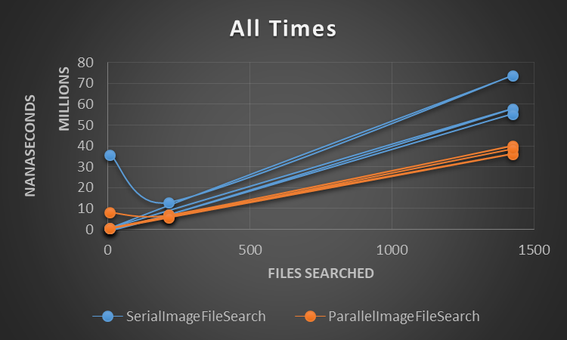
Results & Discussion

Slide 14
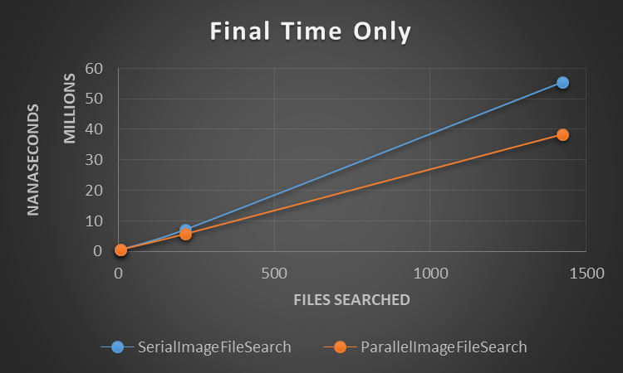
Results & Discussion

Slide 15
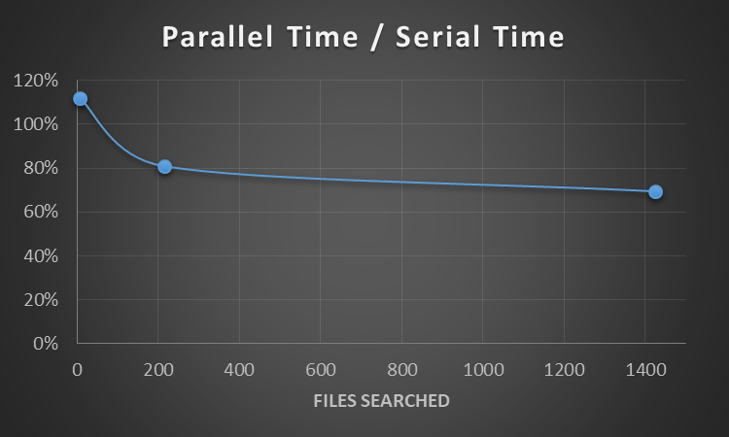
Results & Discussion
files searched | Parallel time / serial time
7 | 112%
214 | 81%
1424 | 69%

Slide 16
Questions?

