Slide 2
0 | 10 | 20 | 30 | 60 | 100
10 | 60 | 30 | 30 | 40 | 0

Slide 3
2
4
6
8
10
8: 1
6: 1
6: 2
4: 1
4: 2
4: 3
2: 1
2: 2
2: 3
2: 4
Map: (key: difference;
Value: number of difference)

Slide 4
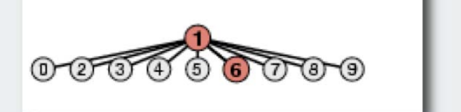
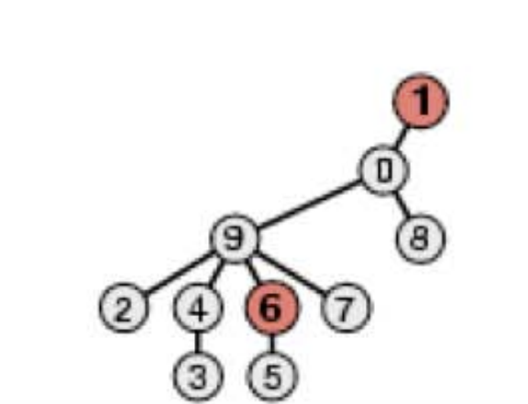
Quick Find Structure
Quick Union Structure

Slide 5
Case 1.
Case 2.
Case 3.

Slide 6
1
0
3
2
1
4
2

