Slide 1

Mini Project-I (K24MCA18P) Odd Semester Session 2024-25
Sanगीत Music Streaming Platform
DEEPAK SHARMA (2426MCA2594)
DEVANSH KUMAR (2426MCA2087)
AVNISH KAUSHIK (2426MCA213)
Project Supervisor:
Ms. Divya Singhal
Assistant professor

Slide 2
Content
Introduction (1 slide)
Literature Review (2 slides)
Objective of the Project (1 slide)
Technology
Hardware Requirements (Development Environment, Server requirement (if required), Client requirement (if required).
Software Requirements (Language and Platforms like Frameworks, VS code, Android Studio and Jupyter notebook etc. )
Modules (2-3 slides)
Workflow (1 slide)
Reports (For Example: Project : Student Monitoring System, so reports like: Student Marks, Subjects, companies visit, and student appears in placement etc.)
References (1 slide)
Notes:
Font Styles: Times New Roman + Font Size: 25

Slide 3

Sanगीत - Music Streaming Made Easy
Welcome to Sanगीत, a user-friendly music streaming application designed to elevate your listening experience. Our platform offers a comprehensive music library, personalized recommendations, and High Quality Music Support.
Notes:
1

Slide 4

Objective of the Project
1
Main Aim
Sanगीत aims to provide an intuitive and engaging music streaming platform for users to enjoy their favorite music.
2
Upload Your Music/Playlist
Anyone can upload their own music on the Platform.
3
High Quality Sound
The main aim of this project is to deliver the best quality of music sound to the user.
Notes:
2

Slide 5

(Technologies Used)
Front-end
Back-end
HTML, CSS, JavaScript, and React.js provide a robust and interactive user interface for Sanगीत.
Node.js powers the backend, handling data storage, user authentication, and music streaming logic.
Data-Base
We are using MONGODB to established the Database.
Notes:
3

Slide 6
Application Features
Music Library
A vast catalog of songs from diverse genres and artists is available for streaming and offline listening.
Offline Music Player
The User can enjoy the music with Online or Offline with the best Music Quality.
Playlists
Users can create and manage custom playlists to curate their music experience and share with others.
Notes:
4

Slide 7
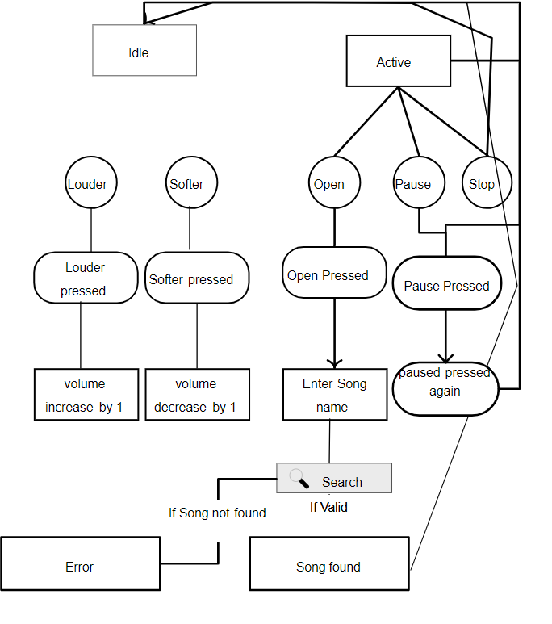
Work-Flow

Slide 8
MODULES
Authentication:
Login, Signup, Social Logins, Password Reset
Dashboard:
User Profile, Recent Activity, Recommended Songs
Music Player:
Play/Pause, Shuffle, Lyrics Sync, Volume Control
Search & Explore:
Search Songs/Albums, Filters by Genre/Mood

Slide 9
5. Playlist Management:
Create/Edit/Delete Playlists, Collaborative Playlists
6. Social & Community:
Follow Users, Likes, Comments, Activity Feed
7. Settings:
Theme (Dark/Light) Mode, Playback Settings
8. Authentication & Authorization:
Secure Login System
9. Music Library:
Store Song Data, Manage Audio Files

Slide 10
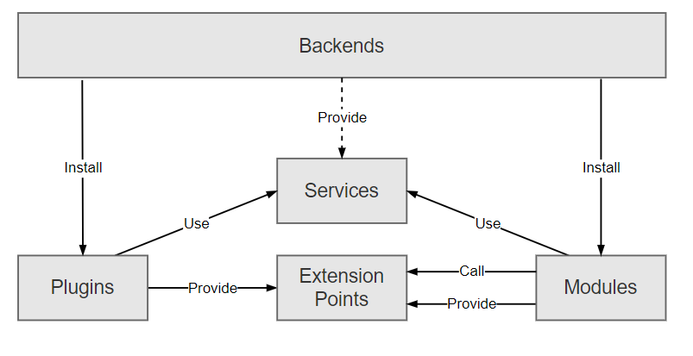
Back-End Architecture
Component
Functionality
Database
Stores music data, user information, and preferences.
API
Provides communication channels between the front-end and back-end, enabling data exchange and functionality.
Authentication System
Securely manages user login and registration, protecting user data and privacy.
Notes:
6

Slide 11
REPORT
1. Introduction to Music Players
Music players are software applications designed to organize, manage, and play digital audio files. With the rise of streaming services and personalized media experiences, web-based music players have gained popularity due to their platform independence and ease of access. Early music players like Winamp or Windows Media Player laid the foundation for audio playback functionalities, including playlists, equalizers, and shuffle modes. Modern advancements focus on seamless user experiences, cloud-based storage, and cross-device functionality (Duncan, 2018).
2. Frontend Technologies for Web Development
The frontend layer of a web-based project is responsible for the user interface (UI) and user interactions. Technologies such as HTML5, CSS3, and JavaScript are core tools used to build interactive and visually appealing websites (Acharya, 2020). JavaScript frameworks and libraries like React, Angular, and Vue.js further streamline the development of complex user interfaces.
3. Backend Technologies and Database Integration
Databases like MySQL, MongoDB, or SQLite play a vital role in storing user data, playlists, and song metadata. Backend frameworks such as Express.js allow seamless API creation to fetch and serve data to the frontend. Music players also benefit from media file compression and encoding techniques, ensuring fast and reliable streaming experiences.

Slide 12
4. Frontend-Backend Integration in Web Applications
The integration between the frontend and backend layers is crucial to building functional web applications. RESTful APIs and GraphQL are widely used to exchange data between client and server efficiently. In music players, these APIs help retrieve playlists, song information, or even user preferences stored in the backend.
5. Conclusion
The development of a web-based music player like Sanगीत involves the integration of both frontend and backend technologies to provide a seamless and efficient user experience. Leveraging HTML5 audio features, JavaScript frameworks, and backend services ensures smooth playback, reliable storage, and quick access to media. Real-time updates and responsive designs further enhance user engagement, while backend integration ensures data management and scalability.

