Slide 1

Mini Project-I (K24MCA18P) Odd Semester Session 2024-25
Question generator
Brijesh 2426mca630
Devesh 2426mca190 & Abhijeet 2426mca1652
Project Supervisor:
Ms. Divya Singhal

Slide 2
Content
Introduction (1 slide)
Literature Review (2 slides)
Objective of the Project (1 slide)
Technology
Hardware Requirements (Development Environment, Server requirement (if required), Client requirement (if required).
Software Requirements (Language and Platforms like Frameworks, VS code, Android Studio and Jupyter notebook etc. )
Modules (2-3 slides)
Workflow (1 slide)
Reports (For Example: Project : Student Monitoring System, so reports like: Student Marks, Subjects, companies visit, and student appears in placement etc.)
References (1 slide)
Notes:
Font Styles: Times New Roman + Font Size: 25

Slide 3
Introduction
AI-Powered Question/Course Generator
This project automates the generation of quizzes, questions, and course content based on
user-provided topics using AI and NLP. It saves time for educators by customizing difficulty
levels, question types, and formats.
Notes:
Font Styles: Times New Roman + Font Size: 25

Slide 4
Literature Review
AI in Education:
The growing role of AI in automating educational content generation.
Use of Natural Language Processing (NLP) for creating diverse, relevant educational material.
Benefits: Time-saving, scalability, customization.
Existing Systems:
Overview of similar systems and how they function.
Limitations of current solutions (e.g., limited customization, scope).
How the AI-powered Question/Course Generator addresses these gaps.
Notes:
Font Styles: Times New Roman + Font Size: 25

Slide 5
Objective of the Project
Objective: To create a system that automatically generates quizzes, questions, and course content with customized difficulty levels and question types, streamlining the educational content creation process.
Notes:
Font Styles: Times New Roman + Font Size: 25

Slide 6
Technology (Hardware Requirements)
Server Requirements: Cloud-based hosting (e.g., AWS, Google Cloud,Supabase).
Client Requirements: Standard browsers for accessing the web application (Chrome, Firefox).
Notes:
Font Styles: Times New Roman + Font Size: 25

Slide 7
Technology (Software Requirements)
Frontend: Next.js
Backend: Supabase
Platforms & Tools: VS Code, Postman, Cloud Computing Platforms (e.g., AWS),
Notes:
Font Styles: Times New Roman + Font Size: 25

Slide 8
Modules
Module 1: AI & Cloud Computing (Brijesh)
NLP-based question generation.
Cloud-based hosting and scalability.
AI models for customizing question difficulty and format.
Notes:
Font Styles: Times New Roman + Font Size: 25

Slide 9
Modules (Contd.)
Module 2: Frontend (Abhijeet)
User interface built using Next.js.
Dashboard for quiz generation and content creation.
User authentication and content customization features.
Notes:
Font Styles: Times New Roman + Font Size: 25

Slide 10
Modules (Contd.)
Module 3: Backend (Devesh)
Node.js for server-side operations.
Database management for storing quizzes and user data.
API development for integration between frontend and AI models.
Notes:
Font Styles: Times New Roman + Font Size: 25

Slide 11
Workflow/Gantt Chart
Steps:
User inputs a topic.
AI generates quiz questions and course content based on the topic.
The system customizes difficulty and question types.
Generated content is reviewed and published by the user.
Notes:
Font Styles: Times New Roman + Font Size: 25

Slide 12
Reports
Examples of Generated Reports:
Quiz Statistics (e.g., number of questions generated, difficulty levels).
Course Content Overview.
User engagement analytics (e.g., quiz takers, performance trends).
Notes:
Font Styles: Times New Roman + Font Size: 25

Slide 13
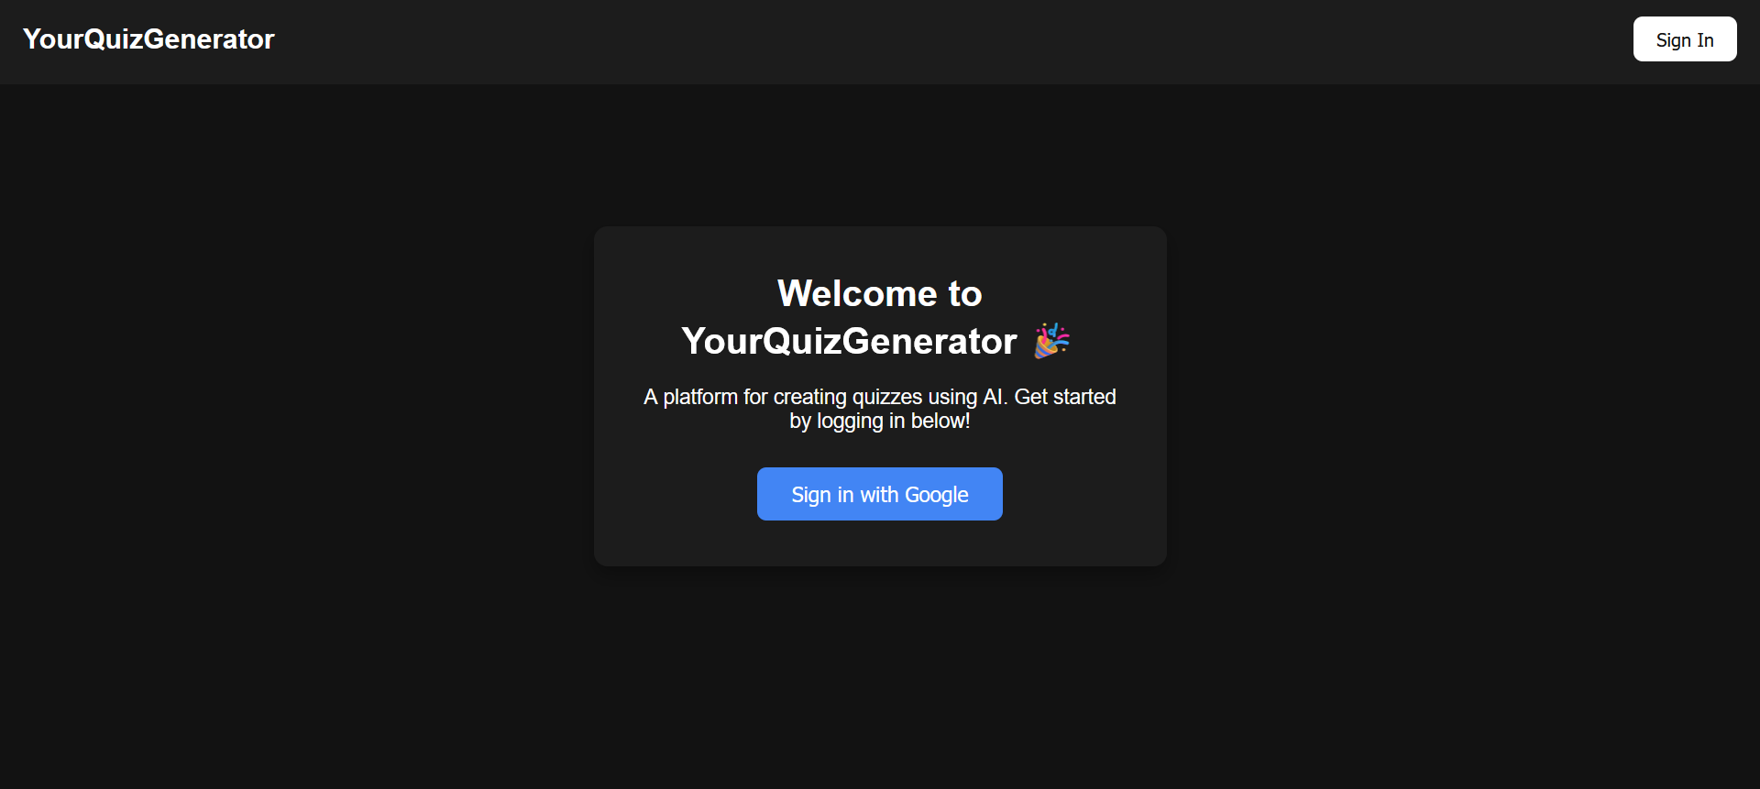
Modules (Contd.)
Notes:
Font Styles: Times New Roman + Font Size: 25

Slide 14
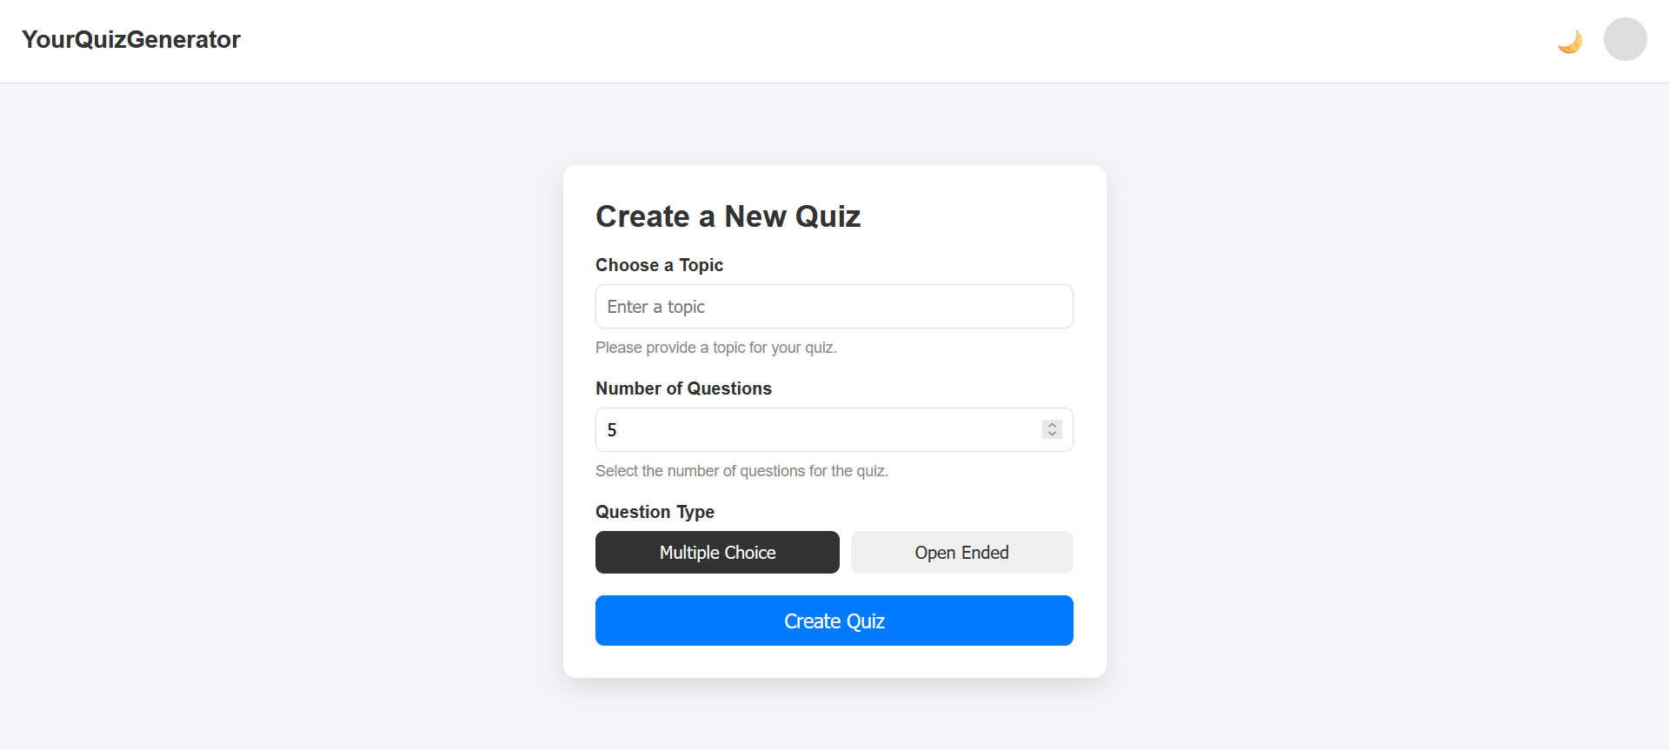
Modules (Contd.)
Notes:
Font Styles: Times New Roman + Font Size: 25

Slide 15
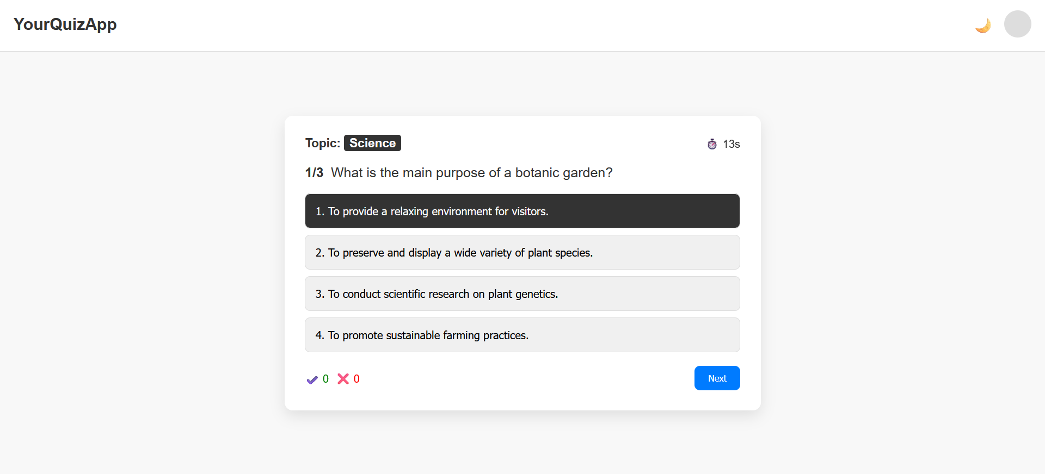
Modules (Contd.)
Notes:
Font Styles: Times New Roman + Font Size: 25

Slide 16
Thank You
Notes:
Font Styles: Times New Roman + Font Size: 25

