Slide 1

Mini Project-I (K24MCA18P) Odd Semester Session 2024-25
`
Anik Kushwaha 2426MCA1684
Ankit Kumar 2426MCA642
Bobby Karnik 2426MCA328
Project Supervisor:
Divya Singhal
Asst. Professor

Slide 2
Content
Introduction
Literature Review
Objective of the Project
Technology
Hardware Requirements
Software Requirements
Modules (2-3 slides)
Workflow (1 slide)
Reports
References (1 slide)
Notes:
Font Styles: Times New Roman + Font Size: 25

Slide 3
Introduction
The Home Appliances Rental Service is a smart and convenient way for people to rent household appliances without having to buy them. It helps individuals, families, students, and businesses who need appliances for a short time or prefer flexible rental options instead of owning them.
The platform allows users to browse, select, and rent a wide range of home appliances such as refrigerators, washing machines, microwaves, televisions, and more, offering convenience and affordability.
Notes:
Font Styles: Times New Roman + Font Size: 25

Slide 4
Literature Review
The Growth of the Sharing Economy
The sharing economy is all about accessing things you need for a short time rather than owning them permanently. This trend started with services like Uber (for rides) and Airbnb (for homes). Now, it’s spreading to everyday items, including home appliances. Studies show that renting is cheaper and helps the environment because it reduces waste.
Consumer Preferences for Renting
People, especially younger generations like millennials and Gen Z, are showing a preference for renting instead of buying. Research shows that these generations value flexibility and don’t want to be tied down by owning too many things. Renting appliances is especially useful for:
Students and young professionals who live in temporary places.
Families needing appliances for a short time, like during home renovations.
Businesses that only need appliances for events or short periods.
Notes:
Font Styles: Times New Roman + Font Size: 25

Slide 5
Literature Review (Contd.)
Challenges of the Rental Market
While renting appliances has many benefits, there are also some challenges. For example, customers worry about whether the appliances will be in good condition or if the service will be reliable. Businesses that offer rental services also face challenges, such as managing deliveries, keeping appliances in good condition, and handling repairs quickly.
Notes:
Font Styles: Times New Roman + Font Size: 25

Slide 6
Objective of the Project
The goal of the Home Appliance Rental Services project is to provide an easy and affordable way for people to rent household appliances without having to buy them. The main objectives are:
Flexible Rental Options: Allow customers to rent appliances for as long as they need, whether it's for a few days, weeks, or months, so they can choose what works best for them.
Ensure Easy and Convenient Service: Create an easy-to-use online platform where customers can browse, rent, and manage their orders, ensuring a smooth rental experience, including hassle-free delivery, installation, and pickup services.
Notes:
Font Styles: Times New Roman + Font Size: 25

Slide 7
Technology (Hardware Requirements)
Development Environment: PC/Laptop with at least 4GB RAM, i3 processor.
Server Requirement: Apache
Client Requirement: Modern browsers (Chrome, Firefox, Safari).
Notes:
Font Styles: Times New Roman + Font Size: 25

Slide 8
Technology (Software Requirements)
Frontend:HTML, CSS, JavaScript, React
Backend: Node.js
Database: MySQL (for data storage and management
Design Tools: Figma, Adobe XD.
Frameworks: Tailwind CSS.
Notes:
Font Styles: Times New Roman + Font Size: 25

Slide 9
Modules
User Registration and Authentication
Features: User sign-up, login, password reset.
Purpose: To allow users to create accounts and securely access the platform.
Product Catalog
Features: A searchable and filterable catalog of appliances with categories (e.g., kitchen appliances, laundry, HVAC).
Purpose: To showcase available appliances for rent with details like features, pricing, and availability.
Notes:
Font Styles: Times New Roman + Font Size: 25

Slide 10
Modules (Contd.)
Rental Plans and Pricing
Features: Define different rental periods (e.g., daily, weekly, monthly), pricing models (e.g., pay-per-use, fixed rate), discounts, and promotions.
Purpose: To manage rental periods and pricing strategies that suit different customer needs.
Order Management
Features: Order placement, order history, order tracking, and cancellation.
Purpose: To handle the process of appliance rental, from selection to return or extension of the rental period.
Reviews and Ratings
Features: Allow users to leave reviews and ratings for appliances and services.
Purpose: To build trust and help potential customers make informed decisions.
Notes:
Font Styles: Times New Roman + Font Size: 25

Slide 11
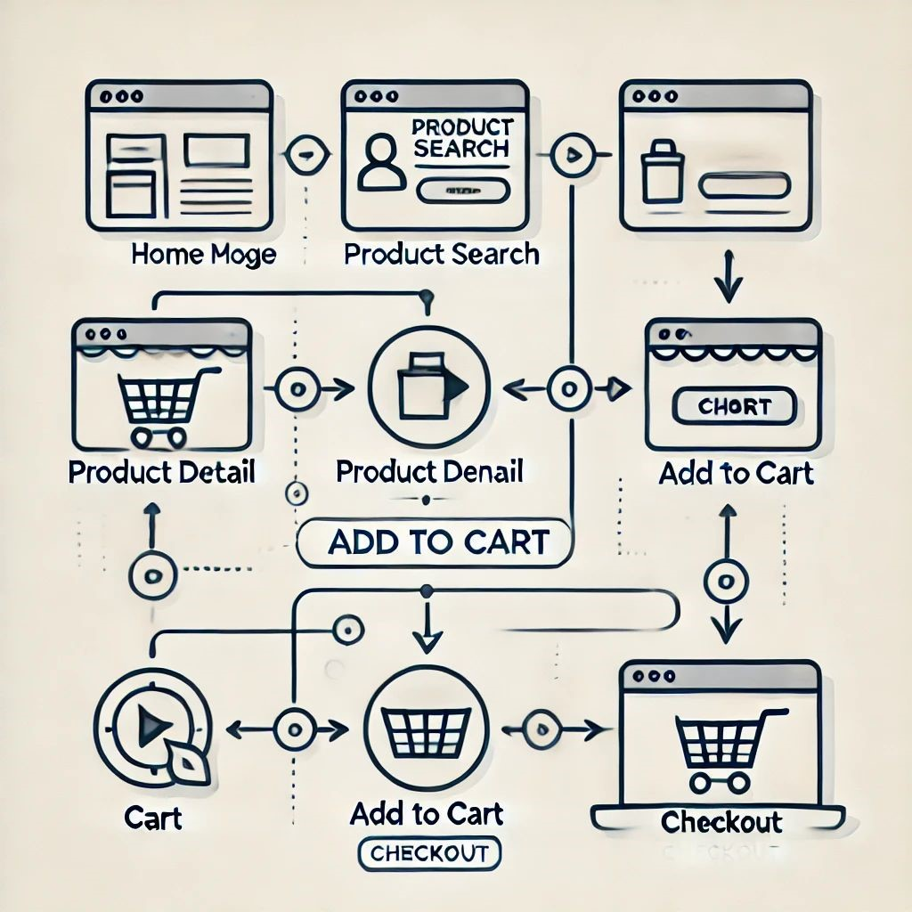
Workflow/Gantt Chart
Notes:
Font Styles: Times New Roman + Font Size: 25

Slide 12
Reports
Customer Reports
Customer Details Report: Contains customer information, including contact details, rental history, and preferences.
Rental Reports
Rental History Report: Contains the details of all rentals, including customer name, rented appliances, rental duration, and cost.
Booking and Orders Reports
Booking Trends Report: Highlights peak times for appliance bookings, the frequency of bookings, and popular appliance types
Notes:
Font Styles: Times New Roman + Font Size: 25

Slide 13
References
Tailwind CSS documentation
React documentation
CSS Tricks
Figma design tutorials
MDN
W3 Schoo
Notes:
Font Styles: Times New Roman + Font Size: 25

