Slide 1

Revolutionizing Blood Donation with a Modern Website
This website is designed to make it easier for people to donate blood, help manage blood supplies more efficiently, and improve the experience for those who donate. It simplifies the process, keeps track of available blood, and ensures donors have a better and smoother experience.
Kriti Anand(2024MCA1822)
Khushi Bora(2024MCA2242)
Gunjan Sharma(2024MCA631)

Slide 2
Login: Secure Access, Personalized Experience
User-Friendly Interface
The website has a simple and easy-to-use design, so it's easy for anyone to navigate and log in. This makes sure that using the website is smooth and accessible for everyone.
Personalized Dashboard
Securely store user information.

Slide 3
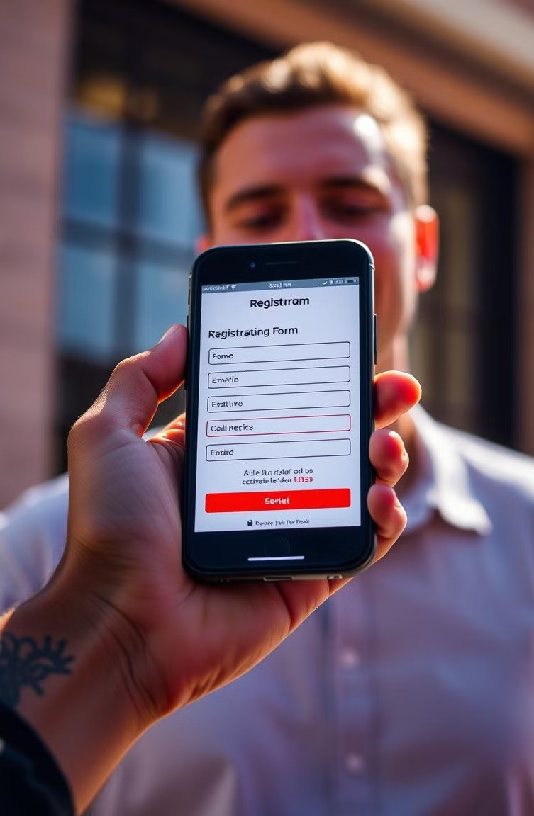
Registration: Easy Onboarding, Streamlined Process
Simple Forms
The registration process is quick and simple, with easy-to- follow instructions and only a few details needed to sign up.
Secure Data Management
Protecting donor privacy is paramount, with secure data storage and encrypted communication.
Immediate Confirmation
Instant confirmation of registration, allowing donors to start the process immediately.

Slide 4

Stock Availability: Real-Time Information
Blood Type Inventory
The website gives live updates on which blood types are available, helping to manage and distribute blood more efficiently.
Location-Based Search
Filter by location, allowing donors to find the nearest blood bank with their desired blood type.

Slide 5

Donation: Easy Scheduling, Convenient Options
Schedule Appointment
Book by phone, ensuring a seamless and convenient process.
1
2
Location Options
Choose from multiple blood bank locations, providing flexibility for donors.

Slide 6
Donor Education: Empowering Knowledge
1
Blood Donation Process
Detailed information about the steps involved, from registration to recovery.
2
Health Benefits of Donation
Highlighting the positive health effects of blood donation for donors.

Slide 7
Data Analytics: Optimizing Operations
Insights
The website uses data to understand how donors behave and track blood stock levels, helping to make better decisions about donations and supply management.
1
Optimization
uses data to improve how things run, making the process more efficient and ensuring donors have a better experience.
2
Predictive Modeling
Predict blood donation needs, allowing for proactive inventory management.
3

Slide 8
Conclusion: A Future of Life- Saving Technology
This website will empower donors, enhance blood bank efficiency, and ultimately save more lives. Join us in this journey of innovation and compassion.

