Slide 1

CIS 351-Data Structure-Tree
April 2, 2020
Dr. Farzana Rahman
Syracuse University

Slide 2


Slide 3
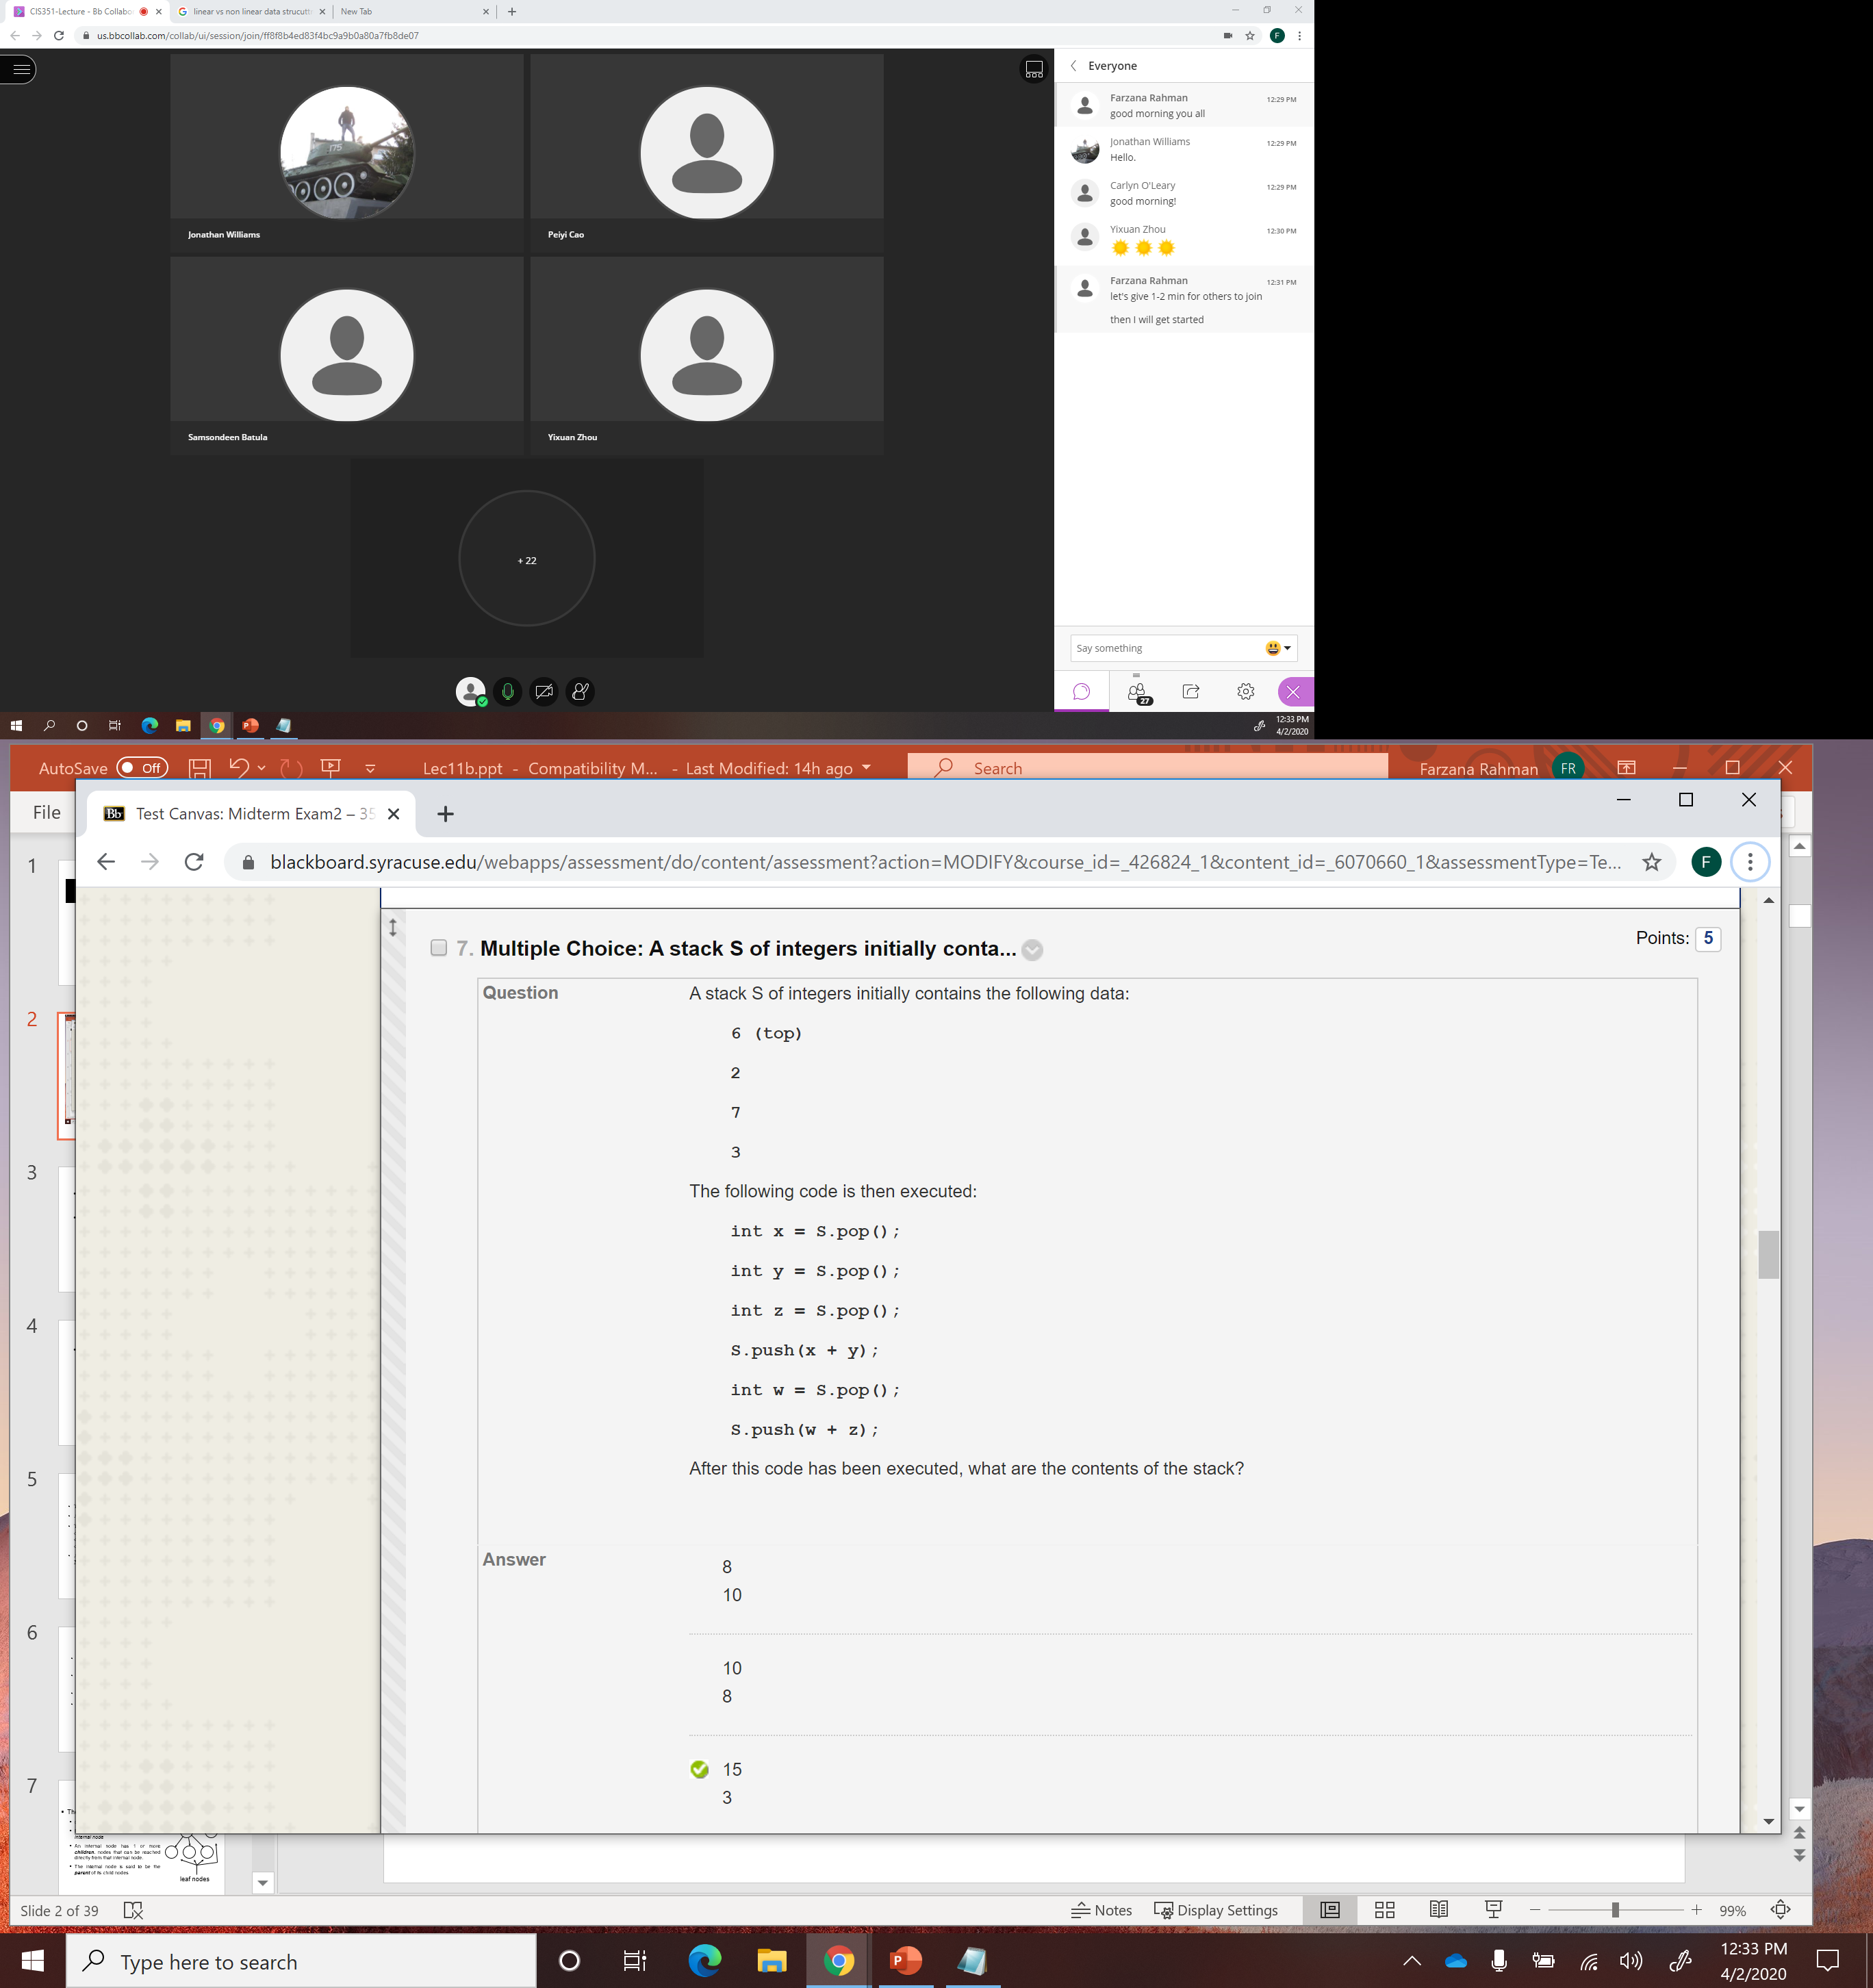

Slide 4
Non-Linear Structure
So far we have seen linear structures:
  lists, vectors, arrays, stacks, queues, etc
Non-linear structure:
  trees
  probably the most fundamental structure in computing
  hierarchical structure
  Terminology: from family trees (genealogy)

Slide 5
Application
Applications of trees
  class hierarchy in Java
  file system
  storing hierarchies in organizations

Slide 6
Tree
Tree defined recursively
A tree is a collection of nodes.
The collection can be empty; otherwise, a tree consists of a distinguished node r, called the root, and zero or more non-empty (sub) trees T₁, T₂, …, T_{k} each of whose roots are connected by a directed edge from r.
A tree is a collection of N nodes, one of which is the root and N-1 edges.

Slide 7
Tree terminology
The root of each subtree is said to be a child of r and r is said to be the parent of each subtree root.
Leaves: nodes with no children (also known as external nodes)
Internal Nodes: nodes with children
Siblings: nodes with the same parent

Slide 8
Terminology
root node
internal
nodes
The Tree ADT has
  one entry point, the root
  Each node is either a leaf or an internal node
  An internal node has 1 or more children, nodes that can be reached directly from that internal node.
  The internal node is said to be the parent of its child nodes
leaf nodes

Slide 9
Tree terminology (continued)
A path from node n₁ to n_{k} is defined as a sequence of nodes n₁, n₂, …, n_{k} such that n_{i} is the parent of n_{i+1} for 1<= i <= k.
The length of this path is the number of edges on the path namely k-1.
The length of the path from a node to itself is 0.
There is exactly one path from the root to each node.

Slide 10
Definitions
root
siblings: two nodes that have the same parent
edge: the link from one node to another
path length: the number of edges that must be traversed to get from one node to another
edge
siblings
path length from root to this
node is 3

Slide 11
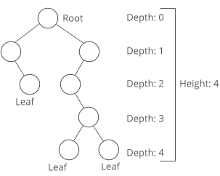
Tree terminology (continued)
Depth (of node): the length of the unique path from the root to a node.
Depth (of tree): The depth of a tree is equal to depth of its deepest leaf.
Height (of node): the length of the longest path from a node to a leaf.
  All leaves have a height of 0
  The height of the root is equal to the depth of the tree
Depth of the tree = Height of the tree - 1
Descendants: any nodes that can be reached via 1 or more edges from this node
Ancestors: any nodes for which this node is a descendant

Slide 12
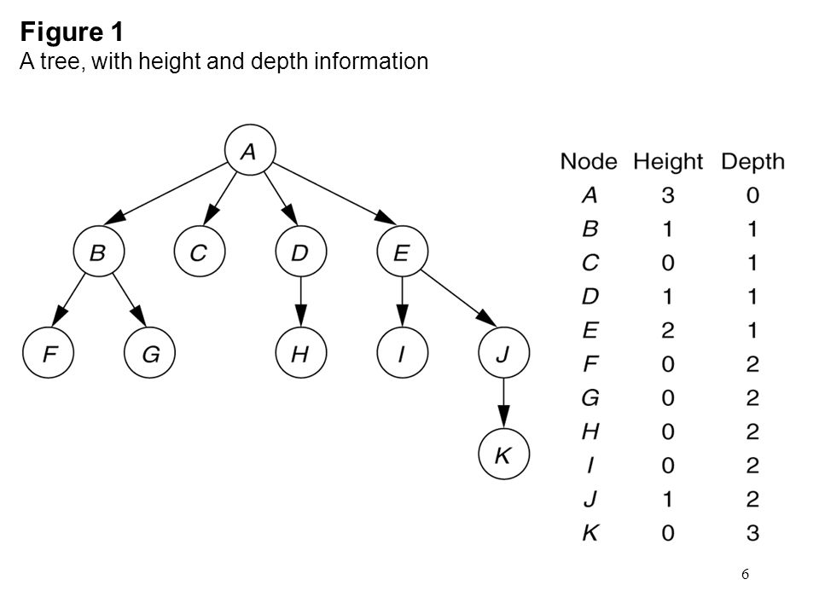

Slide 13
Calculate height of tree
FindHeight( Node root)
If root=NULL
return 0
Else
int l=FindHeight (root->left)
int r=FindHeight(root->right)
Return max(l,r)+1

Slide 14
ADT
Whatever the implementation of a tree is, its interface is the following
  root()
  size()
  isEmpty()
  parent(v)
  children(v)
  isInternal(v)
  isExternal(v)
  isRoot()

Slide 15
Binary tree
A binary tree is composed of zero or more nodes
Each node contains:
  A value (some sort of data item)
  A reference or pointer to a left child (may be null), and
  A reference or pointer to a right child (may be null)
A binary tree may be empty (contain no nodes)
If not empty, a binary tree has a root node
  Every node in the binary tree is reachable from the root node by a unique path
A node with neither a left child nor a right child is called a leaf
  In some binary trees, only the leaves contain a value

Slide 16
Binary Trees
There are many variations on trees but we will start with binary trees
binary tree: each node has at most two children
  the possible children are usually referred to as the left child and the right child
parent
left child
right child

Slide 17
Picture of a binary tree
a
b
c
d
e
f
g
h
i
j
k
l

Slide 18
Recursive definition
Recursive definition:
• a binary tree is empty;
• or it consists of
• a node (the root) that stores an element
• a binary tree, called the left subtree of T
• a binary tree, called the right subtree of T

Slide 19
Binary tree property: Full
full binary tree: a binary tree is which each node has exactly 2 or 0 children

Slide 20
Question
What is the maximum height of a full binary tree with 11 nodes?
3
5
7
11
Not possible to have full binary tree with 11 nodes

Slide 21
Binary tree property: Complete
complete binary tree: a binary tree T with n levels is complete if all levels except possibly the last are completely full, and the last level has all its nodes to the left side.
Where would the next node go
to maintain a complete tree?

Slide 22
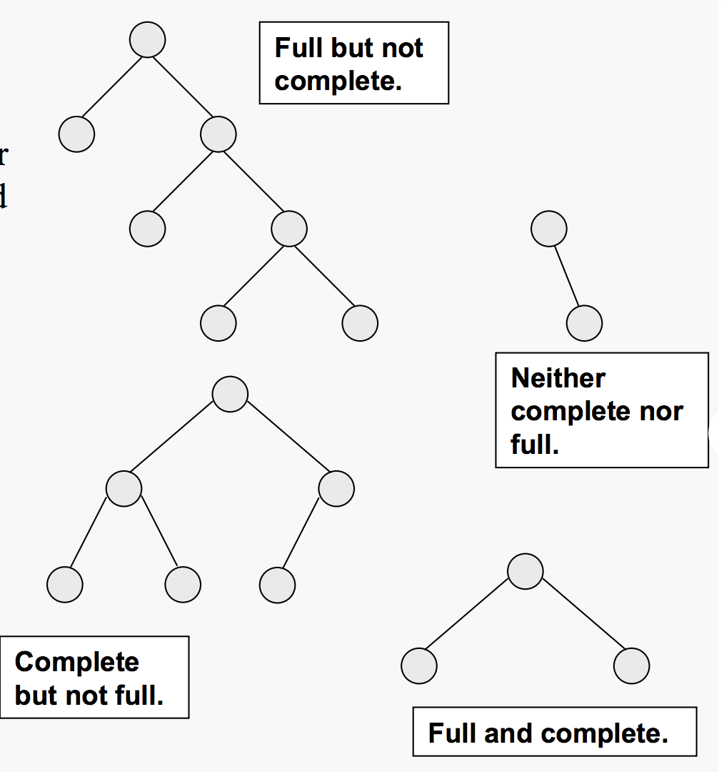

Slide 23
Binary tree property: Perfect
perfect binary tree: a binary tree with all leaf nodes at the same depth. All internal nodes have exactly two children.
a perfect binary tree has the maximum number of nodes for a given height
a perfect binary tree has (2^{(n+1)} - 1) nodes where n is the height of the tree
  height = 0 -> 1 node
  height = 1 -> 3 nodes
  height = 2 -> 7 nodes
  height = 3 -> 15 nodes

Slide 24
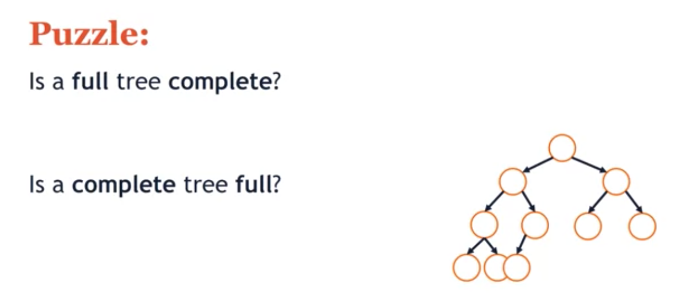

Slide 25
A Binary Node class
public class Bnode <E> {
private E myData;
private Bnode<E> myLeft;
private Bnode<E> myRight;
public BNode();
public BNode(E data, Bnode<E> left, Bnode<E> right)
public E getData()
public Bnode<E> getLeft()
public Bnode<E> getRight()
public void setData(E data)
public void setLeft(Bnode<E> left)
public void setRight(Bnode<E> right)
}

Slide 26
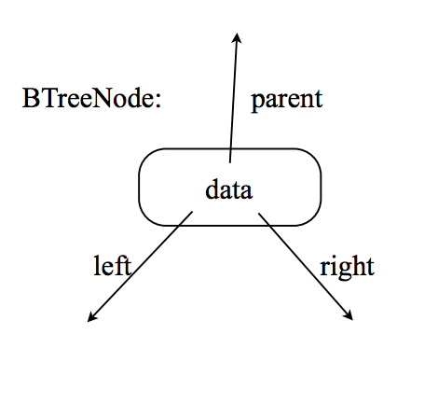
Binary tree implementation
use a linked-list structure; each node points to its left and right children ; the tree class stores the root node and the size of the tree
implement the following functions:
  left(v)
  right(v)
  hasLeft(v)
  hasRight(v)
  isInternal(v)
  is External(v)
  isRoot(v)
  size()
  isEmpty()
also • insertLeft(v,e) , insertRight(v,e) , remove(e) , addRoot(e)

Slide 27
Size and depth
The size of a binary tree is the number of nodes in it
  This tree has size 12
The depth of a node is its distance from the root
  a is at depth zero
  e is at depth 2
The depth of a binary tree is the depth of its deepest node
  This tree has depth 4
a
b
c
d
e
f
g
h
i
j
k
l

Slide 28
Balance
a
a
b
b
c
c
e
d
e
f
g
d
f
h
i
j
g
h
A balanced binary tree
i
j
An unbalanced binary tree
A binary tree is balanced if every level above the lowest is “full” (contains 2^{n} nodes)
In most applications, a reasonably balanced binary tree is desirable

Slide 29
Binary Tree traversals
A binary tree is defined recursively: it consists of a root, a left subtree, and a right subtree
To traverse (or walk) the binary tree is to visit each node in the binary tree exactly once
Tree traversals are naturally recursive
Since a binary tree has three “parts,” there are six possible ways to traverse the binary tree:
  root, left, right
  left, root, right
  left, right, root
  root, right, left
  right, root, left
  right, left, root

Slide 30
Tree Traversals
There are 4 traditional types of traversals
  preorder traversal: process the root, then process all sub trees (left to right)
  in order traversal: process the left sub tree, process the root, process the right sub tree
  post order traversal: process the left sub tree, process the right sub tree, then process the root
  level order traversal: starting from the root of a tree, process all nodes at the same depth from left to right, then proceed to the nodes at the next depth.

Slide 31
Preorder traversal
In preorder, the root is visited first
Here’s a preorder traversal to print out all the elements in the binary tree:
public void preorderPrint(BinaryTree bt) {
if (bt == null) return;
System.out.println(bt.value);
preorderPrint(bt.leftChild);
preorderPrint(bt.rightChild);
}

Slide 32
Inorder traversal
In inorder, the root is visited in the middle
Here’s an inorder traversal to print out all the elements in the binary tree:
public void inorderPrint(BinaryTree bt) {
if (bt == null) return;
inorderPrint(bt.leftChild);
System.out.println(bt.value);
inorderPrint(bt.rightChild);
}

Slide 33
Postorder traversal
In postorder, the root is visited last
Here’s a postorder traversal to print out all the elements in the binary tree:
public void postorderPrint(BinaryTree bt) {
if (bt == null) return;
postorderPrint(bt.leftChild);
postorderPrint(bt.rightChild);
System.out.println(bt.value);
}

Slide 34
Tree traversals using “flags”
The order in which the nodes are visited during a tree traversal can be easily determined by imagining there is a “flag” attached to each node, as follows:
preorder
inorder
postorder
To traverse the tree, collect the flags:
A
A
A
B
C
B
C
B
C
D
E
F
G
D
E
F
G
D
E
F
G
A B D E C F G
D B E A F C G
D E B F G C A

Slide 35
Copying a binary tree
In postorder, the root is visited last
Here’s a postorder traversal to make a complete copy of a given binary tree:
public BinaryTree copyTree(BinaryTree bt) {
if (bt == null) return null;
BinaryTree left = copyTree(bt.leftChild);
BinaryTree right = copyTree(bt.rightChild);
return new BinaryTree(bt.value, left, right);
}

Slide 36
Other traversals
The other traversals are the reverse of these three standard ones
  That is, the right subtree is traversed before the left subtree is traversed
Reverse preorder: root, right subtree, left subtree
Reverse inorder: right subtree, root, left subtree
Reverse postorder: right subtree, left subtree, root

Slide 37
Results of Traversals
To determine the results of a traversal on a given tree draw a path around the tree.
  start on the left side of the root and trace around the tree. The path should stay close to the tree.
pre order: process when
pass down left side of node
12 49 13 5 42
in order: process when pass
underneath node
13 49 5 12 42
post order: process when
pass up right side of node
13 5 49 42 12
12
49
42
13
5

Slide 38
Question: Tree Traversals
What is a the result of a
post order traversal of
the tree to the left?
F C G A K H L D J
F G C K L H J D A
A C F G D H K L J
A C D F G H J K L
L K J H G F D C A
A
C
D
F
G
H
J
K
L

Slide 39
Breadth First Search
Depth First Search
breadth first search: Any search algorithm that considers neighbors of a vertex (node), that is, outgoing edges (links) of the vertex's predecessor in the search, before any outgoing edges of the vertex
depth first search: Any search algorithm that considers outgoing edges (links o children) of a vertex (node) before any of the vertex's (node) siblings, that is, outgoing edges of the vertex's predecessor in the search. Extremes are searched first.

Slide 40
Question
Which traversal of a binary tree is a breadth first search?
Level order traversal
Pre order traversal
In order traversal
Post order traversal
More than one of these

