Slide 1
Class 18
swapping
shuffling
random walk
checkButton
build and use Car class

Slide 2
Bad swap
Memory
Output
x=5
y=10
print("x=",x,"y=",y)
x=y
y=x
print("x=",x,"y=",y)

Slide 3
Good swap 1
Memory
Output
x=5
y=10
print("x=",x,"y=",y)
temp = x
x=y
y=temp
print("x=",x,"y=",y)

Slide 4
Good swap 2 (Python)
Memory
Output
x=5
y=10
print("x=",x,"y=",y)
x, y = y, x
print("x=",x,"y=",y)

Slide 5
Shuffle a list
Demo

Slide 6
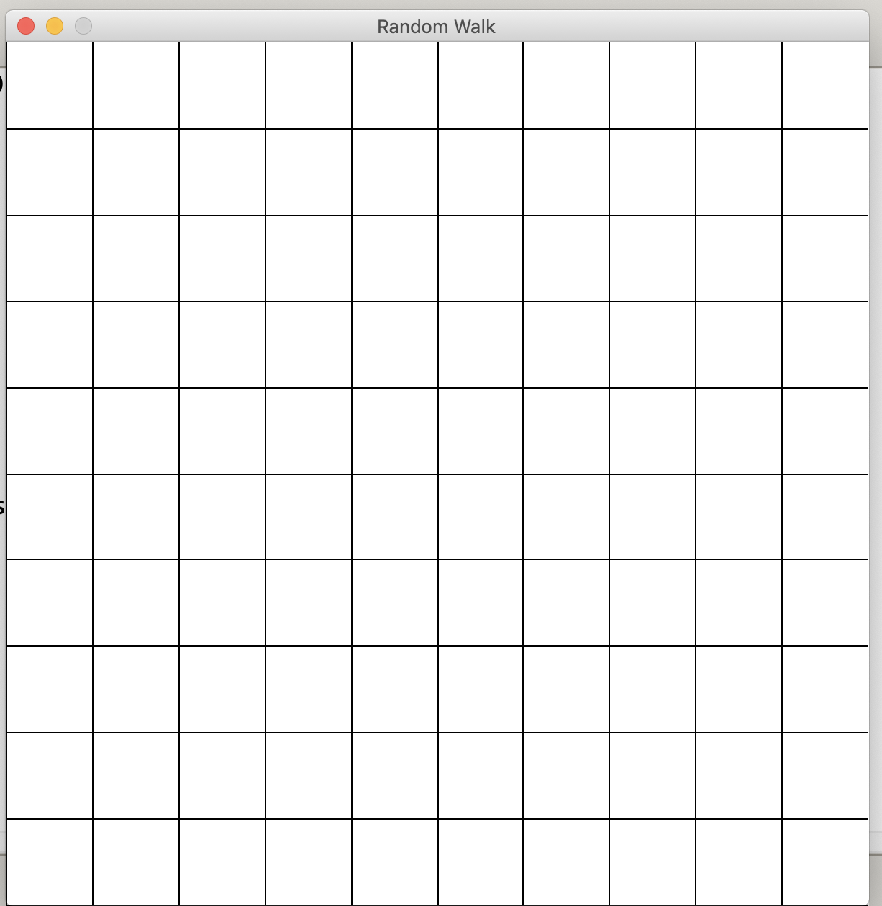
Discuss Random walk counting steps, not circles

Slide 7
checkButton
#clickedPoint is a Point, previous clicked by the mouse
#leftLower is the Point at the lower left of the rectangle
#rightUpper is the Point at the upper right of the rectangle
#Returns True if the clickedPoint is in the rectangle,
# False if the clickedPoint is not in the rectangle.

Slide 8
checkButton
def checkButtonClick(clickedPoint, leftLower, rightUpper):
lx=leftLower.getX()
ly=leftLower.getY()
rx=rightUpper.getX()
ry=rightUpper.getY()
cx=clickedPoint.getX()
cy=clickedPoint.getY()
return (lx<=cx <=rx) and (ly<=cy<=ry)
accessors

Slide 9
checkButton
def checkButtonClick(clickedPoint, leftLower, rightUpper):
lx=leftLower.getX()
ly=leftLower.getY()
rx=rightUpper.getX()
ry=rightUpper.getY()
cx=clickedPoint.getX()
cy=clickedPoint.getY()
return (lx<=cx <=rx) and (ly<=cy<=ry)
accessors

Slide 10
checkButton – alternate code
def checkButtonClick(clickedPoint,
leftLower, rightUpper):
lx=leftLower.getX()
ly=leftLower.getY()
rx=rightUpper.getX()
ry=rightUpper.getY()
cx=clickedPoint.getX()
cy=clickedPoint.getY()
if cx < lx:
return False
elif cx>rx
return False
elif cy< ly:
return False
elif cy>ry:
return False
else:
return True

Slide 11
Car class
want to keep track of total miles and total fuel to know Mile per gallon.
What is the relevant data we need?

Slide 12
Car class
want to keep track of total miles and total fuel to know Mile per gallon.
What are the methods we need?

Slide 13
Car class
want to keep track of total miles and total fuel to know Mile per gallon.
Let's put in accessors

Slide 14
#car.py
class Car:
def __init__(self, miles, fuel):
self.odometer = miles
self.fuel = fuel
def driveTrip(self, miles):
self.odometer += miles
def fillTank(self,gallons):
self.fuel+=gallons

Slide 15
def getOdometer(self):
return self.odometer
def getFuel(self):
return self.fuel
def getMPG(self):
mpg = self.odometer/self.fuel
return mpg

Slide 16
def main():
myHybrid=Car(104000, 2600)
samsTruck=Car(5050, 337)
print("My car's mpg: {0:.4f}".format( myHybrid.getMPG()))
print("Sam's truck's mpg: {0:.4f}".format( samsTruck.getMPG()))

Slide 17
myHybrid.driveTrip(100)
myHybrid.fillTank(10)
print("After my trip.")
print("My car's mpg: {0:.4f}".format(myHybrid.getMPG()))
print("my car's total fuel: ",myHybrid.getFuel())
print("my car's total miles: ",myHybrid.getOdometer())
#*** end of main ***

