Slide 1
class 21
Clear window undraw or multiple windows

Slide 2
clear a window or items from a window
1. remove an item
circ.undraw(win)
2. replace old window with a new window – see link on lecture page.

Slide 3
lab 20
class State:
def __init__(self, name, pop):
self.name = name
self.population = pop

Slide 4
lab 20
In the State class, write a getPopulation method, that returns the population of a State instance.

Slide 5
lab 20
Now write a function usePopulation(aState), (not a class method), that has a State as a parameter and returns the population of that State (use getPopulation inside the function).

Slide 6
lab 20
Modify your call to sort to be
stateList.sort(key=usePopulation)

Slide 7
comparing strings
"happy" < "sad"
"happy" > "Sad"
"happy".upper() < "Sad".upper()

Slide 8
problem with tabs
California 39,776,830
New York 19,862,512
Michigan 9,991,177
Alaska 738,068
Colorado 5,684,203
Hawaii 1,426,393
Arkansas 3,020,327
Maryland 6,079,602
Georgia 10,545,138
Illinois 12,768,320
Oregon 4,199,563
Florida 21,312,211

Slide 9
parallel lists
California 39,776,830
New York 19,862,512
Michigan 9,991,177
Alaska 738,068
Colorado 5,684,203
Hawaii 1,426,393
Arkansas 3,020,327
Maryland 6,079,602
Georgia 10,545,138
Illinois 12,768,320
Oregon 4,199,563
Florida 21,312,211

Slide 10
parallel lists – problem with sorting
California 39,776,830
New York 19,862,512
Michigan 9,991,177
Alaska 738,068
Colorado 5,684,203
Hawaii 1,426,393
Arkansas 3,020,327
Maryland 6,079,602
Georgia 10,545,138
Illinois 12,768,320
Oregon 4,199,563
Florida 21,312,211

Slide 11
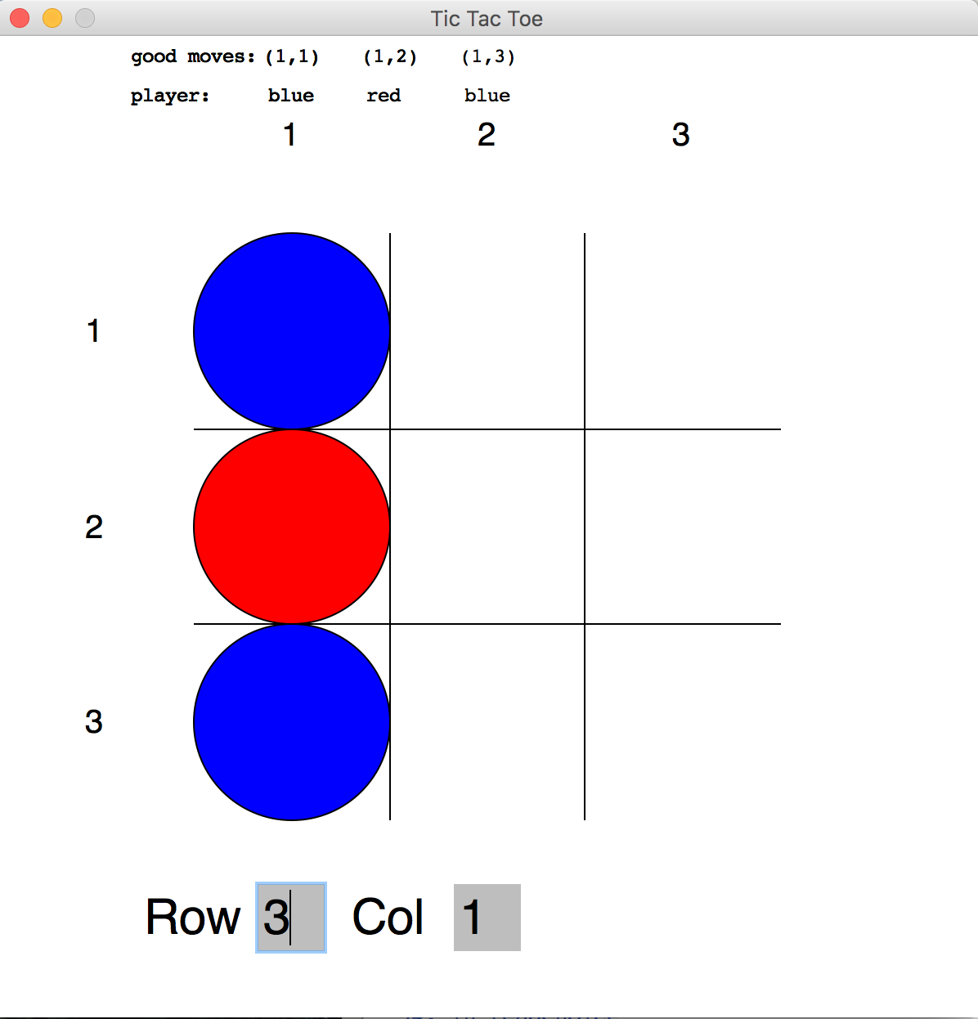
Today's lab

Slide 12
main
row
col
valid
win
rowBox
colBox
row
col
moveListPairs
rowBox
colBox
moveListPais
playerList
win
win
win
rowBox
colBox
win
setUpWindow
makeGrid
drawEntryBoxes
readChoice
checkValid
clearBoxes
makeReport
win
labelGrid
playerList
win
makePlayerReport

