Slide 1
Intro to Classes in Python

Slide 2
Circle class from graphics.py
myCircle = Circle(Point(0,0),20)
Creates a new Circle object
invokes the Circle constructor
associates the variable myCircle with the Circle

Slide 3
Objects have (instance) data State
myCircle = Circle(Point(0,0),20)
a constructor is a method (function within the Circle class)
Invoke it using the name of the class Circle
Parameters are used to give values to some of the instance data of a Circle.

Slide 4
Objects can Do Behaviors
Once an object is created, it can invoke its methods:
myCircle.draw(win)
myCircle.move(dx, dy)

Slide 5
Person class. Design a form. Room for data, but not filled in.
Person
____________
first name
____________
age
____________
weight

Slide 6
Person instances (objects). instance data for each object
Person teacher
Person engineer
Person
____________
first name
____________
age
____________
weight
Person
____________
first name
____________
age
____________
weight
Mo
Susan
29
54
160
130

Slide 7
Why classes
functions help structure the calculations and the tasks of a program
Classes help structure the data, together with some tools (methods) for working with the data

Slide 8
Objects
The information is stored inside the object in instance variables.
The operations, called methods, are functions that “live” inside the object.
Collectively, the instance variables and methods are called the attributes of an object.

Slide 9
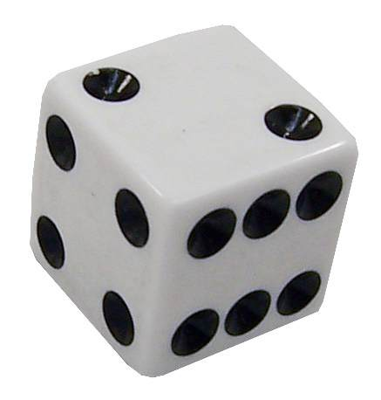
Classes and Objects
An object has state and behavior
Consider a die (singular of dice)
state: how many sides, which face is showing
behavior: it can be rolled, it can be placed on the table, it can say which side is up
Design a class called MSDie that models this state and behavior
The class serves as the blueprint for a die object
We can then instantiate as many die objects as we need for any particular program

Slide 10
Some class terminology
Class – the blueprint
Object, instance – one item built from the blueprint.
Instantiate – make one instance

Slide 11
Example: Multi-Sided Dice
Each MSDie object will know two things:
How many sides it has.
It’s current value
When a new MSDie is created, we specify n, the number of sides it will have.

Slide 12
Example: Multi-Sided Dice
We have three methods that we can use to operate on the die:
roll – set the die to a random value between 1 and n, inclusive.
setValue – set the die to a specific value (i.e. cheat)
getValue – see what the current value is.

Slide 13
Example: Multi-Sided Dice
>>> die1 = MSDie(6)
>>> die1.getValue()
1
>>> die1.roll()
>>> die1.getValue()
5
>>> die2 = MSDie(13)
>>> die2.getValue()
1
>>> die2.roll()
>>> die2.getValue()
9
>>> die2.setValue(8)
>>> die2.getValue()
8

Slide 14
Example: Multi-Sided Dice
# msdie.py
# Class definition for an n-sided die.
from random import randrange
class MSDie:
def __init__(self, sides): #2 underlines before and after
self.sides = sides
self.value = 1
def roll(self):
self.value = randrange(1, self.sides+1)
def getValue(self):
return self.value
def setValue(self, value):
self.value = value

Slide 15
Constructor
# msdie.py
# Class definition for an n-sided die.
from random import randrange
class MSDie:
def __init__(self, sides):
self.sides = sides
self.value = 1
self
MSDie
____________
self.sides
____________
self.value

Slide 16
Example: Multi-Sided Dice
Class definitions have the form class <class-name>: <method-definitions>
Methods look a lot like functions! Placing the function inside a class makes it a method of the class, rather than a stand-alone function.
The first parameter of a method is usually named self, which is a reference to the object on which the method is acting.

Slide 17
Example: Multi-Sided Dice
Suppose we have a main function that executes die1.setValue(8).
Just as in function calls, Python executes the following four-step sequence:
main to MSDie's setValue: main suspends at the point of the method call. Python locates the appropriate method definition inside the class of the object to which the method is being applied. Here, control is transferred to the setValue method in the MSDie class, since die1 is an instance of MSDie.

Slide 18
Example: Multi-Sided Dice
assign arguments to parameters:The formal parameters of the method get assigned the values supplied by the actual parameters of the call. In the case of a method call, the first formal parameter refers to the object: self = die1 value = 8
The body of the method is executed.

Slide 19
Example: Multi-Sided Dice
Return to main: Control returns to the point just after where the method was called. In this case, it is immediately following die1.setValue(8).

Slide 20
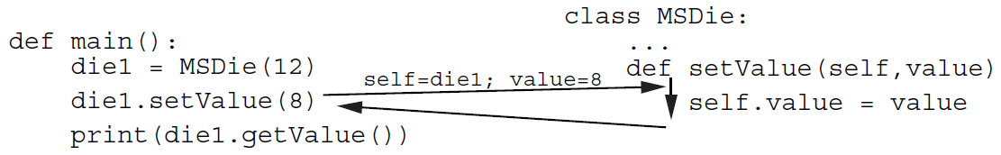
Example: Multi-Sided Dice

Slide 21
Example: Multi-Sided Dice
Methods are called with one parameter, but the method definition itself includes the self parameter as well as the actual parameter:
def __init__(self, sides):
The self parameter is a bookkeeping detail. We can refer to the first formal parameter as the self parameter and other parameters as normal parameters. So, we could say setValue uses one normal parameter.
(self is just any name, but use self)

Slide 22
Example: Multi-Sided Dice
Objects contain their own data. Instance variables provide storage locations inside of an object.
Instance variables are accessed by name using our dot notation: <object>.<instance-var>
Looking at setValue, we see self.value refers to the instance variable value inside the object. Each MSDie object has its own value.

Slide 23
Example: Multi-Sided Dice
Certain methods have special meaning. These methods have names that start and end with two _’s.
__init__ is the object constructor. Python calls this method to initialize a new MSDie. __init__ provides initial values for the instance variables of an object.

Slide 24
Example: Multi-Sided Dice
Instance variables (the ones with self. in front) become part of a particular object, and this information can be passed around the program with the object.
def __init__(self, sides):
self.sides = sides
self.value = 1
This is different than local function variables, whose values disappear when the function terminates.
def writeSum(apples, oranges):
sum=apples + oranges
print("Total: ", sum)

Slide 25
Can but don't
In main we can write
print(die1.value)
instead of
print(die1.getValue())
BUT DON'T

Slide 26
Example: Multi-Sided Dice
Outside the class, the constructor is referred to by the class name: die1 = MSDie(6)
When this statement is executed, a new MSDie object is created and __init__ is executed on that object.
The net result is that die1.sides is set to 6 and die1.value is set to 1.

Slide 27
Example: Multi-Sided Dice
Instance variables can remember the state of a particular object, and this information can be passed around the program as part of the object.
This is different than local function variables, whose values disappear when the function terminates.

