Slide 1
Class 13
function example unstring
if
if else
if elif else
forming simple conditions
relational operators
comparing strings
Boolean expressions
nesting conditions
multiway conditions
multiway conditions(if elif else) vs independent ifs

Slide 2
What is the output?
def unstring(listOfnums):
n=len(listOfnums)
for i in range(n):
listOfnums[i]=float(listOfnums[i].strip())
return listOfnums
aList=['23', ' 45', '27\n']
bList=unstring(aList)
print(bList)

Slide 3
if example: Temperature Warnings
if fahrenheit >= 90:
print("It's really hot out there, be careful!")
if fahrenheit <= 30:
print("Brrrrr. Be sure to dress warmly")

Slide 4
if
if <condition>: <body>
The body is a sequence of one or more statements indented under the if heading.

Slide 5
Forming Simple Conditions
Simple comparison:
<expr> <relop> <expr>
<relop> is short for relational operator

Slide 6
Forming Simple Conditions
Python | Mathematics | Meaning
< | < | Less than
<= | ≤ | Less than or equal to
== | = | Equal to
>= | ≥ | Greater than or equal to
> | > | Greater than
!= | ≠ | Not equal to

Slide 7
Forming Simple Conditions
Notice the use of == for equality. Since Python uses = to indicate assignment, a different symbol is required for the concept of equality.
A common mistake is using = in conditions!

Slide 8
Forming Simple Conditions
Conditions may compare either numbers or strings.
When comparing strings, the ordering is lexigraphic, meaning that the strings are sorted based on the underlying Unicode.
All upper-case Latin letters come before lower-case letters: (“Bbbb” comes before “aaaa”)

Slide 9
Boolean Expression
When a Boolean expression is evaluated, it produces either a value of True (meaning the condition holds), or it produces False (it does not hold).
(Some computer languages use 1 and 0 to represent True and False.)

Slide 10
Examples: Simple Conditions
Boolean conditions are of type bool and the Boolean values of true and false are represented by the literals True and False.
>>> 3 < 4
True
>>> 3 * 4 < 3 + 4
False
>>> "hello" == "hello"
True
>>> "goodbye" < "hello"
True

Slide 11
Two-Way Decisions
if-else statement: if <condition>: <statements> else: <statements>

Slide 12
Aside: Quadratic equation
ax² + bx + c
roots=(-b±sqrt(b²-4ac)) / 2a
if the sqrt exists.
b²-4ac is called the discriminant.

Slide 13
Example: Two-Way Decisions
discrim = b * b - 4 * a * c
if discrim < 0:
print("\nThe equation has no real roots!")
else:
discRoot = math.sqrt(b * b - 4 * a * c)
root1 = (-b + discRoot) / (2 * a)
root2 = (-b - discRoot) / (2 * a)
print ("\nThe solutions are:", root1, root2 )

Slide 14
Multi-Way Decisions
Check the value of discrim when < 0: handle the case of no roots when = 0: handle the case of a double root when > 0: handle the case of two distinct roots
We can do this with two if-else statements, one inside the other.
Putting one compound statement inside of another is called nesting.

Slide 15
Multi-Way Decisions
if discrim < 0:
print("Equation has no real roots")
else:
if discrim == 0:
root = -b / (2 * a)
print("There is a double root at", root)
else:
# Do stuff for two roots

Slide 16
Multi-Way Decisions
Imagine if we needed to make a five-way decision using nesting. The if-else statements would be nested four levels deep!
There is a construct in Python that achieves this, combining an else followed immediately by an if into a single elif.

Slide 17
Multi-Way Decisions
if <condition1>: <case1 statements> elif <condition2>: <case2 statements> elif <condition3>: <case3 statements> … else: <default statements>

Slide 18
Multi-Way Decisions
This form sets off any number of mutually exclusive code blocks.
Python evaluates each condition in turn looking for the first one that is true. If a true condition is found, the statements indented under that condition are executed, and control passes to the next statement after the entire if-elif-else.
If none are true, the statements under else are performed.

Slide 19
Multi-Way Decisions
The else is optional. If there is no else, it’s possible no indented block would be executed.

Slide 20
Example: Multi-Way Decisions
discrim = b * b - 4 * a * c
if discrim < 0:
print("\nThe equation has no real roots!")
elif discrim == 0:
root = -b / (2 * a)
print("\nThere is a double root at", root)
else:
discRoot = math.sqrt(b * b - 4 * a * c)
root1 = (-b + discRoot) / (2 * a)
root2 = (-b - discRoot) / (2 * a)
print("\nThe solutions are:", root1, root2 )

Slide 21
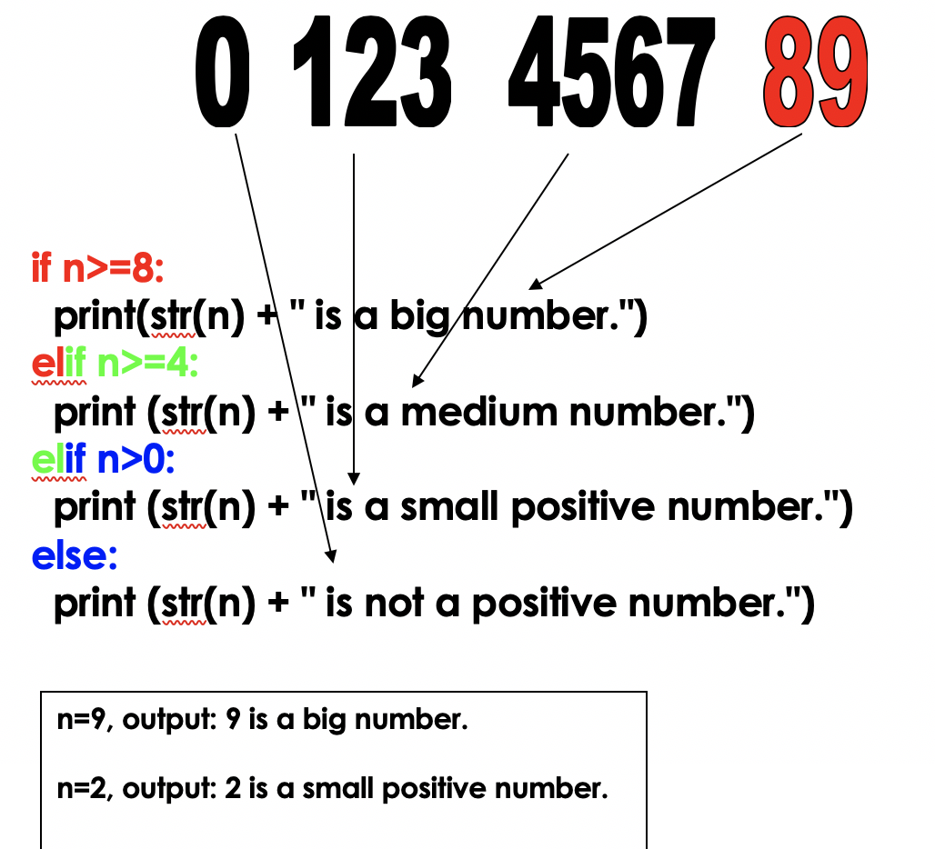


Slide 22
