Slide 1
Class 7
coordinates: pixel and with setCoords
aspect ratio
Rectangle
drawing in a loop
Text
setText
changing the extension of files
Objects and Classes
instance
constructor
instance variables
methods

Slide 2
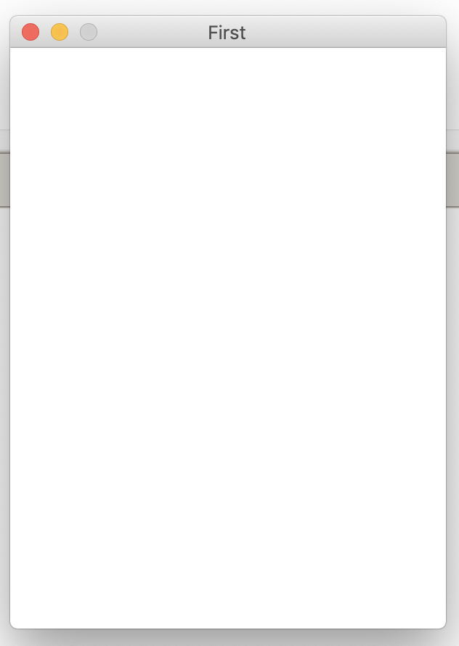
What are the coordinates of the four corners of the window?
win = GraphWin("First",300,400)

Slide 3
What are the coordinates of the four corners of the window?
win = GraphWin("First",300,400)
win.setCoords(0,0,3,4)

Slide 4
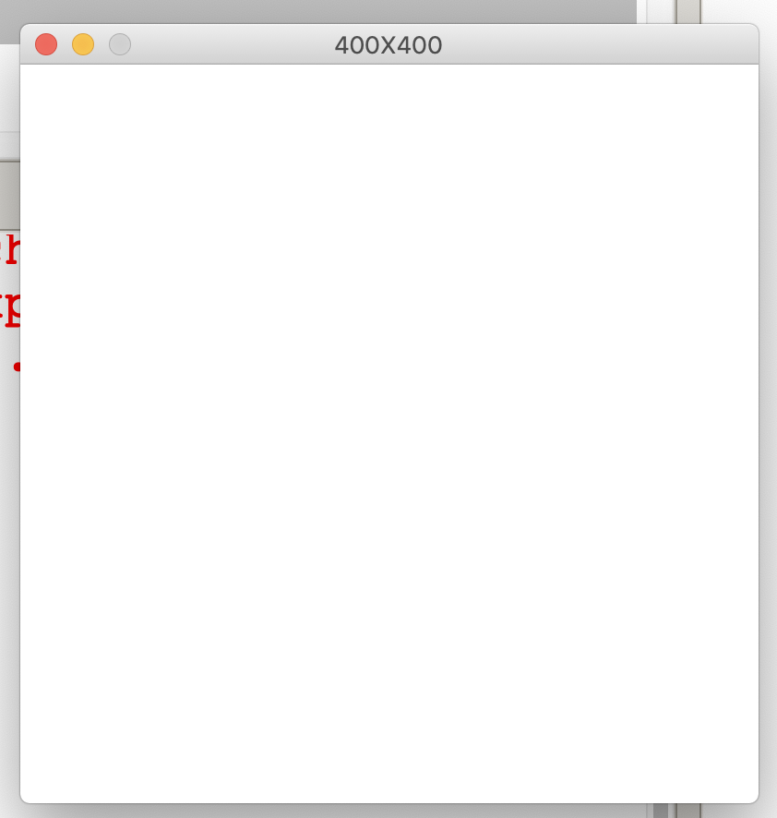
What will we see?
win = GraphWin("400 X 400",400,400)
win.setCoords(0,0,4,4)
circ=Circle(Point(2,2),1)
circ.draw(win)

Slide 5
What will we see?
win = GraphWin("400 X 400",400,400)
win.setCoords(0,0,8,8)
circ=Circle(Point(2,2),1)
circ.draw(win)

Slide 6
What will we see?
win = GraphWin("400 X 400",400,400)
win.setCoords(0,0,2,8)
circ=Circle(Point(2,2),1)
circ.draw(win)

Slide 7
What will we see?
win = GraphWin("400 X 400",400,400)
win.setCoords(0,0,4,4)
rect=\
Rectangle(Point(2,2),Point(3,3.9))
rect.draw(win)

Slide 8
What will we see?
win = GraphWin("400 X 400",400,400)
win.setCoords(0,0,4,4)
for m in range(2,6):
x=1+2*.1
p=Point(x,3)
p.draw(win)

Slide 9
What will we see?
win = GraphWin("400 X 400",400,400)
win.setCoords(0,0,4,4)
for m in range(2,6):
x=1+2*.3
p=Point(x,3)
c=Circle(p,0.1)
c.draw(win)

Slide 10
Where will the text be drawn?
p=(0,0)
word=Text(p,"ABCDE")
word.draw(win)

Slide 11
Where will the text be drawn?
p=(2,2)
word=Text(p,"ABCDE")
word.draw(win)

Slide 12
What happens when you click the mouse?
p=getMouse();
t=Text(p,"Hello")
q=getMouse();
t.setText("Goodbye")

Slide 13
Downloading .py files from my website
trouble downloading some .py files
instead, download .txt file, change the extension to .py
note this doesn't work for all kinds of files. Can't just change .docs to .txt.
Can save a word file: "Save as" plain text, .txt

Slide 14
The Object of Objects
Basic idea – view a complex system as the interaction of simpler objects. An object is a sort of active data type that combines data and operations.
Objects know stuff (contain data) and they can do stuff (have operations).
Objects interact by sending each other messages.

Slide 15
Using Graphical Objects
Computation is performed by asking an object to carry out one of its operations.
Last lab we manipulated GraphWin, Point, Circle, and Rectangle. These are examples of classes.
Today we use Oval, Line, Text

Slide 16
Using Graphical Objects
Each object is an instance of some class, and the class describes the properties of the instance.
If we say that Augie is a dog, we are actually saying that Augie is a specific individual in the larger class of all dogs. Augie is an instance of the dog class.

Slide 17
Using Graphical Objects
To create a new instance of a class, we use a special operation called a constructor. <class-name>(<param1>, <param2>, …)
<class-name> is the name of the class we want to create a new instance of, e.g. Circle or Point.
The parameters are required to initialize the object. For example, Point requires two numeric values.

Slide 18
Using Graphical Objects
p = Point(50, 60) The constructor for the Point class requires two parameters, the x and y coordinates for the point.
These values are stored as instance variables inside of the object.

Slide 19
Using Graphical Objects
Only the most relevant instance variables are shown (others include the color, window they belong to, etc.)

Slide 20
Using Graphical Objects
To perform an operation on an object, we send the object a message. The set of messages an object responds to are called the methods of the object.
Methods are like functions that live inside the object.
Methods are invoked using dot-notation: <object>.<method-name>(<param1>, <param2>, …)

