Slide 1
Class 8
setCoords
Oval
move
Line
cloning vs copying
getMouse, getKey
Using getMouse to wait for user's data
Entry box, getText, setText
type()
string indexing, slicing
string repetition *
concatenation +
len – string length
for <char> in <string>:

Slide 2
click a key and make the letter appear twice
k=win.getKey()
klabel=Text(p,k+k)
klabel.draw(win)

Slide 3
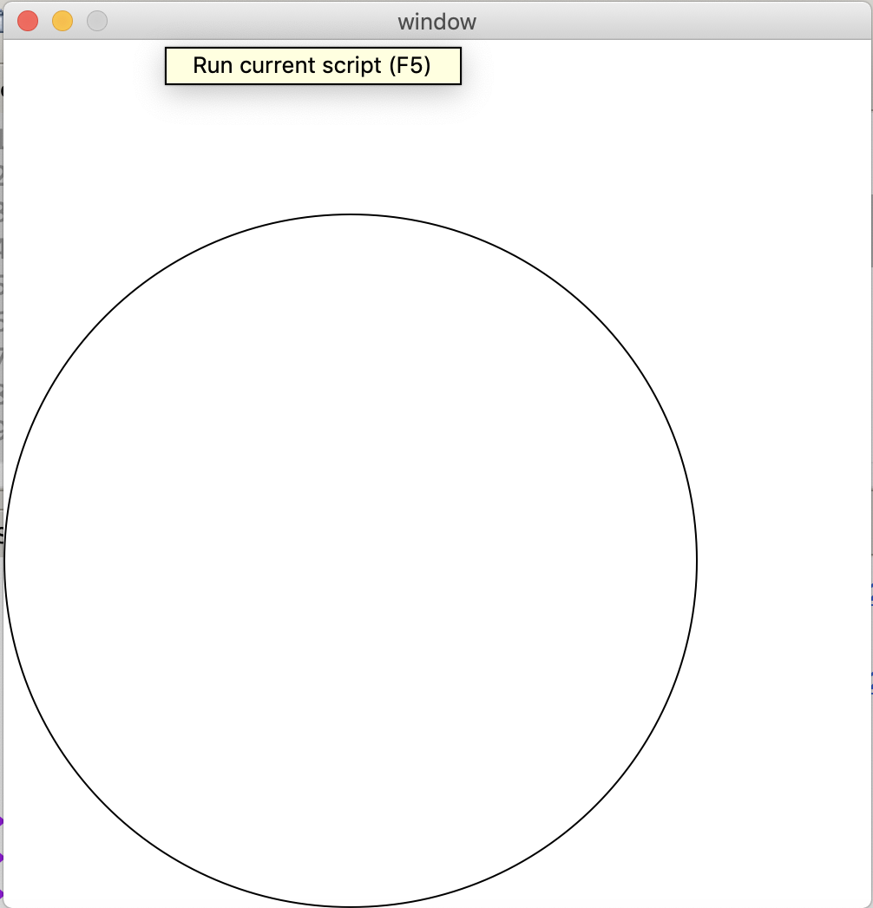
setCoords(lowerLeftX, lowerLeftY, upperRightX, upperRightY) What numbers to put in Point to get
win=GraphWin("window",500,500)
win.setCoords(-2,-2,3,3)
Circle(Point( , ),2).draw(win)

Slide 4
Bounding box for an Oval Does the oval go through the point (0,0)? What will this oval look like?
win=GraphWin("window",500,500)
win.setCoords(-1,-1,4,4)
ov=Oval(Point(0,0),Point(1,2))
ov.draw(win)

Slide 5
copying an object (and move)
ovCopy=ov
ovCopy.move(.5,1)
where will ovCopy be?
where will ov be?

Slide 6
copying an object
ovCopy=ov
ovCopy.move(.5,1)
ov and ovCopy are the same Oval!
there is only one Oval on the screen, not 2

Slide 7
cloning an object Where will ovClone be? Where will ov be?
ovClone=ov.clone()
ovClone.move(.5,-1)
ovClone.draw(win)

Slide 8
cloning an object
ovClone=ov.clone()
ovClone.move(.5,-1)
ovClone.draw(win)
ov and ovClone are different Ovals
ovClone has not yet been drawn, so we need
ovClone.draw(win)

Slide 9
shape.move(dx,dy)
mutator – changes some of the instance values of the shape
if shape has already been drawn, draws shape in new location and undraws from old location

Slide 10
What is the output?
win=GraphWin("window",500,500)
win.setCoords(-1,-1,4,4)
diag=Line(Point(0,0),Point(1,2))
diag.setFill("green")
diag.setWidth(4)
diag.draw(win)

Slide 11
Handling Textual Input
# clickntype.py
from graphics import *
def main():
win = GraphWin("Click and Type", 400, 400)
for i in range(10):
pt = win.getMouse()
key = win.getKey()
label = Text(pt, key)
label.draw(win)

Slide 12
Handling Textual Input
There’s also an Entry object that can get keyboard input.
The Entry object draws a box on the screen that can contain text. It understands setText and getText, with one difference that the input can be edited.

Slide 13
Handling Textual Input

Slide 14
Handling Textual Input
# convert_gui.pyw
# Program to convert Celsius to Fahrenheit using a simple
# graphical interface.
from graphics import *
def main():
win = GraphWin("Celsius Converter", 300, 200)
win.setCoords(0.0, 0.0, 3.0, 4.0)
# Draw the interface
Text(Point(1,3), " Celsius Temperature:").draw(win)
Text(Point(1,1), "Fahrenheit Temperature:").draw(win)
input = Entry(Point(2,3), 5)
input.setText("0.0")
input.draw(win)
output = Text(Point(2,1),"")
output.draw(win)
button = Text(Point(1.5,2.0),"Convert It")
button.draw(win)
Rectangle(Point(1,1.5), Point(2,2.5)).draw(win)

Slide 15
Handling Textual Input
# wait for a mouse click
win.getMouse()
# convert input
celsius = eval(input.getText())
fahrenheit = 9.0/5.0 * celsius + 32
# display output and change button
output.setText(fahrenheit)
button.setText("Quit")
# wait for click and then quit
win.getMouse()
win.close()
main()

Slide 16
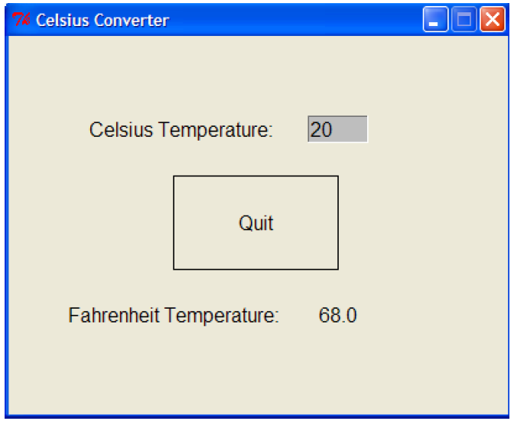
Handling Textual Input

Slide 17
string and list processing

Slide 18
The String Data Type
The most common use of personal computers is word processing.
Text is represented in programs by the string data type.
A string is a sequence of characters enclosed within quotation marks (") or apostrophes (').

Slide 19
The String Data Type
>>> str1="Hello"
>>> str2='spam'
>>> print(str1, str2)
Hello spam
>>> type(str1)
<class 'str'>
>>> type(str2)
<class 'str'>

Slide 20
The String Data Type
Getting a string as input
>>> firstName = input("Please enter your name: ")
Please enter your name: John
>>> print("Hello", firstName)
Hello John
Notice that the input is not evaluated. We want to store the typed characters, not to evaluate them as a Python expression.

Slide 21
The String Data Type
We can access the individual characters in a string through indexing.
The positions in a string are numbered from the left, starting with 0.
The general form is <string>[<expr>], where the value of expr determines which character is selected from the string.

Slide 22
The String Data Type
H
e
l
l
o
B
o
b
0 1 2 3 4 5 6 7 8
>>> greet = "Hello Bob"
>>> greet[0]
'H'
>>> print(greet[0], greet[2], greet[4])
H l o
>>> x = 8
>>> print(greet[x - 2])
B

Slide 23
The String Data Type
H
e
l
l
o
B
o
b
0 1 2 3 4 5 6 7 8
In a string of n characters, the last character is at position n-1 since we start counting with 0.
We can index from the right side using negative indexes.
>>> greet[-1]
'b'
>>> greet[-3]
'B'

Slide 24
The String Data Type
Indexing returns a string containing a single character from a larger string.
We can also access a contiguous sequence of characters, called a substring, through a process called slicing.

Slide 25
The String Data Type
Slicing: <string>[<start>:<end>]
start and end should both be ints
The slice contains the substring beginning at position start and runs up to but doesn’t include the position end.

Slide 26
The String Data Type
H
e
l
l
o
B
o
b
0 1 2 3 4 5 6 7 8
>>> greet[0:3]
'Hel'
>>> greet[5:9]
' Bob'
>>> greet[:5]
'Hello'
>>> greet[5:]
' Bob'
>>> greet[:]
'Hello Bob'

Slide 27
The String Data Type
If either expression is missing, then the start or the end of the string are used.
Can we put two strings together into a longer string?
Concatenation “glues” two strings together (+)
Repetition builds up a string by multiple concatenations of a string with itself (*)

Slide 28
The String Data Type
The function len will return the length of a string.
>>> "spam" + "eggs"
'spameggs'
>>> "Spam" + "And" + "Eggs"
'SpamAndEggs'
>>> 3 * "spam"
'spamspamspam'
>>> "spam" * 5
'spamspamspamspamspam'
>>> (3 * "spam") + ("eggs" * 5)
'spamspamspameggseggseggseggseggs'

Slide 29
looping through a string
>>> len("spam")
4
>>> for ch in "Spam!":
print (ch, end=" ")
S p a m !

Slide 30
The String Data Type
Operator | Meaning
+ | Concatenation
* | Repetition
<string>[] | Indexing
<string>[:] | Slicing
len(<string>) | Length
for <var> in <string> | Iteration through characters

Slide 31
Simple String Processing
Usernames on a computer system
First initial, first seven characters of last name
# get user’s first and last names
first = input("Please enter your first name (all lowercase): ")
last = input("Please enter your last name (all lowercase): ")
# concatenate first initial with 7 chars of last name
uname = first[0] + last[:7]

Slide 32
Simple String Processing
>>>
Please enter your first name (all lowercase): john
Please enter your last name (all lowercase): doe
uname = jdoe
>>>
Please enter your first name (all lowercase): donna
Please enter your last name (all lowercase): rostenkowski
uname = drostenk

