Slide 1
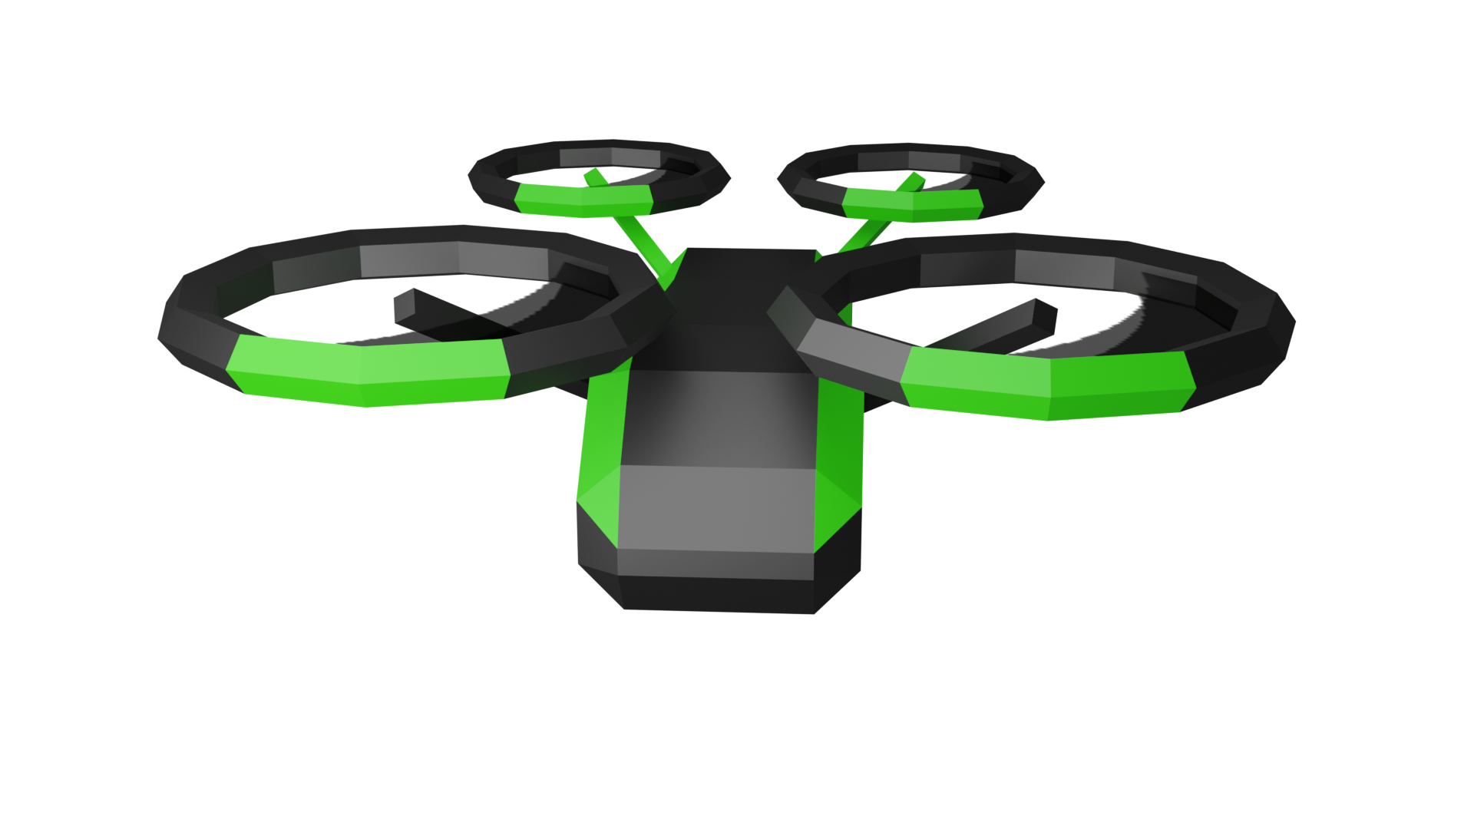

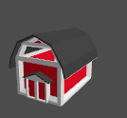
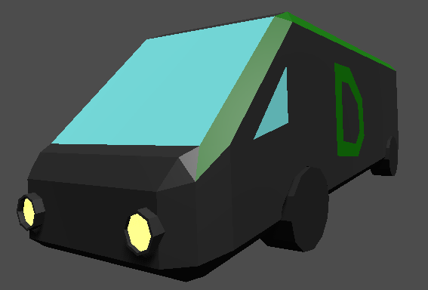

Goal of the game:
The farmer is on a holiday. So, no one is running the farm
People order food via your delivery service
So, now you use your delivery drones to collect the orders directly from the farm.

Slide 2


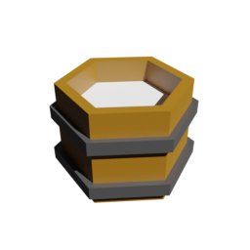
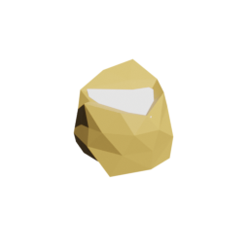
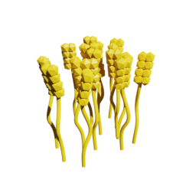
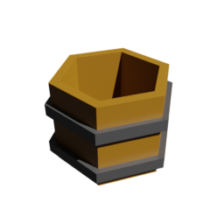



How?
Fly with your drone close to the pickable objects,
Click on the object to collect
You can hold up to 5 items
Click on the delivery van to unload your items into the van.
Once all requested items are stored in the van. You finished the level.
There are nine levels
Every level introduces a new thing.

Slide 3
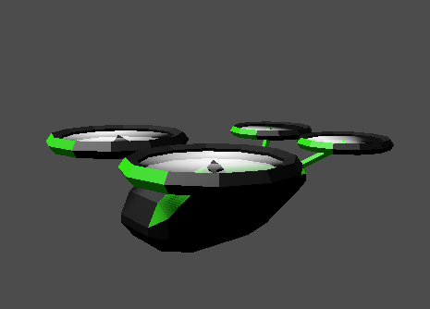


Controls
W
S
space
Shift
A
D
Q
E

Slide 4
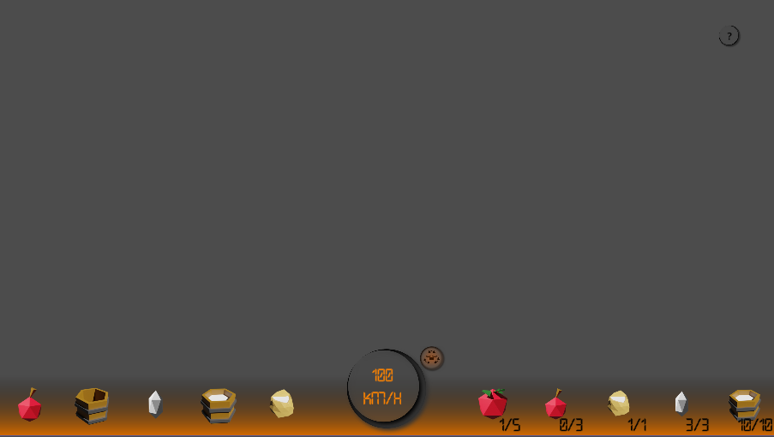


The UI
Stabilizer on
No input = a stationary hover.
This tutorial
Stabilizer off
No input = maintain height, horizontal speed unchanged.
T
This is your speed and the stabilizer indicator.
Shortcut
These are the items in your drone,
This is the order you have to collect.

Slide 5
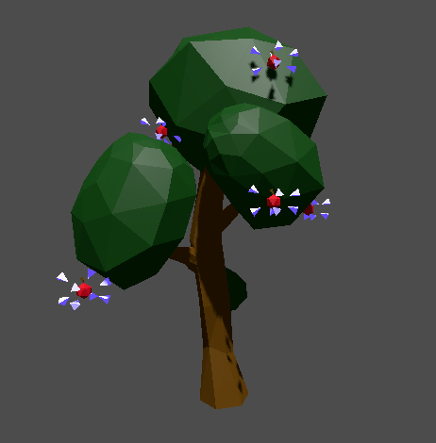

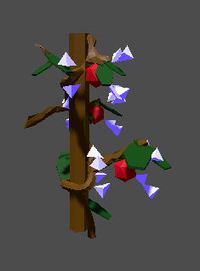
Collecting apples 🍏, tomatoes 🍅 or wheat🌾
Click on apples
Click on tomatoes
Click on wheat

Slide 6

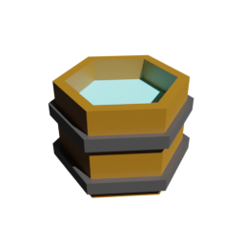
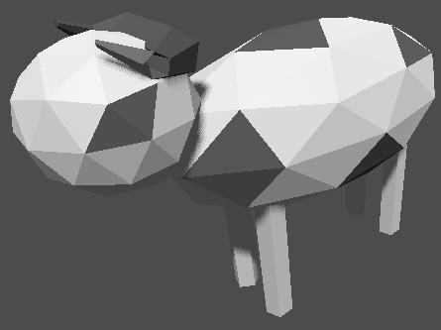
Collecting buckets, water and milk
Fly in barn
Click on bucket
Have bucket in storage
Spawns water
Click on
water
Click on
milk
Drops milk

Slide 7
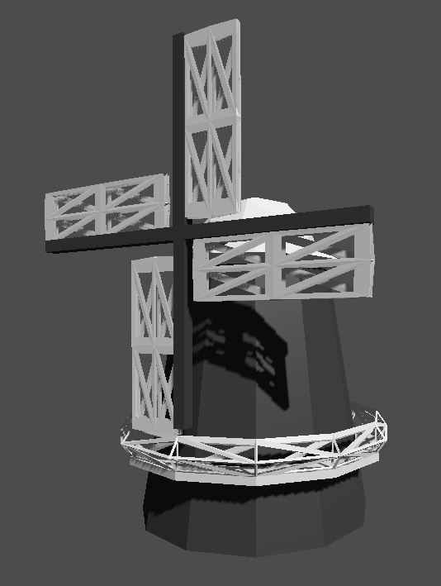
Collecting eggs and flower
Have grain in storage
Click on flower
Spawns flower
Click on egg

Slide 8
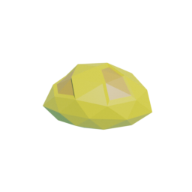
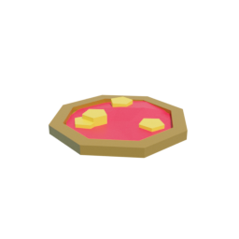
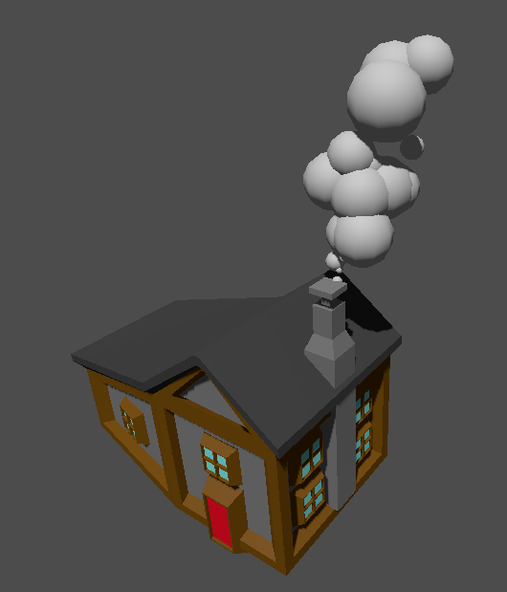
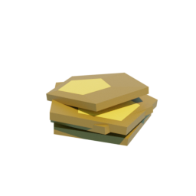
Making bread, pizza or pancakes
Water and flower
Tomatoes and flower
Bakery makes
Bread, pizza or pancakes
Flower, eggs and milk

