Slide 1
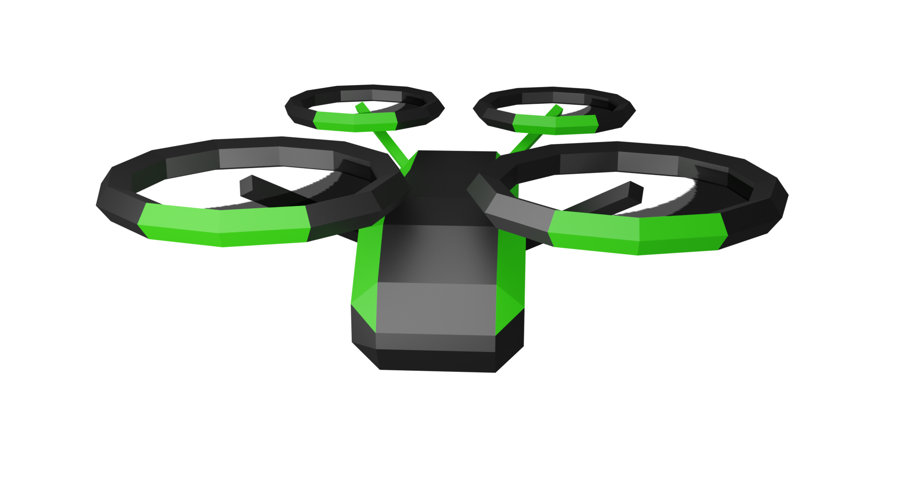
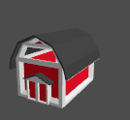
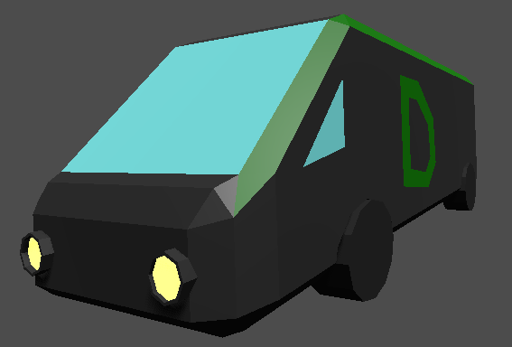
Title of game
Goal of the game:
The farmer is on a holiday. So, no one is running the farm
People order food via your delivery service
So, now you use your delivery drones to collect the orders directly from the farm.

Slide 2


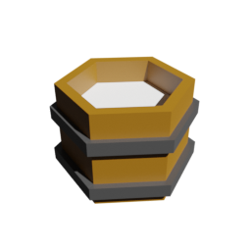

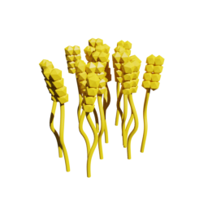
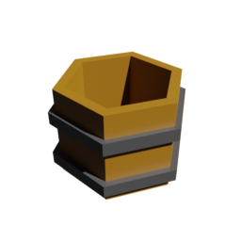


How?
Fly with your drone close to the pickable objects,
Click on the object to collect
You can hold up to 5 items
Click on the delivery van to unload your items into the van.
Once all requested items are stored in the van. You finished the level.

Slide 3
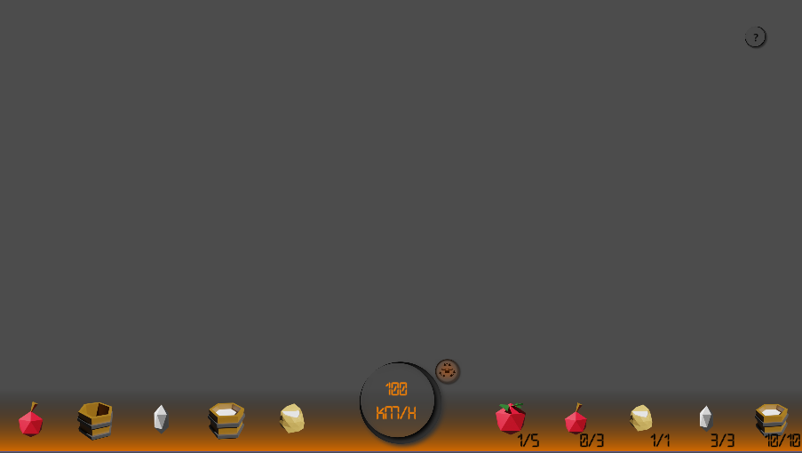


The UI
Stabilizer on
No input = a stationary hover.
This tutorial
Stabilizer off
No input = maintain height, horizontal speed unchanged.
This is your speed and the stabilizer indicator.
These are the items in your drone,
This is the order you have to collect.

Slide 4
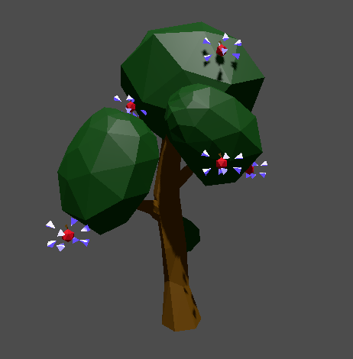

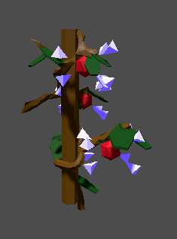
Collecting apples 🍏, tomatoes 🍅 or wheat🌾
Click on apples
Click on tomatoes
Click on wheat

Slide 5

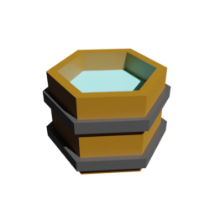
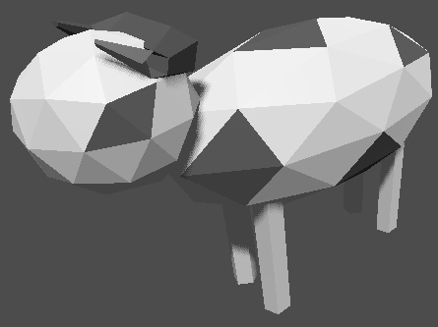
Collecting buckets, water and milk
Fly in barn
Click on apples
Have bucket in storage
Spawns bucket
Click on water
Click on milk
drops

