Slide 1
Nova Syndicate
Infrastructure Reseau Securisee
Projet de fin d'etudes
Dorian Poncelet - Jedha 2026
RNCP 6 AIS

Slide 2
Contexte
• BricoPro : site e-commerce
• 2 sites : Lyon + Marseille
• Infrastructure multi-sites
• VLAN + Defense in Depth
• Wazuh + Suricata
• Prometheus + Loki + Grafana
• Terraform + Ansible

Slide 3
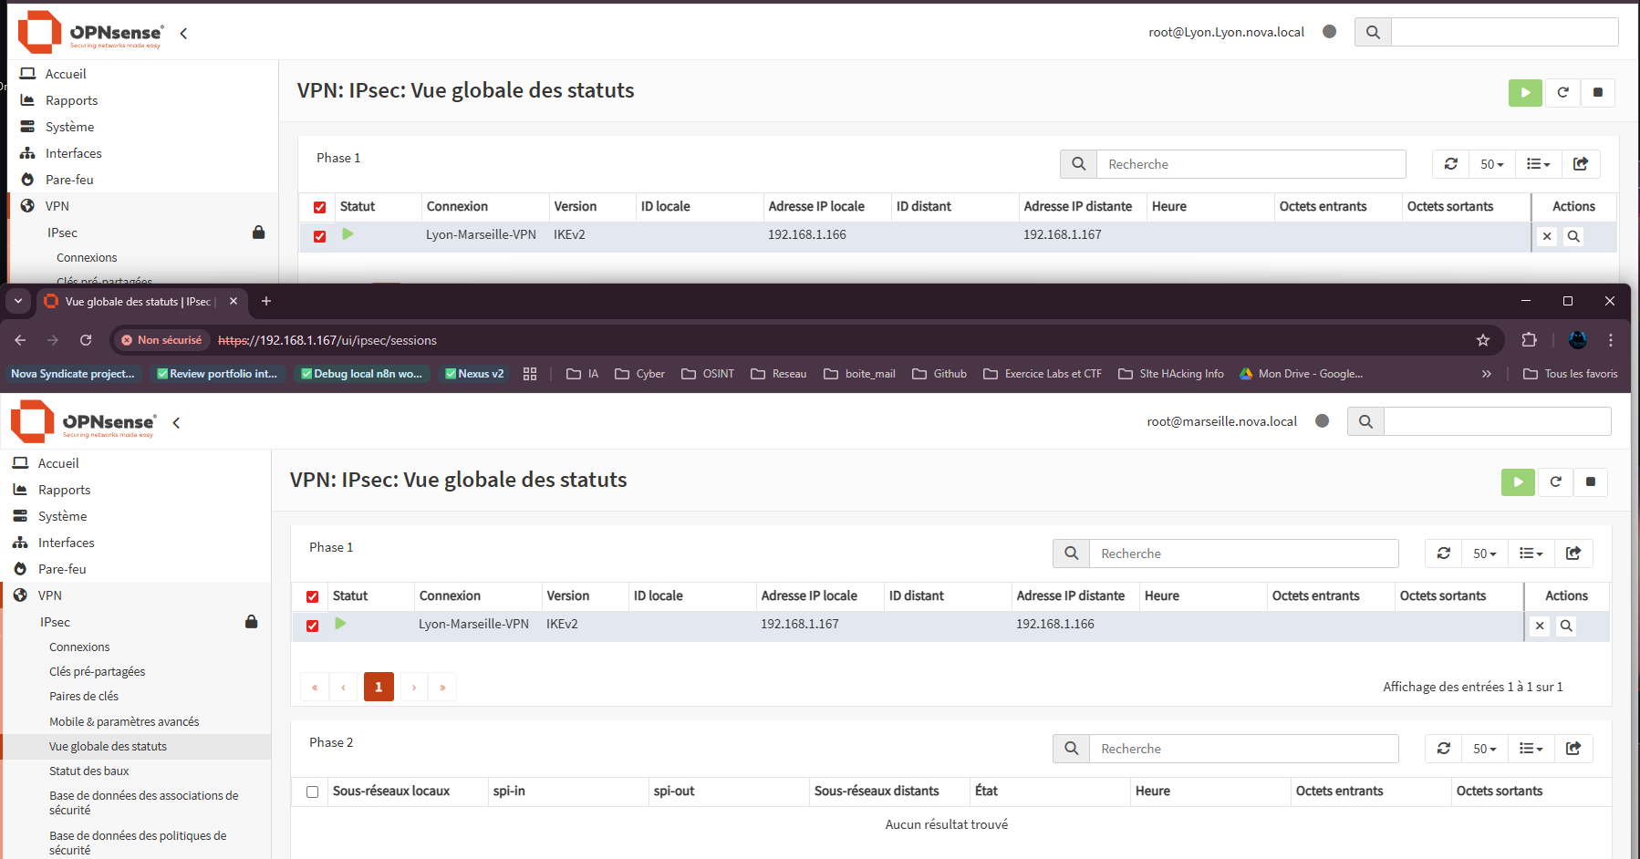
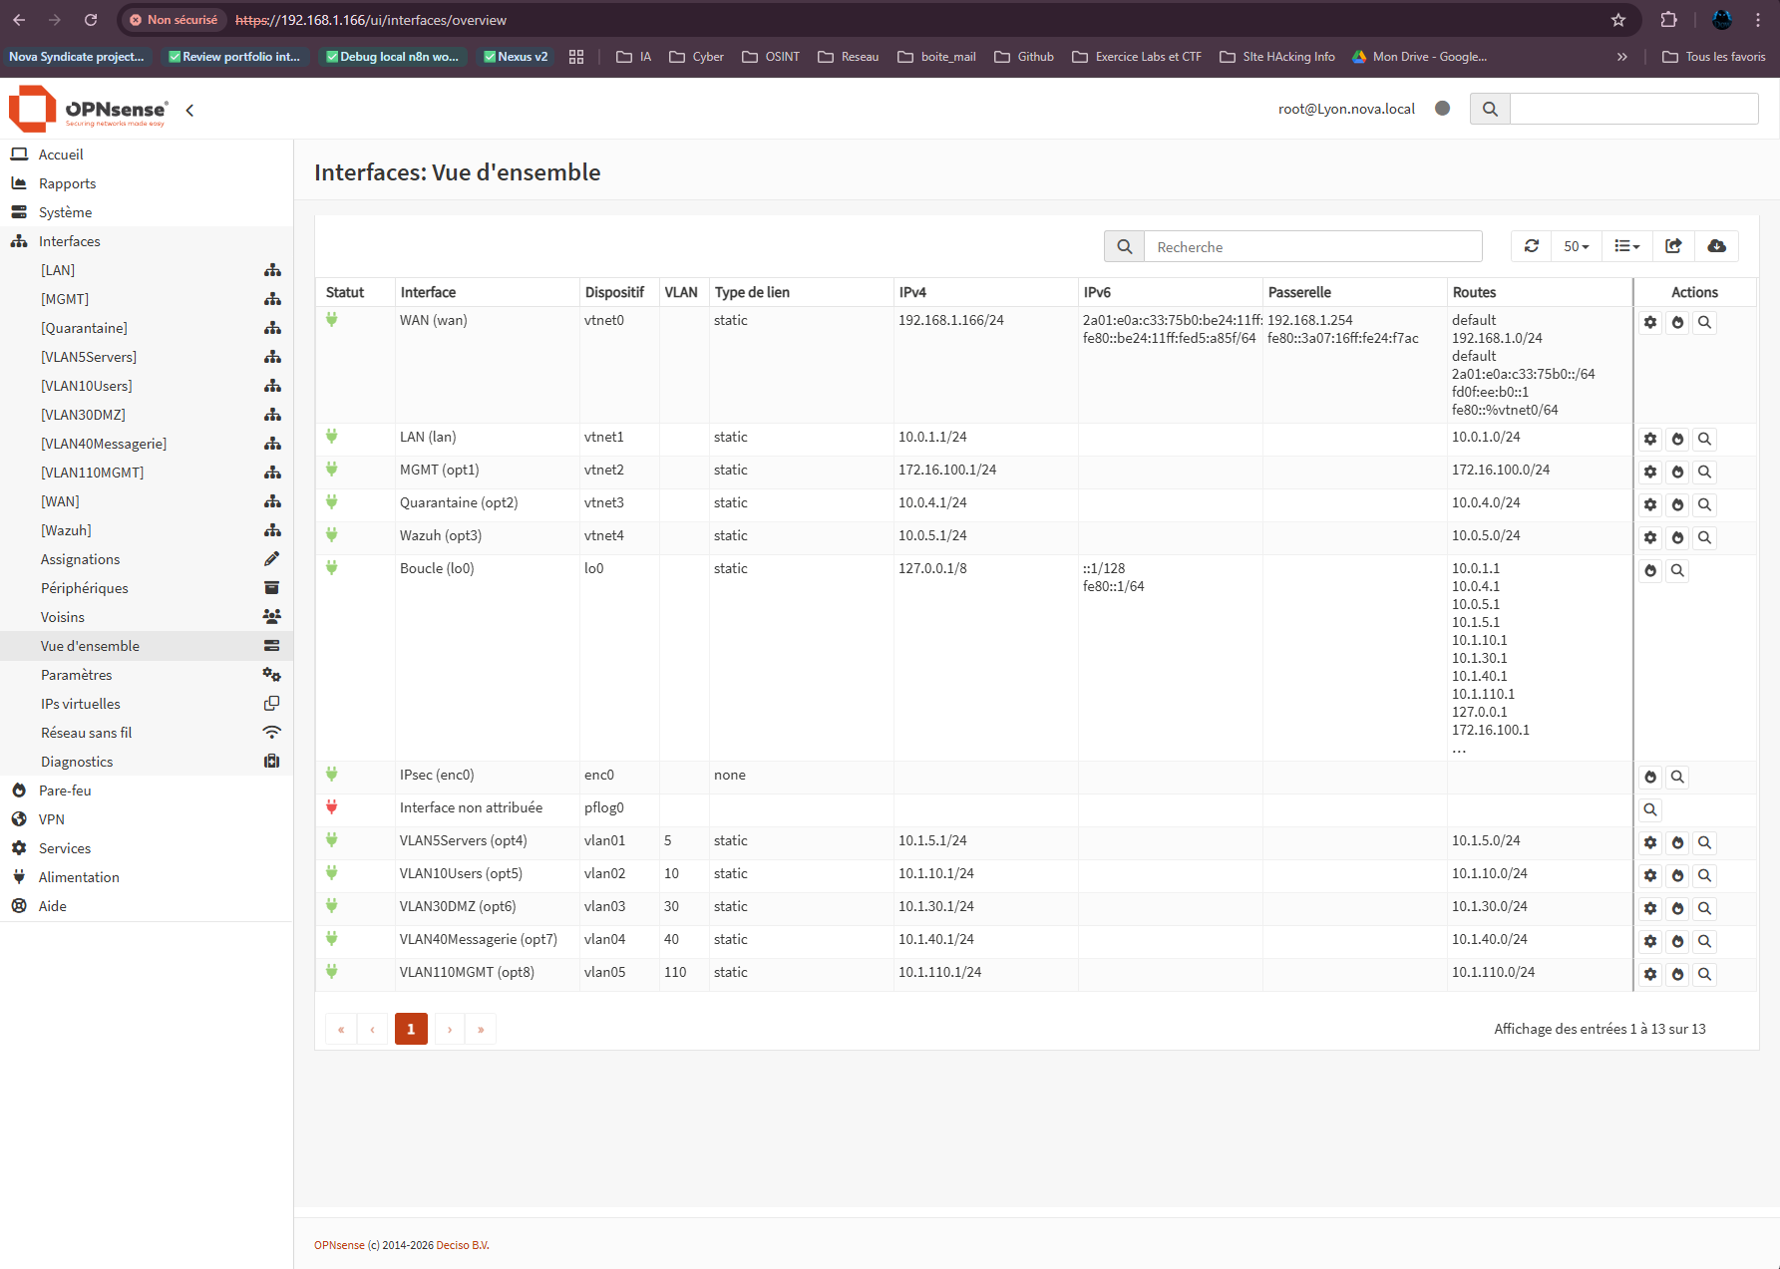
Architecture - Hub & Spoke
[Architecture Diagram]

Slide 4
Stack Technique
• Proxmox + OPNsense + Suricata
• Samba 4 + MariaDB + Nginx
• OpenVPN + Wazuh
• Prometheus + Loki + Grafana
• Trivy + Checkov + Gitleaks

Slide 5
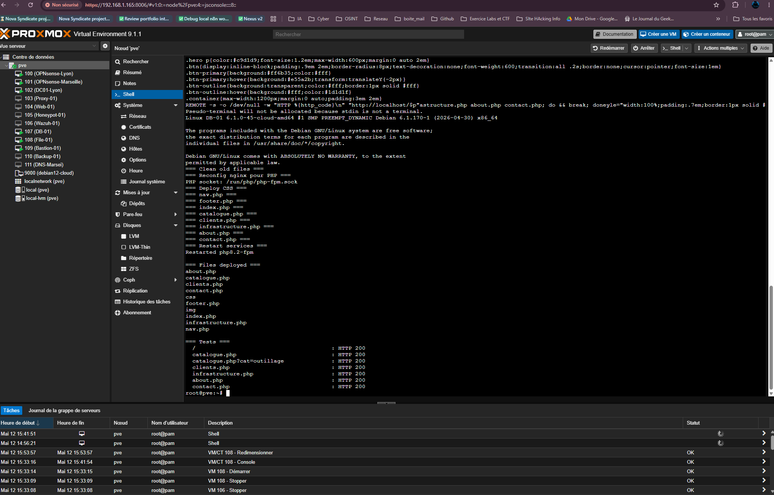
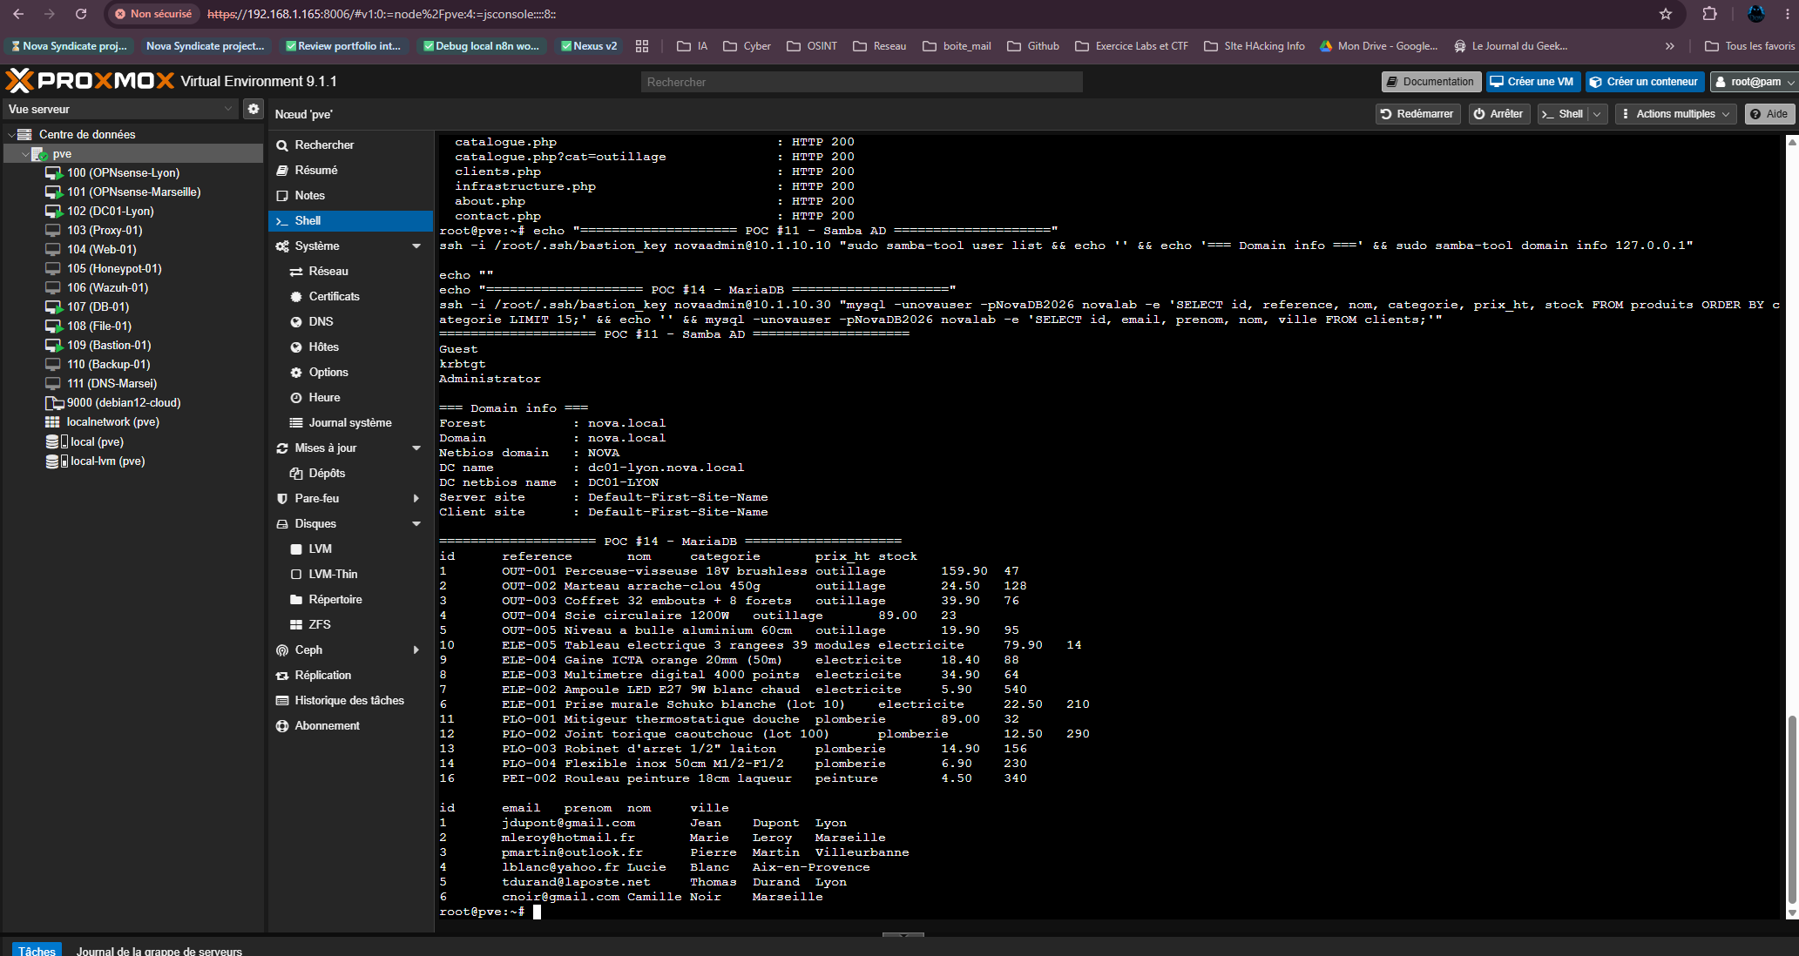
DEMO LIVE

Slide 6
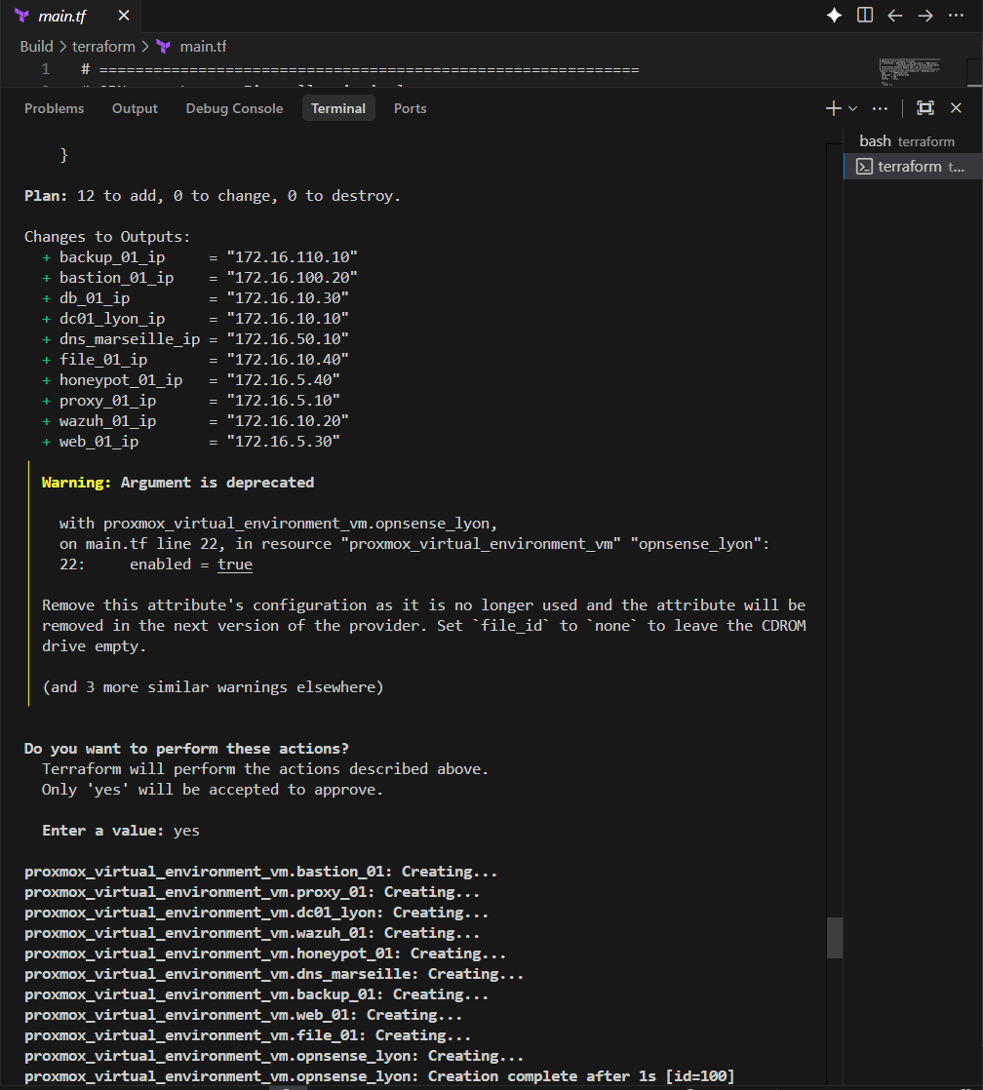
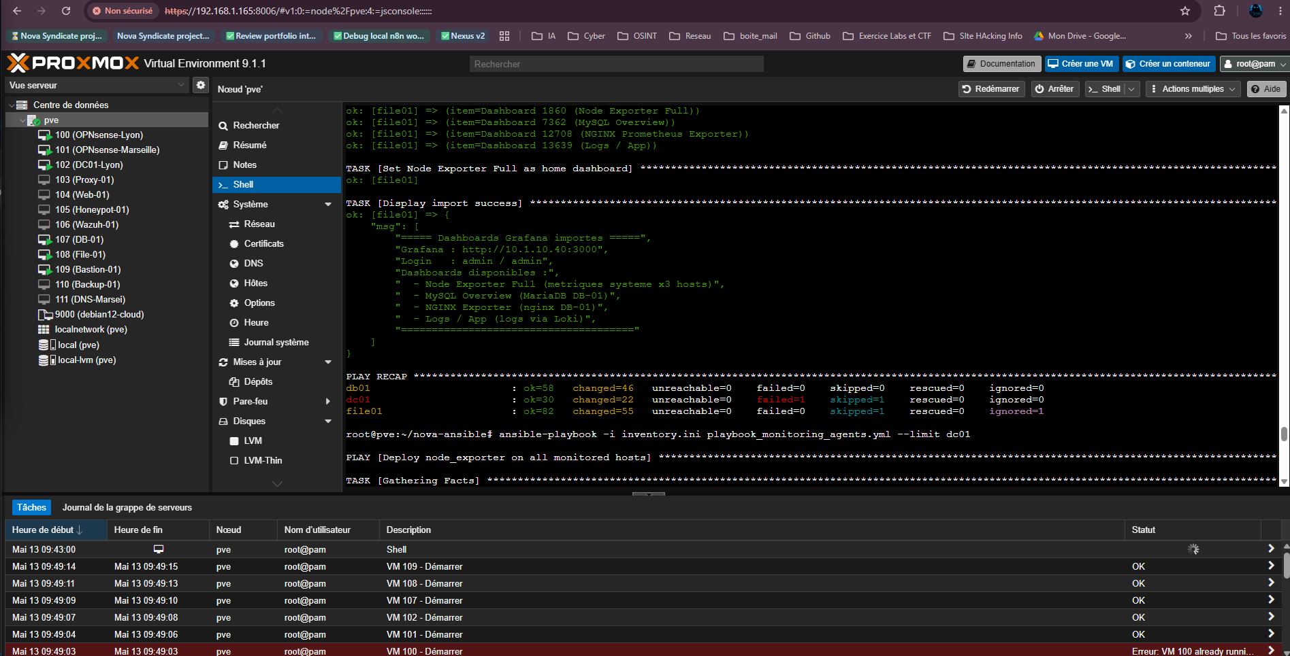
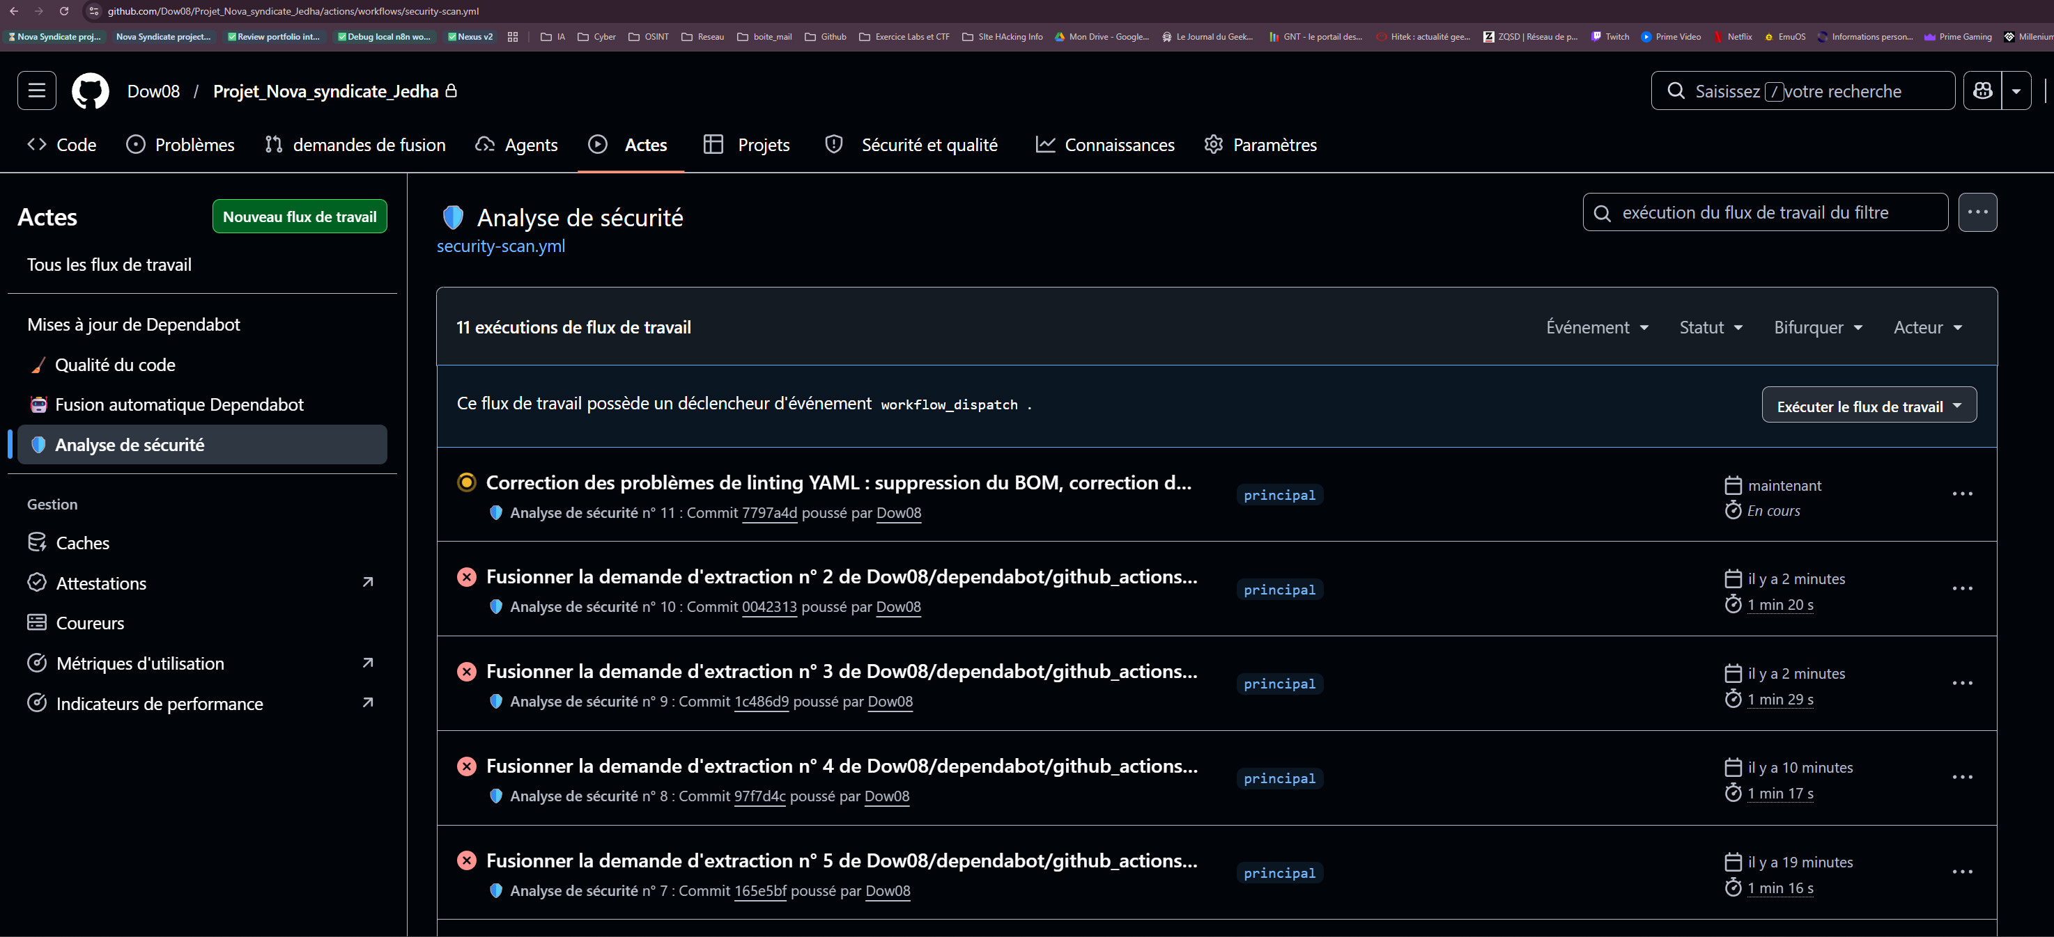
Infrastructure-as-Code + DevSecOps
IaC
• Terraform
• Ansible
• Git
CI/CD
• Trivy
• Checkov
• Gitleaks

Slide 7
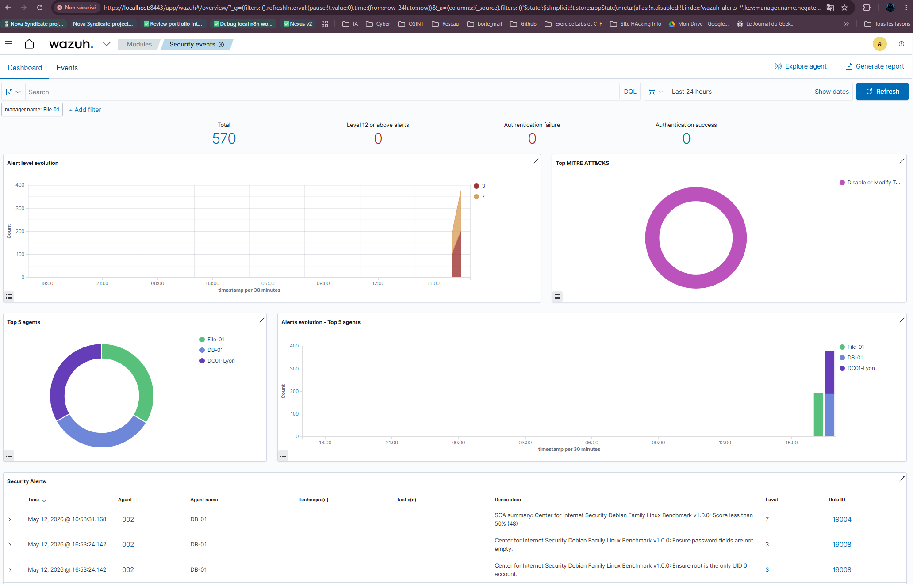
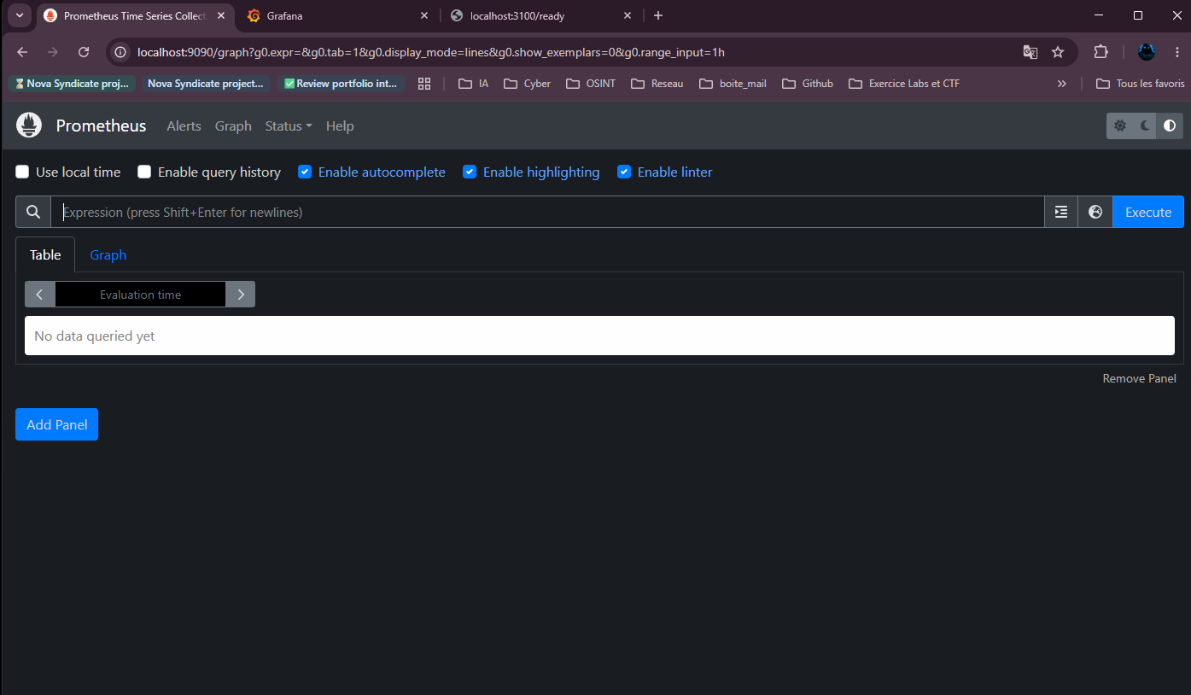
Defense in Depth
1. Perimetre : OPNsense
2. Segmentation : VLANs
3. Hardening : Fail2ban
4. Detection : Wazuh
5. Audit : Loki

Slide 8
PCA / PRA + Conformite
Continuite
• Recuperation
• Repli
• IPsec
Normes
• ISO 27001
• ANSSI
• NIST

Slide 9
Etude Economique
A: 173k EUR
B: 38.7k EUR (Retenu)
C: 95k EUR
Savings: -78%
Souverainete

Slide 10
Conclusion
✓ Infrastructure reproductible
✓ 35+ POC validees
✓ Defense in Depth
✓ Conformite
✓ Economies -78%
QUESTIONS ?

