Slide 1
Short Read Workshop Day 4 Trimming, Mapping, IGV
Lynn Sanford and Ariel Eraso
2023

Slide 2
Day 4 overview
Trimming fastq files
Mapping fastq files
More about mapped file formats
Visualizing mapped files

Slide 3
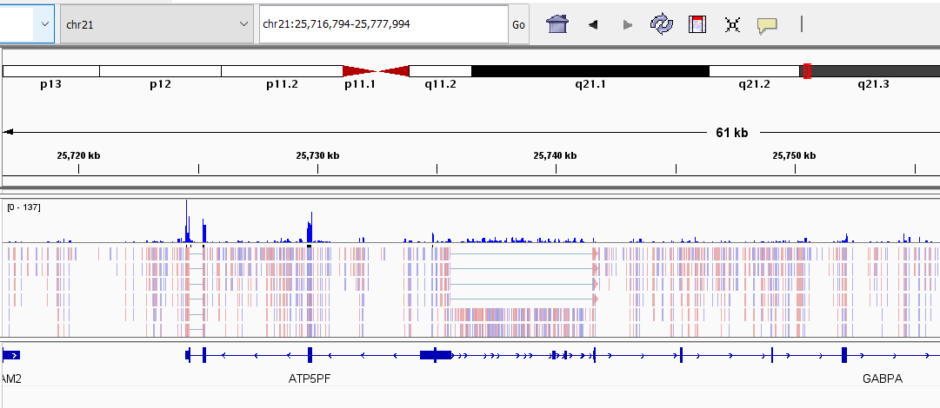
Goal of the Day
View sequencing data as reads aligned to a genome

Slide 4
Trimming/mapping recap
50 base read:
TAGGCTAACTCTGTAGCCCCAGGTACCATGCATAATTGACCAGGATATAG

Slide 5
Trimming/mapping recap
50 base read:
TAGGCTAACTCTGTAGCCCCAGGTACCATGCATAATTGACCAGGATATAG
Trimmomatic
40 base trimmed read:
TAGGCTAACTCTGTAGCCCCAGGTACCATGCATAATTGAC

Slide 6
Trimming/mapping recap
50 base read:
TAGGCTAACTCTGTAGCCCCAGGTACCATGCATAATTGACCAGGATATAG
Trimmomatic
40 base trimmed read:
TAGGCTAACTCTGTAGCCCCAGGTACCATGCATAATTGAC
HISAT2
Genome:
AGCTTCGGATCGATCGACTGACTAGGCTAACTCTGTAGCCCCAGGTACCATGCATAATTGACCGCGATTACGAC
TCGAAGCCTAGCTAGCTGACTGATCCGATTGAGACATCGGGGTCCATGGTACGTATTAACTGGCGCTAATGCTG

Slide 7
Trimming/mapping recap
50 base read:
TAGGCTAACTCTGTAGCCCCAGGTACCATGCATAATTGACCAGGATATAG
Trimmomatic
40 base trimmed read:
TAGGCTAACTCTGTAGCCCCAGGTACCATGCATAATTGAC
HISAT2
Genome:
AGCTTCGGATCGATCGACTGACTAGGCTAACTCTGTAGCCCCAGGTACCATGCATAATTGACCGCGATTACGAC
TCGAAGCCTAGCTAGCTGACTGATCCGATTGAGACATCGGGGTCCATGGTACGTATTAACTGGCGCTAATGCTG
IGV
AGCTTCGGATCGATCGACTGACTAGGCTAACTCTGTAGCCCCAGGTACCATGCATAATTGACCGCGATTACGAC
TCGAAGCCTAGCTAGCTGACTGATCCGATTGAGACATCGGGGTCCATGGTACGTATTAACTGGCGCTAATGCTG

Slide 8
Trimming fastq files with Trimmomatic
Follow Trimomatic worksheet to:
Create Day4 directories and copy scripts
Edit script to run Trimmomatic
Input: fastq files with full-length reads
Output: fastq files with trimmed/filtered reads

Slide 9
How do you trim polyA regions from both sides of reads?

Slide 10
How do you trim polyA regions from both sides of reads?
Make a new fasta file with a polyA segment, or append to the Illumina adapter file, if writeable
>polyA
AAAAAAAAAAAAAAAAAAAAAAAA
ILLUMINACLIP:<new fasta file>:2:30:10

Slide 11
Mapping fastq files with HISat2
Follow Mapping/IGV worksheet to:
Rsync the mapping script
Edit script and run HISAT2
Input: trimmed fastq files
Outputs: .sam, .bam, .sorted.bam, .bam.bai files
Visualize BAM file on the IGV web app

Slide 12
Homework
Day 4 Homework – FASTQC, trimming, mapping, IGV
The assessment tomorrow will run many of the same steps as this homework. These steps are essential in ALL short read data processing.

