Slide 1
Short Read Sequencing Analysis Workshop
Day 2
Learning the Linux Compute Environment

Slide 2
Review of Day 2 Videos
Video 1 – SSH and VPN Introduction
How SSH and VPNs work when accessing remote servers
Video 2 – Remote Rsync / Reading Files
Looking at files on a remote server and getting them to your computer
Video 3 – Searching / editing Files, Pipes, and Outputs
Pieces of your basic toolkit for working on a Linux server
Video 4 – Directory Permissions
Managing who can see and execute different things on the server

Slide 3



In Unix everything is organized as a hierarchy
hoto7260
projects
sread2023

Slide 4
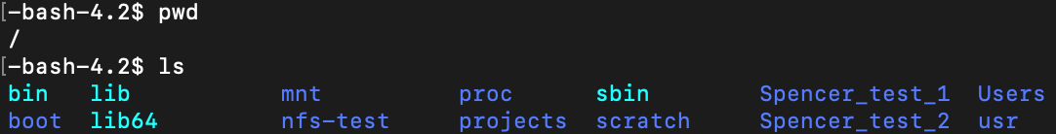
In Unix everything is organized as a hierarchy
/
usr
bin
scratch
Users
hoto7260
dowell
allen
projects
sread2023

Slide 5
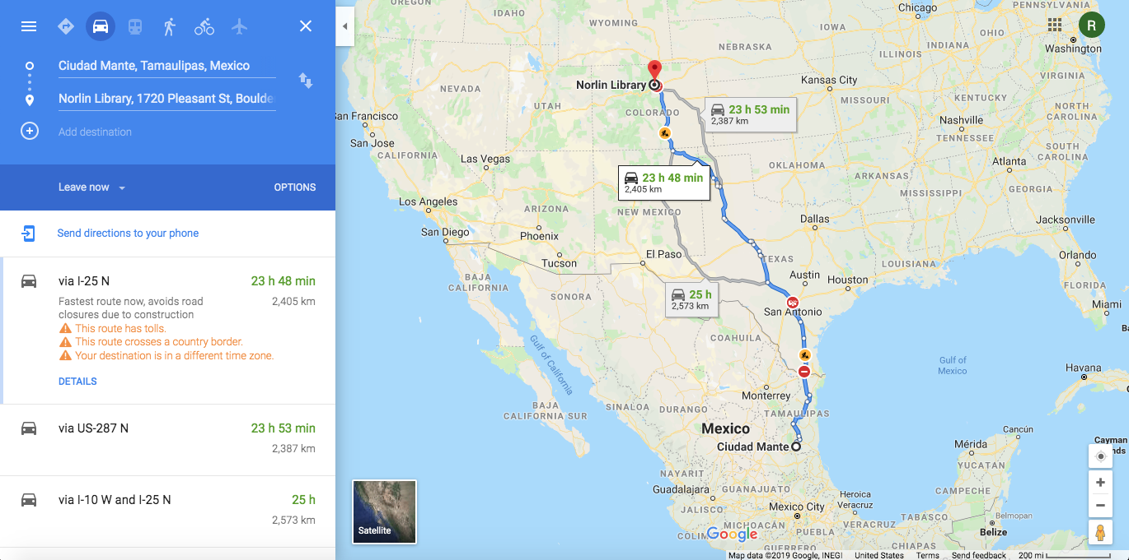
Absolute and relative paths
How do I get to Norlin Library at CU Boulder?
Notes:
Absolute path from Mante (Boulder’s sister city) to Norlin Library.

Slide 6
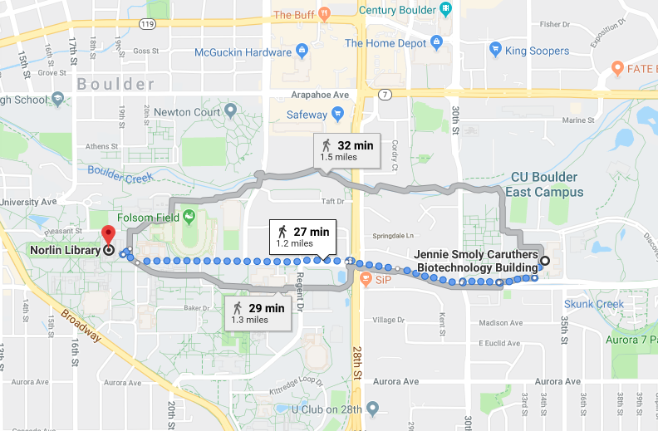
Absolute and relative paths
How do I get to Norlin Library at CU Boulder?
Notes:
Relative path from JSCBB to Norlin Library

Slide 7
Absolute path
/
usr
bin
scratch
Users
hoto7260
dowell
allen
/Users/hoto7260/sread2023
projects
sread2023

Slide 8

Relative path
/
usr
bin
scratch
Users
hoto7260
dowell
allen
projects
sread2023

Slide 9
Relative path
/
usr
bin
scratch
Users
hoto7260
dowell
allen
./sread2023
./ = current directory
projects
sread2023

Slide 10
Relative path
/
usr
bin
scratch
Users
hoto7260
dowell
allen
projects
sread2023

Slide 11
Relative path
/
usr
bin
scratch
Users
hoto7260
dowell
allen
../sread2023
../ = parent directory (hoto7260)
projects
sread2023

Slide 12
Relative path
/
usr
bin
scratch
Users
hoto7260
dowell
allen
projects
sread2023

Slide 13
Relative path
/
usr
bin
scratch
Users
hoto7260
dowell
allen
../../dowell
../../ = parent of parent directory (Users)
projects
sread2023

Slide 14
Navigating relative and absolute paths
Shortcut to home
~
Moving through the file system
Change Directory
cd
Where am I?
Print Working Directory
pwd
$ pwd
$ cd /Users/<username>/
Notes:
TO DO!

Slide 15
The “dot dot” notation
/
..
usr
bin
scratch
Users
..
sahu0957
dowell
allen
..
projects
sread2021

Slide 16
Relative path
/
usr
bin
scratch
Users
sahu0957
dowell
allen
../projects
projects
sread2021

Slide 17
Review of Day 2 Videos
Video 4 – Remote RSYNC, reading files
Access command manuals, use options to customize command functions
Command line I/O, capture STDOUT and STDERR, piping
Video 5 – More file manipulation
Access command manuals, use options to customize command functions
Command line I/O, capture STDOUT and STDERR, piping
Video 6 - Permissions
Exploring Unix Permissions
Video 7
VIM Tutorial

Slide 18
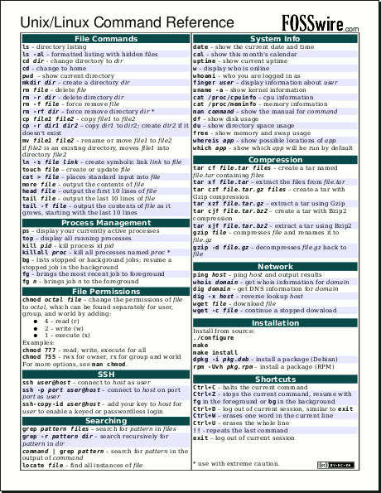
Find a unix/linux cheat sheet
Notes:
http://cheatsheetworld.com/programming/unix-linux-cheat-sheet/

Slide 19

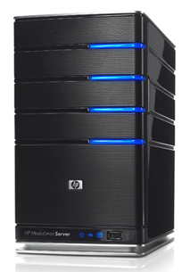
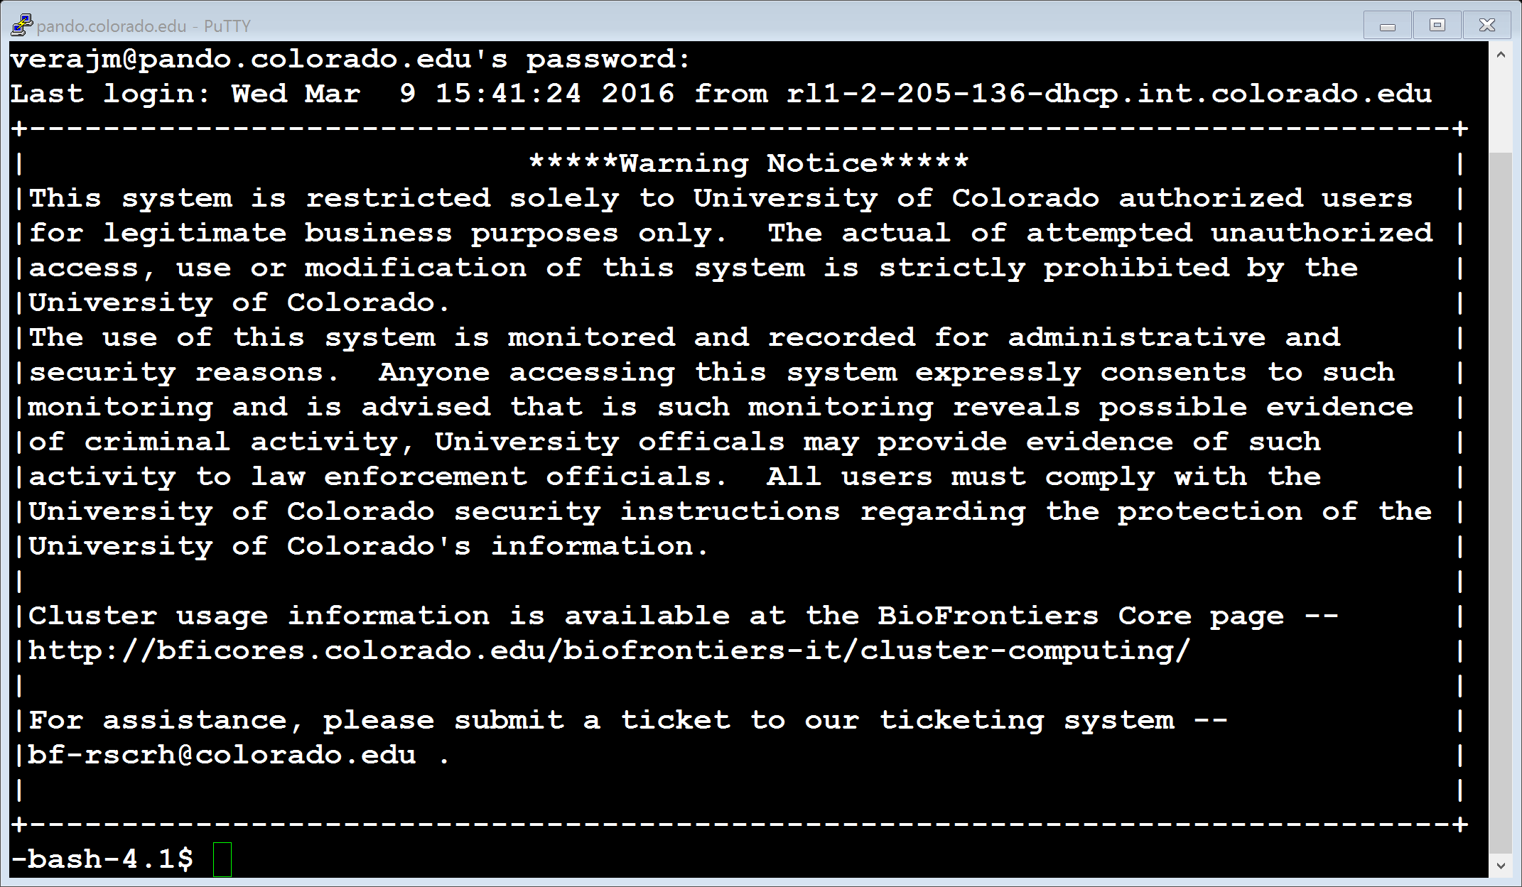

We Use the Shell to Communicate With the OS
Keyboard
Input Device
Operating System
(Linux)
Hardware
(CPU, RAM, Hard Drive)
Shell and Terminal
(Sh, Bash)
Local Machine
(laptop/Desktop Computer)
Remote Machine
cloud or fiji

Slide 20
Understanding the Command Line
Keyboard
Input Device
$ <command> <arguments>

Slide 21
We Use the Shell to Communicate With the OS
Keyboard
Input Device
Operating System
(Linux)
Hardware
(CPU, RAM, Hard Drive)
Shell and Terminal
(Sh, Bash)
Enter a command
Execute the command

Slide 22
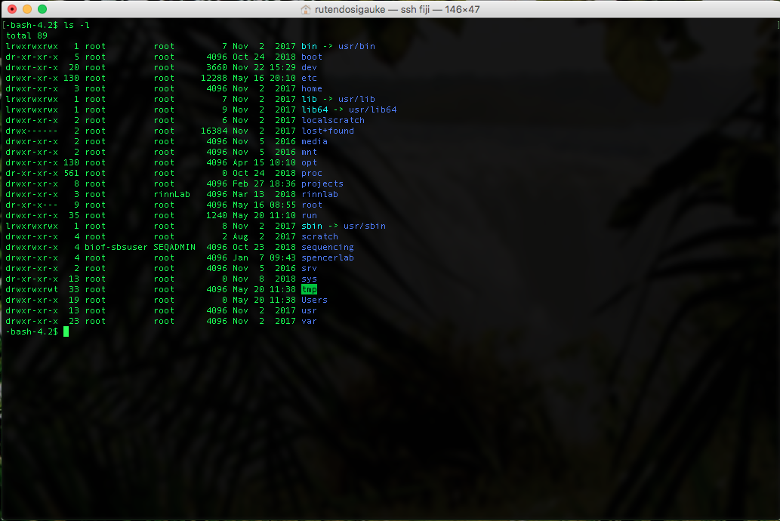
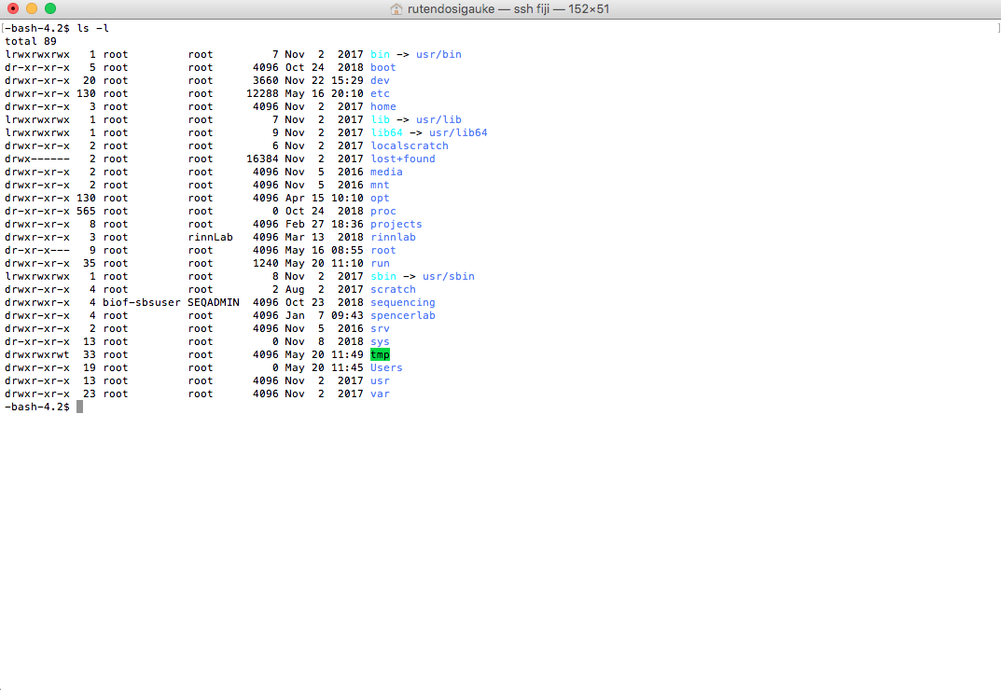


Make the terminal comfortable to work in:
Make the windows large
Open multiple windows and/or tabs
Change font sizes etc. ((For Mac: Command + Plus/Minus, For Windows, find Text size in Preferences)
Terminal

Slide 23
Start Worksheet Part 1
Remember to make the terminal comfortable to work in:
Make the windows large
Open multiple windows and/or tabs
Change font sizes etc. ((For Mac: Command + Plus/Minus, For Windows, find Text size in Preferences)
You can move on to Part 2 when finished with Part 1

Slide 24
If you haven’t already, start Worksheet Part 2
Done with Part 2 already?
Get started on the homework!
Practice the commands in the cheat sheets linked on Github
Help a peer out!

Slide 25

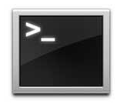
How to Access A Server Via the Terminal
Open a terminal session
MobaXterm(PC users)
Terminal App (Macs)
SSH command
Terminal
$ ssh <username>@IP/server
$ ssh sahu0957@fiji.colorado.edu
fiji.colorado.edu: Enter password when prompted (it will be hidden as you type)
VPN connection required for off-campus access

Slide 26

When in doubt, check the manual
All Unix commands are described in a collection of files called “man pages”
man command
For help on some topic
man -k keyword
For more information on using the man pages
man man
You can get command information with help
command --help
command -h
Note that the man pages uses an ancient method of viewing content:
<spacebar> to go down a page
Arrow keys *should* work to review already seen segments.
<q> to quit the man pages

Slide 27
The home directory
Also called login directory
Serves as user’s personal directory
/Users/<username>
~

Slide 28
Create folders
Make a directory “workshop-day2” in your home
$ cd ~ $ cd $ cd /Users/<user name>
$ mkdir workshop-day2
List contents in your directory
$ ls
Create a “bedfiles” directory in your “workshop-day2” directory
$ mkdir workshop-day2/bedfiles
Directories can be created from any location as long as the full path is provided.

Slide 29
Add subdirectories
Change to your “workshop-day2” directory
Make a “results” directory
Make more directories
“scripts”
“bin”
“data”
$ cd workshop-day2
$ mkdir results
$ mkdir scripts bin data

Slide 30
Listing contents of a directory
ls | ls -l | ls -a | ls -h
List contents in a directory | Generate a detailed list of contents in a directory | Display all file including hidden files | Make information human readable
$ ls
$ ls -l
$ ls -a
$ ls -h
Options can be combined: ls -lah

Slide 31
Listing contents of a directory
Generating list of contents in a specific directory
ls -lah <pathname>
pathname may be
Full path: /home/path/to/directory
Current directory: .
Parent directory: ..
Home directory: ~
$ ls .
$ ls ..
$ ls ../../
$ ls ~

Slide 32
Linux commands for moving files
cp = copy a file or directory
usage: $ cp <source> <destination>
usage: $ cp -r <folder> <destination>
rsync = copy a directory or file remotely or locally
usage: $ rsync <source> <destination>
mv = move directory or file
usage: $ mv <source> <destination>
Can be used to rename a file or directory

Slide 33
Moving files
Copy “chr1_bedfiles.tar.gz” file to your bedfiles directory
Change “chr1_bedfiles.tar.gz” file name to “chr1bedfiles.tar.gz”
$ cp /scratch/Workshop/SR2021/2_unix/bedfiles/chr1_bedfiles.tar.gz bedfiles/
$ cd bedfiles/
$ mv chr1_bedfiles.tar.gz chr1bedfiles.tar.gz

Slide 34
Compressing and decompressing files
Compress / Decompress
gzip / gunzip
zip / unzip
Gzipped Tar Archive
tar xvfz sample.tar.gz
Tar archive
tar xvf sample.tar
$ tar xvzf chr1bedfiles.tar.gz
Notes:
Change over

Slide 35
Questions?

Slide 36
Viewing files in a directory
head | tail | more | less | cat
Print the first 10 lines of a file | Print the last 10 lines of a file | Filter for paging through text one screenful at a time. | Allows backward movement in the file as well as forward movement (opposite of more) | Concatenate files and print on the standard output
-n <int> specify how many lines to be printed | -n <int> specify how many lines to be printed | SPACE to scroll q to quit | SPACE or ^V or f or ^F or arrows to scroll q to quit | Can concatenate multiple files
$ ls -lah
$ head ENCFF050DNG.chr1.bed
$ head -n 20 ENCFF050DNG.chr1.bed
$ tail ENCFF050DNG.chr1.bed
$ tail -n 3 ENCFF050DNG.chr1.bed

Slide 37
Viewing files in a directory
head | tail | more | less | cat
Print the first 10 lines of a file | Print the last 10 lines of a file | Filter for paging through text one screenful at a time. | Allows backward movement in the file as well as forward movement (opposite of more) | Concatenate files and print on the standard output
-n <int> specify how many lines to be printed | -n <int> specify how many lines to be printed | SPACE to scroll q to quit | SPACE or ^V or f or ^F or arrows to scroll q to quit | Can concatenate multiple files
Scroll through ENCFF837ENN.chr1.bed with more
Scroll through ENCFF837ENN.chr1.bed with less
$ more ENCFF837ENN.chr1.bed
$ less ENCFF837ENN.chr1.bed

Slide 38
File manipulation
cut | cut -f | cut -d
Remove sections from each line of files | Select specific fields in a file | Use DELIM instead of TAB for field delimiter
Select columns 1, 2 and 3 in ENCFF837ENN.chr1.bed :
$ cut -f 1,2,3 ENCFF837ENN.chr1.bed
$ awk '{print $1 "\t" $2 "\t" $3}' ENCFF837ENN.chr1.bed
* Awk is a unix programming language that is very useful

Slide 39
Searching files
find | grep | grep -i | grep -v | grep -c | grep -w
Search for files in a directory hierarchy | Search for PATTERNS in each file | Ignore case (upper versus lower case) | Select lines that do not match PATTERN (inverse match) | Count lines that match PATTERN | Select only those lines containing matches that form whole words.
Search for ENCFF050DNG.chr1.bed from your home directory
$ cd
$ find -iname ENCFF050DNG.chr1.bed
Search for lines with the character ‘151’ in ENCFF050DNG.chr1.bed
$ cd /Users/<username>/workshop-day2/bedfiles/
$ grep -w ‘151’ ENCFF050DNG.chr1.bed

Slide 40
Counting features
wc | wc -l | uniq -c | grep -c
Print newline, word, and byte counts for each file | Print the newline counts | Prefix lines by the number of occurrences | Count lines that match PATTERN
Count the number of lines in ENCFF050DNG.chr1.bed
$ wc -l ENCFF050DNG.chr1.bed
Print the line, word and byte counts for ENCFF050DNG.chr1.bed
$ wc ENCFF050DNG.chr1.bed

Slide 41
Sorting files
sort | sort -n | sort -k
Sorts lines of text files | Numeric sort | sort via a key, key defined as location and type
Sorting the ENCFF050DNG.chr1.bed
$ sort ENCFF050DNG.chr1.bed
Sorting the ENCFF050DNG.chr1.bed by the first and second columns
The 1st column is alpha numerically sorted
The 2nd column is numerically sorted
$ sort -k1,1 -k2,2n ENCFF050DNG.chr1.bed

Slide 42
STDERR and STDOUT
> Write standard out to a file
>> Append standard out to a file
2> Write standard error to a file

Slide 43



A PROGRAM
STDOUT
STDERR
STDIN
STDIN = standard input
STDOUT = standard output
https://mario.nintendo.com/

Slide 44
Pipes Continued
PROGRAM a
STDOUT
PROGRAM b
STDIN
STDOUT
PROGRAM c

Slide 45
Pipes Continued
cat
PROGRAM a
STDOUT
cut -f 1,3
FILE
PROGRAM b
STDIN
STDOUT
grep “FEATURE”
PROGRAM c
cat FILE | cut -f 1,3 | grep “FEATURE” > OUTFILE.txt

Slide 46
Pipes Continued
cat
PROGRAM a
STDOUT
cut -f 1,3
FILE
PROGRAM b
STDIN
STDOUT
grep “FEATURE”
PROGRAM c
cat FILE | cut -f 1,3 | grep “SECOND-FEATURE” >> OUTFILE.txt

Slide 47
Pipes Continued
cat
PROGRAM a
STDOUT
cut -f 1,3
FILE
PROGRAM b
STDIN
STDOUT
grep “FEATURE”
PROGRAM c
cat FILE | cut -f 1,3 | grep “FEATURE” > OUTFILE.txt 2> ERRORS.txt

Slide 48
Using pipes in unix
Copy a bedgraph to your bedfiles directory
/scratch/Workshop/SR2019/2_unix/bedfiles/SRR4090090_chr21_22.bedGraph.gz
$ cp /scratch/Workshop/SR2019/2_unix/bedfiles/SRR4090090_chr21_22.bedGraph.gz /Users/<name>/workshop-day2/bedfiles/
Decompress the file (Hint: check the file extension)
$ pwd
$ cd /Users/<name>/workshop-day2/bedfiles/
$ gunzip SRR4090090_chr21_22.bedGraph.gz
Open the file and filter chr21 from the bedgraph and write the file with only columns 1,2 and 3 to your data folder
$ head SRR4090090_chr21_22.bedGraph
$ tail SRR4090090_chr21_22.bedGraph
$ cat SRR4090090_chr21_22.bedGraph | cut -f 1,2,3 | grep ‘chr21’ > ../data/SRR4090090_chr21.bedGraph

Slide 49
Using pipes in unix
Concatenate ENCFF050DNG.chr1.bed and ENCFF837ENN.chr1.bed
Sort by the first column (alpha numerically) and the second column (numerically)
Save the first 5 columns to a file called ENCFF_merge_sorted.bed in your data folder
$ cat ENCFF050DNG.chr1.bed ENCFF837ENN.chr1.bed | sort -k1,1 -k2,2n | cut -f 1,2,3,4,5 > /Users/rutendos/workshop-day2/data/ENCFF_merge_sorted.bed
$ cat ENCFF* | sort -k1,1 -k2,2n | cut -f1-5 > ../data/ENCFF_merge_sorted.bed

Slide 50
Deleting files
rm | rm -r
Remove files | Remove directories and their contents recursively
Delete the ENCFF_merge_sorted.bed file in the data folder
$ rm /Users/<username>/workshop-day2/data/ENCFF_merge_sorted.bed

Slide 51
Questions?

Slide 52


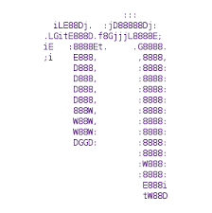


What is Vim ?
Vim is a free, open source terminal based text editor
Edit content of human-readable files
Several options exist for terminal text editors
Emacs
Nano
Sublime
Visual Studio Code

Slide 53
Using Vim
vim = Vi Improved
To open <file> for editing in Vim
$ vim <file>
In your “workshop-day2” directory create a new file:
$ touch vim_example.txt
Open the file with vim
$ vim vim_example.txt

Slide 54
Using Vim
Vim has 2 operating modes:
Command mode (default) (Vim commands only)
Insert mode (editing)
i/I ➢ insert
o/O ➢ open new line
a/A ➢ append
Switch back to command mode
esc

Slide 55
Using Vim
Open the “SRR4090090_chr21_22.bedGraph” in vim
Enter and exit the insert mode
type “i” → you are now in insert mode
Hit “esc” → command mode
Copy and paste 3 lines in the SRR4090090_chr21_22.bedGraph
Yank/copy the line: shift + y
Paste the line: p
Insert Mode: i/I, o/O
Command Mode: esc

Slide 56
Using Vim
Insert Mode: i/I, o/O
Command Mode: esc
In command mode:
Type “gg” → you will be taken to first line in file
Type “shift + o” → you have now opened a new line and are in insert mode
Type “ shift + g” → you will be taken to the last line of the file

Slide 57
Insert a line in Vim
Insert Mode: i/I, o/O
Command Mode: esc
Go back to the top of the SRR4090090_chr21_22.bedGraph
gg
Insert a comment line
i
#chr start stop
Save file
esc -> escape insert mode
:w -> save file

Slide 58
Using Vim
Insert Mode: i/I, o/O
Command Mode: esc
In vim:
Type “o” → you have now opened a new line and are in insert mode
Return to command mode:
Type “dd” → this will delete the current line
Type “u” → to undo this change

Slide 59
Save and Exit Vim
Insert Mode: i/I, o/O
Command Mode: esc
In vim:
Type “:w” and hit enter → this will save changes to the file
Type “:wq” and hit enter → this will save changes and exit
Type “:q!” and hit enter → this will quit without saving changes

Slide 60
Creating a bash script
In vim create a new document called “math.sh”
a=5
echo a
echo $a
close and run script
$ bash math.sh

Slide 61
Documenting your work is important
Create a README
README.txt file list information about files, archives, and directories
Things to include:
Brief description of file content
Date and method of data generation, data generator
While in your home directory
$ ls -l workshop-day2/* > README.txt

Slide 62
Edit your README file in vim
$ vim README.txt
Start editing/annotating your README.txt
List all your directories and or file names and what they will do
For example: Bowtie/
# This directory will contain all the output from Bowtie
Save changes and exit (:wq!)
Insert Mode: i/I, o/O
Command Mode: esc

Slide 63
The End
Questions??
Don’t forget the homework.
Help session in JSCBB A108 from 1-3pm
Watch videos for Day 3

