Slide 1
Short Read Workshop Day 4 Trimming, Mapping, IGV
Lynn Sanford and Ariel Eraso
2023

Slide 2
Day 4 overview
Trimming fastq files
Mapping fastq files
More about mapped file formats
Visualizing mapped files

Slide 3
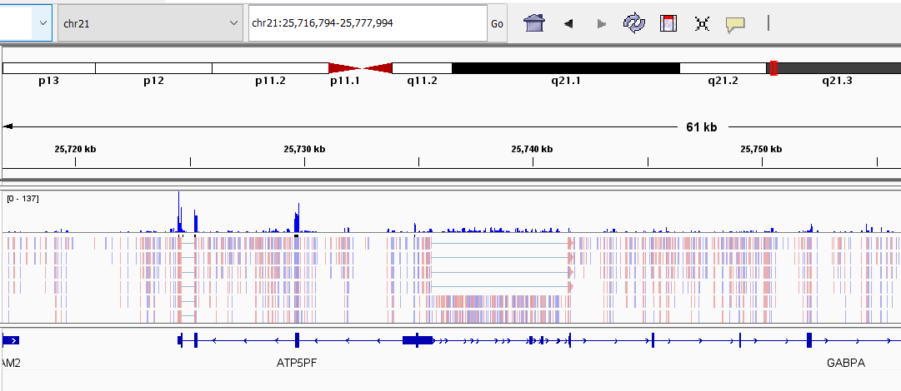
Goal of the Day
View sequencing data as reads aligned to a genome

Slide 4
Trimming/mapping recap
50 base read:
TAGGCTAACTCTGTAGCCCCAGGTACCATGCATAATTGACCAGGATATAG

Slide 5
Trimming/mapping recap
50 base read:
TAGGCTAACTCTGTAGCCCCAGGTACCATGCATAATTGACCAGGATATAG
Trimmomatic
40 base trimmed read:
TAGGCTAACTCTGTAGCCCCAGGTACCATGCATAATTGAC

Slide 6
Trimming/mapping recap
50 base read:
TAGGCTAACTCTGTAGCCCCAGGTACCATGCATAATTGACCAGGATATAG
Trimmomatic
40 base trimmed read:
TAGGCTAACTCTGTAGCCCCAGGTACCATGCATAATTGAC
HISAT2
Genome:
AGCTTCGGATCGATCGACTGACTAGGCTAACTCTGTAGCCCCAGGTACCATGCATAATTGACCGCGATTACGAC
TCGAAGCCTAGCTAGCTGACTGATCCGATTGAGACATCGGGGTCCATGGTACGTATTAACTGGCGCTAATGCTG

Slide 7
Trimming/mapping recap
50 base read:
TAGGCTAACTCTGTAGCCCCAGGTACCATGCATAATTGACCAGGATATAG
Trimmomatic
40 base trimmed read:
TAGGCTAACTCTGTAGCCCCAGGTACCATGCATAATTGAC
HISAT2
Genome:
AGCTTCGGATCGATCGACTGACTAGGCTAACTCTGTAGCCCCAGGTACCATGCATAATTGACCGCGATTACGAC
TCGAAGCCTAGCTAGCTGACTGATCCGATTGAGACATCGGGGTCCATGGTACGTATTAACTGGCGCTAATGCTG
IGV
AGCTTCGGATCGATCGACTGACTAGGCTAACTCTGTAGCCCCAGGTACCATGCATAATTGACCGCGATTACGAC
TCGAAGCCTAGCTAGCTGACTGATCCGATTGAGACATCGGGGTCCATGGTACGTATTAACTGGCGCTAATGCTG

Slide 8
Variables

Slide 9
Variables - defining
variablename=
a=5
gene_name=ACTB
filepath=/Users/<username>/sr2023/day04/scripts
filelist=$(ls .)

Slide 10
Variables – evaluating (calling)
$variablename
echo $a
grep $gene_name <filename>
trim_script=“$filepath”/d4_trim_qc.sbatch
OR
trim_script=${filepath}/d4_trim_qc.sbatch
wc $filelist

Slide 11
Variables – evaluating (calling)
$variablename
echo $a
grep $gene_name <filename>
trim_script=“$filepath”/d4_trim_qc.sbatch
OR
trim_script=${filepath}/d4_trim_qc.sbatch
wc $filelist
Several ways of evaluating:
$a
${a}
“$a”
These differ slightly, and you will see us use them all in scripts

Slide 12
Trimming fastq files with Trimmomatic
Follow Trimomatic worksheet to:
Create Day4 directories
Edit script to run Trimmomatic
Input: fastq files with full-length reads
Output: fastq files with trimmed/filtered reads
Extra: Edit the d4_fastqc.sbatch script to run pre-trim qc and compare the plots/stats to post-trim

Slide 13
How do you trim polyA regions from both sides of reads?

Slide 14
How do you trim polyA regions from both sides of reads?
Make a new fasta file with a polyA segment, or append to the Illumina adapter file, if writeable
>polyA
AAAAAAAAAAAAAAAAAAAAAAAA
ILLUMINACLIP:<new fasta file>:2:30:10

Slide 15
Mapping fastq files with HISat2
Follow Mapping/IGV worksheet to:
Rsync the mapping script
Edit script and run HISAT2
Input: trimmed fastq files
Outputs: .sam, .bam, .sorted.bam, .bam.bai files
Visualize BAM file on the IGV web app

Slide 16
Homework
Day 4 Homework – FASTQC, trimming, mapping, IGV
The assessment tomorrow will run many of the same steps as this homework. These steps are essential in ALL short read data processing.

