Slide 1
Short Read Sequencing Analysis Workshop
Day 3 – Using Compute Resources at BioFrontiers
Zach Maas and Mary Allen
Original Slides from Jonathan DeMasi

Slide 2
Learning Objectives
Understand why and when we use compute clusters
Know how to rsync data from AWS to your computer (and the other way around!)
Download things from the Internet using wget
Submit a job to the scheduler and interpret the output
Diagnose job failures

Slide 3
Outline For Today
Questions about videos????
Brief review of compute cluster
Brief review of job scripts and SBATCH headers
Modules (Lmod)
Transferring or Downloading public data
Practical example using rsync
Practical example with curl
SRAtools
Practice!

Slide 4
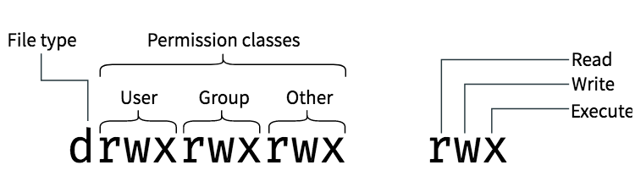
File Permissions (Simple)

Slide 5
Special Characters in Bash Scripts
$ - The dollar sign character is used for representing variables
“ “ - Double quotes will expand variables like $USER, single quotes will not
* - The star character is a “wildcard”. It expands to all files in the directory. For example, *.txt will expand to every file ending in .txt, this is useful for pattern matching
# - The hash sign / octothorpe starts a comment. Any text after it will not be executed
<, >, >> - The angle bracket characters are used for redirecting command output. There are many variations using these.
| - The pipe character takes the output from one command and feeds it in as the input into another command
; - The semicolon character is identical to
& - When placed after a command, the ampersand character will send that command to the background and immediately start the next command
\ - The backslash is an escape character. If you need to use one of these special characters, you can do so by prefixing it with a backslash. For example. \$ will be interpreted as a dollar sign character, not as the start of a variable.

Slide 6




Compute Cluster Resource Allocation
Head Node
(limited resources)
Compute Cluster
(Shell and Terminal)
Users
Compute Nodes
Compute resources are group and designated to specific compute nodes

Slide 7
Compute Cluster Resource Allocation
Head Node
(limited resources)
Head node: very limited resources
*Use with caution!
Users
(Shell and Terminal)
Compute nodes: extensive compute resources
execute all computational tasks in job scripts
Jobs scripts are a list of one or more commands or programs to be executed
Requires a system to manage compute node resources
Compute Nodes

Slide 8
Compute Cluster Resource Management
Head Node
(limited resources)
Slurm
Users
Manages resources to execute jobs
Executes jobs as resources become available
(Shell and Terminal)
Compute Nodes
Notes:
8

Slide 9
Why Use Compute Clusters
Compute clusters are designed for compute-intensive processes
combining the power of multiple servers, clustered systems can tackle large and complex workloads
Because workload can be shared we can consolidate and optimize resource utilization
Higher availability
The ability to provide end users with access to a service for a high percentage of time while reducing unscheduled outages
Higher reliability
Reduced frequency of system failure
Improved scalability
Easily add additional nodes/resources to the cluster with minimal disruption to remaining nodes

Slide 10


Running Jobs On The Compute Cluster
Head Node
(limited resources)
Batch script
Batch scripts are text files written in bash (or other shell scripting languages)
SBATCH Headers
specify settings for running our job script
Commands
list of command(s) to execute
Compute Nodes

Slide 11
SBATCH headers
#SBATCH -p <partition> → specify job partition (queue) to run the job
#SBATCH --time=00:00:00 → hrs:minutes:seconds
#SBATCH --mem=<memory>
#SBATCH –-ntasks= → specify how many cores/processors are needed for the job
#SBATCH –-job-name=<jobname> → give the job a name
#SBATCH –-mail-type=ALL
#SBATCH –-mail-user=<you@email.com>
#SBATCH –-error=<path/file.err> → specify name and location of error file
#SBATCH –-output=<path/file.log> → specify name and location of log file

Slide 12
Understanding Modules
Environment variables modify the way we interact with the cluster or help us to “find” things
Common environment variables are PATH, PYTHON_PATH, LD_LIBRARY_PATH
Modules allow you to easily and dynamically add to and change environment variables
All modules are unloaded after you terminate your current session

Slide 13
Module Commands
$ module avail
List all available modules
$ module load <module>
Load a specific module
$ module list
List the modules currently loaded
$ module unload <module>
Unload a specific module
$ module purge
Remove all loaded modules

Slide 14

What Causes A Job To Fail
Numerous sources of error that can prevent successful job completion
Incorrect command-line setup; misuse of parameters
Incorrect file formats
Incorrect path designations
Issues with version compatibility
Incorrectly setup job script/SBATCH headers

Slide 15
How To Know When A Job Fails
Expected output files are not present or are empty
Job finishes much quicker than expected
Error messages in your error file

Slide 16
How To Troubleshoot Failed Jobs
SBATCH headers
#SBATCH --error=<path/file.err> ➢ specify name and location of error file
#SBATCH --output=<path/file.log> ➢ specify name and location of log file
Error file
Captures all STDERR output
Log file
Will capture STDERR if no location is specified
Captures standard out (that is not explicitly captured in your individual commands)

Slide 17
BREAK

Slide 18
The way to do things
The right way to do things
Download your data
Lock its permissions so it can never be edited!!!
Keep the raw data somewhere backed up!!!
NEVER TOUCH RAW DATA!!!
Run programs on your data
Set up your storage system optimally
Make a directory on /scratch for each of your projects (/scratch/Shares/labname/ or scratch/Users/username/)
Make an input and output directory in that directory
rsync your raw data to your input directory on scratch
scratch is not backed up!!!!!
Make a scripts directory (in someplace that is backed up, for example /Users/username/)
Back up your scripts directory to github
All software you run should be in a script (not on command line!)
Make a README file that tells everything you would put in your lab notebook, track as you go
Where is the raw data
Which scripts did you run on it
What files did you make and where are they
Keep the living room clean!
After you run a program, you may have an intermediate file you want to keep
When you get intermediate files you want to back up rsync them to somewhere backed up
Always check your results
QUALITY, QUANITY (NUMBER OF READS), VISUALIZE
Delete stuff on /scratch frequently (Data on scratch costs more and clogs up the system)
Upload the raw data and the final processed files to NIH GEO
Publish all your data
All versions of all programs used must be noted in the methods section
github can be used to share the code you used
Download your data
Run programs on your data
Use any storage space you want… for instance
/Users/<username>/
Publish your data

Slide 19

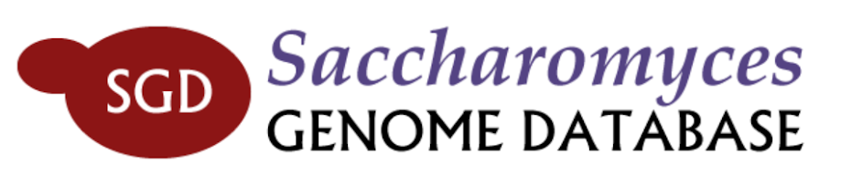
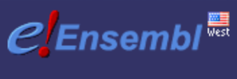
Extensive Publicly Available Data and Tools
Publicly available datasets
NCBI Gene Expression Omnibus (GEO)
NCBI FTP site and SRA database
Genbank
UCSC Table Browser
Ensembl
Model organism specific site like SGD
Programs/packages
SourceForge
GitHub

Slide 20
How To Download Data to Server From Internet
curl -O – used to download files from the net
Usage: $ curl -O <url> ➢ download file at <url> to current directory
ftp = internet file transfer program
Connect to a remote host (i.e. server) and copy files via file transfer protocol (FTP)
Usage: $ ftp <options> <host>
Example: $ ftp ftp.ncbi.nih.gov
sftp = secure version of ftp command

Slide 21
Let’s practice!
In your home directory (/Users/<gh_username>), open a new file with vim
Using the day 3 cheat sheet, let’s write a basic sbatch script (just the headers-don’t forget the #!)
#!/bin/bash
Assume the tasks you’re running are all only single-core, single thread tasks. (--ntasks=1).
Let’s ask for 4G of RAM. We shouldn’t need this much though.
Specify a 10 minute walltime.
We want the job to send us mail for any event

Slide 22
Now for the commands...
We need to wget or curl a file (ftp://ftp.1000genomes.ebi.ac.uk/vol1/ftp/phase3/data/HG00096/sequence_read/SRR062641.filt.fastq.gz)
We’re going to run fastqc against this file
Basic syntax fastqc -t 1 -o /path/to/output/dir <file>
The output directory must exist before running fastqc – let’s add a line to create it before the fastqc line
Don’t forget to make sure fastqc is in your $PATH environment variable. Make sure that you are using fastqc/0.11.5

Slide 23
The last part...
rsync the fastqc output back to your laptop and open the html file.

Slide 24
The End
Questions??
Don’t forget the homework.
Watch videos for Day 4
Help sessions: 1-3PM in E1B11
IT Questions? Email bit-help@colorado.edu

Slide 25

Acknowledgments
Workshop Coordinator: Mary Allen
Funding: BioFrontiers Institute and Colorado Office of Economic Development and International Trade
Additional Acknowledgments
Compute Resources: BioFrontiers IT Staff
Robin Dowell and Dowell Lab
©2019

