Slide 1
Short Read Sequencing Analysis Workshop
Day 2
Learning the Linux Compute Environment
Get Github open to sr2023
Get terminal open

Slide 2
Review of Day 2 Videos
Video 1 – SSH and VPN Introduction
How SSH and VPNs work when accessing remote servers
Video 2 – Remote Rsync / Reading Files
Looking at files on a remote server and getting them to your computer
Video 3 – Searching / editing Files, Pipes, and Outputs
Pieces of your basic toolkit for working on a Linux server
Video 4 – Directory Permissions
Managing who can see and execute different things on the server

Slide 3
Important things to know about Linux
It seems harder but it has advantages
File systems (how do I get places?)

Slide 4
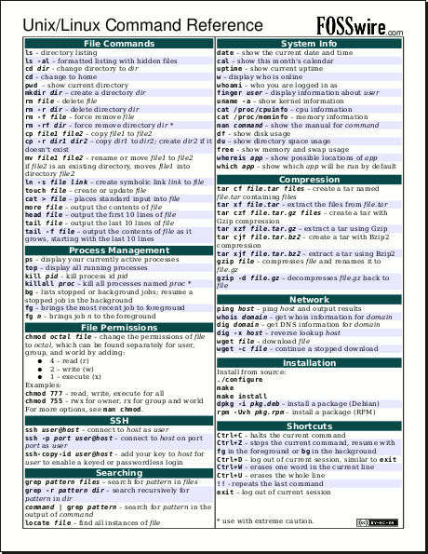
Find a unix/linux cheat sheet
The commands might be named weirdly
Cheat sheets on Github
Notes:
http://cheatsheetworld.com/programming/unix-linux-cheat-sheet/

Slide 5




In Unix/Linux everything is organized as a hierarchy
pwd “print working directory”
ls “list” – list files
hoto7260
projects
sread2023

Slide 6
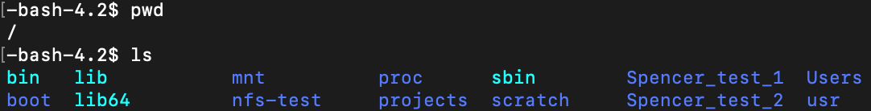
In Unix everything is organized as a hierarchy
/
usr
bin
scratch
Users
hoto7260
dowell
allen
projects
sread2023

Slide 7
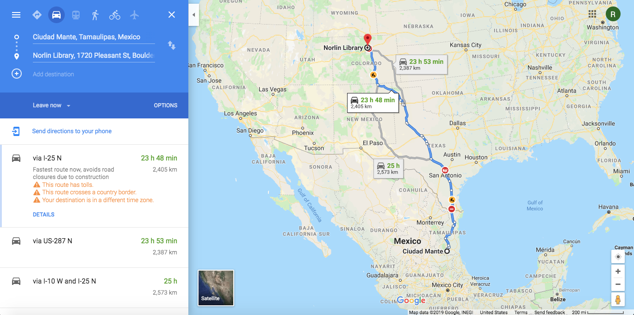
Absolute and relative paths
How do I get to Norlin Library at CU Boulder?
Notes:
Absolute path from Mante (Boulder’s sister city) to Norlin Library.

Slide 8
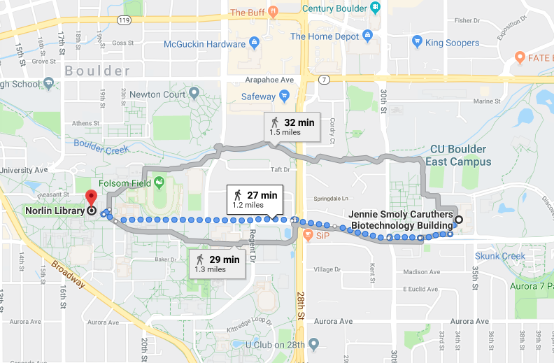
Absolute and relative paths
How do I get to Norlin Library at CU Boulder?
Notes:
Relative path from JSCBB to Norlin Library

Slide 9
Absolute path
/
usr
bin
scratch
Users
/Users/hoto7260/sread2023
allen
hoto7260
dowell
*To get the absolute path of file, use command realpath
projects
sread2023

Slide 10

Relative path
/
usr
bin
scratch
Users
hoto7260
dowell
allen
projects
sread2023

Slide 11
Relative path
/
usr
bin
scratch
Users
hoto7260
dowell
allen
./sread2023
./ = current directory
projects
sread2023

Slide 12
Relative path
/
usr
bin
scratch
Users
hoto7260
dowell
allen
projects
sread2023

Slide 13
Relative path
/
usr
bin
scratch
Users
hoto7260
dowell
allen
../sread2023
../ = parent directory (hoto7260)
projects
sread2023

Slide 14
Relative path
/
usr
bin
scratch
Users
hoto7260
dowell
allen
projects
sread2023

Slide 15
Relative path
/
usr
bin
scratch
Users
hoto7260
dowell
allen
../../dowell
../../ = parent of parent directory (Users)
projects
sread2023

Slide 16
Questions?

Slide 17
Important things to know about Linux
It seems harder but is sometimes WAY easier
File systems (how do I get places?)
Linux tools don’t care about file extensions: Make sure you are using the correct one.
ls & man

Slide 18

Type ls in your directory
What else can ls do?
man ls

Slide 19
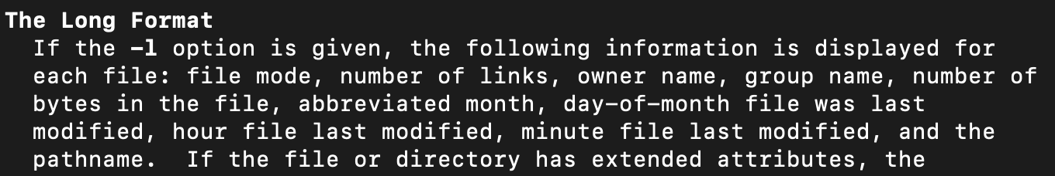
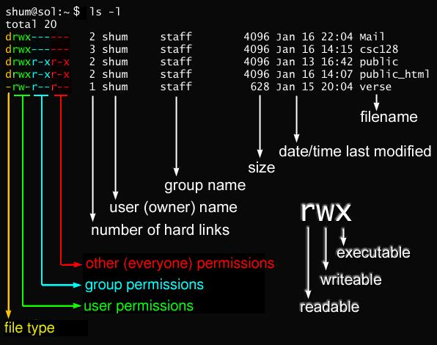
Highlights
All
Long
Notes:
https://javarevisited.blogspot.com/2012/03/10-example-of-chmod-command-in-unix.html?ref=hackernoon.com

Slide 20
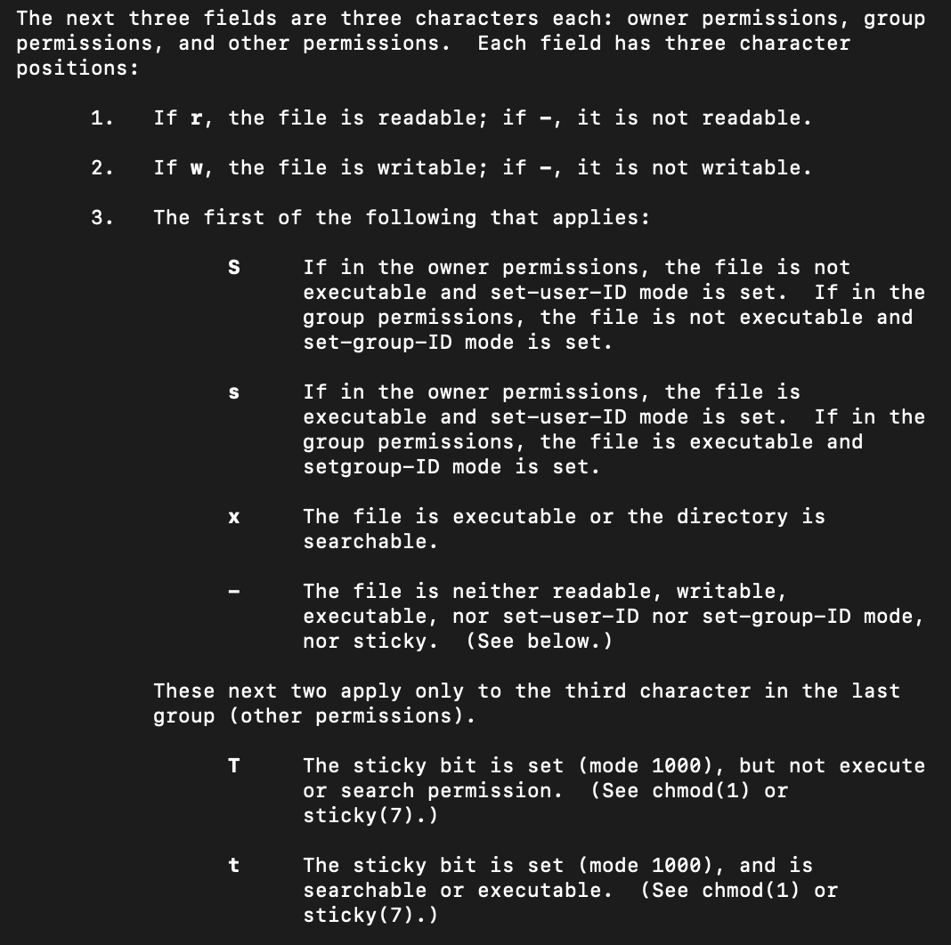
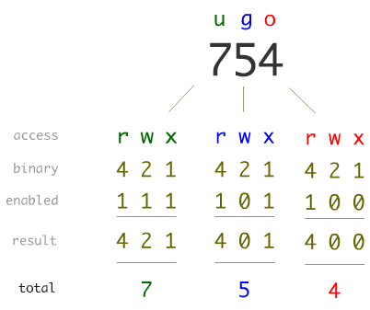
File permissions
Important for sharing files
Change with chmod
Watch the video!
Notes:
https://javarevisited.blogspot.com/2012/03/10-example-of-chmod-command-in-unix.html?ref=hackernoon.com

Slide 21
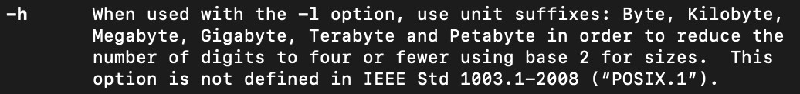
Highlights cont…
Highlights:
All
Long
“Human readable”

Slide 22
Questions?

Slide 23
Navigating relative and absolute paths
Shortcut to home
~
Moving through the file system
Change Directory
cd
Where am I?
Print Working Directory
pwd
$ pwd
$ cd /Users/<username>/
Notes:
TO DO!

Slide 24
The “dot dot” notation
/
..
usr
bin
scratch
Users
..
sahu0957
dowell
allen
..
projects
sread2021

Slide 25
Relative path
/
usr
bin
scratch
Users
sahu0957
dowell
allen
../projects
projects
sread2021

Slide 26
Review of Day 2 Videos
Video 4 – Remote RSYNC, reading files
Access command manuals, use options to customize command functions
Command line I/O, capture STDOUT and STDERR, piping
Video 5 – More file manipulation
Access command manuals, use options to customize command functions
Command line I/O, capture STDOUT and STDERR, piping
Video 6 - Permissions
Exploring Unix Permissions
Video 7
VIM Tutorial

Slide 27

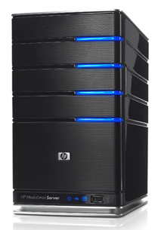
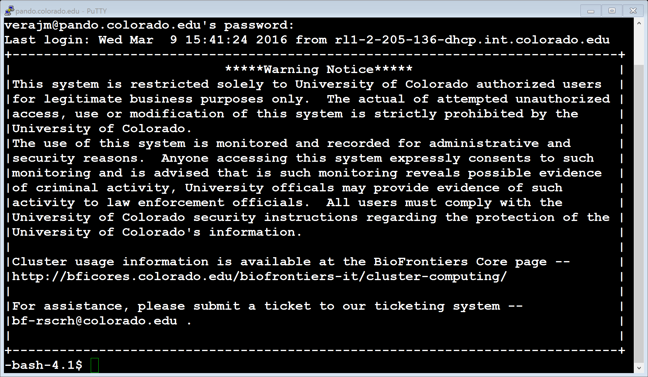

We Use the Shell to Communicate With the OS
Keyboard
Input Device
Operating System
(Linux)
Hardware
(CPU, RAM, Hard Drive)
Shell and Terminal
(Sh, Bash)
Local Machine
(laptop/Desktop Computer)
Remote Machine
cloud or fiji

Slide 28
Understanding the Command Line
Keyboard
Input Device
$ <command> <arguments>

Slide 29
We Use the Shell to Communicate With the OS
Keyboard
Input Device
Operating System
(Linux)
Hardware
(CPU, RAM, Hard Drive)
Shell and Terminal
(Sh, Bash)
Enter a command
Execute the command

Slide 30
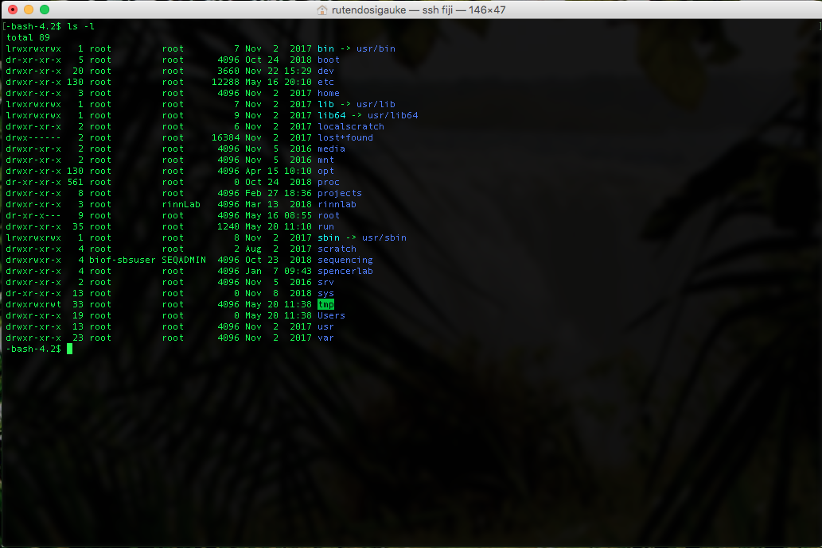
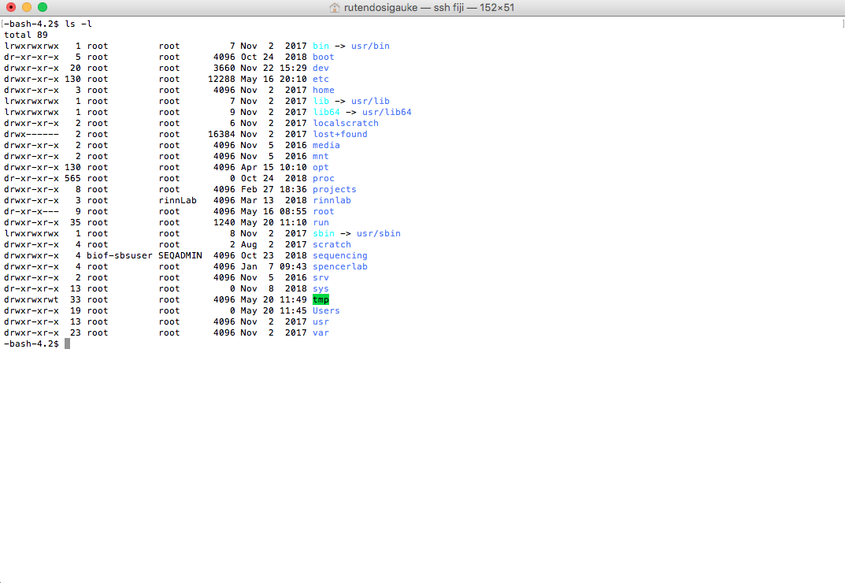


Make the terminal comfortable to work in:
Make the windows large
Open multiple windows and/or tabs
Change font sizes etc. ((For Mac: Command + Plus/Minus, For Windows, find Text size in Preferences)
Terminal

Slide 31
Start Worksheet Part 1
Remember to make the terminal comfortable to work in:
Make the windows large
Open multiple windows and/or tabs
Change font sizes etc. ((For Mac: Command + Plus/Minus, For Windows, find Text size in Preferences)
You can move on to Part 2 when finished with Part 1

Slide 32
If you haven’t already, start Worksheet Part 2
Done with Part 2 already?
Get started on the homework!
Practice the commands in the cheat sheets linked on Github
Help a peer out!

Slide 33

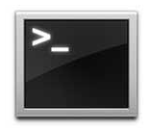
How to Access A Server Via the Terminal
Open a terminal session
MobaXterm(PC users)
Terminal App (Macs)
SSH command
Terminal
$ ssh <username>@IP/server
$ ssh sahu0957@fiji.colorado.edu
fiji.colorado.edu: Enter password when prompted (it will be hidden as you type)
VPN connection required for off-campus access

Slide 34

When in doubt, check the manual
All Unix commands are described in a collection of files called “man pages”
man command
For help on some topic
man -k keyword
For more information on using the man pages
man man
You can get command information with help
command --help
command -h
Note that the man pages uses an ancient method of viewing content:
<spacebar> to go down a page
Arrow keys *should* work to review already seen segments.
<q> to quit the man pages

Slide 35
The home directory
Also called login directory
Serves as user’s personal directory
/Users/<username>
~

Slide 36
Create folders
Make a directory “workshop-day2” in your home
$ cd ~ $ cd $ cd /Users/<user name>
$ mkdir workshop-day2
List contents in your directory
$ ls
Create a “bedfiles” directory in your “workshop-day2” directory
$ mkdir workshop-day2/bedfiles
Directories can be created from any location as long as the full path is provided.

Slide 37
Add subdirectories
Change to your “workshop-day2” directory
Make a “results” directory
Make more directories
“scripts”
“bin”
“data”
$ cd workshop-day2
$ mkdir results
$ mkdir scripts bin data

Slide 38
Listing contents of a directory
ls | ls -l | ls -a | ls -h
List contents in a directory | Generate a detailed list of contents in a directory | Display all file including hidden files | Make information human readable
$ ls
$ ls -l
$ ls -a
$ ls -h
Options can be combined: ls -lah

Slide 39
Listing contents of a directory
Generating list of contents in a specific directory
ls -lah <pathname>
pathname may be
Full path: /home/path/to/directory
Current directory: .
Parent directory: ..
Home directory: ~
$ ls .
$ ls ..
$ ls ../../
$ ls ~

Slide 40
Linux commands for moving files
cp = copy a file or directory
usage: $ cp <source> <destination>
usage: $ cp -r <folder> <destination>
rsync = copy a directory or file remotely or locally
usage: $ rsync <source> <destination>
mv = move directory or file
usage: $ mv <source> <destination>
Can be used to rename a file or directory

Slide 41
Moving files
Copy “chr1_bedfiles.tar.gz” file to your bedfiles directory
Change “chr1_bedfiles.tar.gz” file name to “chr1bedfiles.tar.gz”
$ cp /scratch/Workshop/SR2021/2_unix/bedfiles/chr1_bedfiles.tar.gz bedfiles/
$ cd bedfiles/
$ mv chr1_bedfiles.tar.gz chr1bedfiles.tar.gz

Slide 42
Compressing and decompressing files
Compress / Decompress
gzip / gunzip
zip / unzip
Gzipped Tar Archive
tar xvfz sample.tar.gz
Tar archive
tar xvf sample.tar
$ tar xvzf chr1bedfiles.tar.gz
Notes:
Change over

Slide 43
Questions?

Slide 44
Viewing files in a directory
head | tail | more | less | cat
Print the first 10 lines of a file | Print the last 10 lines of a file | Filter for paging through text one screenful at a time. | Allows backward movement in the file as well as forward movement (opposite of more) | Concatenate files and print on the standard output
-n <int> specify how many lines to be printed | -n <int> specify how many lines to be printed | SPACE to scroll q to quit | SPACE or ^V or f or ^F or arrows to scroll q to quit | Can concatenate multiple files
$ ls -lah
$ head ENCFF050DNG.chr1.bed
$ head -n 20 ENCFF050DNG.chr1.bed
$ tail ENCFF050DNG.chr1.bed
$ tail -n 3 ENCFF050DNG.chr1.bed

Slide 45
Viewing files in a directory
head | tail | more | less | cat
Print the first 10 lines of a file | Print the last 10 lines of a file | Filter for paging through text one screenful at a time. | Allows backward movement in the file as well as forward movement (opposite of more) | Concatenate files and print on the standard output
-n <int> specify how many lines to be printed | -n <int> specify how many lines to be printed | SPACE to scroll q to quit | SPACE or ^V or f or ^F or arrows to scroll q to quit | Can concatenate multiple files
Scroll through ENCFF837ENN.chr1.bed with more
Scroll through ENCFF837ENN.chr1.bed with less
$ more ENCFF837ENN.chr1.bed
$ less ENCFF837ENN.chr1.bed

Slide 46
File manipulation
cut | cut -f | cut -d
Remove sections from each line of files | Select specific fields in a file | Use DELIM instead of TAB for field delimiter
Select columns 1, 2 and 3 in ENCFF837ENN.chr1.bed :
$ cut -f 1,2,3 ENCFF837ENN.chr1.bed
$ awk '{print $1 "\t" $2 "\t" $3}' ENCFF837ENN.chr1.bed
* Awk is a unix programming language that is very useful

Slide 47
Searching files
find | grep | grep -i | grep -v | grep -c | grep -w
Search for files in a directory hierarchy | Search for PATTERNS in each file | Ignore case (upper versus lower case) | Select lines that do not match PATTERN (inverse match) | Count lines that match PATTERN | Select only those lines containing matches that form whole words.
Search for ENCFF050DNG.chr1.bed from your home directory
$ cd
$ find -iname ENCFF050DNG.chr1.bed
Search for lines with the character ‘151’ in ENCFF050DNG.chr1.bed
$ cd /Users/<username>/workshop-day2/bedfiles/
$ grep -w ‘151’ ENCFF050DNG.chr1.bed

Slide 48
Counting features
wc | wc -l | uniq -c | grep -c
Print newline, word, and byte counts for each file | Print the newline counts | Prefix lines by the number of occurrences | Count lines that match PATTERN
Count the number of lines in ENCFF050DNG.chr1.bed
$ wc -l ENCFF050DNG.chr1.bed
Print the line, word and byte counts for ENCFF050DNG.chr1.bed
$ wc ENCFF050DNG.chr1.bed

Slide 49
Sorting files
sort | sort -n | sort -k
Sorts lines of text files | Numeric sort | sort via a key, key defined as location and type
Sorting the ENCFF050DNG.chr1.bed
$ sort ENCFF050DNG.chr1.bed
Sorting the ENCFF050DNG.chr1.bed by the first and second columns
The 1st column is alpha numerically sorted
The 2nd column is numerically sorted
$ sort -k1,1 -k2,2n ENCFF050DNG.chr1.bed

Slide 50
STDERR and STDOUT
> Write standard out to a file
>> Append standard out to a file
2> Write standard error to a file

Slide 51



A PROGRAM
STDOUT
STDERR
STDIN
STDIN = standard input
STDOUT = standard output
https://mario.nintendo.com/

Slide 52
Pipes Continued
PROGRAM a
STDOUT
PROGRAM b
STDIN
STDOUT
PROGRAM c

Slide 53
Pipes Continued
cat
PROGRAM a
STDOUT
cut -f 1,3
FILE
PROGRAM b
STDIN
STDOUT
grep “FEATURE”
PROGRAM c
cat FILE | cut -f 1,3 | grep “FEATURE” > OUTFILE.txt

Slide 54
Pipes Continued
cat
PROGRAM a
STDOUT
cut -f 1,3
FILE
PROGRAM b
STDIN
STDOUT
grep “FEATURE”
PROGRAM c
cat FILE | cut -f 1,3 | grep “SECOND-FEATURE” >> OUTFILE.txt

Slide 55
Pipes Continued
cat
PROGRAM a
STDOUT
cut -f 1,3
FILE
PROGRAM b
STDIN
STDOUT
grep “FEATURE”
PROGRAM c
cat FILE | cut -f 1,3 | grep “FEATURE” > OUTFILE.txt 2> ERRORS.txt

Slide 56
Using pipes in unix
Copy a bedgraph to your bedfiles directory
/scratch/Workshop/SR2019/2_unix/bedfiles/SRR4090090_chr21_22.bedGraph.gz
$ cp /scratch/Workshop/SR2019/2_unix/bedfiles/SRR4090090_chr21_22.bedGraph.gz /Users/<name>/workshop-day2/bedfiles/
Decompress the file (Hint: check the file extension)
$ pwd
$ cd /Users/<name>/workshop-day2/bedfiles/
$ gunzip SRR4090090_chr21_22.bedGraph.gz
Open the file and filter chr21 from the bedgraph and write the file with only columns 1,2 and 3 to your data folder
$ head SRR4090090_chr21_22.bedGraph
$ tail SRR4090090_chr21_22.bedGraph
$ cat SRR4090090_chr21_22.bedGraph | cut -f 1,2,3 | grep ‘chr21’ > ../data/SRR4090090_chr21.bedGraph

Slide 57
Using pipes in unix
Concatenate ENCFF050DNG.chr1.bed and ENCFF837ENN.chr1.bed
Sort by the first column (alpha numerically) and the second column (numerically)
Save the first 5 columns to a file called ENCFF_merge_sorted.bed in your data folder
$ cat ENCFF050DNG.chr1.bed ENCFF837ENN.chr1.bed | sort -k1,1 -k2,2n | cut -f 1,2,3,4,5 > /Users/rutendos/workshop-day2/data/ENCFF_merge_sorted.bed
$ cat ENCFF* | sort -k1,1 -k2,2n | cut -f1-5 > ../data/ENCFF_merge_sorted.bed

Slide 58
Deleting files
rm | rm -r
Remove files | Remove directories and their contents recursively
Delete the ENCFF_merge_sorted.bed file in the data folder
$ rm /Users/<username>/workshop-day2/data/ENCFF_merge_sorted.bed

Slide 59
Questions?

Slide 60


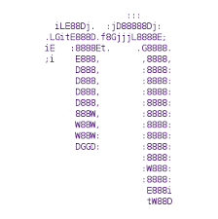


What is Vim ?
Vim is a free, open source terminal based text editor
Edit content of human-readable files
Several options exist for terminal text editors
Emacs
Nano
Sublime
Visual Studio Code

Slide 61
Using Vim
vim = Vi Improved
To open <file> for editing in Vim
$ vim <file>
In your “workshop-day2” directory create a new file:
$ touch vim_example.txt
Open the file with vim
$ vim vim_example.txt

Slide 62
Using Vim
Vim has 2 operating modes:
Command mode (default) (Vim commands only)
Insert mode (editing)
i/I ➢ insert
o/O ➢ open new line
a/A ➢ append
Switch back to command mode
esc

Slide 63
Using Vim
Open the “SRR4090090_chr21_22.bedGraph” in vim
Enter and exit the insert mode
type “i” → you are now in insert mode
Hit “esc” → command mode
Copy and paste 3 lines in the SRR4090090_chr21_22.bedGraph
Yank/copy the line: shift + y
Paste the line: p
Insert Mode: i/I, o/O
Command Mode: esc

Slide 64
Using Vim
Insert Mode: i/I, o/O
Command Mode: esc
In command mode:
Type “gg” → you will be taken to first line in file
Type “shift + o” → you have now opened a new line and are in insert mode
Type “ shift + g” → you will be taken to the last line of the file

Slide 65
Insert a line in Vim
Insert Mode: i/I, o/O
Command Mode: esc
Go back to the top of the SRR4090090_chr21_22.bedGraph
gg
Insert a comment line
i
#chr start stop
Save file
esc -> escape insert mode
:w -> save file

Slide 66
Using Vim
Insert Mode: i/I, o/O
Command Mode: esc
In vim:
Type “o” → you have now opened a new line and are in insert mode
Return to command mode:
Type “dd” → this will delete the current line
Type “u” → to undo this change

Slide 67
Save and Exit Vim
Insert Mode: i/I, o/O
Command Mode: esc
In vim:
Type “:w” and hit enter → this will save changes to the file
Type “:wq” and hit enter → this will save changes and exit
Type “:q!” and hit enter → this will quit without saving changes

Slide 68
Creating a bash script
In vim create a new document called “math.sh”
a=5
echo a
echo $a
close and run script
$ bash math.sh

Slide 69
Documenting your work is important
Create a README
README.txt file list information about files, archives, and directories
Things to include:
Brief description of file content
Date and method of data generation, data generator
While in your home directory
$ ls -l workshop-day2/* > README.txt

Slide 70
Edit your README file in vim
$ vim README.txt
Start editing/annotating your README.txt
List all your directories and or file names and what they will do
For example: Bowtie/
# This directory will contain all the output from Bowtie
Save changes and exit (:wq!)
Insert Mode: i/I, o/O
Command Mode: esc

Slide 71
The End
Questions??
Don’t forget the homework.
Help session in JSCBB A108 from 1-3pm
Watch videos for Day 3

