Slide 1
Short Read Workshop Day 6
Introduction to R and RStudio
Rutendo Sigauke
2024

Slide 2


Day 6 Overview
Running R in the terminal
Running R in RStudio
Submitting R script as an sbatch job

Slide 3
Goal of the day
Learn how to run R code!
Practice installing packages, tidying data, saving files and plotting.

Slide 4

What is R?
R is a free statistical computing and graphing software
Can be installed from their website https://www.r-project.org/
R can be run in a few environments:
RStudio
Jupyter

Slide 5
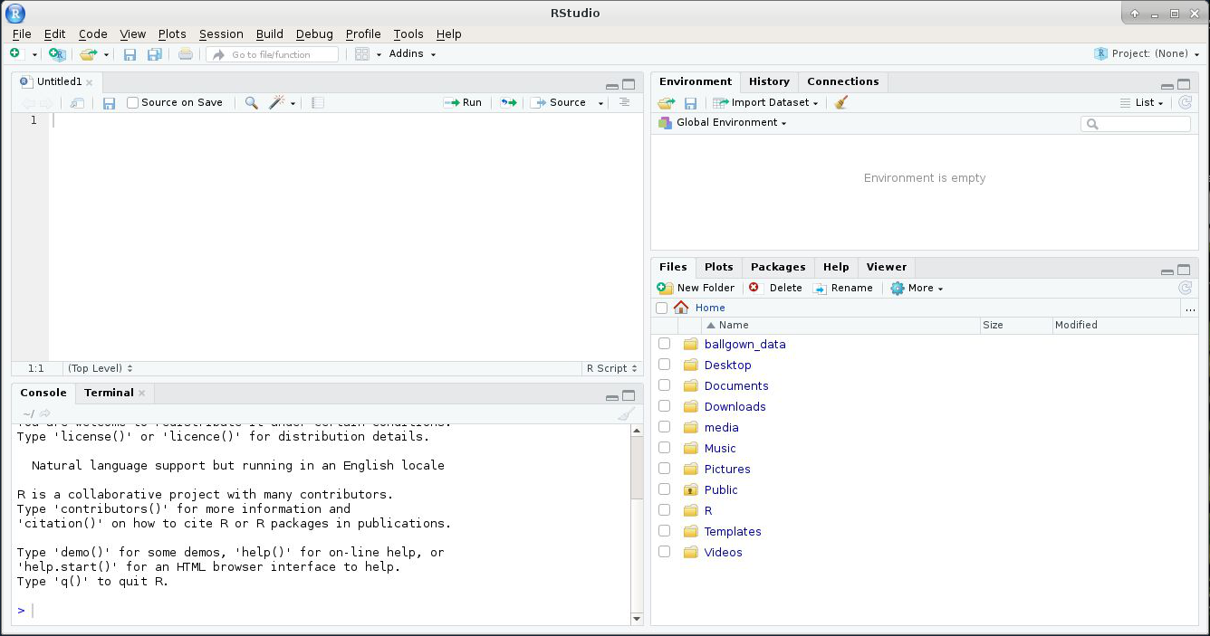
Summary of RStudio
R scripts, R markdown, R notebooks
Summary of all the data loaded in Rstudio
R console, Terminal
Directories, Plots, Packages...

Slide 6
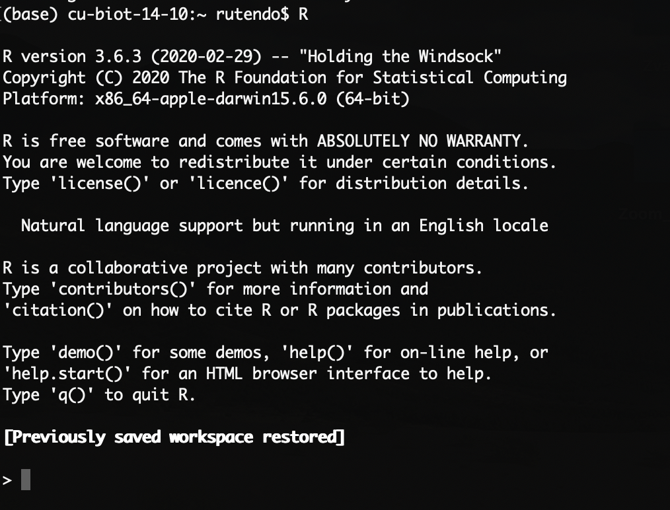
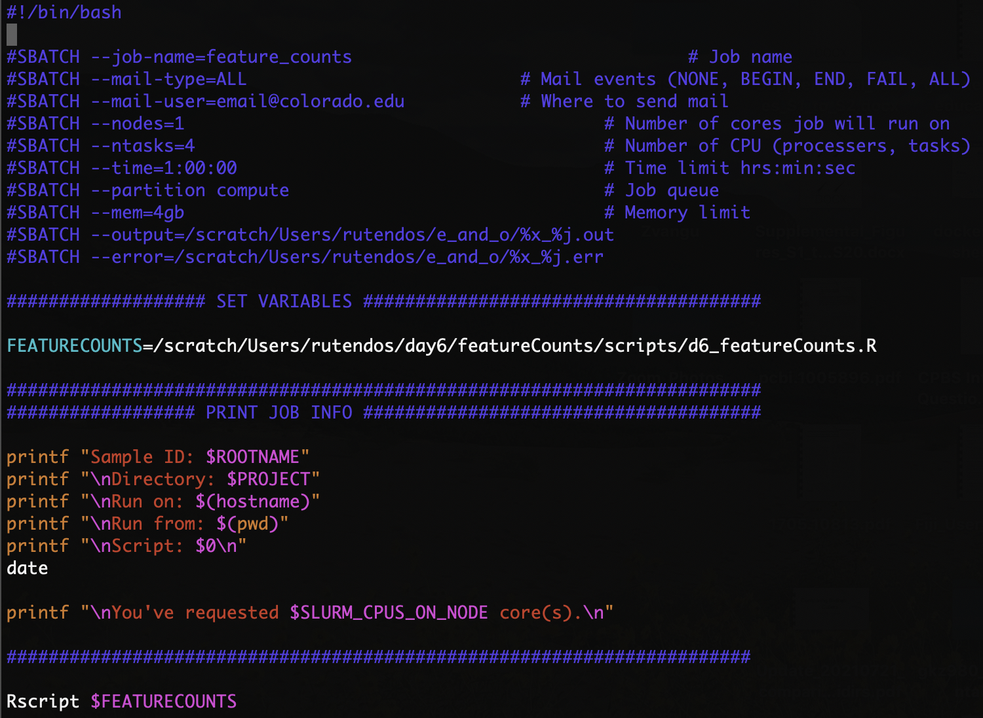
There are different ways to interact with R
R console
R Studio
Submit an R script as a job
Enter R code here
Enter R code and visualize plots
Run R script here
Interactive
More interactive
Least interactive
For more compute intensive scripts

Slide 7
R you ready to learn some R?
Let’s go over the Day6_worksheet1_Introduction_to_R.md worksheet:
Introduction to R in the terminal
Learn basic R commands
R console

Slide 8
Learning R in RStudio
In Day6_worksheet2_R_in_Rstudio.md (Section A):
We will go over the Learning_R.R worksheet in R Studio:
Introduction to R and R Markdown
Introduction to the iris dataset
Installing and loading libraries
tidyverse
Generating summary statistic in R
Making plots with ggplot2
Manipulating data.frames
R Studio

Slide 9
Challenge Question
How would you perform a computationally intensive R job?
i.e. Requires more memory than on your personal computer.

Slide 10
Writing an R script to submit on a supercomputer
Follow Day6_worksheet2_R_in_Rstudio.md (Section B):
Edit Learning_R_submit_aws.R
Save plots and tables to a working directory in the script
Run the R script as a job on AWS
Use the RScript command to call your script

Slide 11
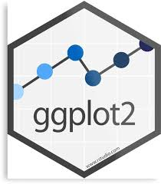


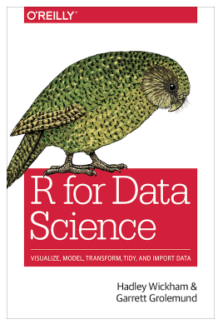
More resources for R
ggplot2 website https://ggplot2.tidyverse.org/
R-bloggers https://www.r-bloggers.com/
Quick-R https://www.statmethods.net/
R for Data Science (by Hadley Wickham & Garrett Grolemund) http://r4ds.had.co.nz/

Slide 12
Homework
Complete the Learning_R_Additional_Practice.R
This homework will go over most of the topics covered today, but on a different dataset. There will be more advanced questions that build on what was in the inclass session.
2. Install rsubread
A library for counting reads from bam files over genome features such as genes. Install this in the R on AWS.
3. For Project B (bulk RNA-seq) install DESeq2
This library takes in counts as input and performs differential gene expression analyses on the input features. You will be using this library in Day7b. Install this on your local machine.
This takes a long time, so get this installed before Day7.

