Slide 1
Day 9: R Visualizations & GO Analysis for Project B
Georgia Barone & Malia Fredrickson

Slide 2
Learning Objectives
Finish up bedtools worksheet from yesterday if you haven’t already (06_day8_bedtools.sbatch)
Expand your abilities to plot data in R
GO analysis to look for functional enrichment in our results

Slide 3
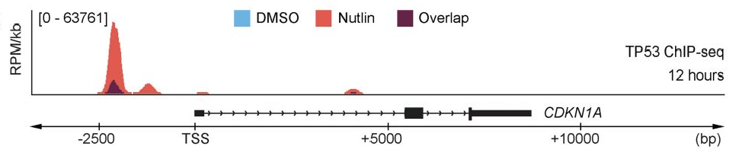
Recap of Yesterday
ChIP-seq
Processed ChIP-seq data (trimming, mapping, multiqc, peak calling, motif analysis)
Drew comparisons between ChIP-seq & RNA-seq data with bedtools package

Slide 4
Today we answer our overarching research questions:
What genes are differentially expressed and have a p53 ChIP peak in their promoter?
Do these genes fall into one functional classification, molecular pathway, or biological function?

Slide 5
We’ve gotten close to answering these questions throughout this project
We calculated differential gene expression on Day 7.
We called p53 ChIP peaks on Day 8.
We used bedtools to get a list of p53 ChIP peaks overlapping genes in control (DSMO) conditions.
We got an equivalent list of p53 ChIP peaks overlapping genes in experimental (Nutlin) conditions.
Now let’s put all these things together!

Slide 6
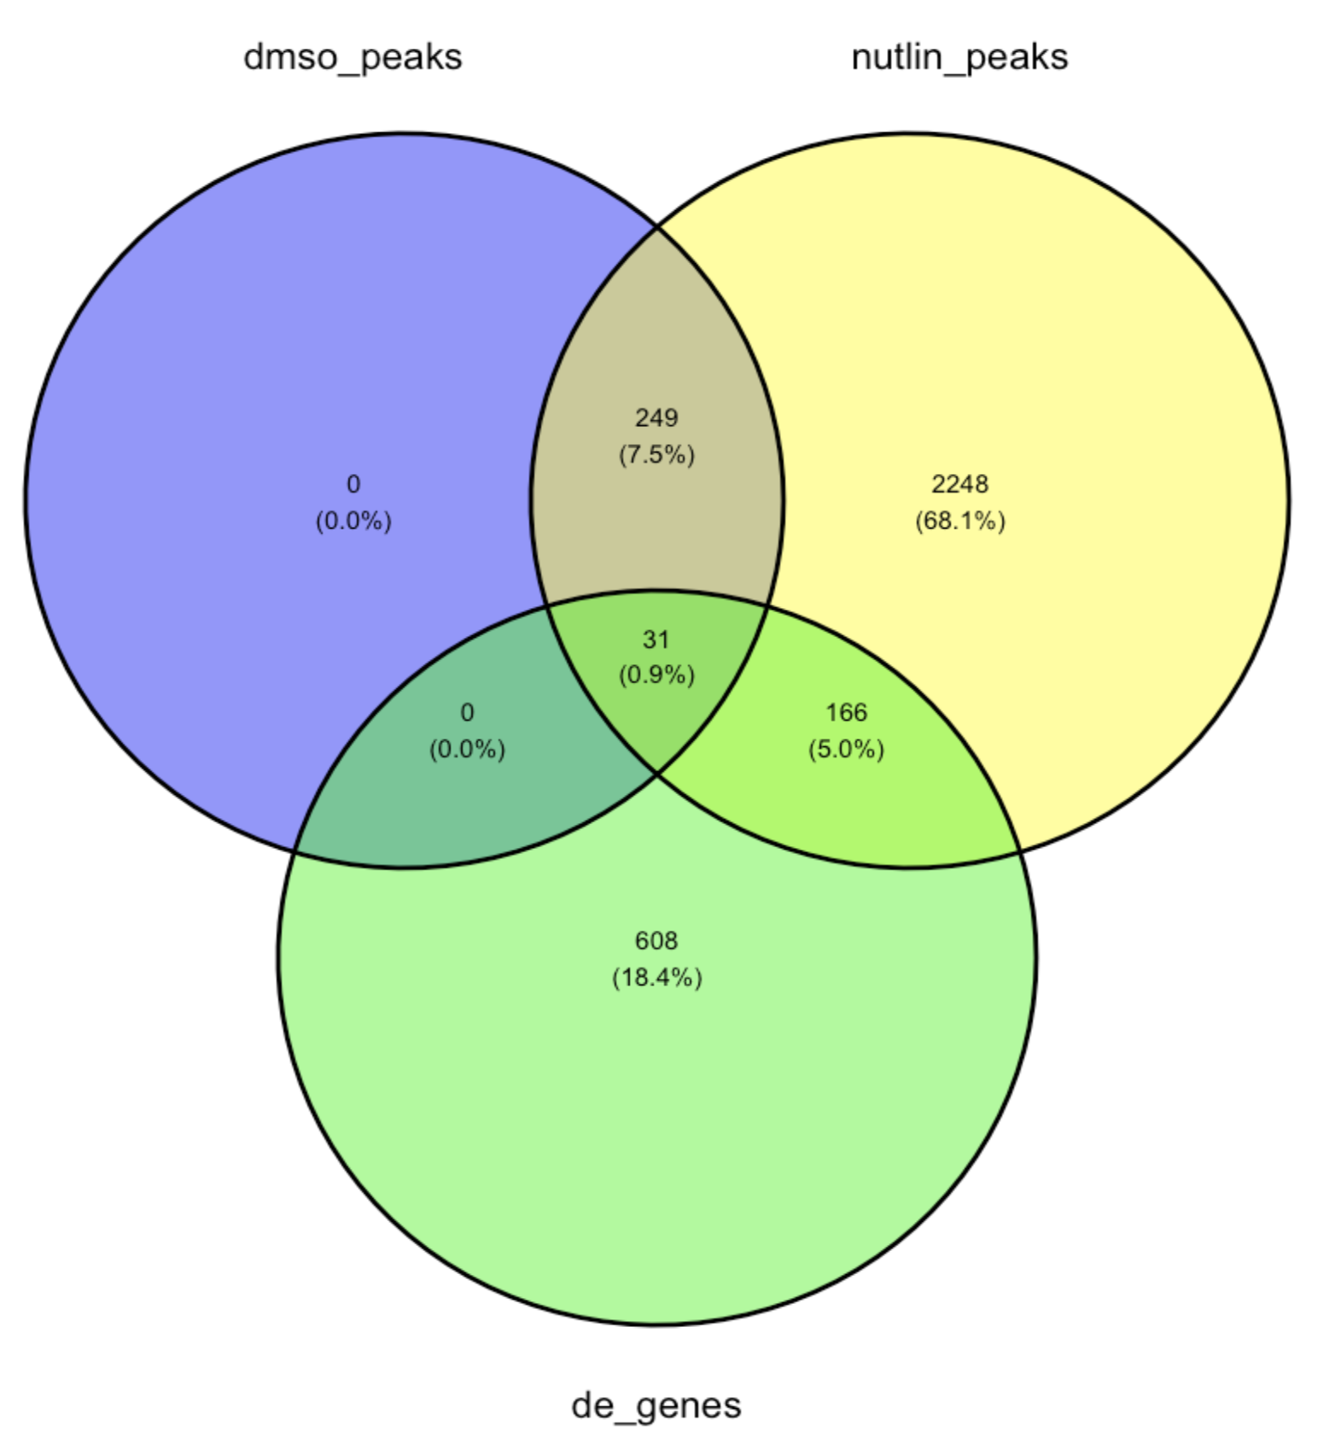
Work on 01_r_graphing_worksheet.md
In this worksheet you will:
Load in p53 peaks that overlap genes
Load in differential expression data
Generate a venn diagram showing the overlap of:
genes with ChIP peaks from the Nutlin samples
genes with ChIP peaks from the DSMO samples
genes with a ChIP peak that are differentially expressed

Slide 7
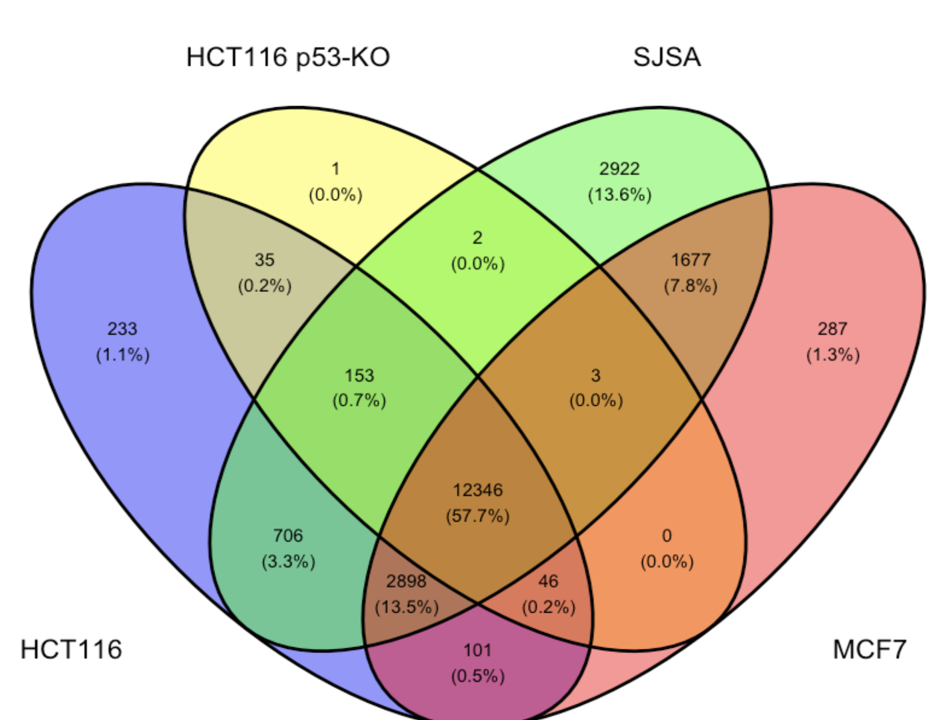
Work on 01_r_graphing_worksheet.md
4. Next, we will compare differential expression between cell lines (SJSA, MCF7, HCT116, and HCT116 with p53 KO) to see how consistent the p53 response is across these cell lines.

Slide 8
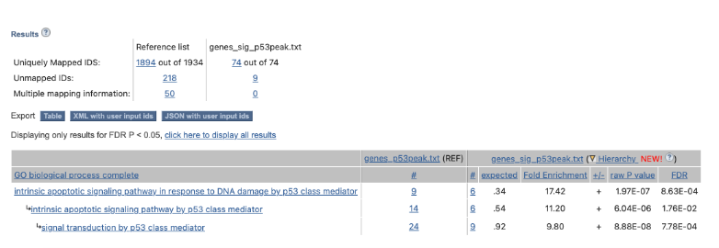
Work on 2_go_analysis_worksheet.pdf
4. Lastly, we will run a GO analysis on the genes we saved with a p53 peak (both bound and differentially expressed/bound, we saved these genes in 01_r_graphing_worksheet.md)
p53 ✅

