Slide 1
Day 1 overview
SSH keys and logging on to AWS
Review library prep and sequencing
Basic Bash/Intro to Git
Library QC
Vim and Vimtutor

Slide 2
Logging on to the super computer
On the website (https://biodatasci.colorado.edu/shortread/sr2023/) under Day 1, open and follow the worksheet named SSH Keys and AWS
You must
1) Be logged into your GitHub account
2) Have a terminal application open (see worksheet for details)
After adding your SSH keys, log into the AWS:
ssh <github_username>@18.216.90.72
If you need help, flag us with a red sticky note
If you are successfully logged on, put up a green sticky note

Slide 3
Library prep and sequencing

Slide 4
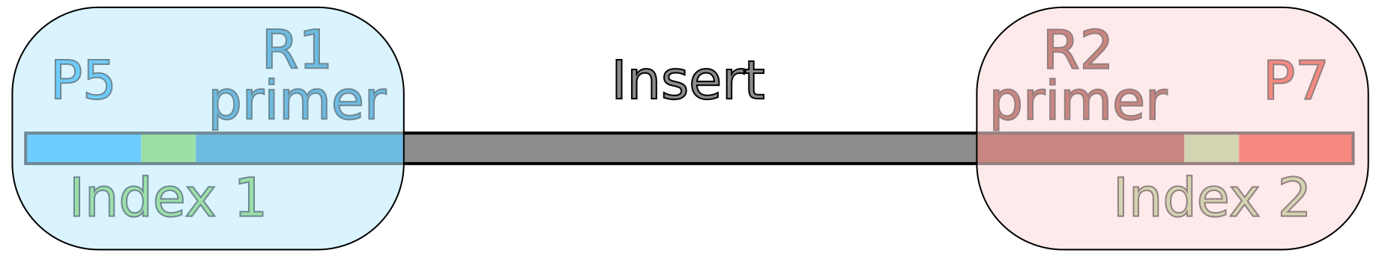
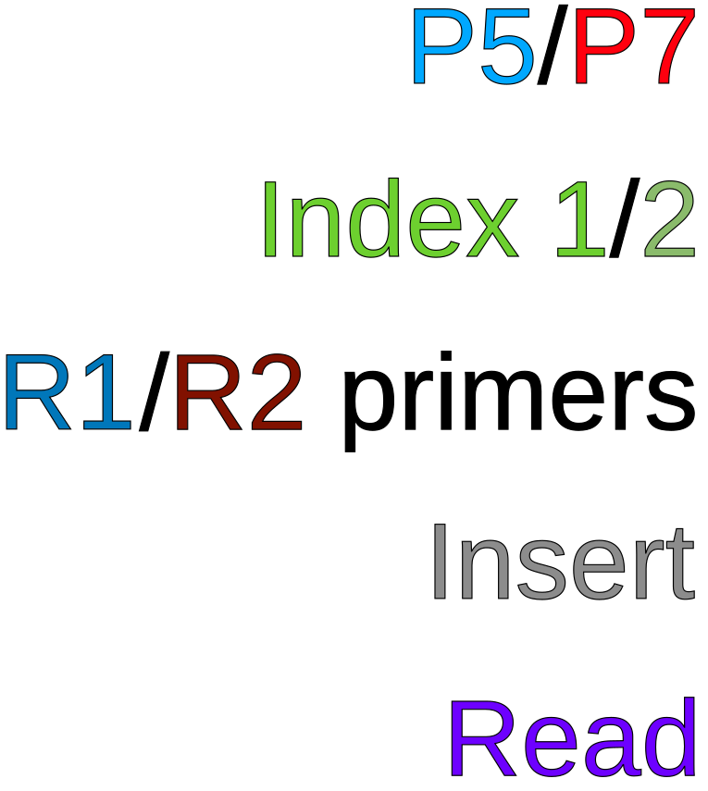
Anatomy of a library
Adapter 1
Adapter 2
Ends that attach to flow cell
ID sequences for multiplexing samples
Sequencing primers
Fragment of sample DNA/cDNA
Sequenced portion of fragment

Slide 5
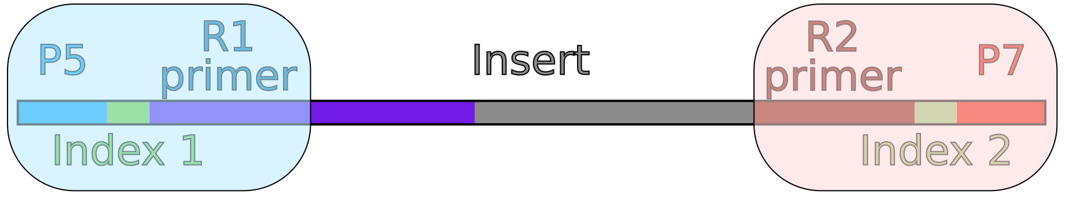
Anatomy of a library
Adapter 1
Adapter 2
Ends that attach to flow cell
ID sequences for multiplexing samples
Sequencing primers
Fragment of sample DNA/cDNA
Sequenced portion of fragment

Slide 6
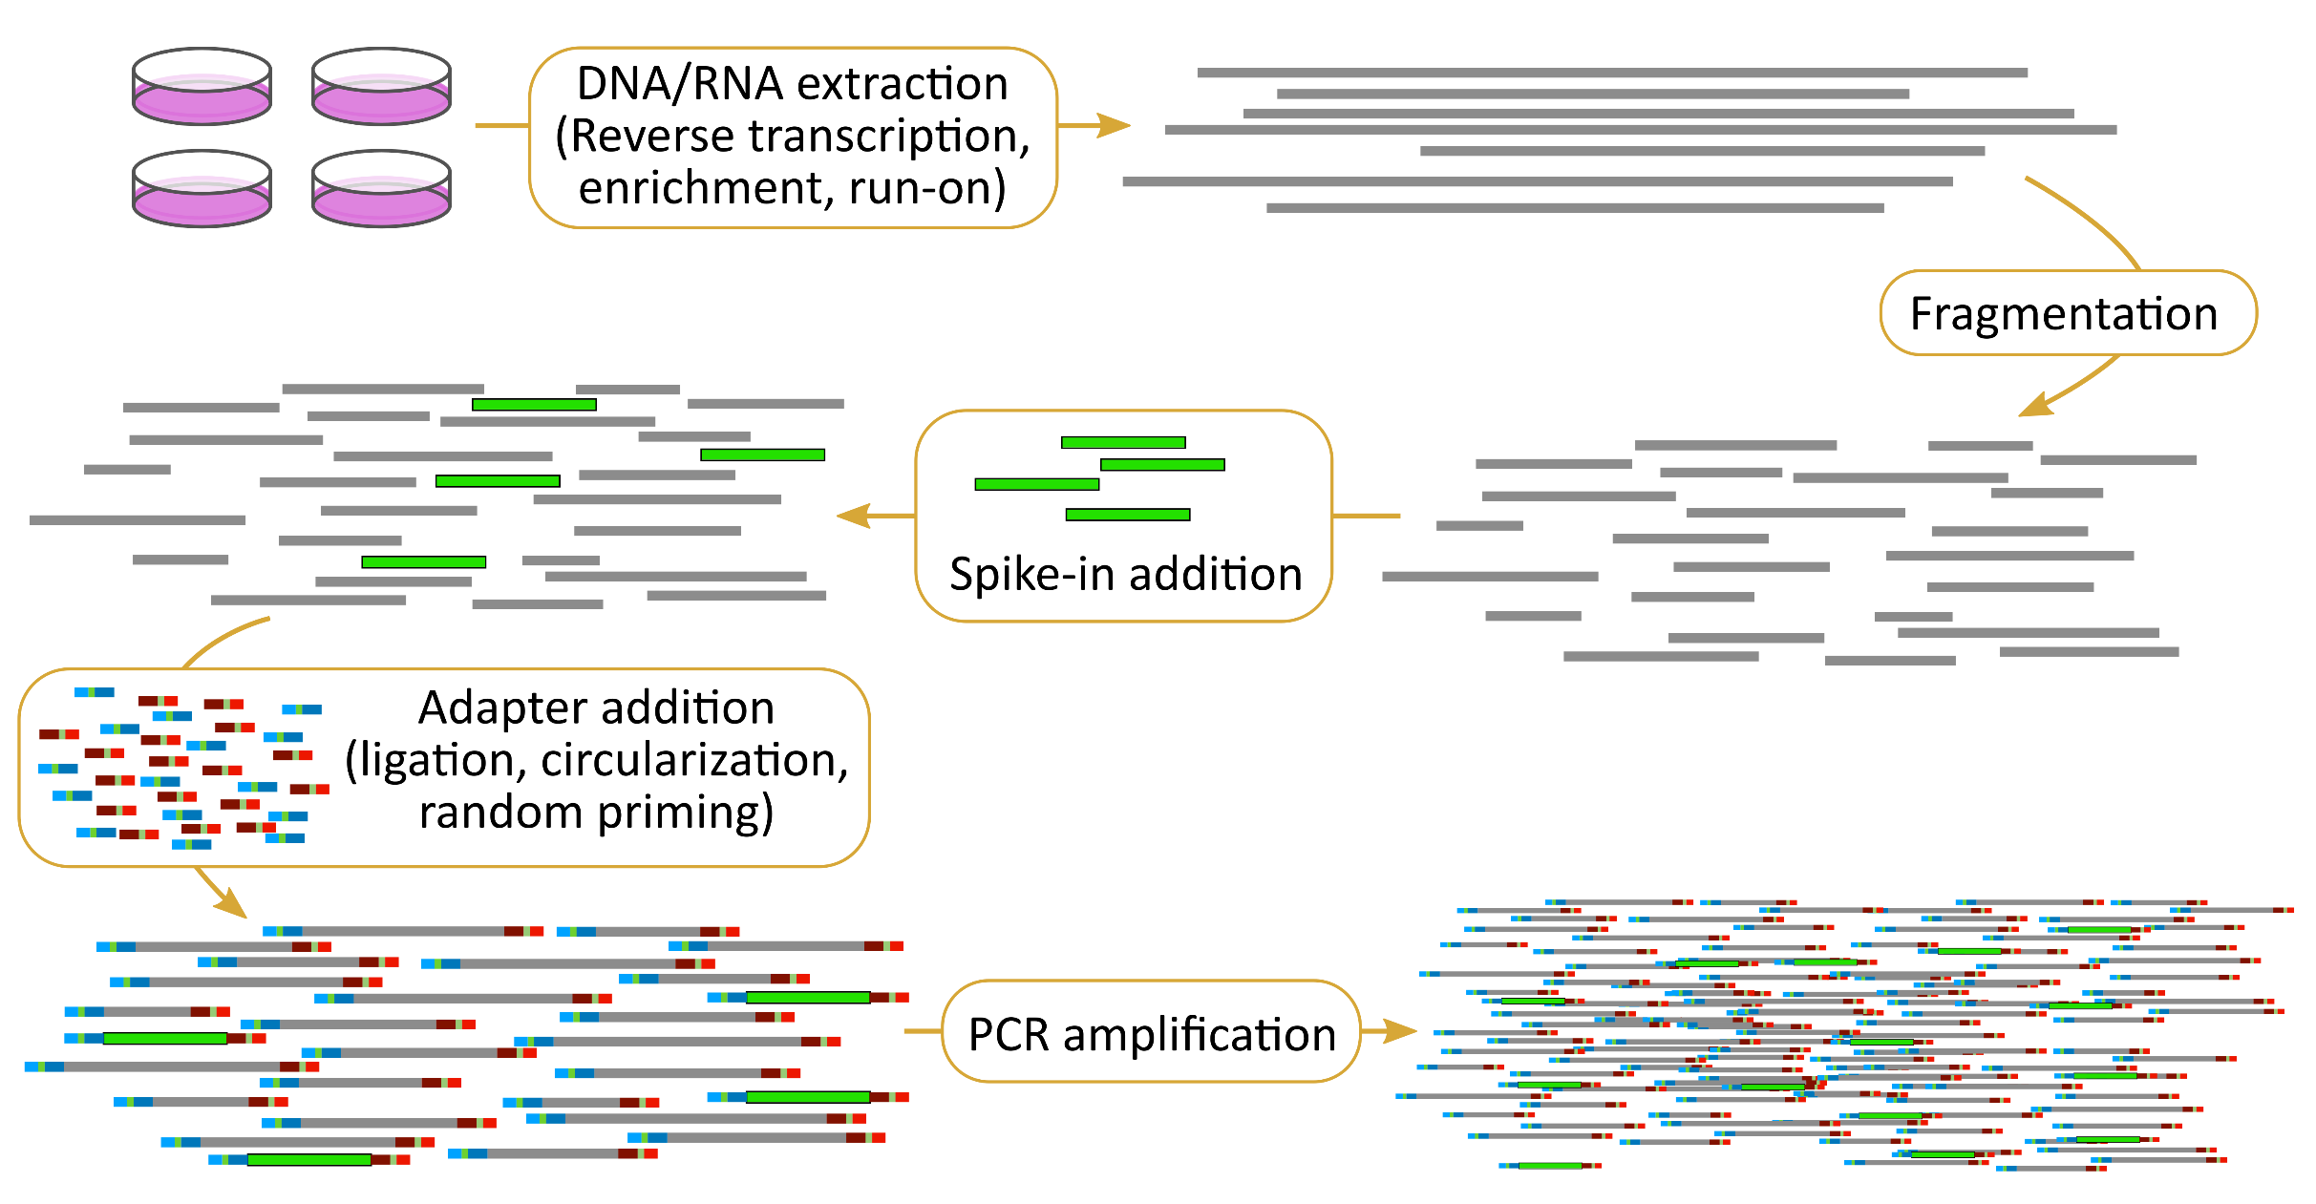
Creating libraries

Slide 7
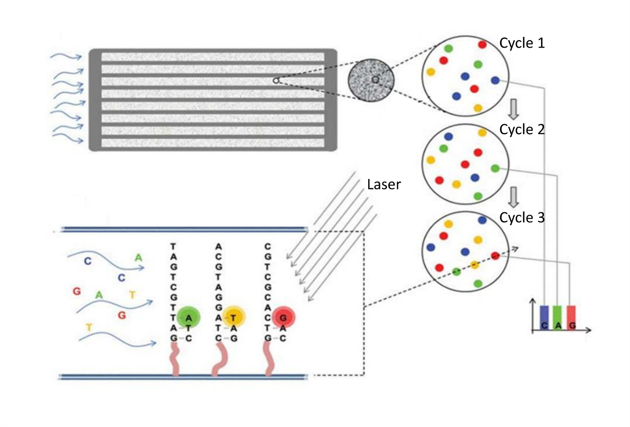
Illumina sequencing technology
Imaging a slide (flow cell) with millions/billions of DNA clusters
by cycling in fluorescent nucleotides
Sequencing:
http://tucf-genomics.tufts.edu/home/ordering

Slide 8
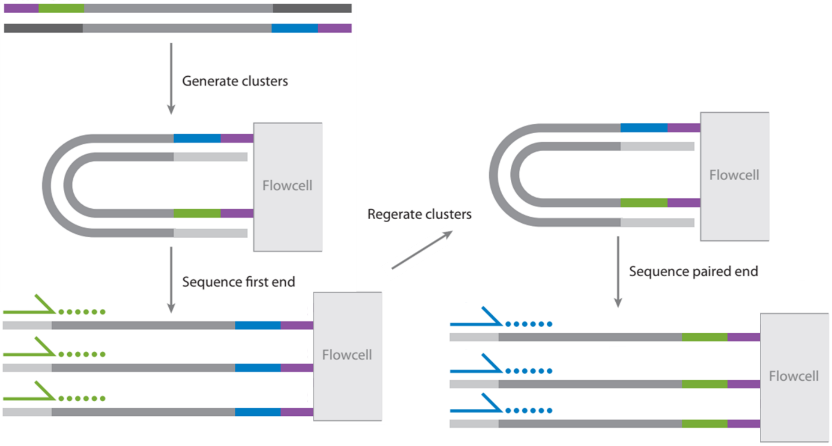
Single/paired end sequencing
Mardis. https://doi.org/10.1146/annurev-anchem-062012-092628

Slide 9
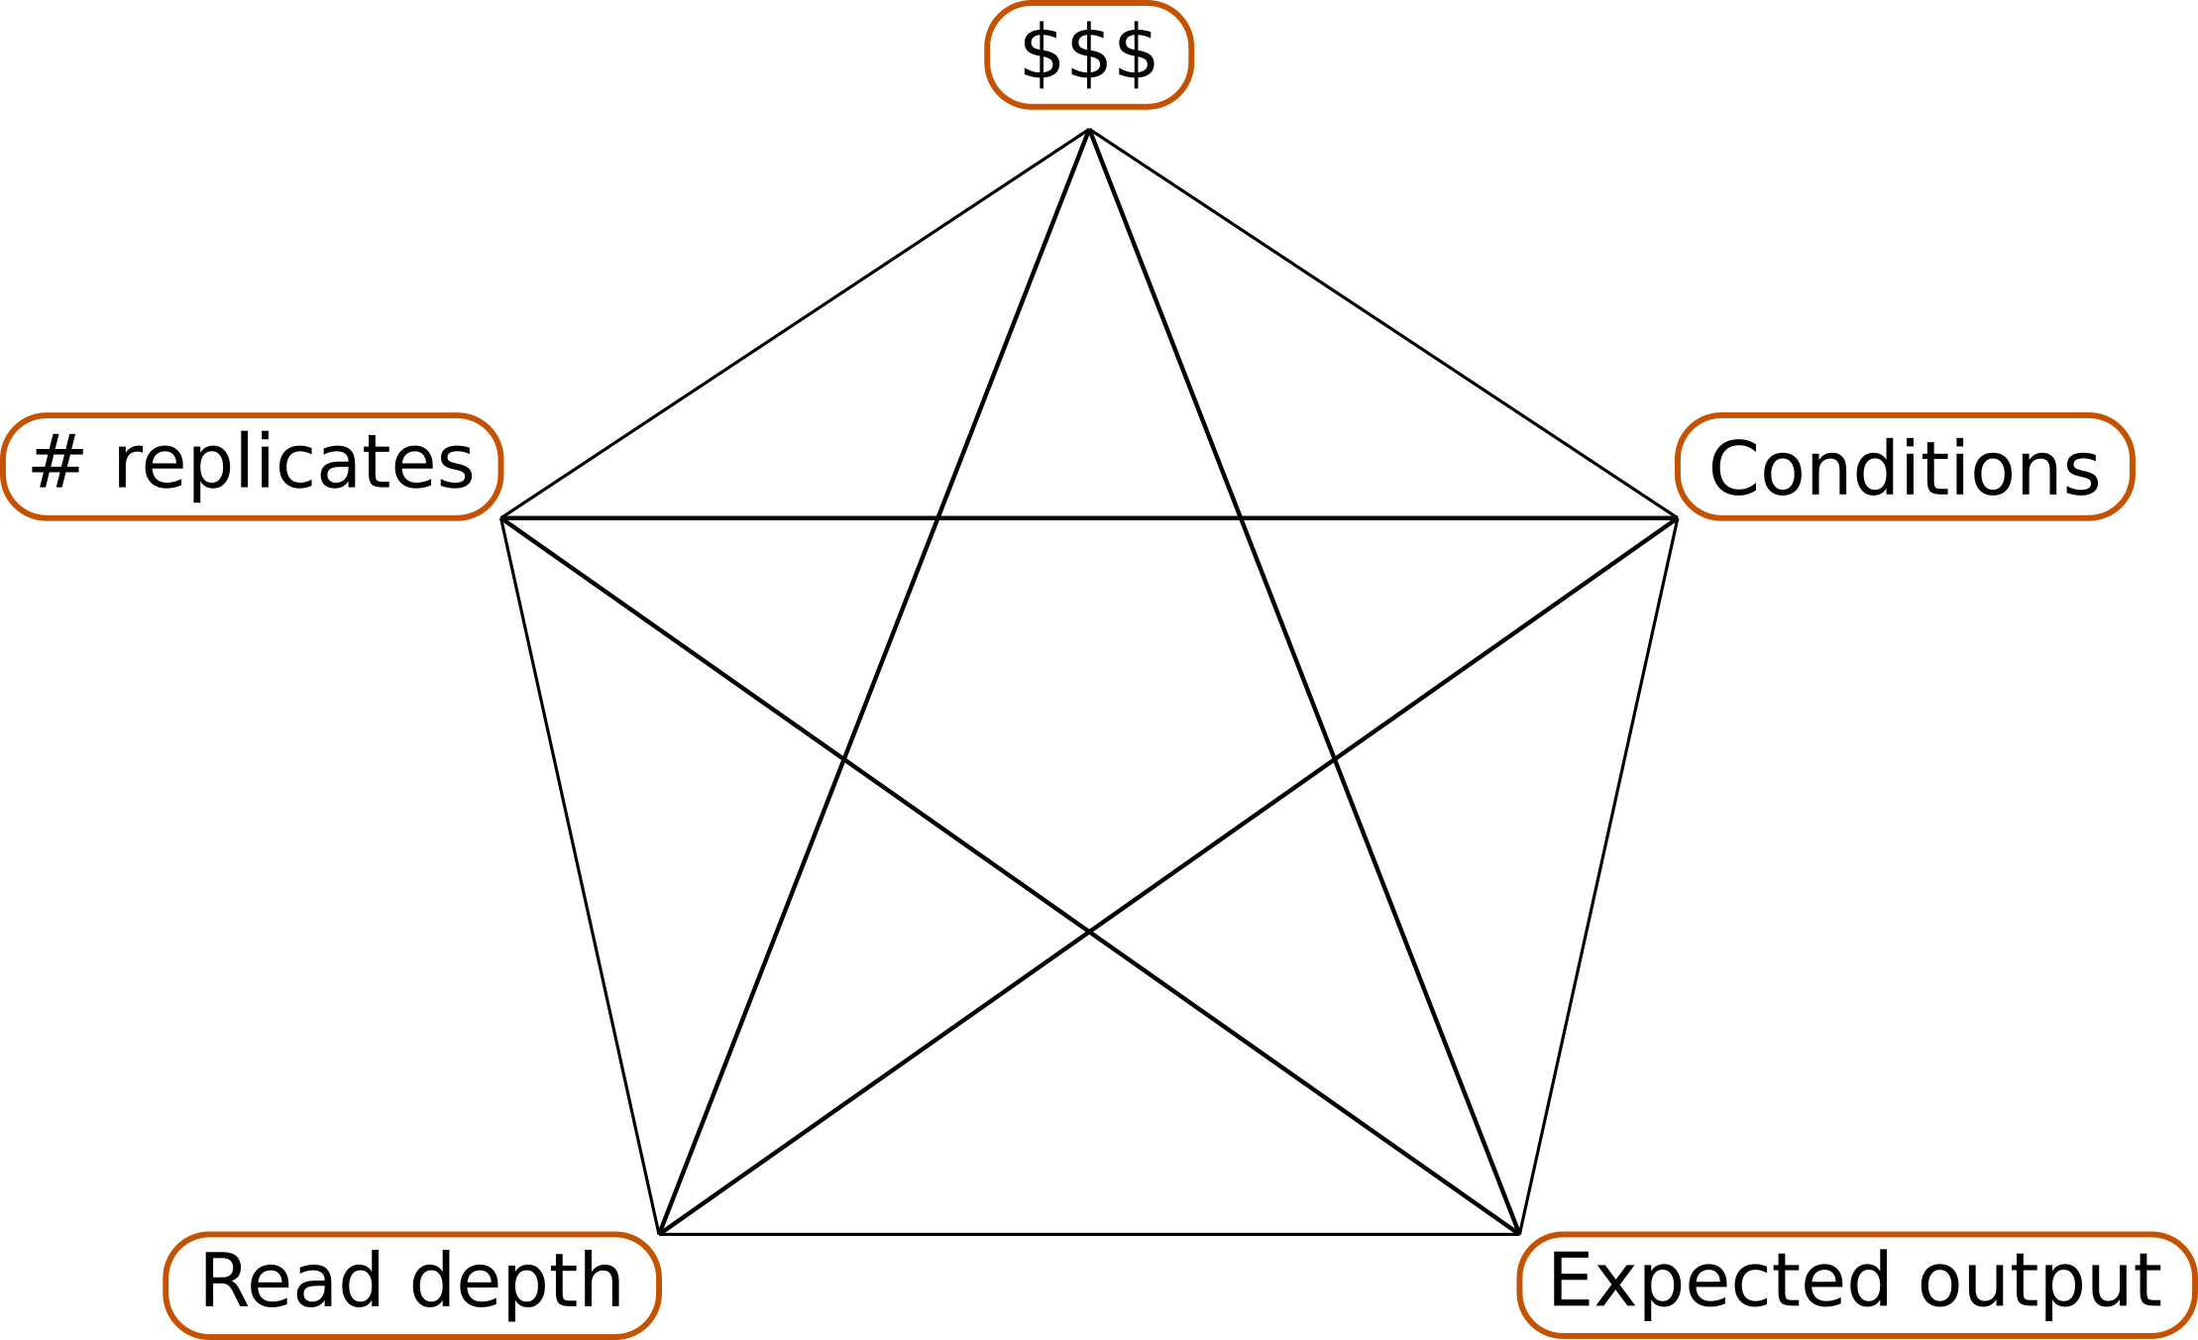
Designing a sequencing experiment

Slide 10
Basic Bash and Git/GitHub
On the website (https://biodatasci.colorado.edu/shortread/sr2023/) under Day 1, open and follow the worksheet named Git, GitHub, and basic Bash
You’ll interact with the sr2023 GitHub repository. We will use this repository throughout the class
This repo is at https://github.com/Dowell-Lab/sr2023
If you need help, flag us with a red sticky note
If you’ve cloned the repo and finished the worksheet, put up a green sticky note

Slide 11
Break (If you haven’t gotten onto the AWS, please log into Google Shell now)

Slide 12
Library QC

Slide 13
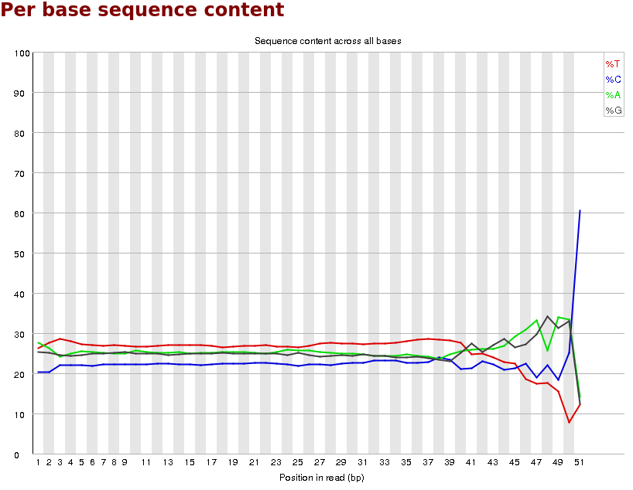
FastQC
Base diversity
Complexity

Slide 14
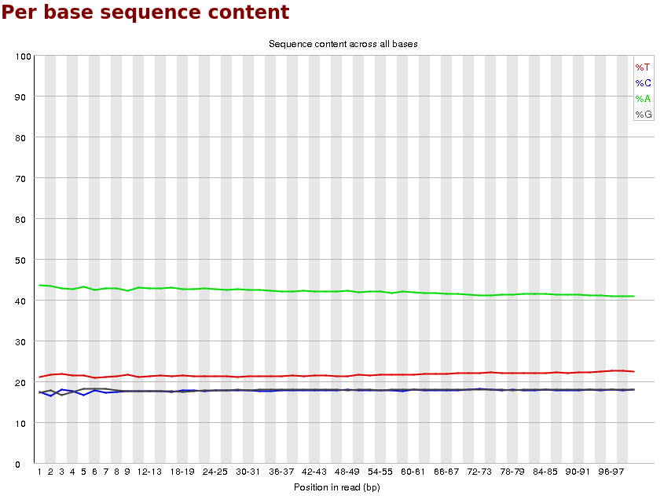
FastQC
Base diversity
Complexity

Slide 15
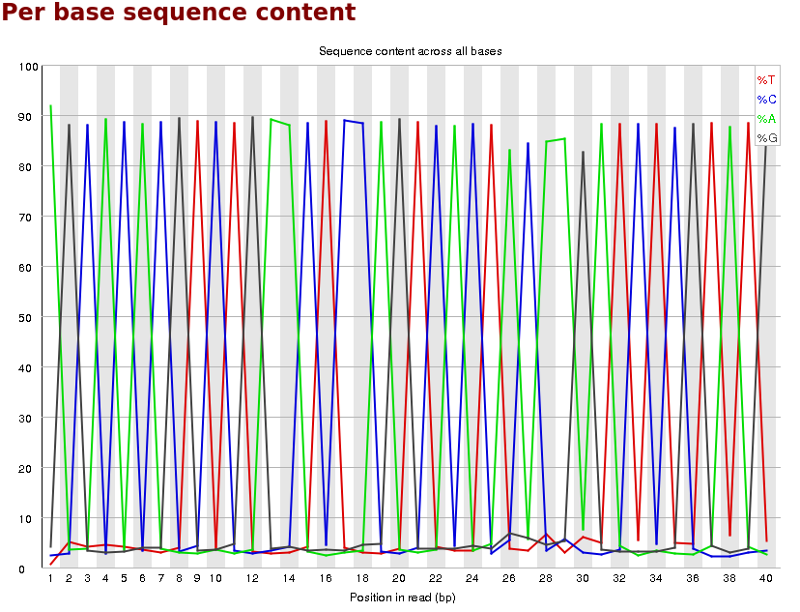
FastQC
Base diversity
Complexity

Slide 16
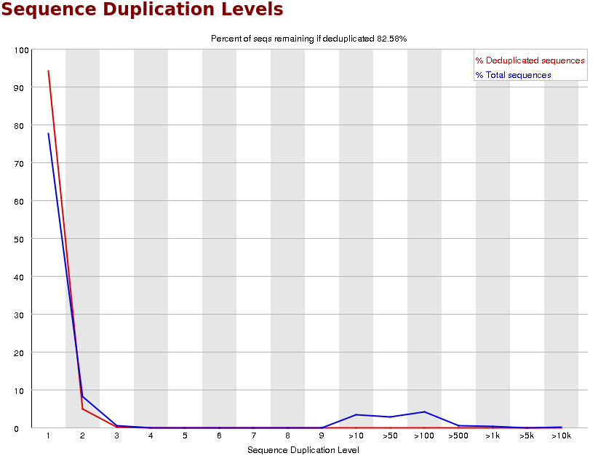
FastQC
Complexity
Duplication

Slide 17
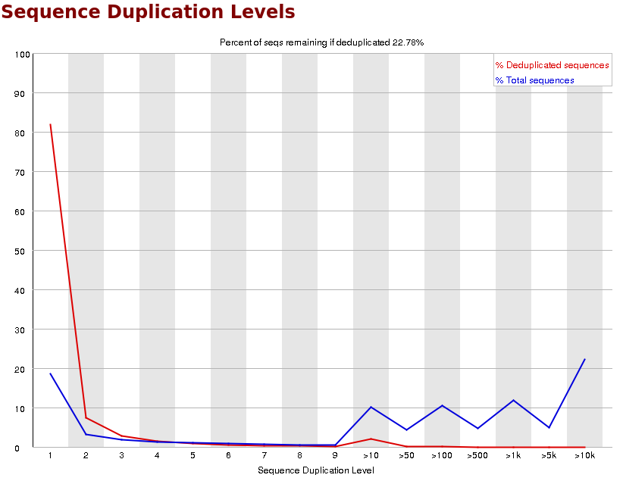
FastQC
Complexity
Duplication

Slide 18
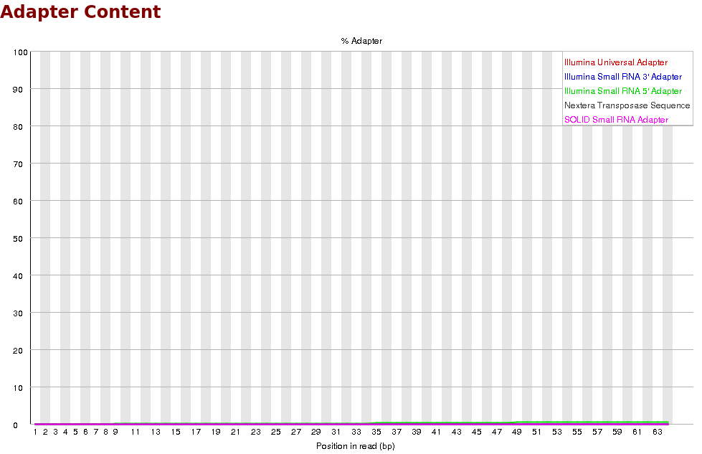
FastQC
Adapter Contamination

Slide 19
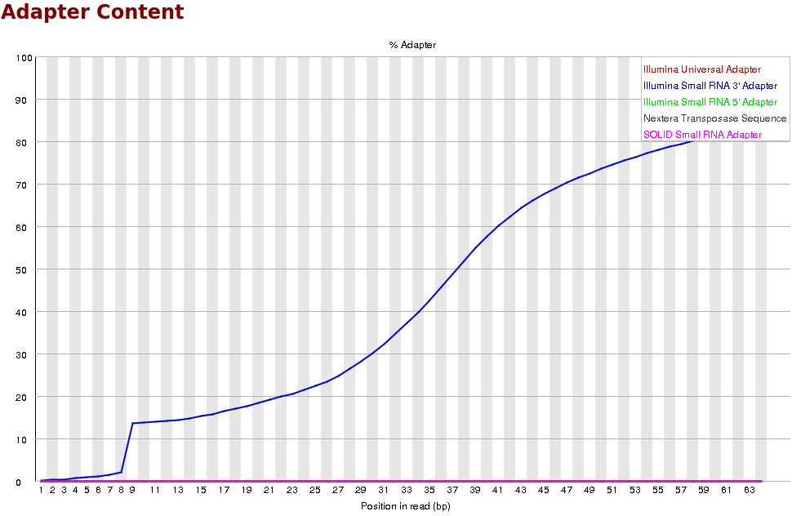
FastQC
Adapter Contamination

Slide 20

VIM and vimtutor
What is VIM?
Text editor – read, write and save text files
Entirely keyboard-based
You cannot use your mouse to move the cursor!
vimtutor is on every linux system and teaches you how to use vim – open it now

Slide 21
Variables in Bash (see worksheet)
On the website (https://biodatasci.colorado.edu/shortread/sr2023/) under Day 1 (or from the GitHub repo), open and follow the worksheet named Creating a variable in bash
If you need help, flag us with a red sticky note
If you’ve cloned the repo and finished the worksheet, put up a green sticky note

