Slide 1
Short Read Workshop Day 7
Counting Reads and Differential Expression
Rutendo Sigauke
2023

Slide 2

Day 7 Overview
M&Ms
featureCounts
DESeq2

Slide 3
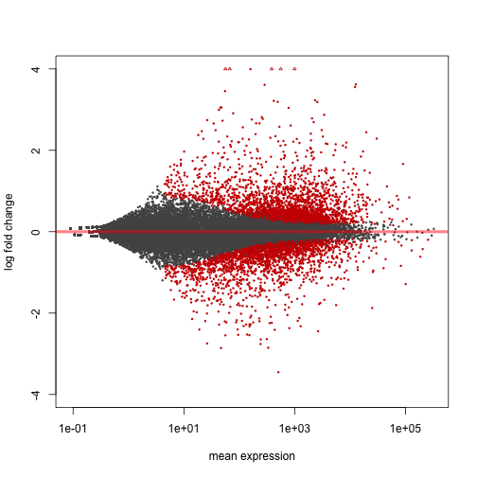
Goal of the Day
Find genes that are different between samples
Map reads to reference genome
Count reads
Perform differential gene expression analysis

Slide 4
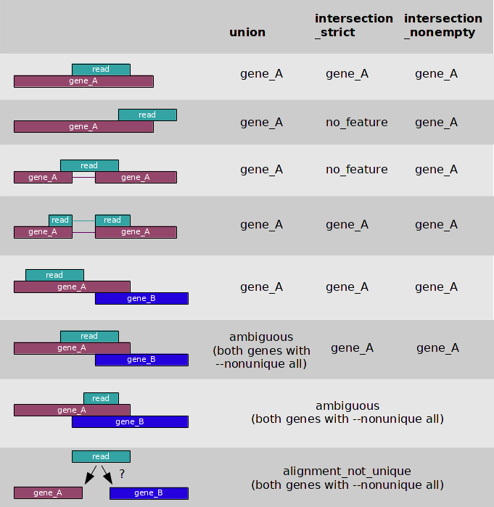
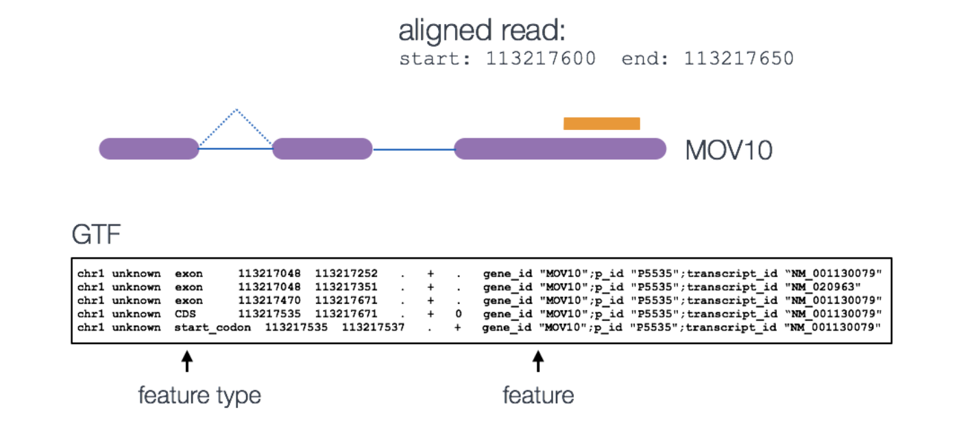
featureCounts counts reads over features in R
There are several options in featureCounts
fc <- featureCounts(files=bam_file_list,
annot.ext=gtf,
isGTFAnnotationFile=TRUE,
GTF.featureType="exon",
GTF.attrType="gene_id",
useMetaFeatures=TRUE,
allowMultiOverlap=TRUE,
largestOverlap=TRUE,
countMultiMappingReads=TRUE,
isPairedEnd=TRUE,
strandSpecific=1,
nthreads=N)
https://hbctraining.github.io/Intro-to-rnaseq-hpc-O2/lessons/05_counting_reads.html

Slide 5
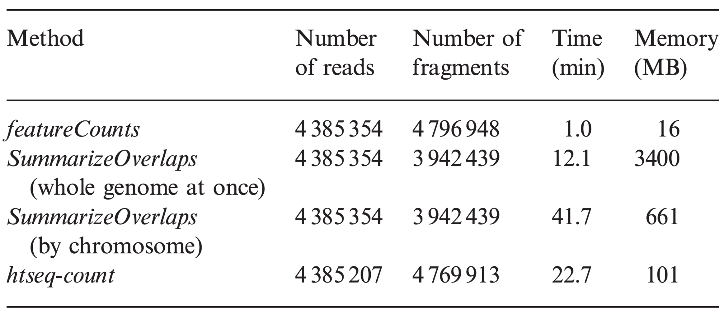
The are other tools for counting reads but featureCounts is more efficient
featureCounts is faster and more efficient.
Liao et al. Bioinformatics 2014 doi:10.1093/bioinformatics/btt656

Slide 6
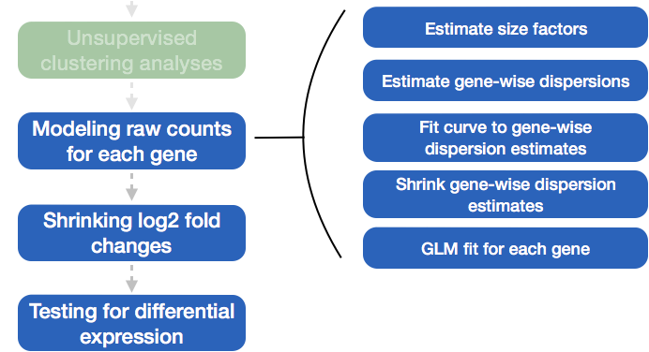
DESeq2 Recap
https://hbctraining.github.io/DGE_workshop_salmon/lessons/04_DGE_DESeq2_analysis.html

Slide 7
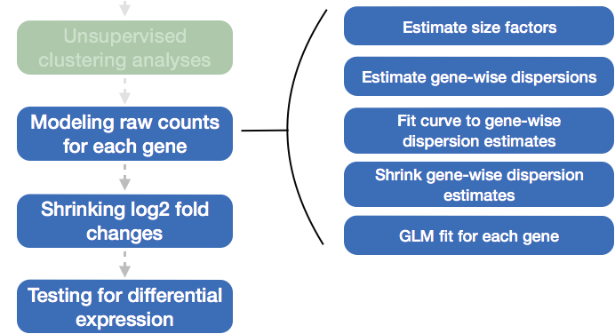
DESeq2 Recap
Assumption: MOST features are not changing
https://hbctraining.github.io/DGE_workshop_salmon/lessons/04_DGE_DESeq2_analysis.html

Slide 8
Counting reads with featureCounts
Follow featureCounts worksheet:
Open R and install Rsubread
Get d7_featureCounts.R and d7_featureCounts.sbatch scripts
Edit both scripts and execute the sbatch script

Slide 9
Challenge Question
What feature would you used to count reads for RNA-seq?
Gene
Exon
Transcripts

Slide 10
Challenge Question
What feature would you used to count reads for RNA-seq?
Gene
Exon
Transcript
✓

Slide 11
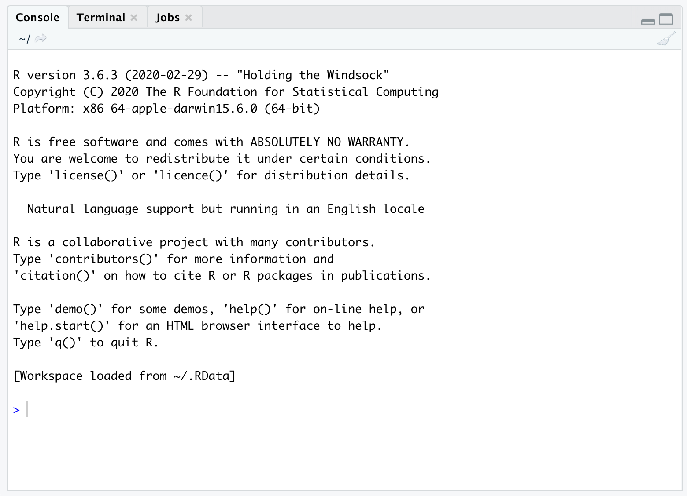
Run DESeq2…
Follow DESeq2 worksheet
This will be run in an R console in RStudio

Slide 12
Challenge Question
How would you run DESeq2 on the supercomputer?

Slide 13
Challenge Question
How would you run DESeq2 on the supercomputer?
Install DESeq2 in your R packages directory
Make a conditions table that matches your count table
Run the R script through an sbatch script

Slide 14
Homework
Explore DE genes with a heatmap
Run DESeq2 to explore differential expression with nicotine and caffeine treatments

