Slide 1
Day 9: ChIP-seq, MACS
and BEDTools
Instructors: Jessica Westfall and Lynn Sanford

Slide 2
Recap of the videos
ChIP-seq introduction
Evaluating ChIP-seq data
Peak calling with MACS
MEME Suite introduction
BEDTools introduction
ATAC-seq overview

Slide 3
Learning Objectives
Downstream analysis of ChIP-seq and ATAC-seq data
Demonstrate the use of a peak calling program MACS2 to identify genomic regions with robust signal in each of these data types
control/input
ENCODE Blacklist
Visualize the raw data and corresponding called peaks
Downstream analyses
Comparing peaks to other features (e.g genes) : using BEDTools
Motif discovery (MEME)

Slide 4
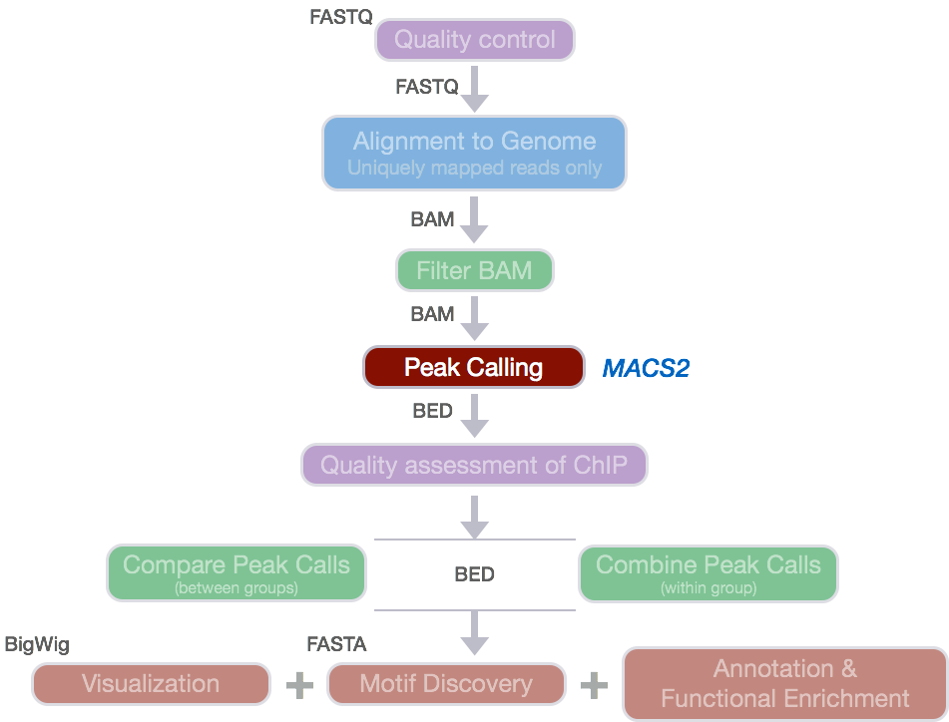
Peak calling pipeline
Step 1: fastQC for quality control
Step 2: HISAT2 to map reads
Step 3: Quality control via Preseq and MultiQC
Step 4: Peak calling via MACS2
Step 5 and beyond: Downstream analysis using tools such as BEDTools, MEME,
https://hbctraining.github.io/Intro-to-ChIPseq/lessons/05_peak_calling_macs.html

Slide 5
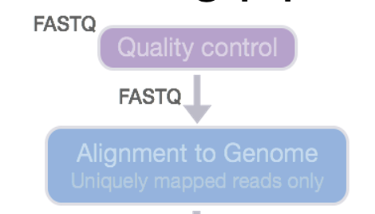

fastq > alignment > SAM/BAM conversion
Step 1: fastQC for quality control
Step 2: HISAT2 to map reads
**note that splicing is not relevant for mapping these DNA based methods
Step 3: Quality control via Preseq and MultiQC
multiQC will look through the files and directories that contain compatible results/reports

Slide 6
Quality control
fastQC
HISAT report
Preseq
Sequence reads quality
base sequence quality
GC content
sequence length and duplication
overrepresented sequences
Alignment rate of reads
Estimating complexity of sequencing library
Notes:
The preseq package is aimed at predicting and estimating the complexity of a genomic sequencing library, equivalent to predicting and estimating the number of redundant reads from a given sequencing depth and how many will be expected from additional sequencing using an initial sequencing experiment. The estimates can then be used to examine the utility of further sequencing, optimize the sequencing depth, or to screen multiple libraries to avoid low complexity samples.

Slide 7
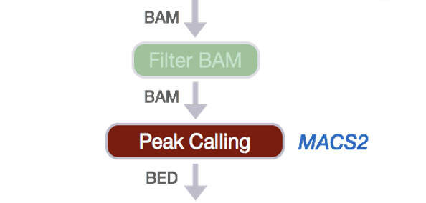
Peak calling
Step 4: Peak calling via MACS2
Notes:
Documents/5Categories_Trrific_genomeDist_April
chr11:47,737,497-47,871,428 (HG19)

Slide 8
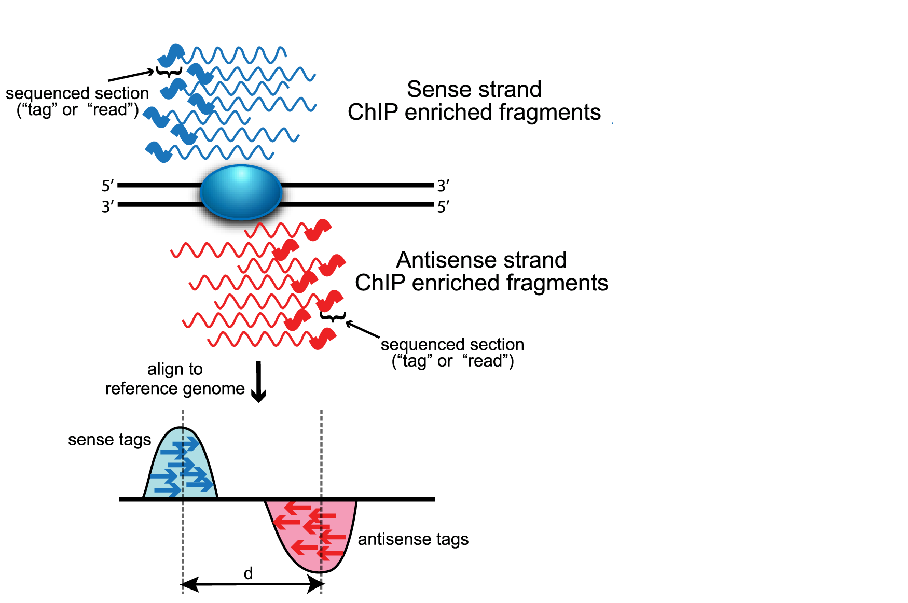
ChIP-seq peak calling for enrichment
ChIP-seq identifies two type of enrichment
Broad peaks: eg., histone modification. Here we are looking for broad peaks that cover entire gene bodies
Narrow peak: eg., transcription factor binding. Here we are looking for regions of higher amplitude compared to background
Image source: Wilbanks and Faccioti, PLoS One 2010

Slide 9
Peak calling
Step 4: Peak calling via MACS2
MACS2 Broad calls
MACS2 Narrow calls
FStitch
Notes:
Documents/5Categories_Trrific_genomeDist_April
chr11:47,737,497-47,871,428 (HG19)

Slide 10
MACS genomic input/control
Controls are important!
ChIP-seq and ATAC-seq are protocols that produce background noise as well as meaningful signal
Therefore, you need controls to not call background noise as peaks
p/q value cutoffs matter and should vary based on your experiment
Know your data type: your experiment should inform the parameters of the peak caller
Blacklist regions: some genomic regions almost always show up in these protocols so remove these regions using a Blacklist
Notes:
MACS uses multiple Poisson distributions to model the local background noise within each region from the input data
One parameter models for estimating the expected number of reads in the window

Slide 11
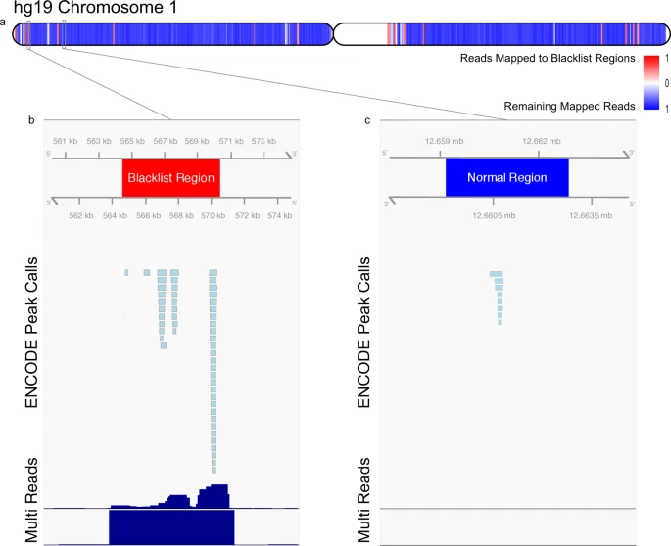
Blacklist regions should be removed
These regions contain repetitive regions across the genome and almost always are enriched in ChIP-seq data.
https://www.nature.com/articles/s41598-019-45839-z

Slide 12
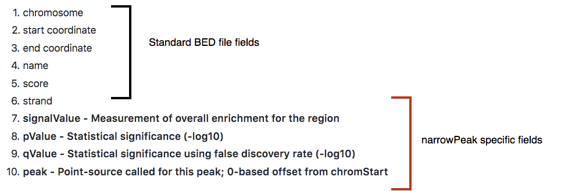
MACS output
Image: https://hbctraining.github.io/Intro-to-ChIPseq/lessons/05_peak_calling_macs.html

Slide 13
Annotation files
Files of chromosomal coordinates
Chromosome Start coordinate End coordinate More metadata
chr1 20000000 20005000 …
chr5 4050000 4100000 …
Many different file formats
BED, GTF, bedGraph, SAF, VCF, etc.
Each of these is just a text file with standardized columns
Coordinates can be 0- or 1-indexed, closed or open or half-open, depending on format
File format best friend: https://genome.ucsc.edu/FAQ/FAQformat.html

Slide 14
Bedtools
Made to manipulate BED files – very useful file format
Usually fairly small
Can easily add columns if you need them
Many different commands in one package
https://bedtools.readthedocs.io/en/latest/content/bedtools-suite.html
Some are more complicated, but many of the common commands are basic math/logic/set operations oriented toward genomic data
After you manipulate annotation files, look at them by eye!

Slide 15
Additional Resources
Other Peak Callers:
Fstitch: https://github.com/Dowell-Lab/FStitch
SICER: https://zanglab.github.io/SICER2/
PeakSeq: https://www.nature.com/articles/nbt.1518
Hpeak: https://bmcbioinformatics.biomedcentral.com/articles/10.1186/1471-2105-11-369
PeakRanger: https://bmcbioinformatics.biomedcentral.com/articles/10.1186/1471-2105-12-139
BEDTools Documentation https://bedtools.readthedocs.io/en/latest/
BEDTools tutorial: http://quinlanlab.org/tutorials/bedtools/bedtools.html

