Slide 1
Introduction to R and RStudio
Short Read Workshop
Day 6

Slide 2
Recap of Day 6 Video
Introduction to R and RStudio
Overview of R
Loading data into R
Filtering data frames in R
Based on a column value and IDs
Brief installation instructions
Data visualization and plotting with ggplot2 (in R)
Syntax introduction
Example scatter plot for differential expression data (MA plot)

Slide 3


Day 6 Overview
Running R in the terminal
Running R in RStudio
Submitting R script as an sbatch job

Slide 4
Goal of the day
Learn how to run R code!
Practice installing packages, tidying data, plotting and saving files.

Slide 5

What is R?
R is a free statistical computing and graphing software
Can be installed from their website https://www.r-project.org/
R can be run in a few environments:
RStudio
Jupyter

Slide 6
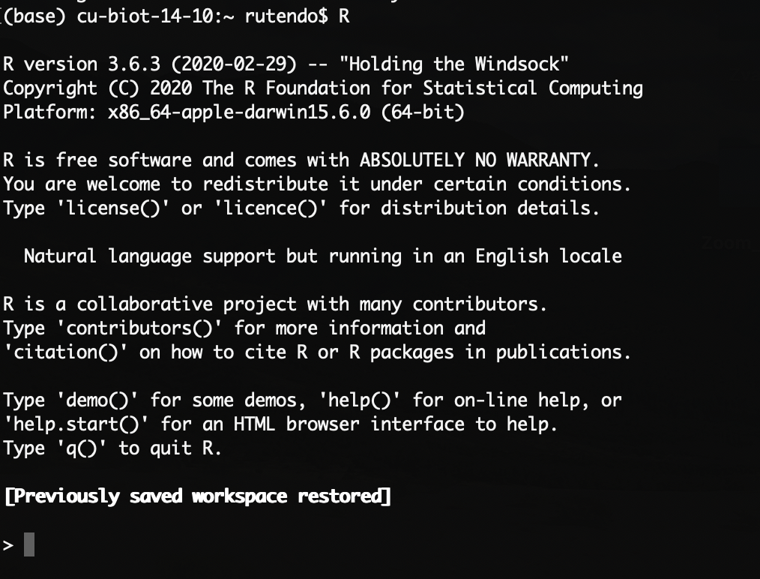
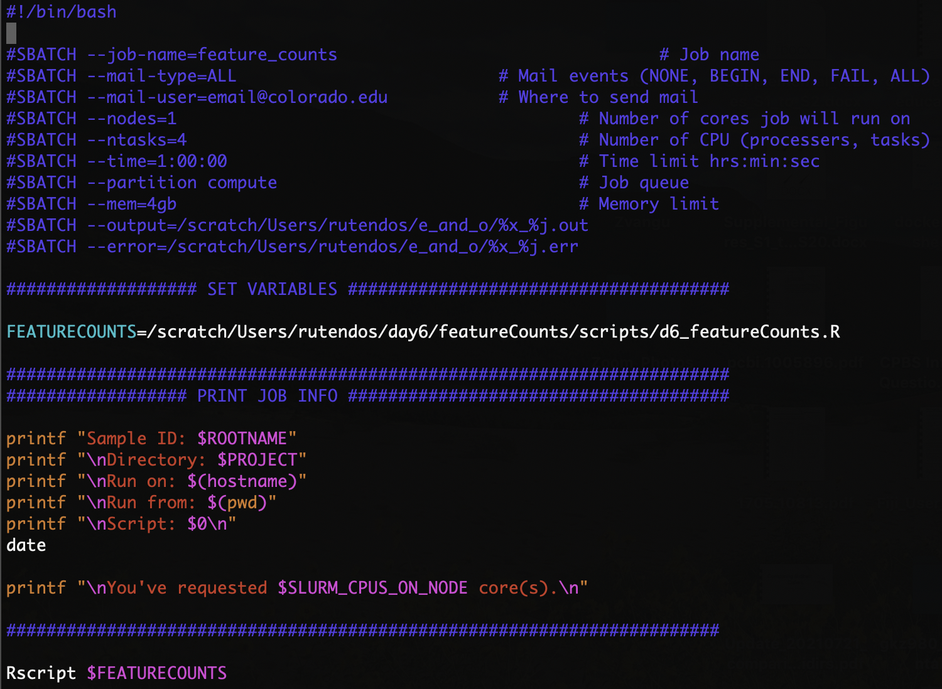
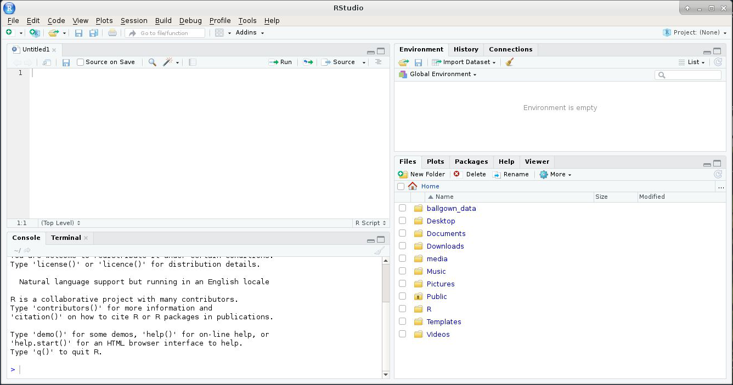
There are different ways to interact with R
R console
R Studio
Submit an R script as a job
Enter R code here
Enter R code and visualize plots
Run R script here
Interactive
More interactive
Least interactive
For more compute intensive scripts

Slide 7
Summary of RStudio
R scripts, R markdown, R notebooks
Summary of all the data loaded in Rstudio
R console, Terminal
Directories, Plots, Packages...

Slide 8
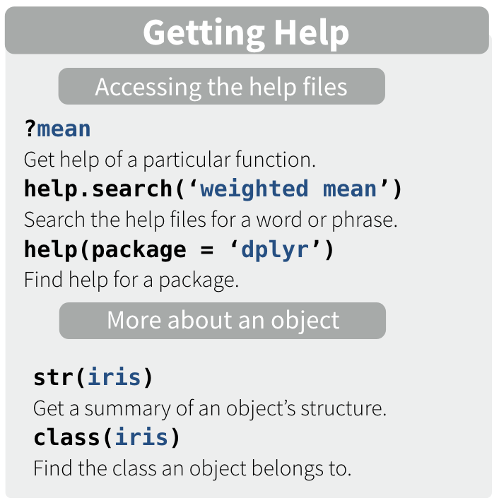
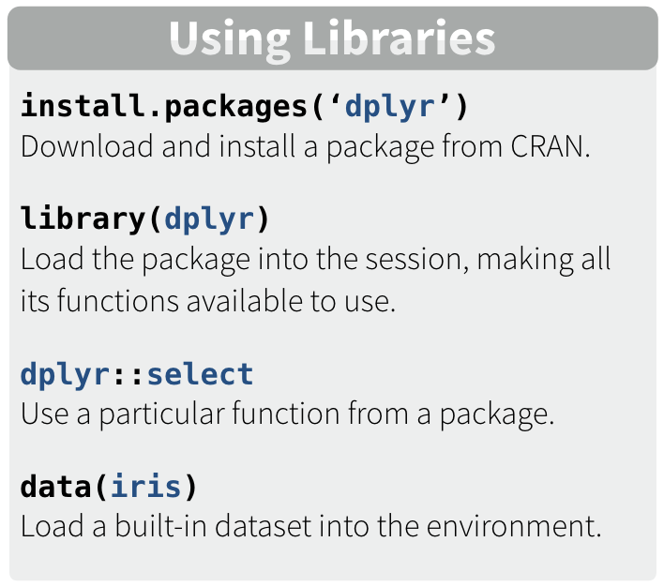
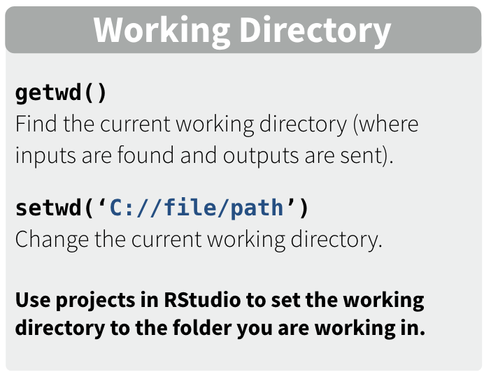
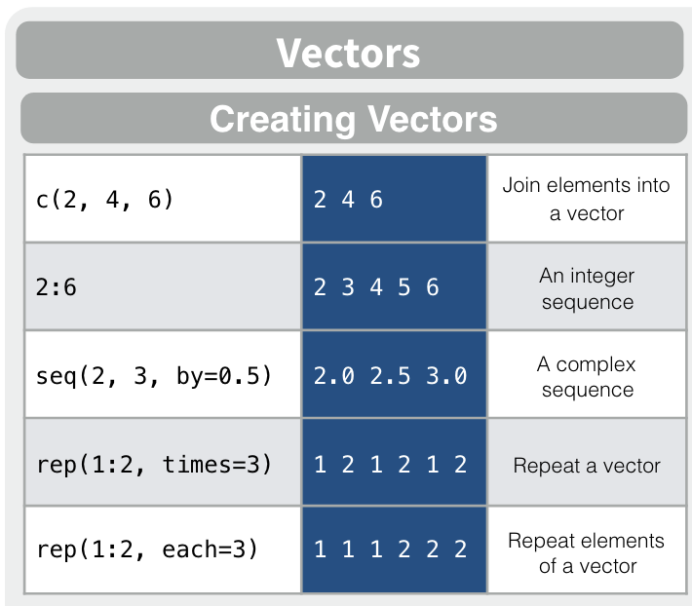
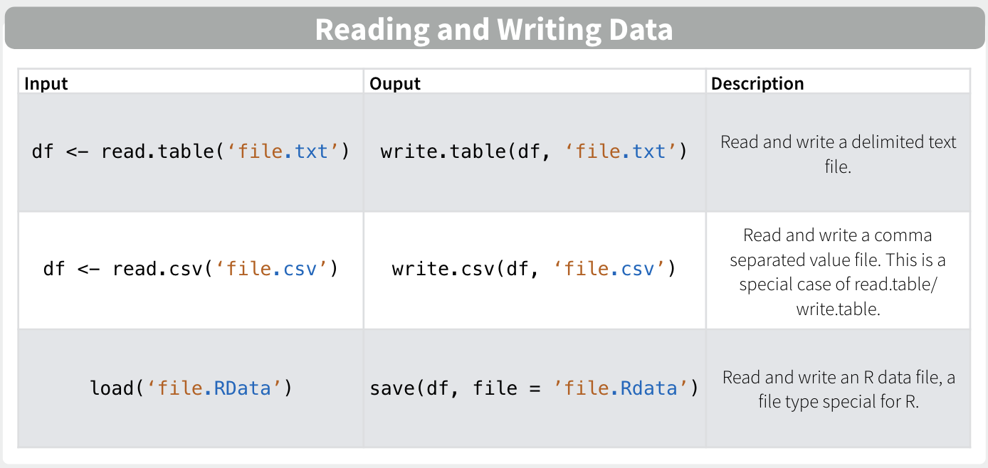
Brief introduction to R syntax
https://iqss.github.io/dss-workshops/R/Rintro/base-r-cheat-sheet.pdf

Slide 9
Installation demo
In an R console, we will install dadjokeapi!
# First, we will load R
module load R/4.3.1
# In the terminal, we launch R console
$ R
# Now we can install the Dad Joke API package from CRAN
install.packages("dadjokeapi")
# This is a basic prompt to get a joke :)
dadjokeapi::groan()
https://github.com/jhollist/dadjokeapi

Slide 10
R you ready to learn some R?
Let’s go over the Day6_worksheet1_Introduction_to_R.md worksheet:
Introduction to R in the terminal
Learn basic R commands
R console

Slide 11
Learning R in RStudio
In Day6_worksheet2_R_in_Rstudio.md (Section A):
We will go over the Learning_R.R worksheet in R Studio:
Introduction to R and R Markdown
Introduction to the iris dataset
Installing and loading libraries
tidyverse
Generating summary statistic in R
Making plots with ggplot2
Manipulating data.frames
R Studio

Slide 12
Challenge Question
How would you perform a computationally intensive R job?
i.e. Requires more memory than on your personal computer.

Slide 13
Writing an R script to submit on a supercomputer
Follow Day6_worksheet2_R_in_Rstudio.md (Section B):
Edit Learning_R_submit_aws.R
Save plots and tables to a working directory in the script
Run the R script as a job on AWS
Use the RScript command to call your script

Slide 14
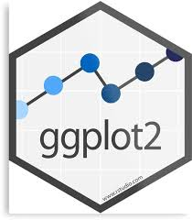


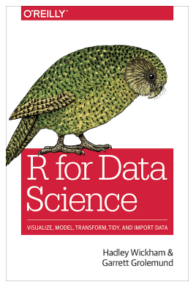
More resources for R
ggplot2 website https://ggplot2.tidyverse.org/
R-bloggers https://www.r-bloggers.com/
Quick-R https://www.statmethods.net/
R for Data Science (by Hadley Wickham & Garrett Grolemund) http://r4ds.had.co.nz/

Slide 15
Homework
1. Complete the Learning_R_Additional_Practice.R
This homework will go over most of the topics covered today, but on a different dataset. There will be more advanced questions that build on what was in the inclass session.
2. For Project B (multi-omics)
Install rsubread
Install this in R on AWS.
install DESeq2
Install this on your local machine.
This takes a long time, so get this installed before Day7.

