Slide 1
Day 1 overview
SSH keys and logging into the AWS
Basic Bash/Intro to Git
Vim and Vimtutor
Review library prep and sequencing (non-DS2)

Slide 2
Logging into the supercomputer
Open and follow the worksheet SSH_AWS
(https://github.com/Dowell-Lab/srworkshop/tree/main/day01/worksheets/SSH_AWS.md)
You MUST
Be logged into your GitHub account
Have a terminal application open (see worksheet for details)
After finishing the worksheet, try to log into the AWS:
ssh <github_username>@3.20.14.225
**replace <github_username>, including brackets, with your username
If you need help, flag us with a red sticky note
If you are successfully logged in, put up a green sticky note

Slide 3
Basic Bash and Git/GitHub
Open and follow the worksheet Git_github_bash
(https://github.com/Dowell-Lab/srworkshop/tree/main/day01/worksheets/Git_github_bash.md)
This worksheet orients you to the class GitHub repository and gets you started with some basic Bash navigation
Main commands: pwd Print working (current) directory
cd Change directory
ls List contents
If you need help, flag us with a red sticky note
If you are done, put up a green sticky note

Slide 4
Break
If you do not have a working terminal,
please log into Google Shell now
(…/srworkshop/day01/worksheets/Google_shell.md)

Slide 5
Vim and Vimtutor
What is Vim?
Text editor – read, write, and save text files
Entirely keyboard-based
You CANNOT use your mouse to move the cursor!!!
Vimtutor is on every Unix/Linux system and teaches you how to use Vim
Open and follow the worksheet Vimtutor_crashes_colors
(…/srworkshop/day01/worksheets/Vimtutor_crashes_colors.md)
If you need help, flag us with a red sticky note
If you are done, put up a green sticky note

Slide 6
Day 1 overview
SSH keys and logging into the AWS
Basic Bash/Intro to Git
Vim and Vimtutor
Review library prep and sequencing (non-DS2)

Slide 7
Homework for day 2
Videos for day 1 (if not already done)
Videos for day 2
Vimtutor
Lessons 1 and 2
Advanced students should do lessons 3-5
Day1_homework (library QC challenge)

Slide 8
Short Read Workshop Week 2
Day 6: Introduction to R
Beginning of Day 7: Differential Expression Demo
Days 7-9: Mini-projects
Project A (Room A104) – Single Cell RNA-seq
Project B (Room A108) – Multi-omics: RNA-seq/ChIP-seq(/ATAC-seq)
End of Day 9: Reconvene and discuss
Day 10: Potpourri

Slide 9
Library prep and sequencing

Slide 10
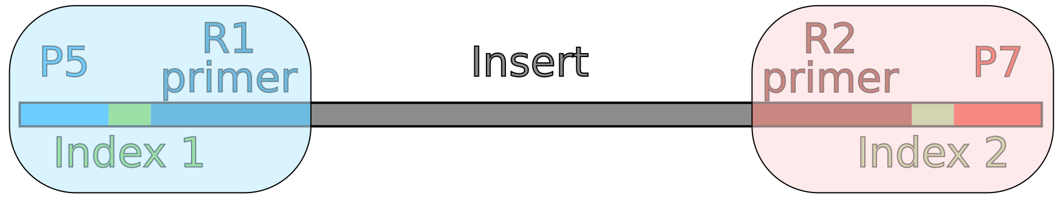
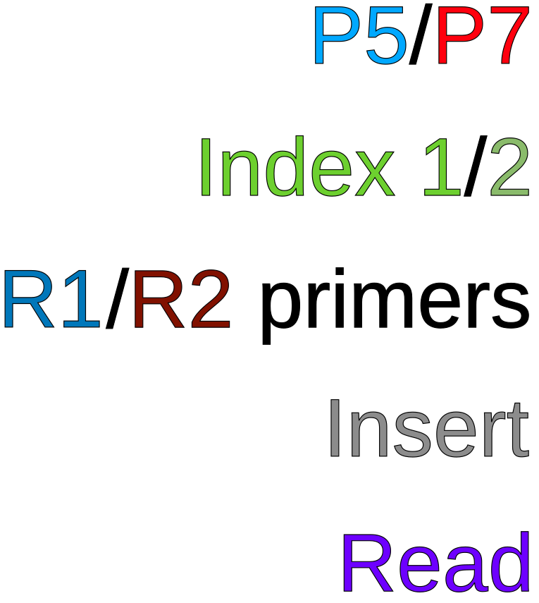
Anatomy of a library
Adapter 1
Adapter 2
Ends that attach to flow cell
ID sequences for multiplexing samples
Sequencing primers
Fragment of sample DNA/cDNA
Sequenced portion of fragment

Slide 11
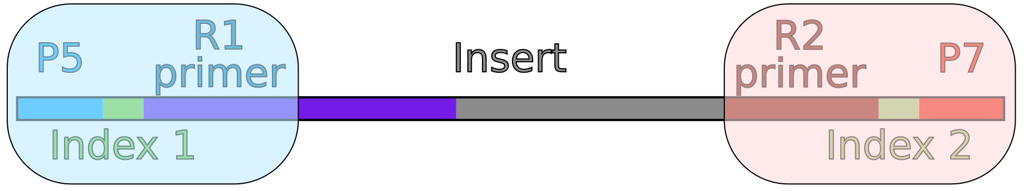
Anatomy of a library
Adapter 1
Adapter 2
Ends that attach to flow cell
ID sequences for multiplexing samples
Sequencing primers
Fragment of sample DNA/cDNA
Sequenced portion of fragment

Slide 12
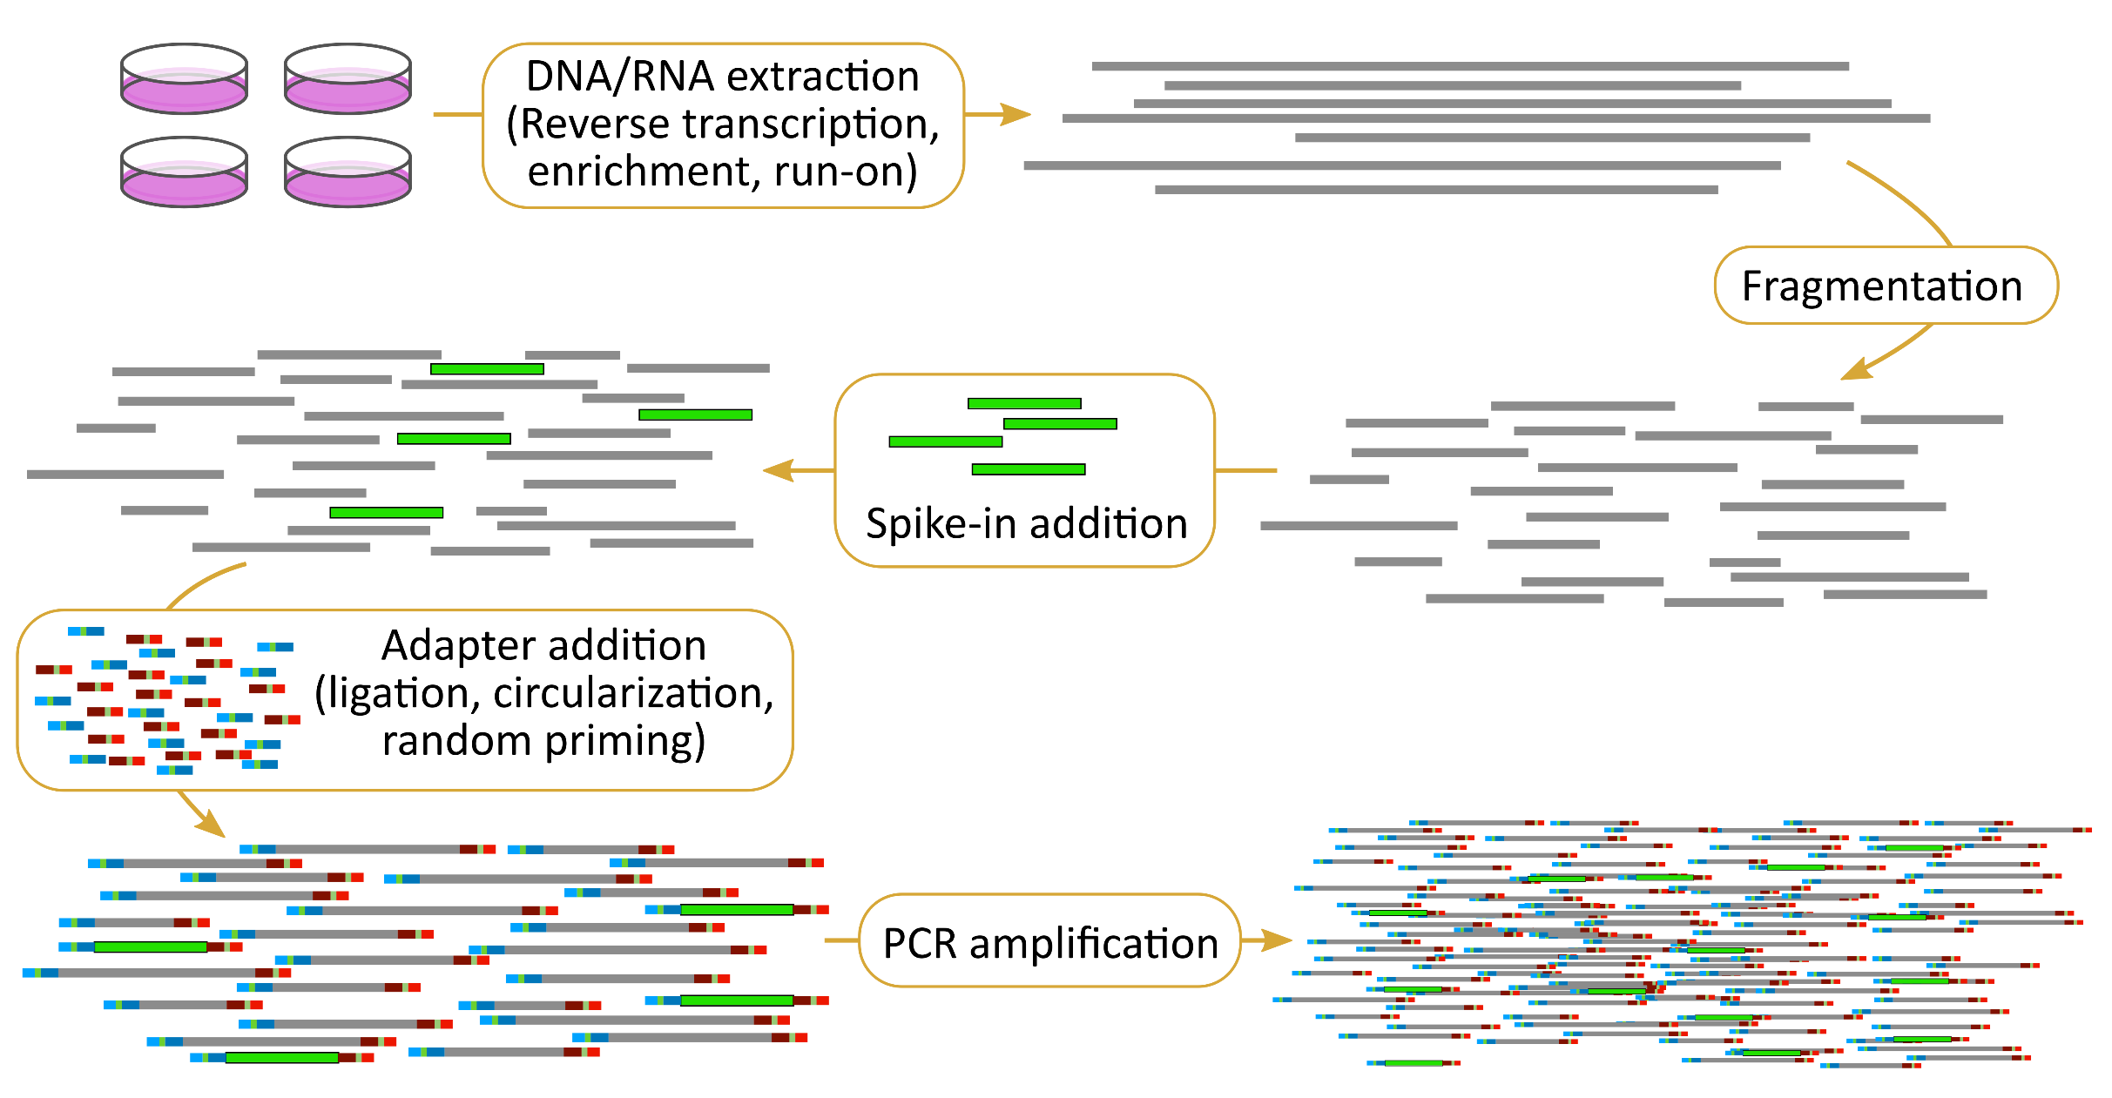
Creating libraries

Slide 13
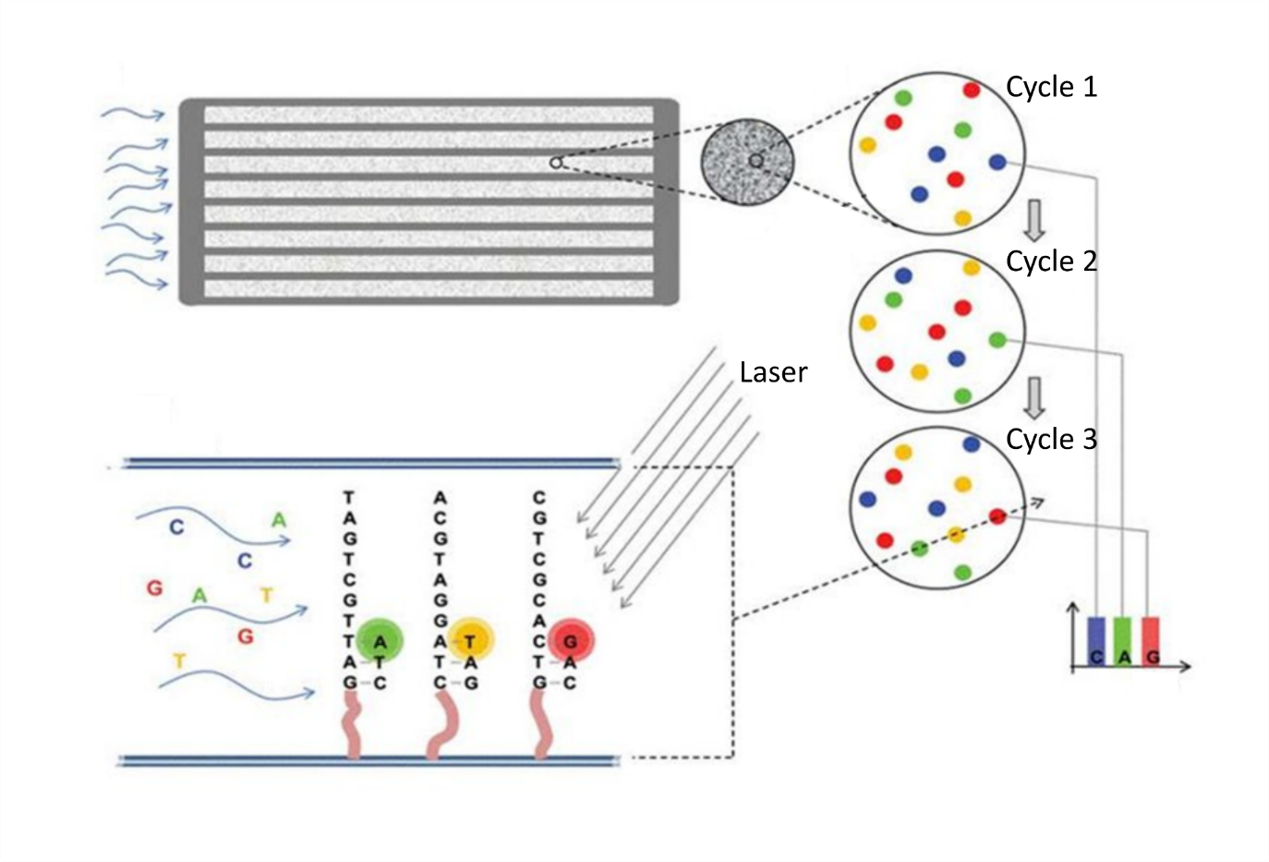
Illumina sequencing technology
Imaging a slide (flow cell) with millions/billions of DNA clusters
by cycling in fluorescent nucleotides
Sequencing:
http://tucf-genomics.tufts.edu/home/ordering

Slide 14
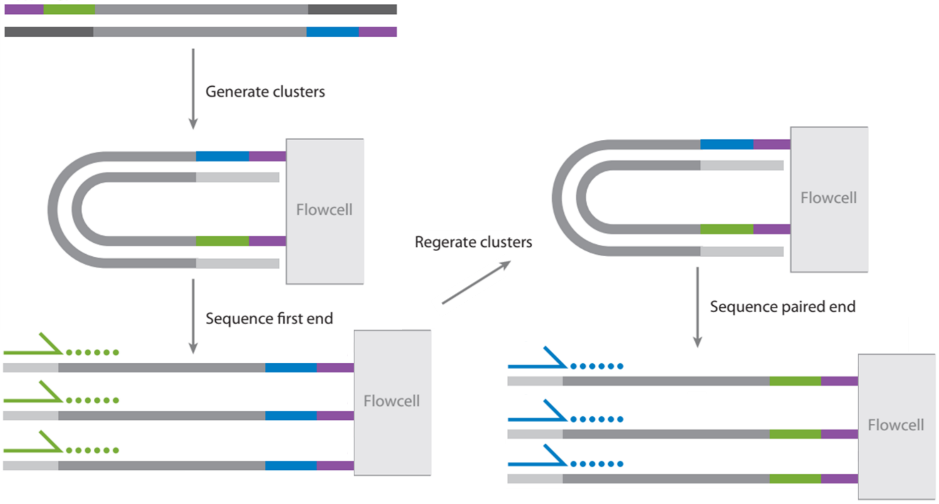
Single/paired end sequencing
Mardis. https://doi.org/10.1146/annurev-anchem-062012-092628

Slide 15
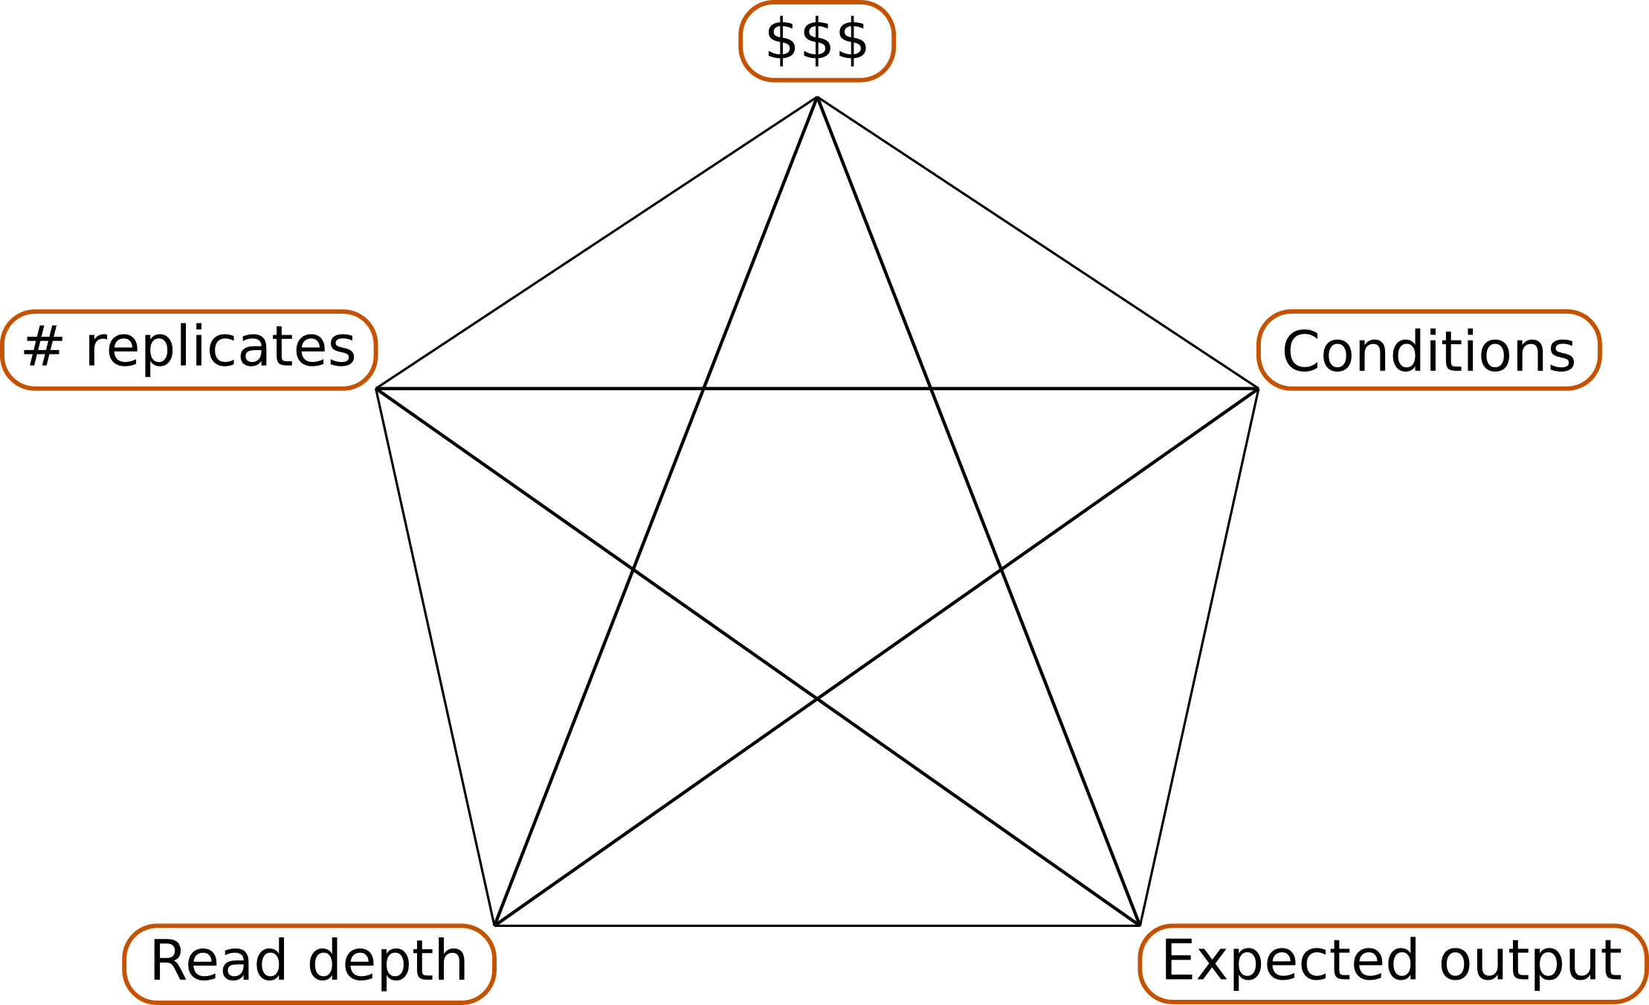
Designing a sequencing experiment

Slide 16
Library QC

Slide 17
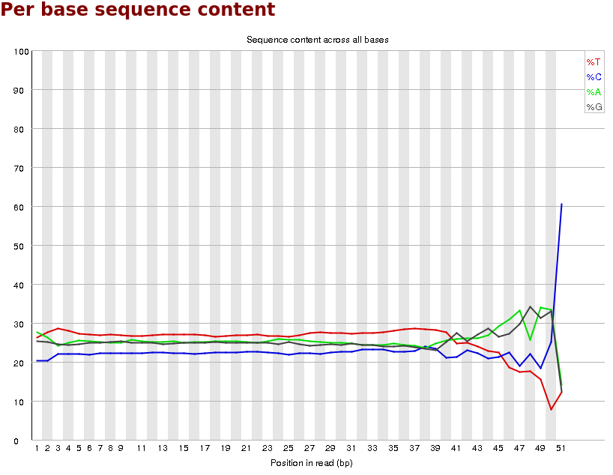
FastQC
Base diversity
Complexity

Slide 18
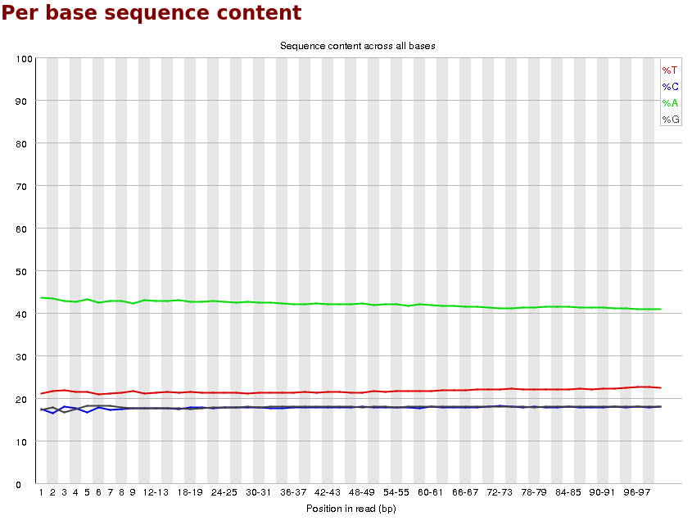
FastQC
Base diversity
Complexity

Slide 19
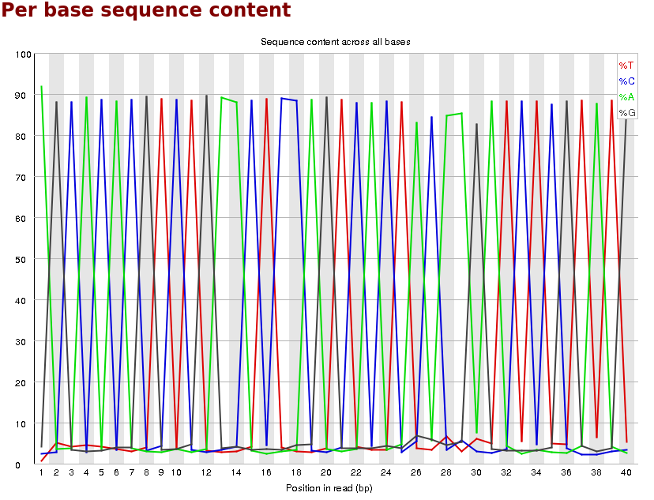
FastQC
Base diversity
Complexity

Slide 20
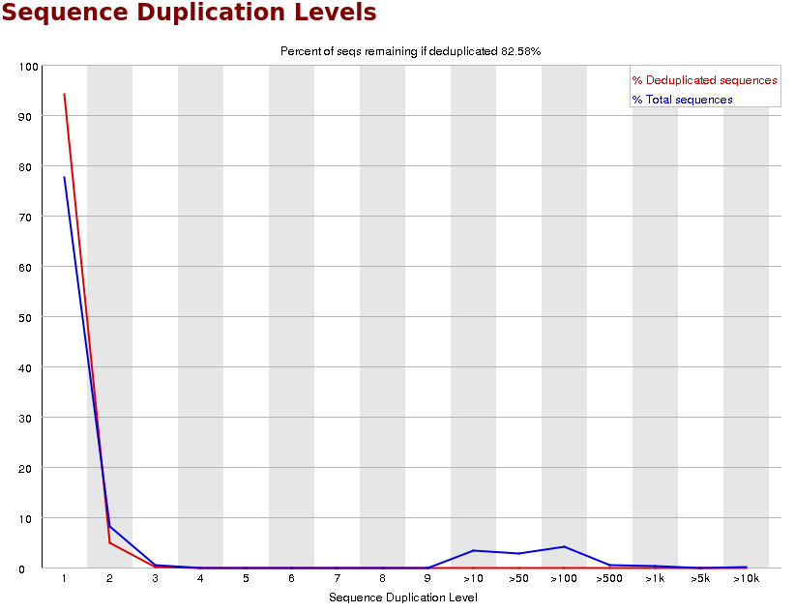
FastQC
Complexity
Duplication

Slide 21
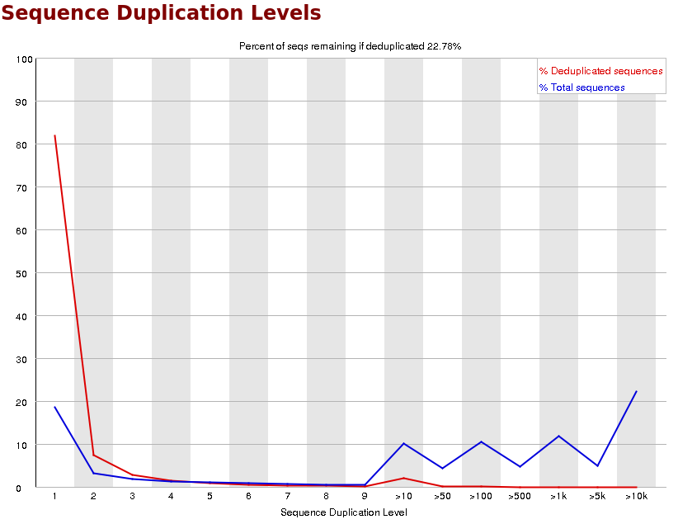
FastQC
Complexity
Duplication

Slide 22
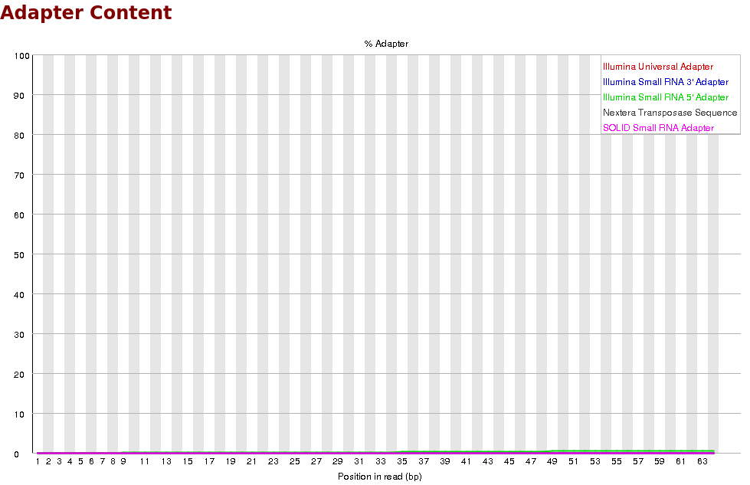
FastQC
Adapter Contamination

Slide 23
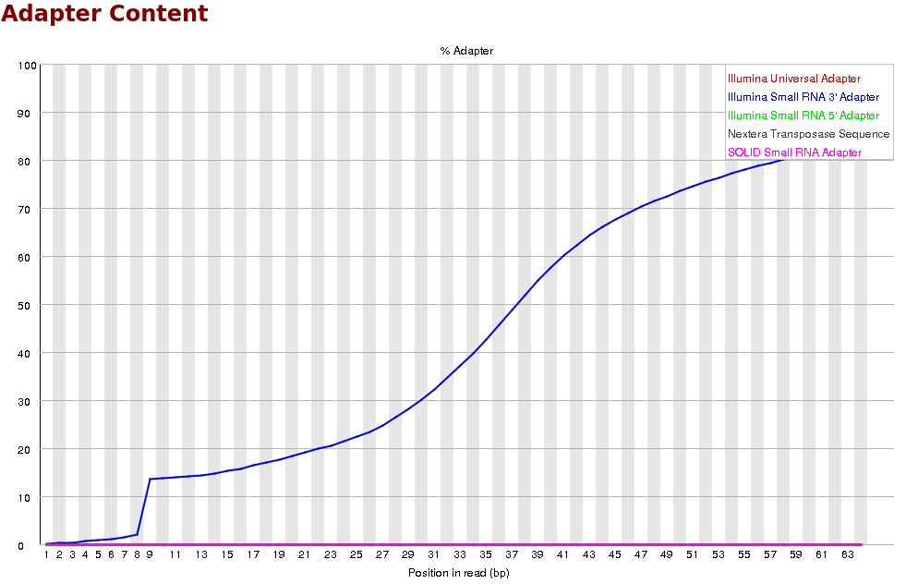
FastQC
Adapter Contamination

