Slide 1
Day 3 overview
Making scripts
Understanding compute clusters
Using Slurm with SBATCH scripts
Troubleshooting SBATCH scripts
Transferring and downloading files

Slide 2
Make a script
In a terminal on your local machine:
Open a new file called test_script.sh
Add the following four lines:
#!/bin/bash
pwd
sleep 3
echo “This is a test script”
Save and exit, then run the script with:
sh test_script.sh

Slide 3
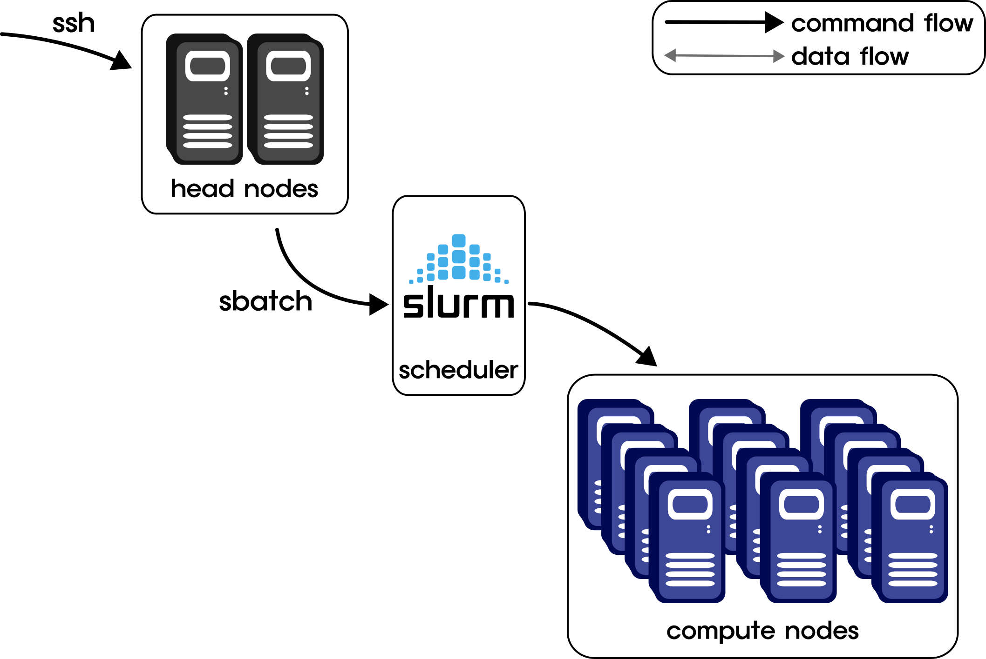

Compute cluster architecture

Slide 4
Compute cluster architecture
Head nodes
Very limited resources
Only intended for basic interfacing/commands
Compute nodes
Extensive resources
Take job scripts (lists of commands)
Require a scheduler to manage resources

Slide 5
Compute cluster architecture
Slurm (scheduler)
Manages resources to execute jobs
Executes jobs as resources become available

Slide 6
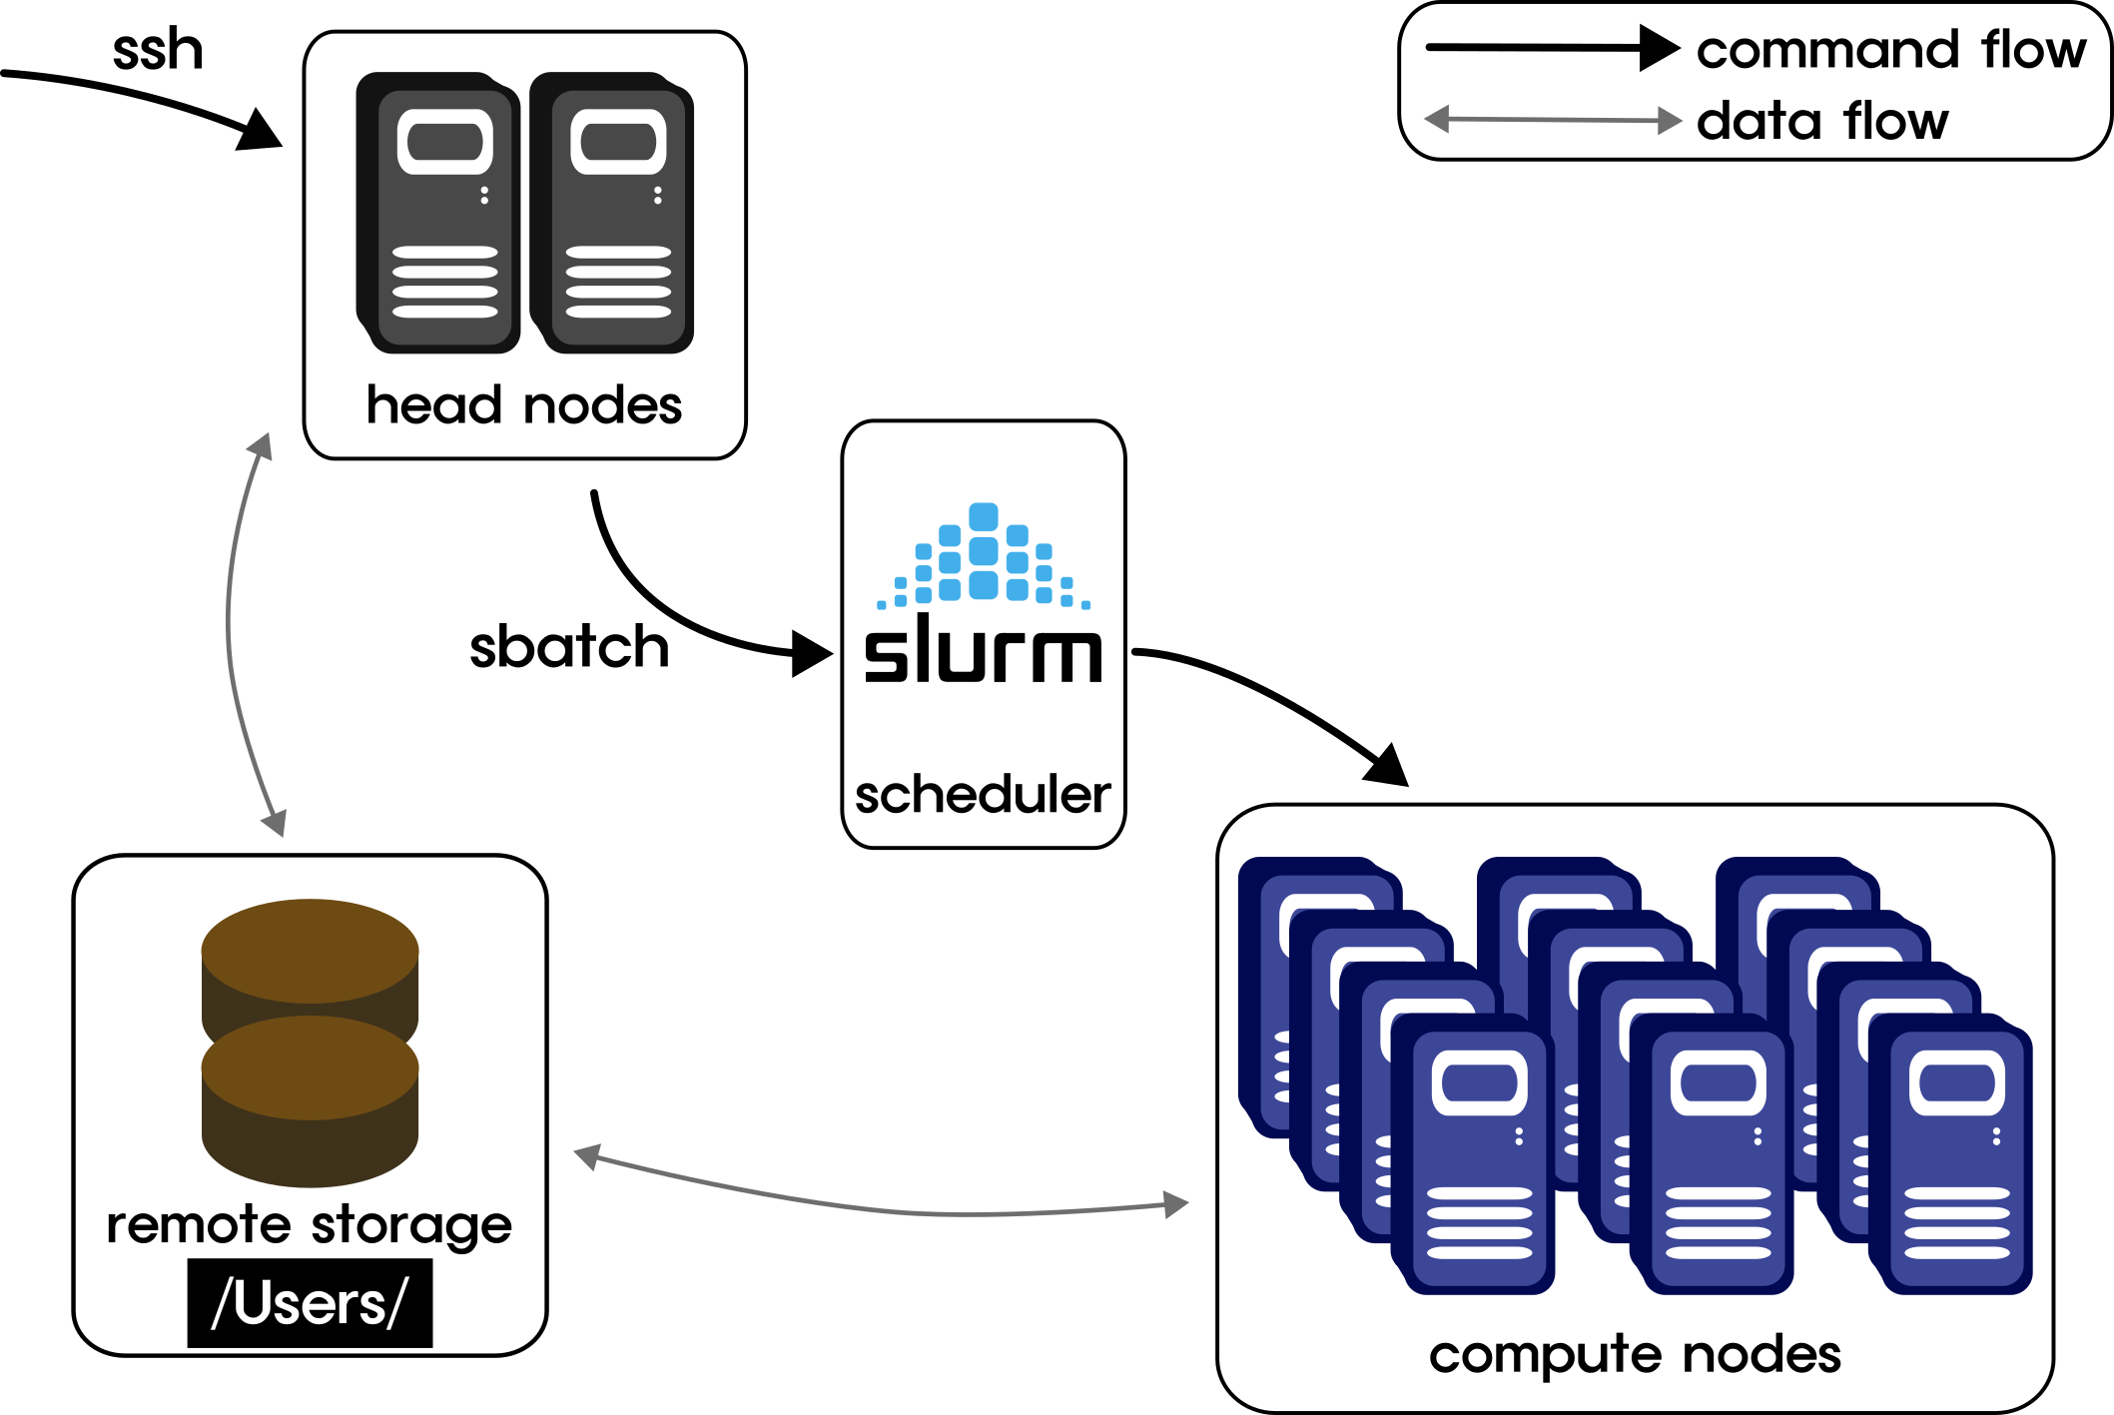
Compute cluster architecture
Remote storage
Off-site from cluster (slow)
Backed up
For Fiji, located under /Users/<username>
Local storage
On-site with cluster (fast)
NOT backed up, $$$
For Fiji, located under /scratch/Users/<username>

Slide 7
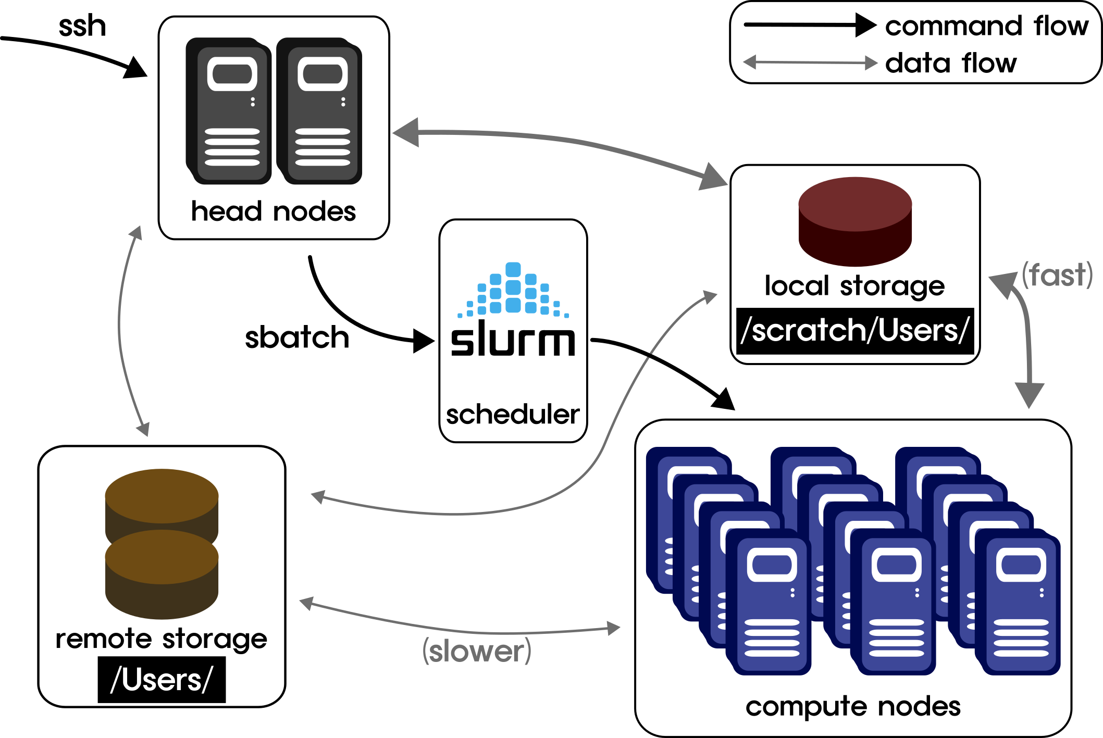
Compute cluster architecture
Remote storage
Off-site from cluster (slow)
Backed up
For Fiji, located under /Users/<username>
Local storage
On-site with cluster (fast)
NOT backed up, $$$
For Fiji, located under /scratch/Users/<username>

Slide 8
Run a job!
Day 3 worksheet Part 1
Create an SBATCH script with a header and a command
Run the script as a job
Troubleshoot

Slide 9
SBATCH header
#!/bin/bash
#SBATCH -p <partition> → specify job partition (queue) to run the job
#SBATCH --time=00:00:00 → hrs:minutes:seconds
#SBATCH --mem=<memory>
#SBATCH –-ntasks= → how many cores/processors are needed for the job
#SBATCH –-job-name=<jobname> → give the job a name
#SBATCH –-mail-type=ALL
#SBATCH –-mail-user=<you@email.com>
#SBATCH –-error=<path>/%x_%j.err → specify name and location of error file
#SBATCH –-output=<path>/%x_%j.out → specify name and location of log file
Output/error files are primarily used for troubleshooting:
These files capture STDERR and STDOUT that isn’t captured within the script
%x and %j are Slurm variables that will be automatically filled into the filenames
%x is the job name. If not specified in the header, it will be the name of your sbatch script file
%j is the unique job ID assigned to your job by Slurm
Using these variables ensures that you’ll always have unique filenames for every job

Slide 10

How to know when a job fails
Expected files are empty or missing
Job finishes much quicker than expected
Errors appear in your error file
Why does a job fail?
Incorrect command/parameters
Incorrect paths
Incorrect SBATCH header
Incorrect file format
Issues with software versions

Slide 11
BREAK

Slide 12
Understanding Modules
Environmental variables alter how we interact with the cluster or help us “find” commands
An important environmental variable is $PATH, which specifies where the computer looks for commands
(look at it with echo $PATH)
Modules are set up by admin and allow you to easily change environmental variables
Not present on every compute cluster
Modules are automatically unloaded after a session terminates

Slide 13
Module commands
module avail List available modules
module spider Describe modules (with tab complete)
module load <module> Load specific module
module list List currently loaded modules
module unload <module> Unload specific module
module purge Unload all current modules

Slide 14
Analyze data!
Day 3 worksheet Part 2
In your SBATCH script, write a command to run the program FastQC
Run the script as a job
Troubleshoot if necessary
Transfer the HTML output to your local computer and view it

Slide 15
Homework for day 4
Videos for day 3 (if not already done)
Videos for day 4
Homework_day3.md worksheet

