Slide 1
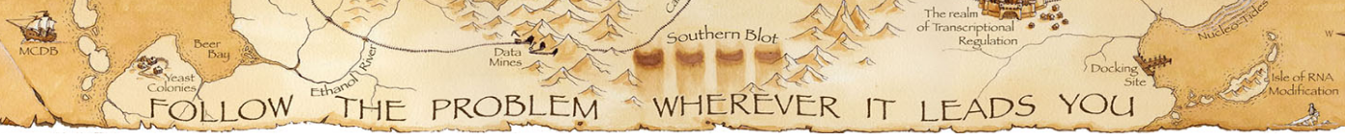
Day 5: Looping, visualization & Assessment
© David Deen
2023/07/28
Samuel Hunter
DnA Lab
University of Colorado Boulder, BioFrontiers

Slide 2
What you have learned so far on week 1 …
- Working on a unix-like command terminal - Connecting to computer cluster (AWS or BioFrontiers Fiji).
- Quality Control Checks: FASTQC - Running scripts: Processing high throughput sequencing files (FASTQ) to obtain a reference genome aligned/mapped SAM/BAM files
Goals for today:
Part 1 (1 hour): Transforming intermediate files to ones you check (Create BedGraphs and TDFs for visualization + For loops if we have time) Part 2 (2 hours): Assessment of skills learned up to today.

Slide 3
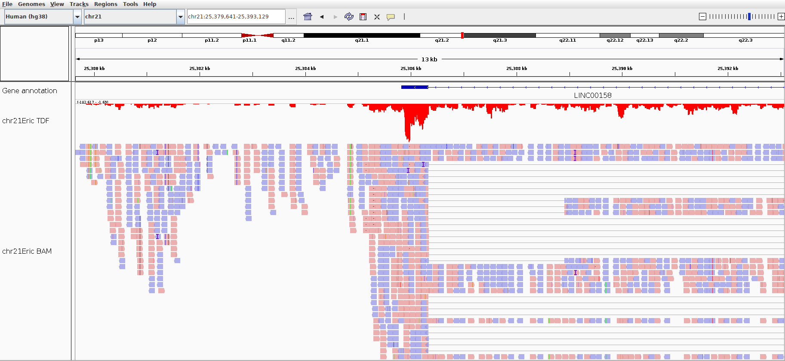
Comparing BAM and TDF files on IGV
Observed region on screen = 13 kb
annotation
TDF
BAM
Individual
mapped reads

Slide 4
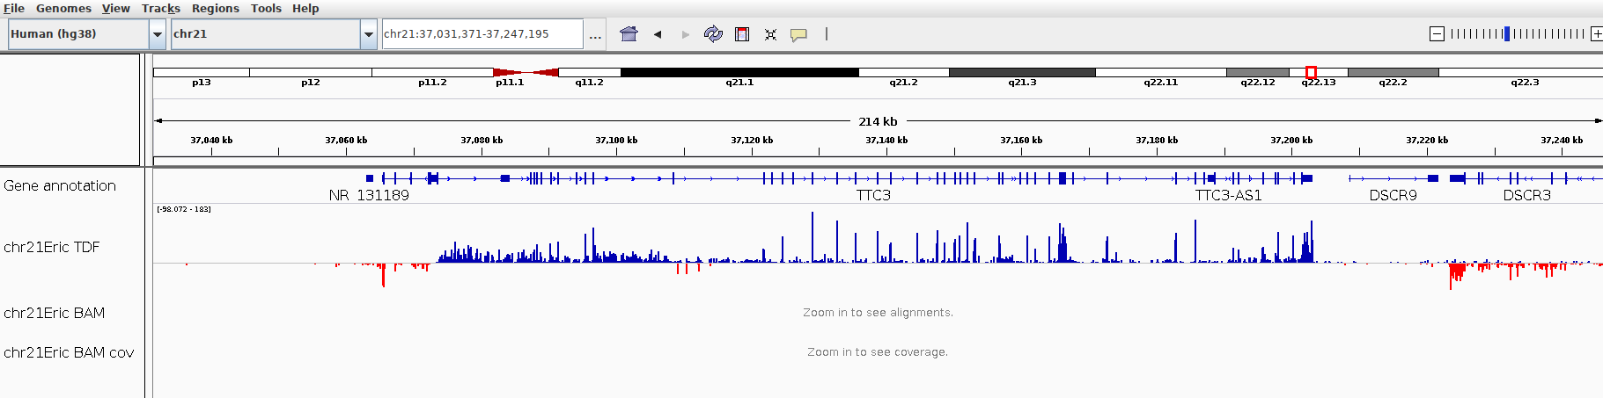
Comparing BAM and TDF files on IGV
Observed region on screen = 214 kb
annotation
TDF
BAM
IGV does not display individually mapped reads on such a big region at once!
But IGV does okay displaying TDF coverage across any zoom region.

Slide 5
Go to the Day5 worksheet on Github, and get started on today’s exercise

Slide 6
Each dataset is processed the same way, so that we end up with usable files for analysis
hisat2.sbatch
samtools.sbatch
bedtools.sbatch
igvtools.sbatch
FASTQ
BAM
Bedgraph
TDF
Read Sequences
Sequence and alignment
Number of reads in a region
Binary file for visualization
But for each FASTQ file, I’ll need to edit all of my variable names and submit the jobs individually!

Slide 7


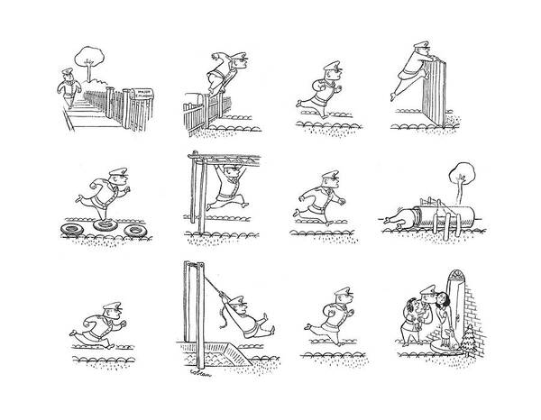
The coordinator that tells the contestants to go on the obstacle course. This is what actually gets everything going.
Contestants to go through code (obstacle course). There are multiple.
The code (obstacle course) that stays the same and we want to reuse.
CPU
Fastq
Fastq
Script: d5-fastq-to-tdf.sbatch
Script: run_d5-fastq-to-tdf.sbatch
Fastq
Fastq

Slide 8
CPU
CPU
CPU
CPU

Slide 9
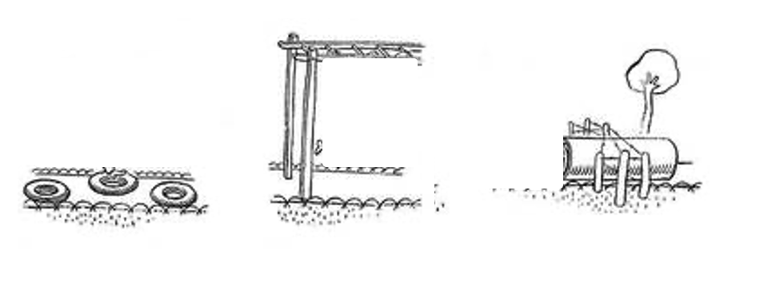
Script: d5-fastq-to-tdf.sbatch
Script: d5-fastq-to-tdf.sbatch
Script: d5-fastq-to-tdf.sbatch
Script: d5-fastq-to-tdf.sbatch

Slide 10
Script: run_d5-fastq-to-tdf.sbatch
Script: d5-fastq-to-tdf.sbatch
Script: d5-fastq-to-tdf.sbatch
Script: d5-fastq-to-tdf.sbatch
Script: d5-fastq-to-tdf.sbatch

Slide 11
Script: run_d5-fastq-to-tdf.sbatch
Fastq
Fastq
Script: d5-fastq-to-tdf.sbatch
Script: d5-fastq-to-tdf.sbatch
Fastq
Fastq
Script: d5-fastq-to-tdf.sbatch
Script: d5-fastq-to-tdf.sbatch

Slide 12
For Loops in a nutshell:
For every dataset in (my/directory/of/fastqs)
Do
FASTQ
BAM
Bedgraph
TDF
Done!
We feed each FASTQ file into the scripts without needing to submit the jobs individually or manually edit the variable names

Slide 13
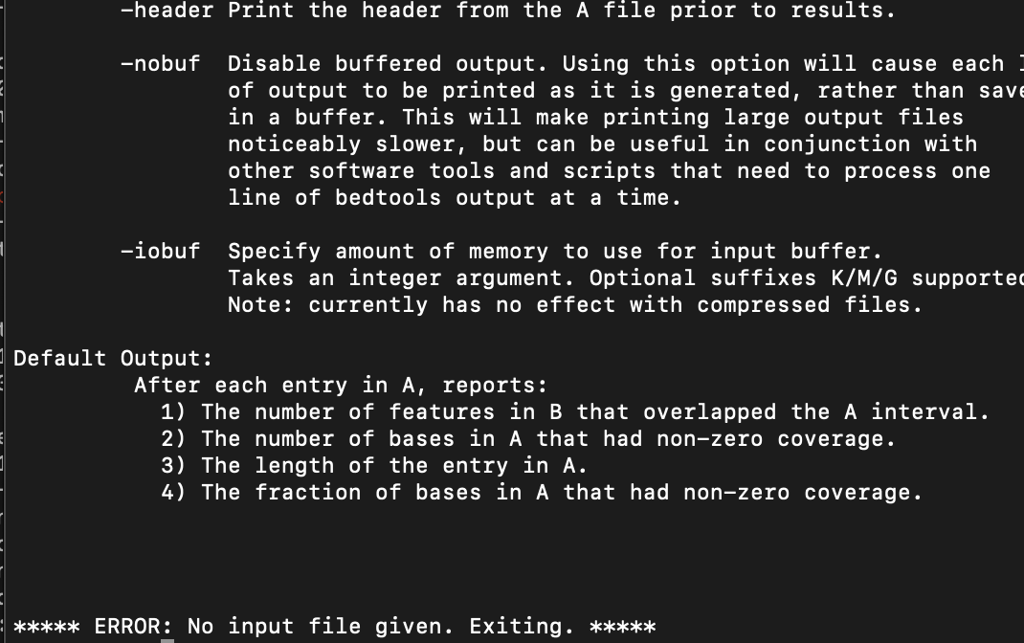
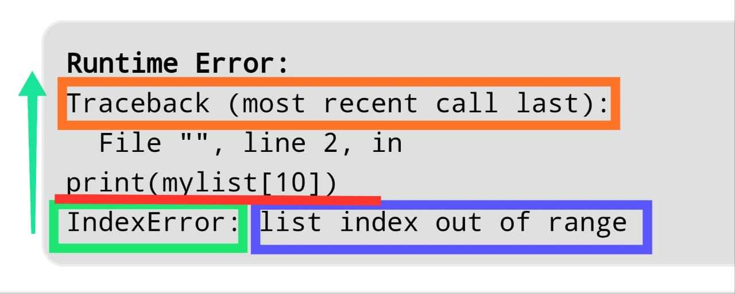
First things to check when error
Did you check what the error and output files said?
If you can’t find them, check that you fixed the path in the script for these files
Reading an error:
Usually the most helpful part of the error is at the bottom of it
TYPOS (especially filenames and folders)

Slide 14
Day 5: Assessment

Slide 15


Check out the other FASTQ datasets in Day5. Imagine these files are fresh off the sequencer… can you write your own scripts to turn them from raw FASTQs to TDFs? What QC checks should you perform?
(Extra-very-real-points: Do all files with a loop!)
FASTQ ➡ SAM ➡ BAM ➡
➡ BEDGRAPH ➡ TDF F

Slide 16
First things to check when error
Did you check what the error and output files said?
If you can’t find them, check that you fixed the path in the script for these files
Reading an error:
Usually the most helpful part of the error is at the bottom of it
TYPOS (especially filenames and folders)

