Slide 1
Counting Reads and Differential Expression
Short Read Workshop
Day 7

Slide 2
Recap of Day 7 Videos
Counting reads (for RNA-seq)
Steps to counting reads and normalizing counts
Differential expression overview
Introduction to differential expression analysis
Differential expression analysis with DESeq2
DESeq2 Negative Binomial theoretical model
Multifactor designs with DESeq2
Expanded designs in DESeq2

Slide 3
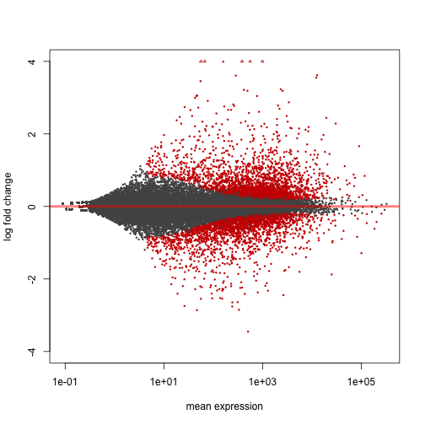
Goal of the Day
Find genes that are different between samples
Map reads to reference genome
Count reads
Perform differential gene expression analysis

Slide 4
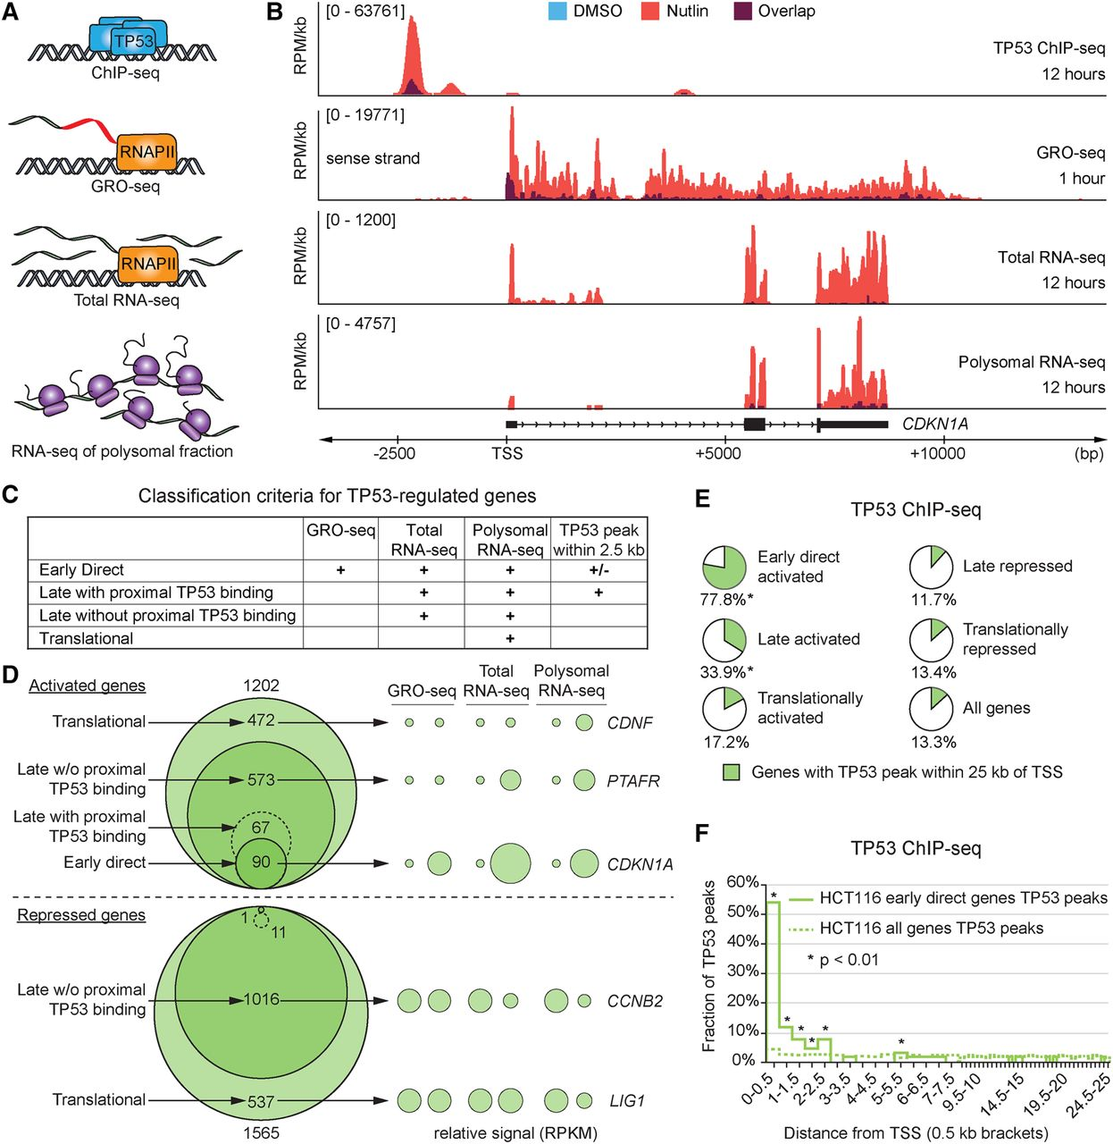
Project B: Identification of the p53 transcriptional program using RNA-seq and ChIP-seq
Andrysik et al., 2017, doi: 10.1101/gr.220533.117
In HCT116, SJSA, and MCF7 cell types.
Question: Which genes are driven by p53 activation?

Slide 5
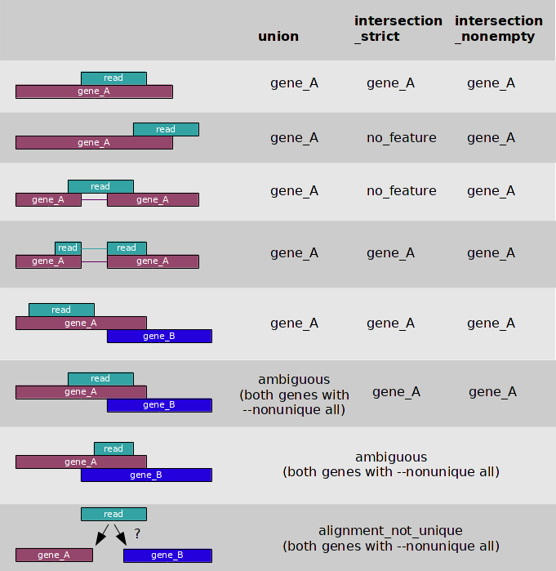
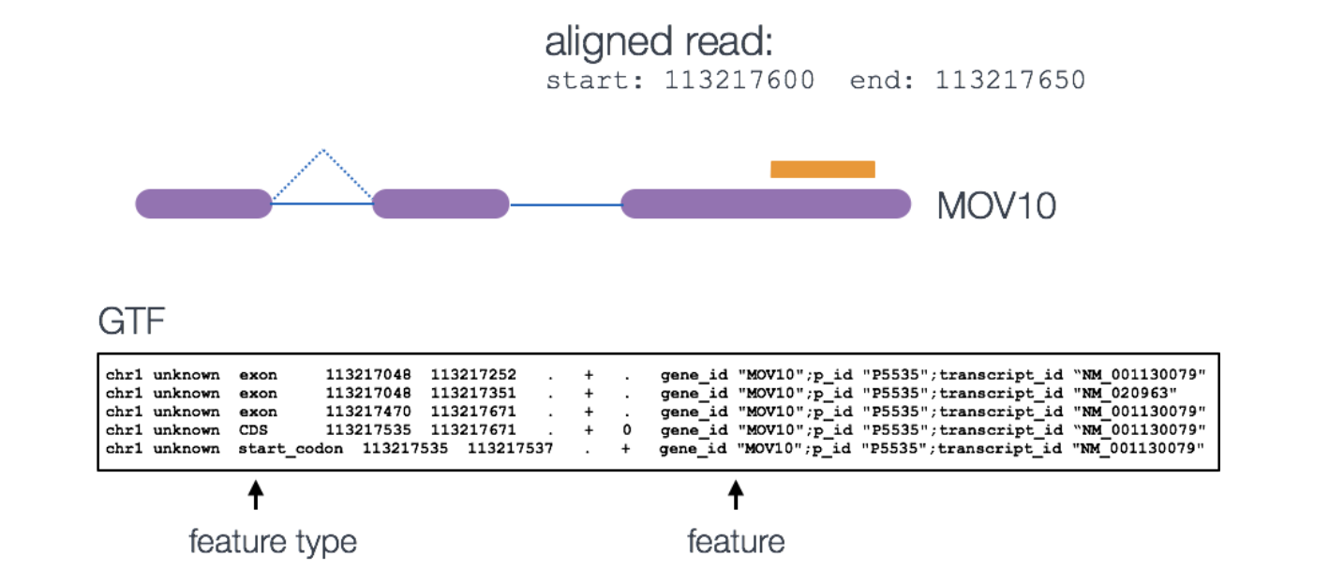
featureCounts counts reads over features in R
There are several options in featureCounts
fc <- featureCounts(files=bam_file_list,
annot.ext=gtf,
isGTFAnnotationFile=TRUE,
GTF.featureType="exon",
GTF.attrType="gene_id",
useMetaFeatures=TRUE,
allowMultiOverlap=TRUE,
largestOverlap=TRUE,
countMultiMappingReads=TRUE,
isPairedEnd=TRUE,
strandSpecific=1,
nthreads=N)
https://hbctraining.github.io/Intro-to-rnaseq-hpc-O2/lessons/05_counting_reads.html

Slide 6
Counting reads with featureCounts
Follow featureCounts worksheet:
Open R and install Rsubread on AWS
Get d7_featureCounts.R and d7_featureCounts.sbatch scripts
Edit both scripts and execute the sbatch script

Slide 7
Challenge Question
What feature would you used to count reads for RNA-seq?
Gene
Exon
Transcripts

Slide 8
Challenge Question
What feature would you used to count reads for RNA-seq?
Gene
Exon
Transcripts
✓

Slide 9
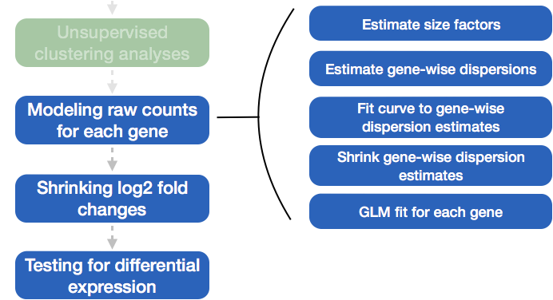
DESeq2 Recap
https://hbctraining.github.io/DGE_workshop_salmon/lessons/04_DGE_DESeq2_analysis.html

Slide 10
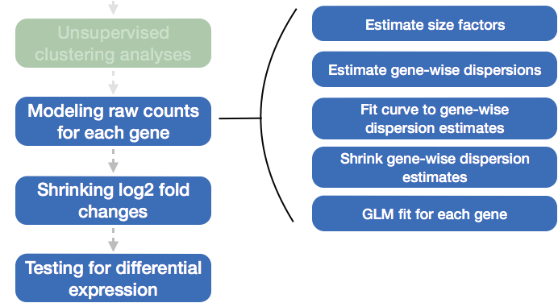
DESeq2 Recap
Assumption: MOST features are not changing
https://hbctraining.github.io/DGE_workshop_salmon/lessons/04_DGE_DESeq2_analysis.html

Slide 11
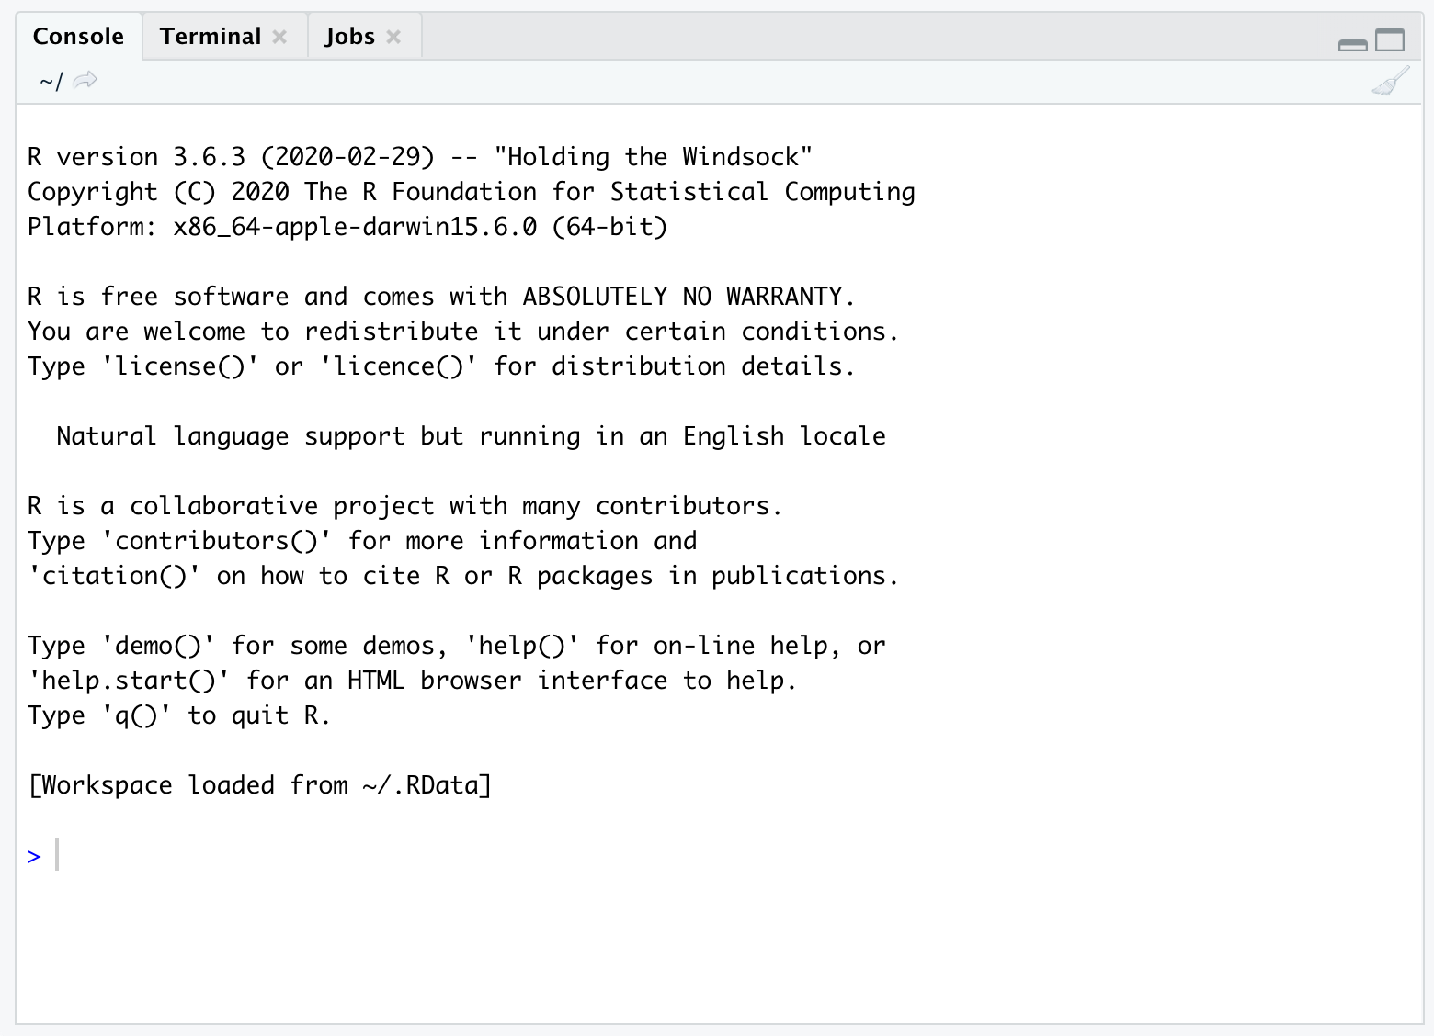
Run DESeq2…
Follow DESeq2 worksheet
This will be run in an R console in RStudio

Slide 12
Challenge Question
How would you run DESeq2 on the supercomputer?

Slide 13
Challenge Question
How would you run DESeq2 on the supercomputer?
Install DESeq2 in your R packages directory
Make a conditions table that matches your count table
Run the R script through an sbatch script

Slide 14
Homework
Run DESeq2 to explore differential expression with a different cell line

