Slide 1
Computer Graphics
Lecture 12
Colour: physics and light

Slide 2
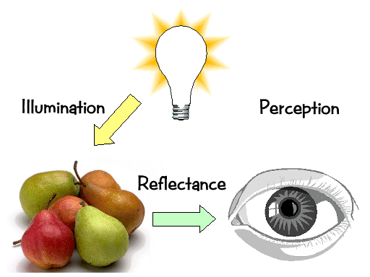
The Elements of Colour
Perceived light of different wavelengths is in approximately equal weights – achromatic.
>80% incident light from white source reflected from white object.
<3% from black object.
Narrow bandwidth reflected – perceived as colour

Slide 3
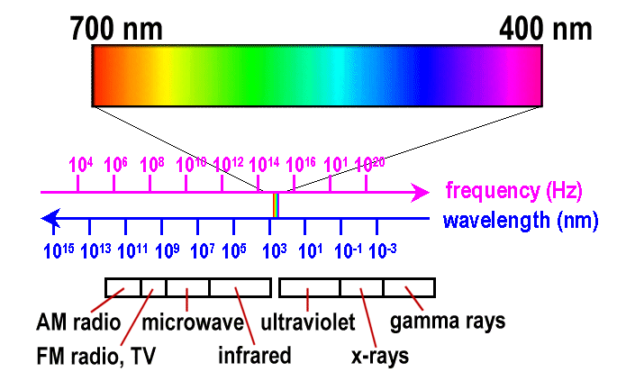
The Visible Spectrum

Slide 4
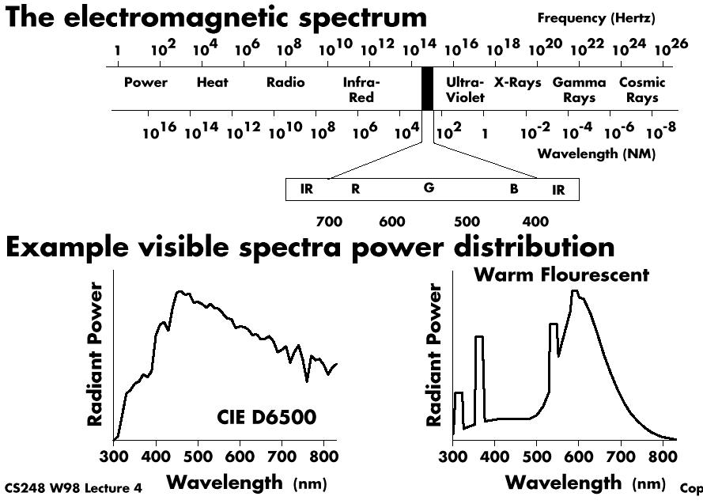
Daylight Vision
UV
Clear Sky
© Pat Hanrahan.

Slide 5
Measuring Light and Colour
Physics: Radiometry
 The amount of power per wavelength interval
Termed radiance, we will often use intensity
Psychophysics
Photometry
 The relative brightness of a light source (colour or black/white) when compared to a standard candle
Termed luminance
Uniform perceptual scale
Termed lightness
Colourimetry

Slide 6
Colour Matching Experiment.
Adjust brightness of 3 primaries to “match” colour
C - colour to be matched, RGB - laser sources (R=700 nm, G=546 nm, B=435 nm)
C
R
G
C
R
B
G
B
C = R + G + B
C + R = G + B
Therefore: humans have trichromatic color vision

Slide 7
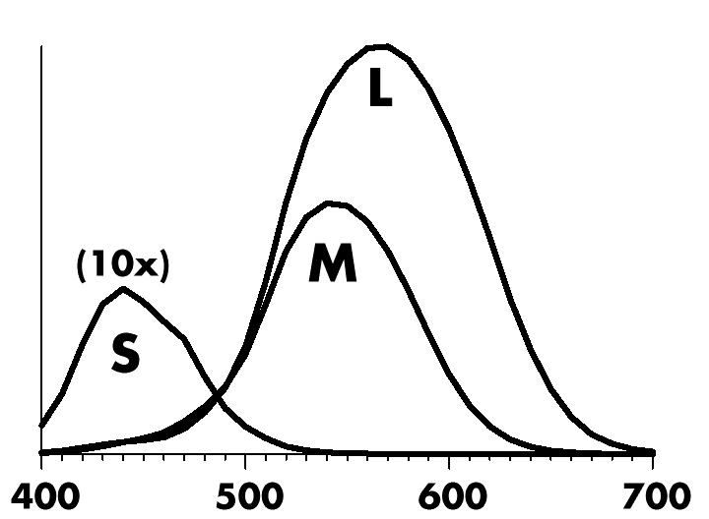
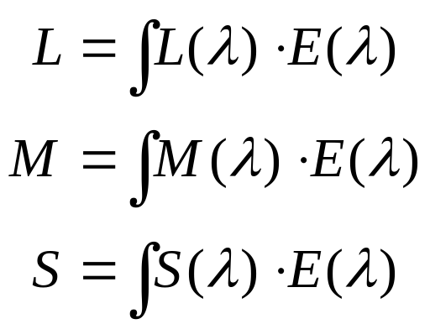
Human Colour Vision.
There are 3 light sensitive pigments in your cones (L,M,S), each with different spectral response curve.
Biological basis of colour blindness
– genetic disease.
© Pat Hanrahan.

Slide 8
Colour Matching is Linear!
Grassman’s Laws
1. Scaling the colour and the primaries by the same factor
preserves the match :
2C=2R+2G+2B
2. To match a colour formed by adding two colours, add
the primaries for each colour
C₁+C₂=(R₁ +R₂)+(G₁ +G₂ )+(B₁ +B₂)

Slide 9
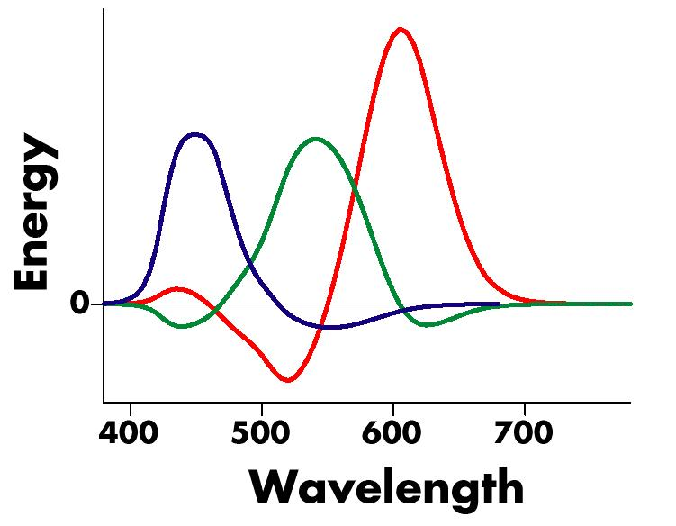
Spectral Matching Curves
Red, Green & Blue primaries.
Match each pure colour in the visible spectrum with the 3 primaries, and record the values of the three as a function of wavelength.
Note : We need to specify a negative amount
of one primary to represent all colours.
© Pat Hanrahan.

Slide 10
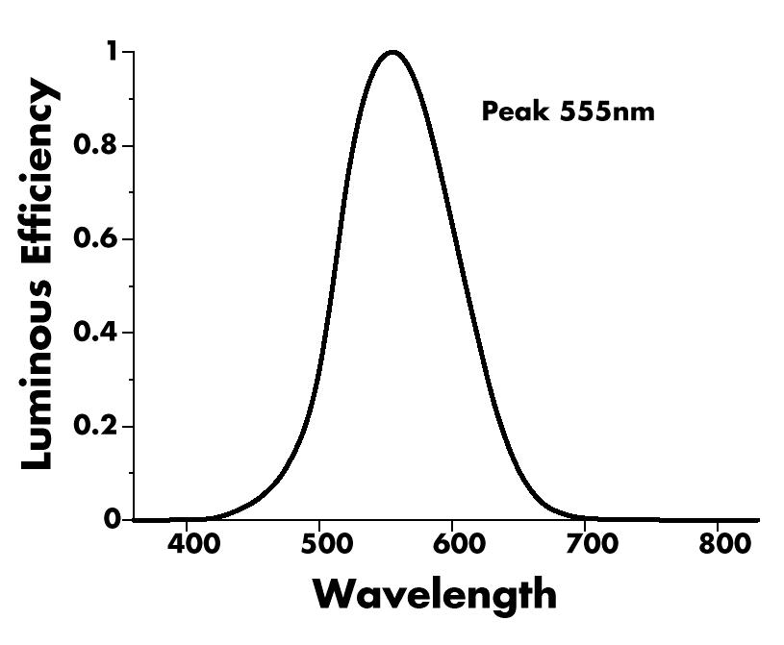
Luminance
Compare colour source
to a grey source
• Luminance
Y = .30R + .59G + .11B
Colour signal on a B&W tv
(Except for gamma, of course)
• Perceptual measure : Lightness
L* = Y ^{1/3}

Slide 11
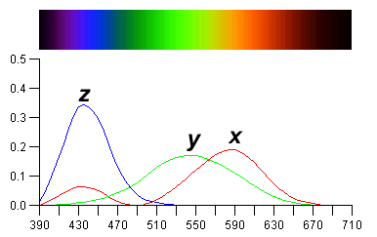
CIE Colour Space
For only positive mixing coefficients, the CIE (Commission Internationale d’Eclairage) defined 3 new hypothetical light sources x, y and z (as shown) to replace red, green and blue.
Primary Y intentionally has same response as luminance response of the eye.
The weights X, Y, Z form the 3D CIE XYZ space (see next slide).

Slide 12
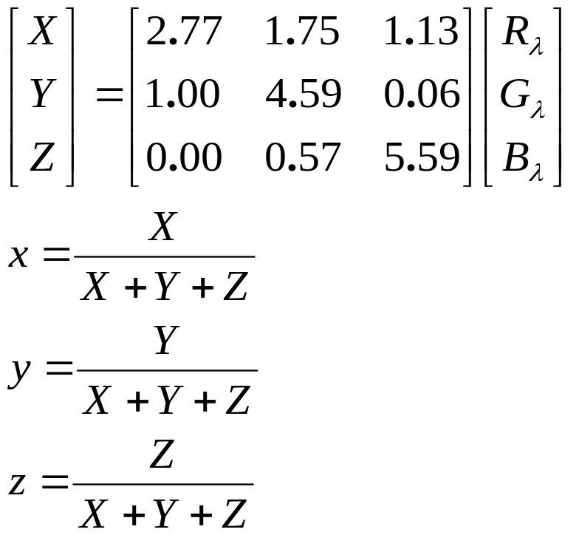
Chromaticity Diagram.
CIE Colour Coordinates
Often convenient to work in 2D colour space, so 3D colour space projected onto the plane X+Y+Z=1 to yield the chromaticity diagram.
The projection is shown opposite and the diagram appears on the next slide.
Normalise by the total amount of light energy.

Slide 13
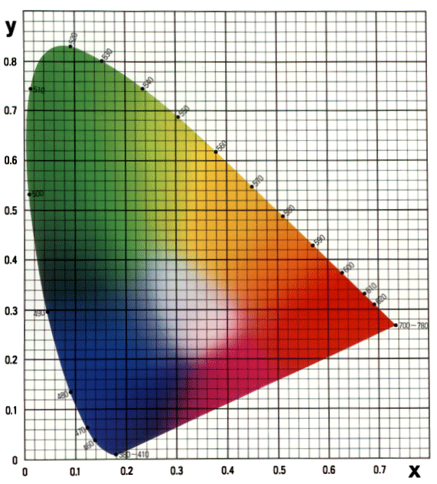
CIE Chromaticity Diagram
C is “white” and close to x=y=z=1/3
The dominant wavelength of a colour, eg. B, is where the line from C through B meets the spectrum, 580nm for B (tint).
A and B can be mixed to produce any colour along the line AB here including white. True for EF (no white this time).
True for ijk (includes white)
E
F
D
i
B
C
j
A
k

Slide 14
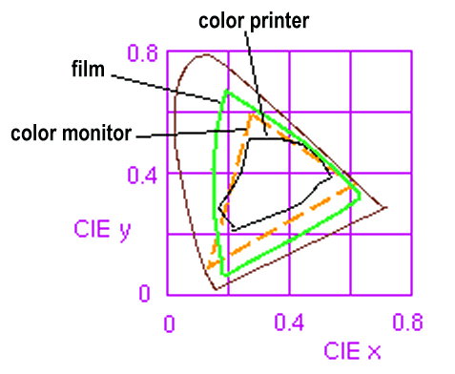
Some device colour “gamuts”
The diagram can be used to compare the gamuts of various devices. Note particularly that a colour printer can’t reproduce all the colours of a colour monitor. Note no triangle can cover all of visible space.
C

Slide 15
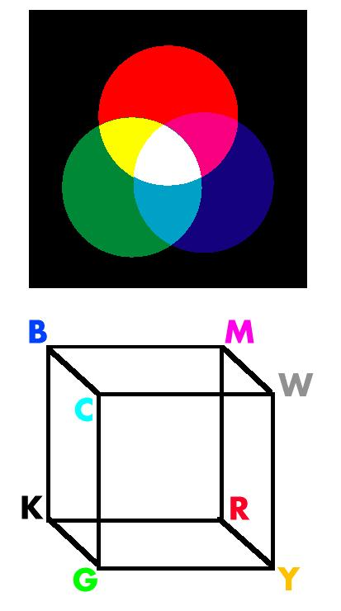
Colour Cube.
R,G,B model is additive, i.e we add amounts of 3 primaries to get required colour.
Can visualise RGB space as cube, grey values occur on diagonal K to W.

Slide 16
Intuitive Colour Spaces.
Artist specification of colours resulting from a pure pigment :
Tint – Adding white to a pure pigment
Shade – Adding black to a pure pigment.
Tone – Add both black & white.
Tints
White
Saturated →
Pure
Pigment
Greys
Tones
Shades
Black

Slide 17
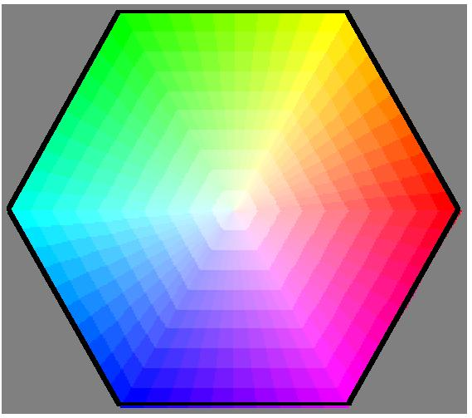
Intuitive Colour Spaces.
Hexagon is a diagonal Cross-Section of the
3D Colour Cube.

Slide 18
The HSV Colour Space.
V
Green 120°
Yellow
1.0
Cyan
Red 0°
H – Hue, or the colour of the pure pigment.
S – Saturation of the colour.
V – Value, or brightness.
If V = 0, H is Undefined.
Blue 240°
Magenta
H
Black
0.0
S

Slide 19
The HSL Colour Space.
1.0
L
White
H – Hue, or the colour of the pure pigment.
S – Saturation of the colour.
L – Lightness, or brightness.
If L = 0,1 H is Undefined.
Maximum saturation occurs when L = 0.5
Green 120°
Yellow
Cyan
0.5
Red 0°
Blue 240°
Magenta
H
Black
0.0
S

Slide 20
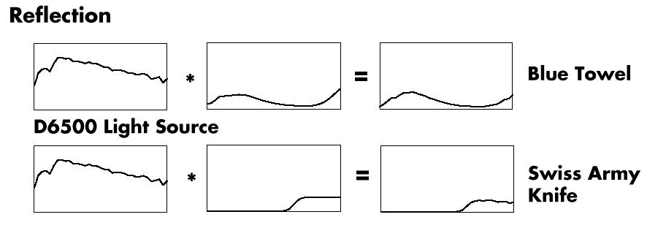
Filtering
Comments
Transmission similar
Things look different under different illuminations
Multiplying colour components is an approximation!

Slide 21
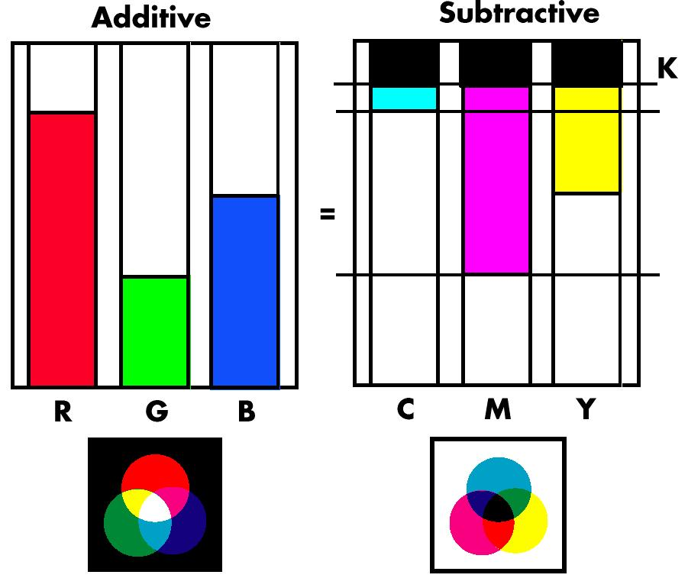
CMYK – subtractive colour model.
R = (1-C) (1-K) W
G = (1-M) (1-K) W
B = (1-Y) (1-K) W
K = G(1-max(R,G,B))
C = 1 - R/(1-K)
M = 1 - G/(1-K)
Y = 1 - B/(1-K)

Slide 22
Summary.
Humans have tri-chromatic vision.
All visible colours represented in CIE colour diagram.
No three selected primaries in CIE colour space can generate all visible colours.
Intuitive colour spaces.
Subtractive colour models for hard copy.

Slide 23
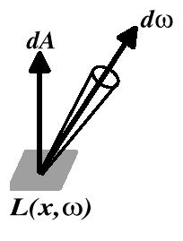
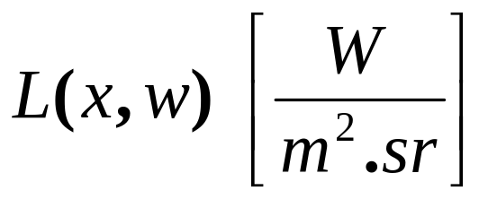
Radiometry : Radiance辐射率
Radiometry is the science of light energy measurement
Definition: The radiance (luminance) is the power per unit area per unit solid angle.
Properties:
1. Fundamental quantity
2. Stays constant along a ray
3. Response of a sensor proportional to radiance

Slide 24
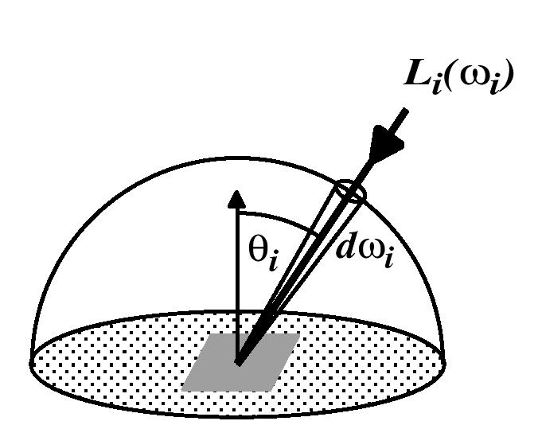
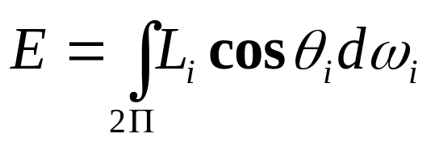
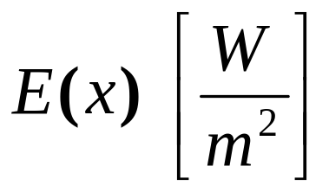
Radiometry: Irradiance and Radiosity.
Definition: The irradiance (illuminance) is the power per
unit area incident on a surface.
Definition: The radiosity (luminosity) is the power per unit area leaving a surface.

Slide 25
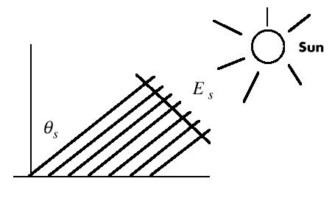
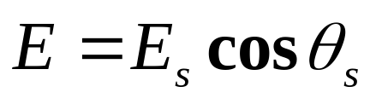
Irradiance: Distant Source

Slide 26
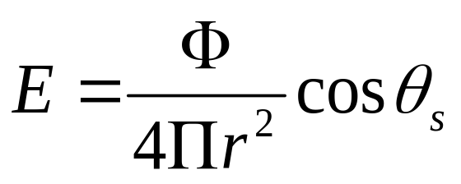
Irradiance: Point Source
Inverse square law fall off
Still has cosine dependency.

Slide 27
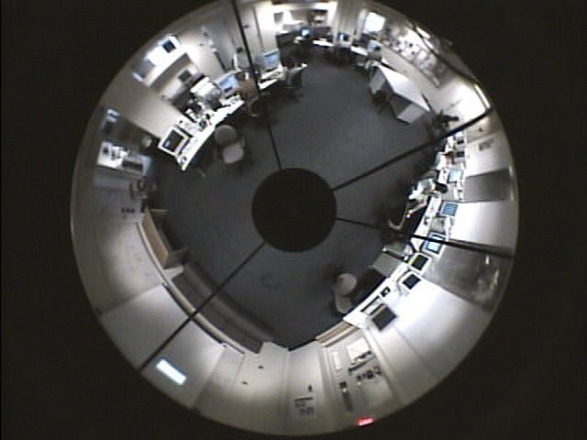
What does Irradiance look like?

Slide 28
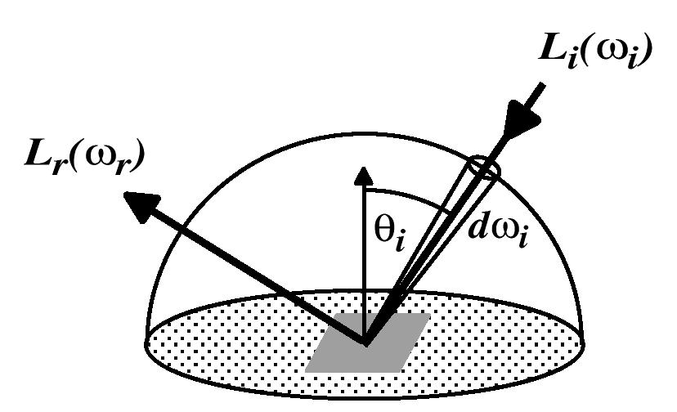
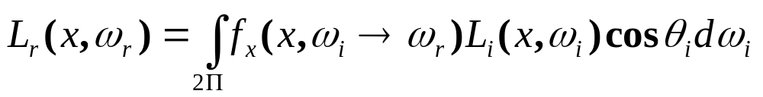
The Reflection Equation.
Linear response
2. Bidirectional reflectance distribution function (BRDF) defines outgoing radiance for a given incoming irradiance – characteristic property of surface.

Slide 29
Approximating the BRDF.
All illumination models in graphics are approximations to the BRDF for surfaces.
Frequently chosen for their visual effect, and ease of implementation, rather than on physical principles.
BRDF is approximated by reflection functions.
Usually a total hack !

Slide 30
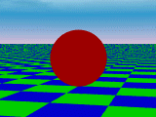
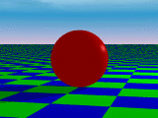
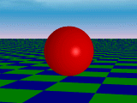
Light sources
Ambient
Omni/Point light
Direction Light
Spot Lights
Area Light
Extended Light

Slide 31
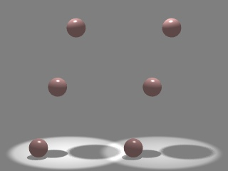
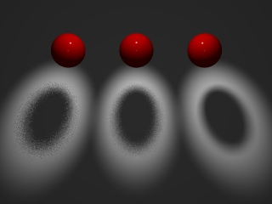

Slide 32
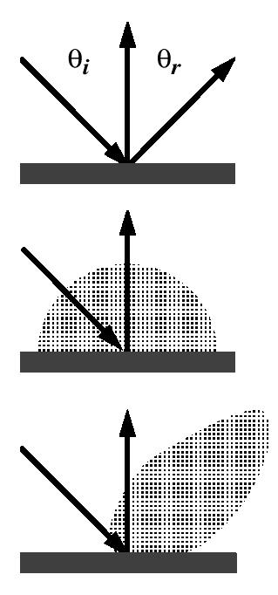
Types of Reflection Functions
Ambient.
Ideal Specular
  Mirror
  Reflection Law
Ideal Diffuse
  Matte
  Lambert’s Law
Specular
  Glossiness and Highlights
  Phong and Blinn Models

Slide 33
Ambient Reflection.
Simplest illumination model.
There is assumed to be global ambient illumination in the scene, I_{a}
Amount of ambient light reflected from a surface defined by ambient reflection coefficient, k_{a}.
Ambient term is I = I_{a}.k_{a}
No physical basis whatsoever !

Slide 34
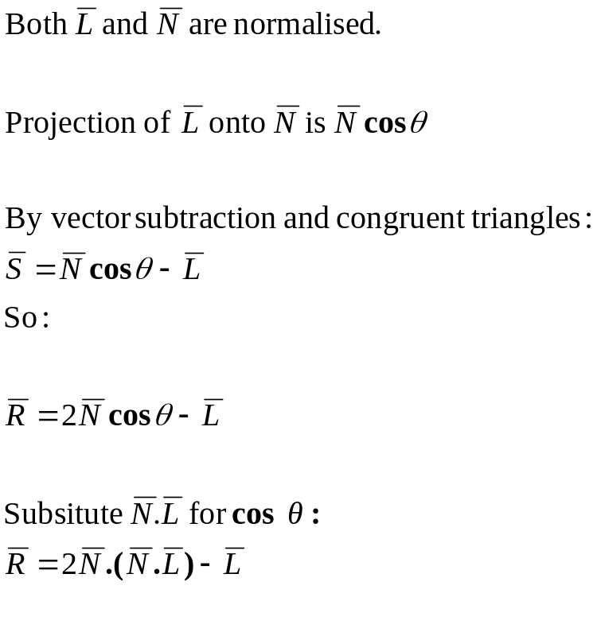





Mirror: Ideal Specular Surface
Calculation of the reflection vector involves mirroring L about N.
Law of Reflection
θ_{i}
θ_{r}
θ_{r}= θ_{i}

Slide 35
Matte: Ideal Diffuse Reflection.
Dull surfaces such as chalk exhibit diffuse or Lambertian reflection.
Reflect light with equal intensity in all directions.
For a given surface, brightness depends only on the angle between the surface normal and the light source.

Slide 36
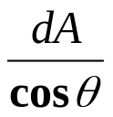
Matte: Ideal Diffuse Reflection.
I_{p}
2 effects to consider :
The amount of light reaching the surface.
  Beam intercepts an area dA/ cos θ
  cos θ dependence.
The amount of light seen by the viewer.
  Also cos θ dependence per unit surface area
  BUT amount of surface seen by viewer also has cos θ dependence.
θ
θ
dA

Slide 37
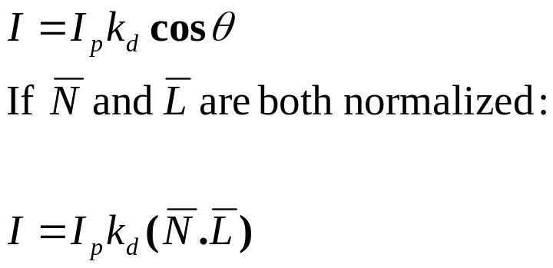
Matte: Ideal Diffuse Reflection.
I_{p}
The diffuse lighting equation is :
θ
θ
dA

Slide 38
Matte: Ideal Diffuse Reflection.
Diffuse coefficient defined for each surface.
Diffusely lit objects often look harshly lit
  Ambient light often added.
Poor physical basis for diffuse reflection.
  Internal reflections inside the material etc…

Slide 39


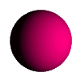
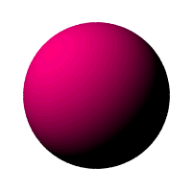
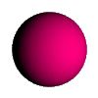
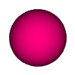
Examples

Slide 40
Specular reflection.
Can be observed on a shiny surface, e.g nice red apple lit with white light.
Observe highlights on surface.
Highlight appears as the colour of the light, rather than of the surface.
Highlight appears in the direction of ideal reflection. Now view direction important.
Materials such as waxy apples, shiny plastics have transparent reflective surface.

Slide 41


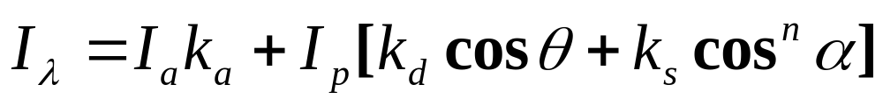
The Phong model.
Assume specular highlight is at a maximum when α = 0 , and falls off rapidly with larger values of α
Fall-off depends on cos^{n} α.
n referred as specular exponent.
For perfect reflector, n is infinite.
θ
θ
α

Slide 42

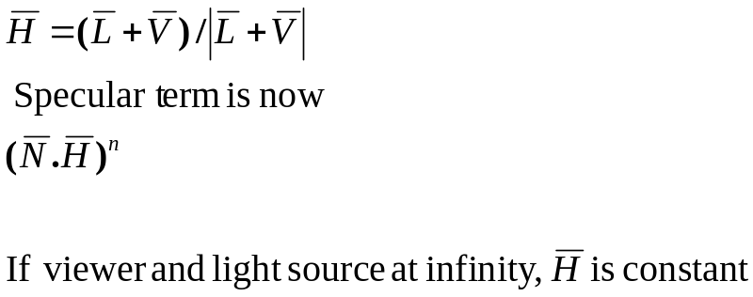
The Phong model.
An alternative formulation uses halfway vector, H
It’s direction is halfway between viewer and light source.
If the surface normal was oriented at H, viewer would see brightest highlights.
Note α ≠ β , both formulations are approximations.
β
θ
θ
α

Slide 43
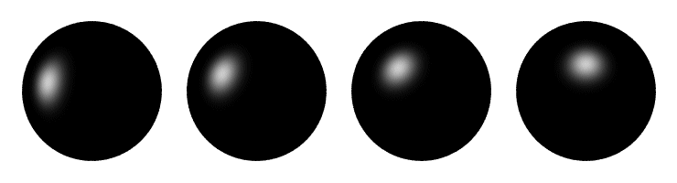
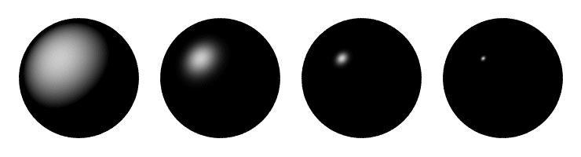
Examples

Slide 44
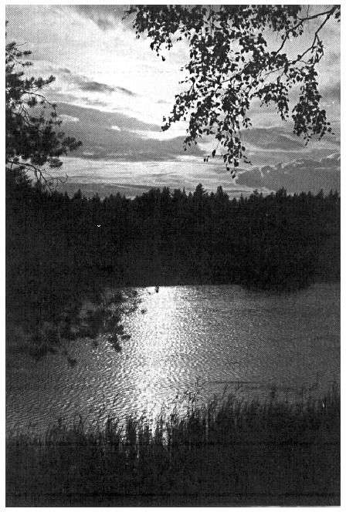

Rough Surface : Microfacet distribution.
Physical justification for Phong model is that the surface is rough and consists of microfacets which are perfect specular reflectors.
Distribution of microfacets determines specular exponent.

Slide 45
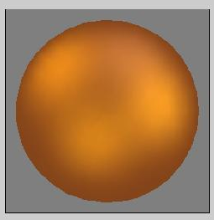
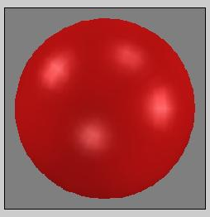
Material Selection.
Ambient 0.52
Diffuse 0.00
Specular 0.82
Shininess 0.10
Light intensity 0.31
Ambient 0.39
Diffuse 0.46
Specular 0.82
Shininess 0.75
Light intensity 0.52

Slide 46
Summary of Lighting.
Surface reflection specified by BRDF.
BRDF approximated by ambient, diffuse and specular reflection.
Lambertian reflection.
Phong Lighting model.

