Slide 1
Computer Graphics
Lecture 1
Raster Graphics

Slide 2
Graphics Pipelines
Graphics processes generally execute sequentially
Typical ‘pipeline’ model
There are two ‘graphics’ pipelines
  The Geometry or 3D pipeline
  The Imaging or 2D pipeline
Lecture 1

Slide 3
Geometry Pipeline
Animation/Interaction : time
Modeling: shapes
Shading: reflection and lighting
Transformation: viewing
Hidden Surface Elimination
Imaging
Pipeline
Lecture 1

Slide 4
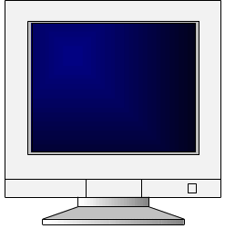
Imaging Pipeline
Geometry
Rasterization and Sampling
Pipeline
Texture Mapping
Image Composition
Intensity and Colour Quantization
Framebuffer/Display
Lecture 1

Slide 5
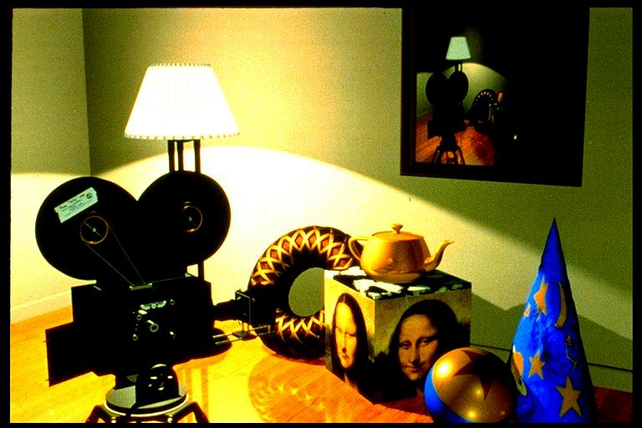
An example
The scene we are trying to represent:
Images courtesy of Picture Inc.
Lecture 1

Slide 6
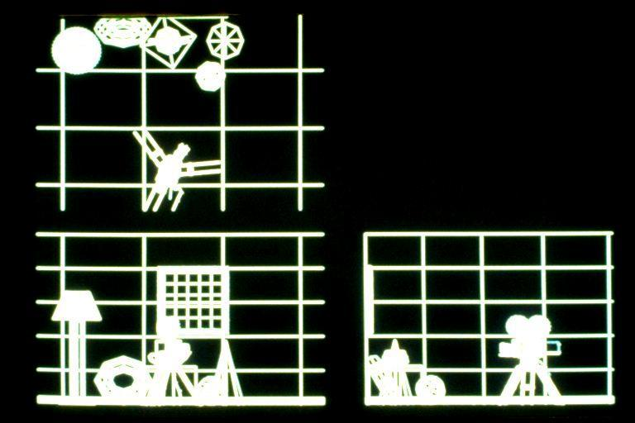
Wireframe model – Orthographic views
Lecture 1

Slide 7
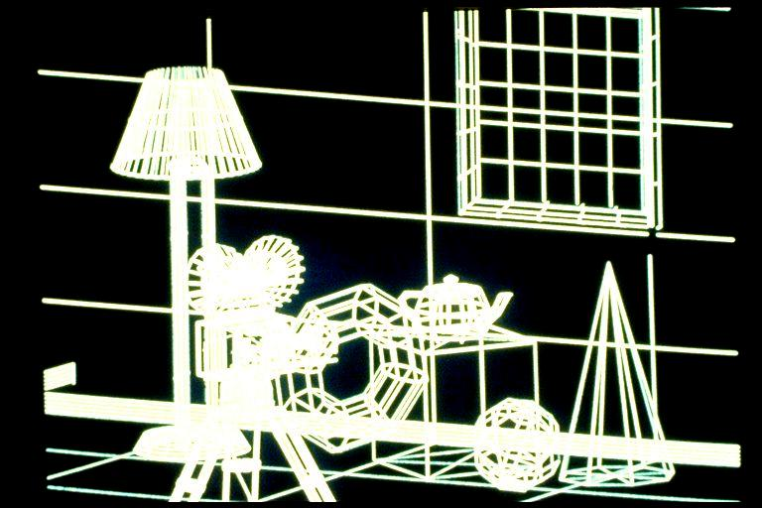
Perspective View
Lecture 1

Slide 8
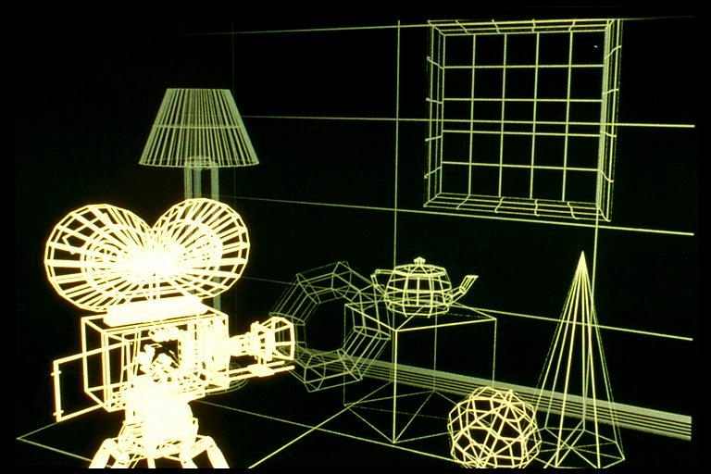
Depth Cue
Lecture 1

Slide 9
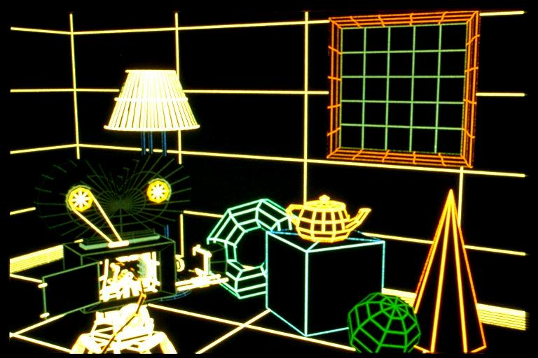
Hidden Line Removal – add colour
Lecture 1

Slide 10
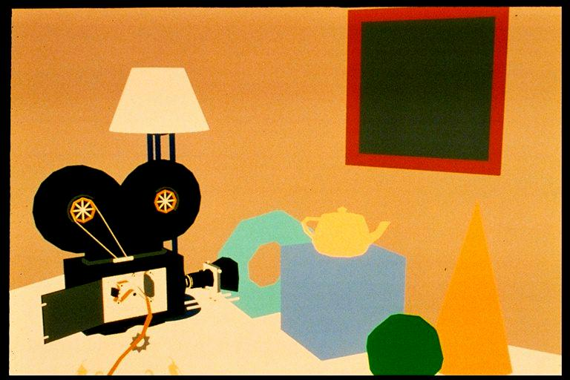
Constant Shading – Ambient
Lecture 1

Slide 11
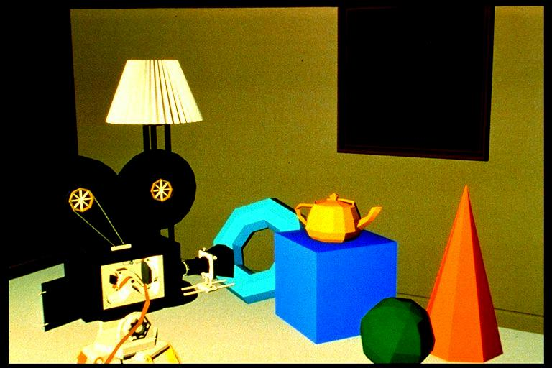
Faceted Shading – Flat
Lecture 1

Slide 12
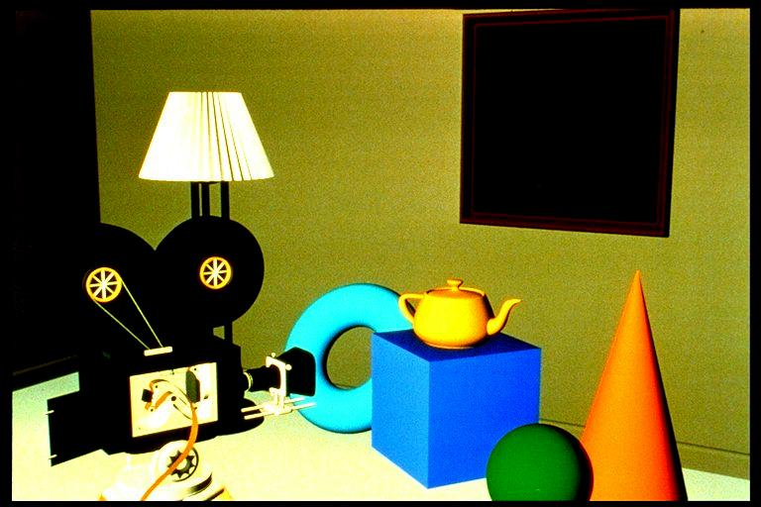
Gouraud shading, no specular highlights
Lecture 1

Slide 13
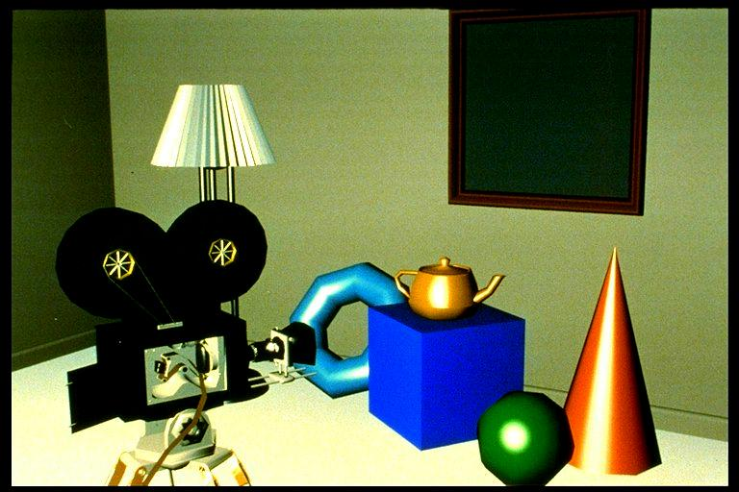
Specular highlights added
Lecture 1

Slide 14
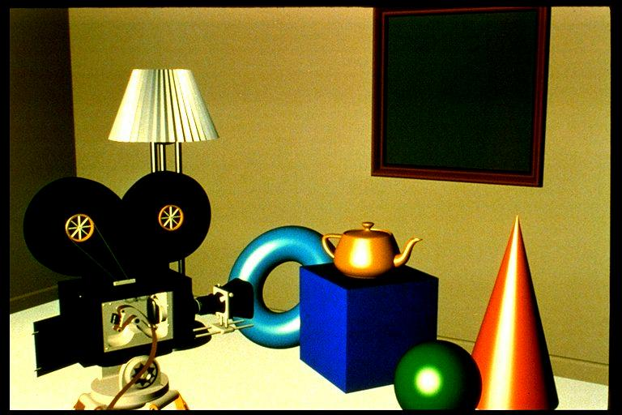
Phong shading
Lecture 1

Slide 15
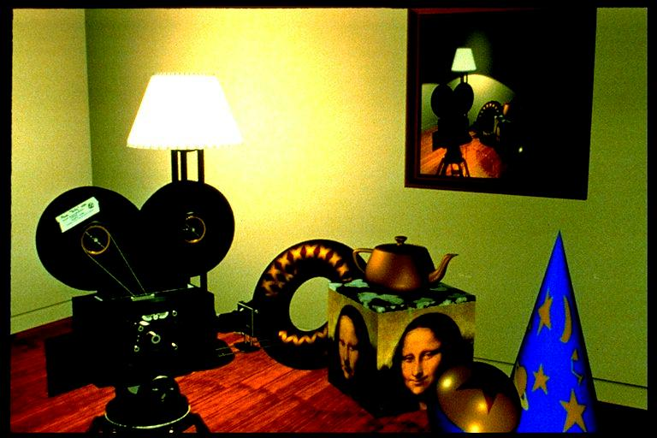
Texture mapping
Lecture 1

Slide 16

Texture mapping
Lecture 1

Slide 17
Reflections, shadows & Bump mapping
Lecture 1

Slide 18
Graphics Definitions
Point
  a location in space, 2D or 3D
  sometimes denotes one pixel
Line
  straight path connecting two points
  infinitesimal width, consistent density
  beginning and end on points
Lecture 1

Slide 19
Graphics Definitions
Vertex
  point in 3D
Edge
  line in 3D connecting two vertices
Polygon/Face/Facet
arbitrary shape formed by connected vertices
  fundamental unit of 3D computer graphics
Lecture 1

Slide 20
Geometry Definitions
Point,
Line, Curve
Face, Polygon, Mesh, Surface
Solid, Volume
Typical Geometrical Objects
  Plane, Cube, Sphere/Ball, Cone, Torus, Cylinder
  Revolution, Rule, Pipe,…
Lecture 1

Slide 21
Graphics Definitions
Raster
  derived from TV systems for a row of pixels
  commonly referred to as a scanline
  does influence algorithms – reducing memory requirements, parallelism, etc.
  is the derivation of rasterization, scan-line algorithms
Lecture 1

Slide 22
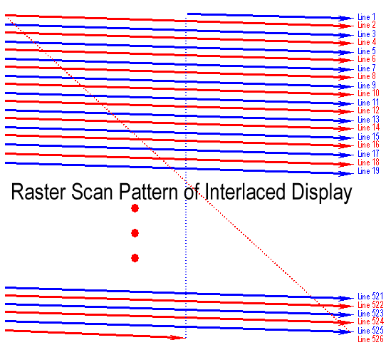
Raster interlaced scanning
Lecture 1

Slide 23

Raster pros and cons
  Disadvantages
    Requires screen-sized memory array
    Discrete spatial sampling (pixels)
    Moire patterns result when shadow-mask and dot-pitch frequencies are mismatched
    Convergence (varying angles of approach distance of e-beam across CRT face)
    Limit on practical size (< 40 inches)
    Spurious X-ray radiation
    Occupies a large volume
  Advantages
    Allows solids to be displayed
    Uses low-cost CRT H/W (TVs)
    Whole Screen is constantly updated
    Bright light-emitting display technology
Lecture 1

Slide 24
Resolution & Sampling
World is continuous, digital media is discrete ...
World has to be sampled at a finite resolution.
Three aspects:
Color and intensity resolution: ()
  Physical limits: color “pigments,”, saturation.
  Human limits: just-noticeable-differences.
Spatial resolution: (x, y)
  Physical limits: controllable pixel size, frame buffer size
  Human limits: photoreceptor density + optics.
Temporal resolution: t
  Physical limits: film transport, channel bandwidth.
  Human limits: neuronal response time.
Lecture 1

Slide 25
Perceptual Resolutions
Experiments
Resolving lines pairs, sinusoidal gratings
  Max 50-60 cycles per degree, or 1 min of arc.
Hyperacuity
  5 arcsecs for very fine line position judgements!
Measurements of the photoreceptor mosaic
Foveal (1deg.) vs. peripheral
Two types of photorceptors
Rods: 100 million total, 1μm diameter
Cones: 3 subtypes (L,M,S), 5 million total
1 μm ( fovea ) -10 μm ( peripheral ) diameter.
Fovea resolution: 10 arcmins (S), 0.5 arcmins (L,M) spacing
Source : P Hanrahan 98
Lecture 1

Slide 26
Image Resolution in Practice
Television
NTSC 640x480x8b 1/4 MB
GA-HDTV 1920x1080x8b ~2MB
Workstations
Bitmapped display 960x1152x1b ~1 Mb
Color workstation 1280x1024x24b 5 MB
Laserprinters
300 dpi (8.5”x300)(11”x300) 1.05 MB
2400 dpi (8.5”x2400)(11”x2400) ~64 MB
Film (line pairs/mm)
35mm (diagonal) slide (ASA25~125 lp/mm) = 3000
  3000 x 2000 x 3 x 12b ~27 MB
Source : P Hanrahan 98
Lecture 1

Slide 27
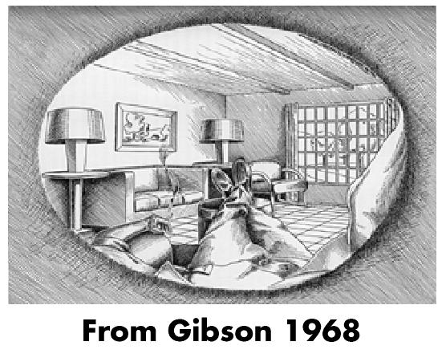
Field of View
Visual field
Monocular : 160 deg (h) x 135 deg (v)
Binocular : 200 deg (h) x 135 deg (v)
Wide field of view creates a sense of immersion
Conventional television viewing :
FOV = 10deg
10 deg/1200 lines
= 0.5 arcmin
h
7.1 h
Source : P Hanrahan 98
Lecture 1

Slide 28
Aspect Ratio
Frame aspect ratio (FAR) = horizontal/vertical size
TV 4:3
HDTV 16:9
US Page 8.5:11 ~ 3:4
35mm 3:2
Panavision 2.35:1
PAR = pixel aspect ratio, = FAR * vres/hres.
Lecture 1

Slide 29
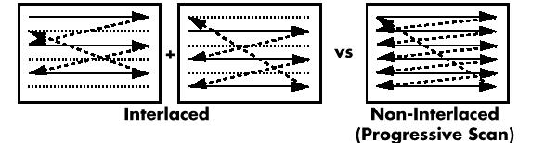
Refresh Rates and Bandwidth
Critical flicker fusion rate
high ambient light, large field: - 80 Hz
low ambient light: 20-30 Hz
Frames per second (FPS)
Film (double framed) 24 FPS
NTSC (interlaced) 30 FPS x 1/4 MB/F = 8 MB/s
Workstation (non-interlaced) 75 FPS x 5 MB/F = 375 MB/s
Even field
Odd field
Image © P Hanrahan
Lecture 1

Slide 30
Memory Bandwidth – crucial!
CPU Speed : Moores Law, 2x per year.
Memory capacity per chip: 50% per year.
Cost per MB : 40% per year.
Bandwidth (per pin) : 12% per year.
Access time : 10% per year.
Source: Torborg et al 1996.
Lecture 1

Slide 31
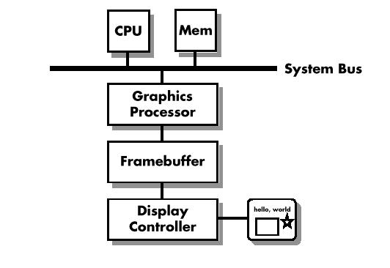
Raster Graphics System Architecture
Image © P Hanrahan
Lecture 1

Slide 32
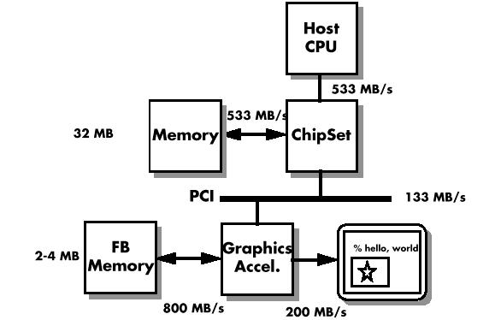
Home PC Architecture
Image © P Hanrahan
Lecture 1

Slide 33
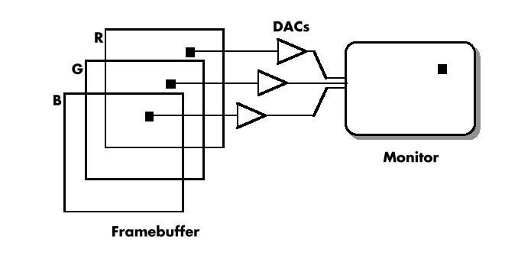
RGB Framebuffer
Image © P Hanrahan
Lecture 1

Slide 34
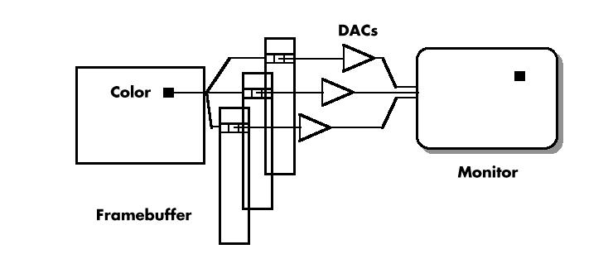
Colour Index Framebuffer
Image © P Hanrahan
Lecture 1

Slide 35
Other Buffers
Single and double buffering: Front and Back
Z-Buffer - remove hidden lines.
Texture Map Buffer
Accumulation Buffer - for multiple rendering.
Stencil Buffer - for masking purposes.
Stereo: Left and Right
Lecture 1

Slide 36
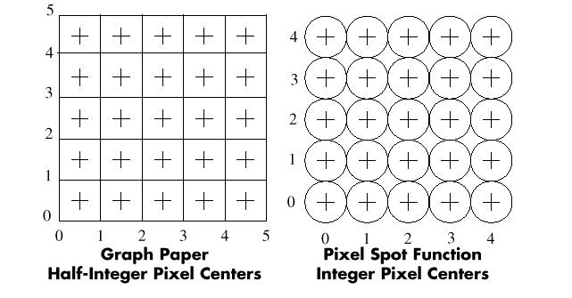
Pixel Conventions
Image © P Hanrahan
Lecture 1

Slide 37
Overlap Model
Pixel value is a weighted average over a spot with radius i.
Weighting function is conical, or more optimally gaussian.
CRT pixels overlap.
A Pixel is NOT a little square.
2i
Lecture 1

Slide 38
Measuring Light and Colour
Physics: Radiometry
  The amount of power per wavelength interval
  Termed radiance, we will often use intensity
Psychophysics: Photometry, later colorimetry
  The relative brightness of a light source (colour or black/white) when compared with a standard candle
  Termed luminance
  Uniform perceptual scale
  Termed lightness
Lecture 1

Slide 39
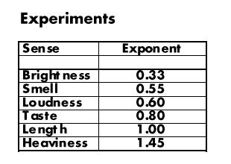
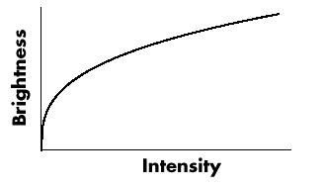
Perception of Intensities
Steven’s Law
  Sensation (S) vs. Intensity (I)
  S = I^{P}
Source : P Hanrahan 98
Lecture 1

Slide 40
Contrast
Contrast or Dynamic Range : Imax/Imin
Human Vision: 100:1
Printed page: 10:1
Film, monitors: 80:1
Typical viewing conditions: 5:1
Source : P Hanrahan 98
Lecture 1

Slide 41
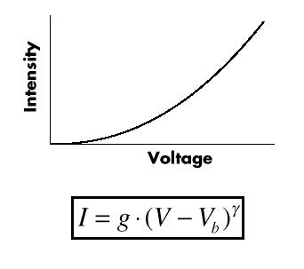
Monitor Gamma
Typical Monitor, γ = 2.5
Two controls on monitor:
  Black Level (Brightness): Vb
  Picture (Contrast): g
Source : P Hanrahan 98
Lecture 1

Slide 42
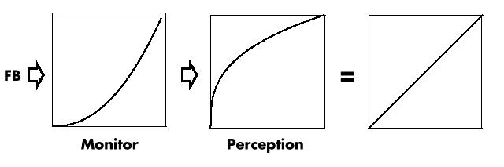
Monitor + Perception = Linear
Linear !
If we linearly increment CRT control voltage, we linearly increment values of perceived brightness
Source : P Hanrahan 98
Lecture 1
Notes:
Perception space / intensity space – not examinable.

Slide 43
Perceptual Space
Has better distribution of values
Has better saturation of colours
But difficult to compute lighting, blending, etc.
Big problem!
Lecture 1

Slide 44
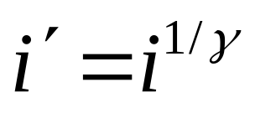
Intensity Space.
Operate in a linear intensity space
Need to apply gamma correction before calculating voltages.
Use look-up table related to monitor.
Typically gamma = 2.5
Lecture 1

Slide 45
Example of TV.
TV’s need to display images in intensity space.
TV’s have a gamma of 2.5
Perform gamma correction in camera.
Cheaper and better immunity to noise.
See also http://www.vtiscan.com/~rwb/gamma.html
Scene
Transmission
Viewer
Camera, γ = 0.45
TV, γ = 2.5
Source : P Hanrahan 98
Lecture 1

Slide 46
Quantization
Definition: The process of turning a high precision number into a low precision number
Why?
Conserve memory
Binary output devices
How?
Minimize error
Distribute error spatially
Lecture 1
Notes:
Quantization – not examinable.

Slide 47
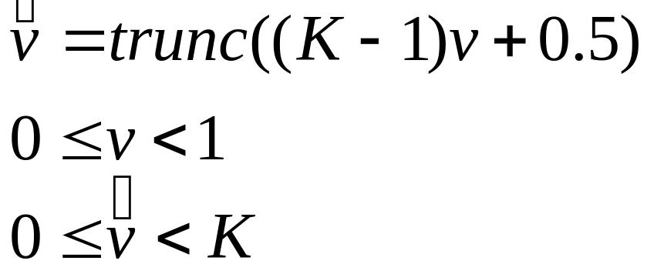
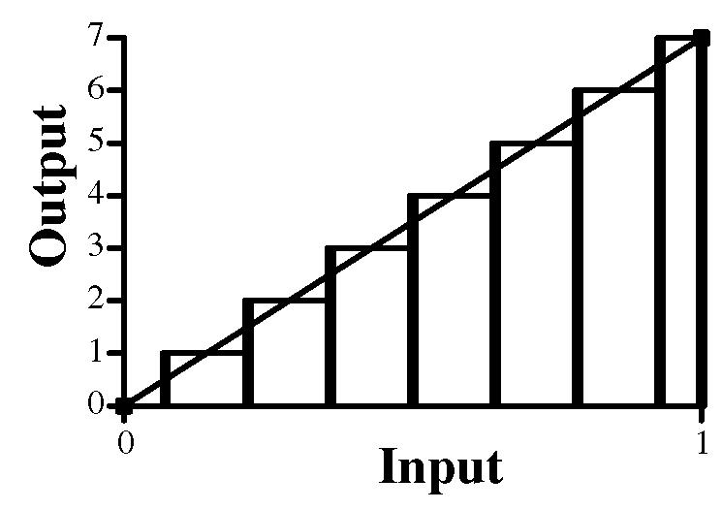
Uniform Quantization
Uniform map:
K = 8
Lecture 1

Slide 48
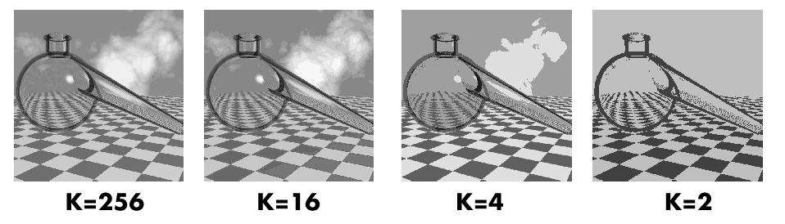
Uniform Quantization
Lecture 1

Slide 49
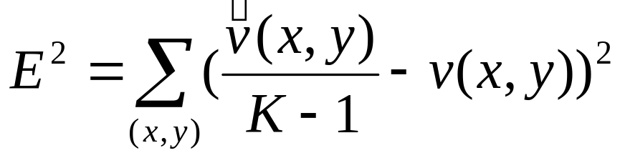
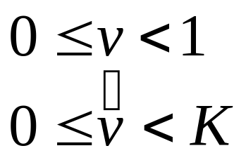
Quantization Error
Quantization introduces error
To reduce error:
1. Optimal quantization (minimize error)
2. Dithering (trade-off intensity/space error)
Lecture 1

Slide 50
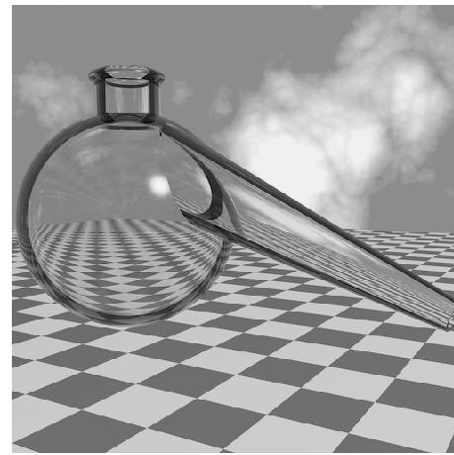
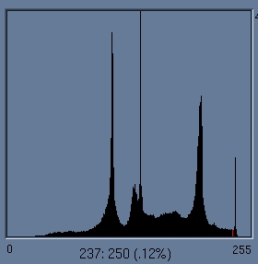
Image Histogram
Uniformly quantize image to M levels.
Plot number of pixels within each level.
As bin size -> 0
Divide by total number to get pixel probability distribution function p(v)
Lecture 1

Slide 51
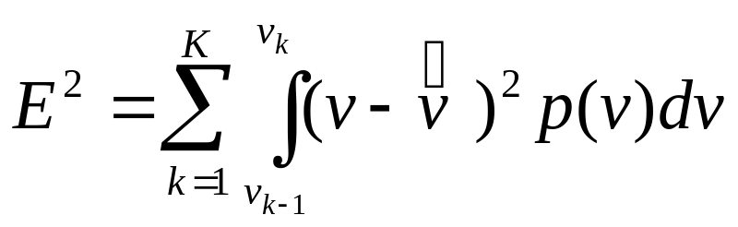

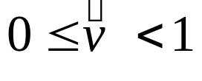

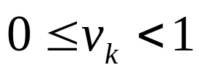
Non-uniform Quantization.
Re-write error in terms of p(v).
Quantised value of v,
Value of v at interval k,
Note : these values no longer integers 0….K
Lecture 1

Slide 52

Optimum Quantization.
Minimise error
  Error from each interval is equal.
P(v)
Area defines error.
v
Lecture 1

Slide 53
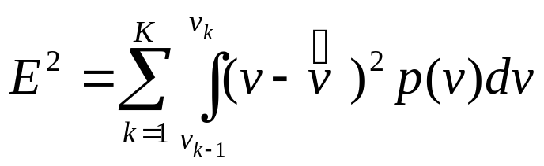
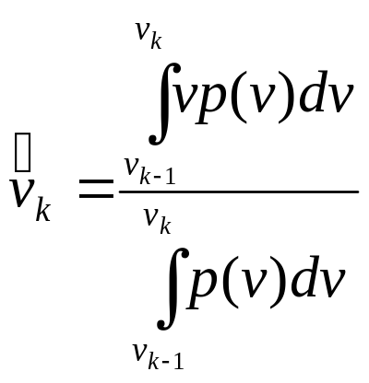

Least Squares Quantization.
Calculate
Means.
P(v)
Lecture 1

Slide 54
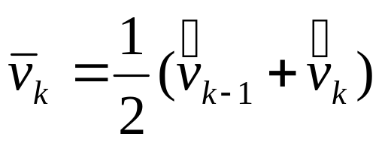


Least Squares Quantization.
interval
P(v)
Solve by iteration.
Move intervals towards larger p(v)
Lecture 1

Slide 55
Summary
Resolution and Sampling
Bandwidth
A pixel is NOT a little square
Intensity
Gamma correction
Quantization
Lecture 1

