Slide 1
Computer Graphics
Animation Techniques
Solving Ordinary Differential Equations

Slide 2
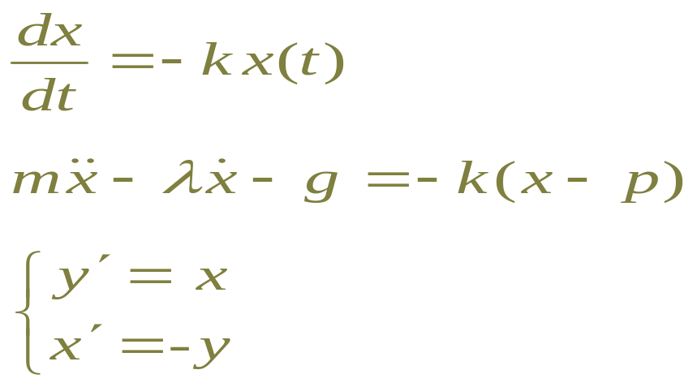
What is an ODE?
Ordinary Differential Equation
Relates value of a function to its derivatives:
“Ordinary” = function of one variable
Partial Differential Equation (PDE): more variables

Slide 3
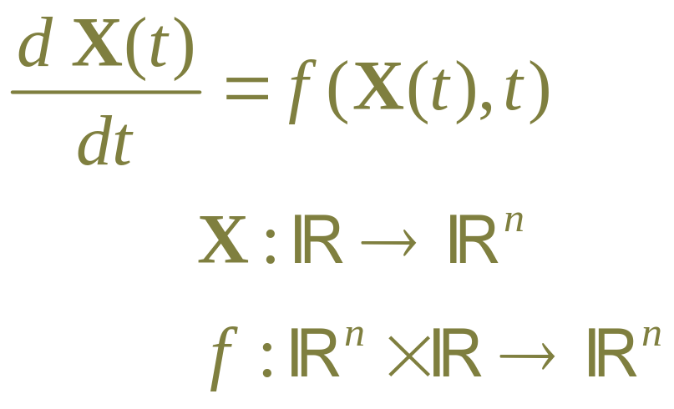
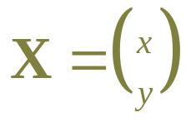
Standard ODE
Generic form for first-order ODE:
Note:
  typically t is time
  sometimes use Y instead of X, sometimes x instead of t
  names sometimes confusing: often

Slide 4
Why do we care?
Differential equations describe (almost) everything in the world:
  physics
  chemistry
  engineering
  ecology
  economy
  weather
  …
Also useful for animation!
ODEs are fundamental. PDEs build on ODEs

Slide 5
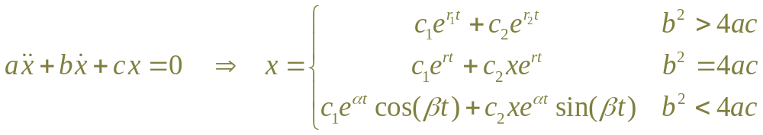
Solving differential equations
Analytic solutions to differential equations
  Many standard forms, e.g.
But most can’t be solved analytically

Slide 6
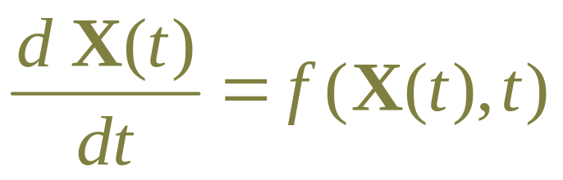
Numerical solutions to ODEs
Given a function f(X,t) compute X(t)
Typically, initial value problems:
  Given values X(t₀)=X₀
  Find values X(t) for t > t₀
Also, boundary value problems, constrained problems, …

Slide 7
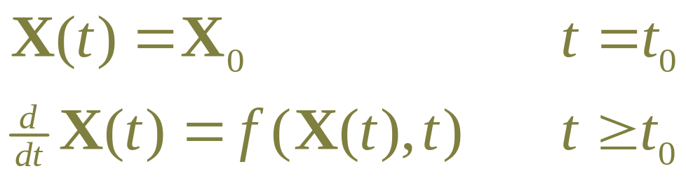
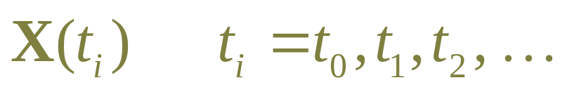
Solving ODEs for animation
For animation, want a series of values:
  samples of the continuous function X(t)
  i.e., frames of an animation

Slide 8

Path through a field
f(X,t) is a vector field defined everywhere
  it may change based on t

Slide 9
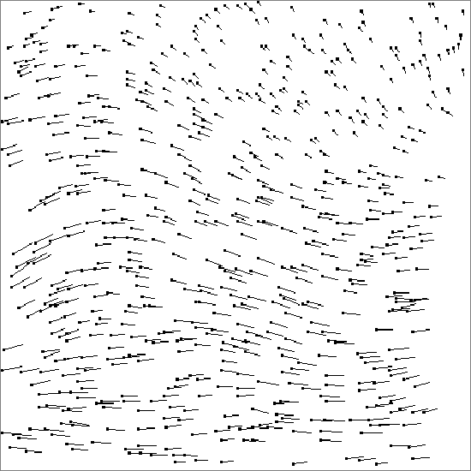
Path through a field
f(X,t) is a vector field defined everywhere
X(t) is a path through the field
X₀

Slide 10
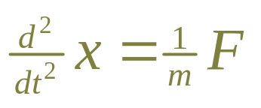
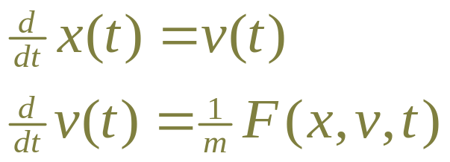
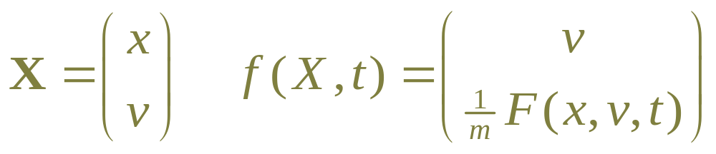
Higher order ODEs
E.g., Mechanics has 2nd order ODE:
Express as 1st order ODE by defining v(t):

Slide 11
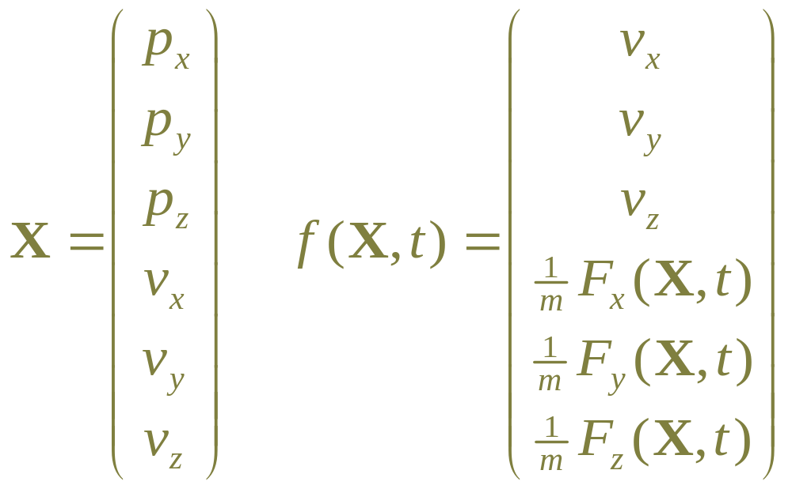
E.g., for a 3D particle
We have a 6 dimension ODE problem:

Slide 12
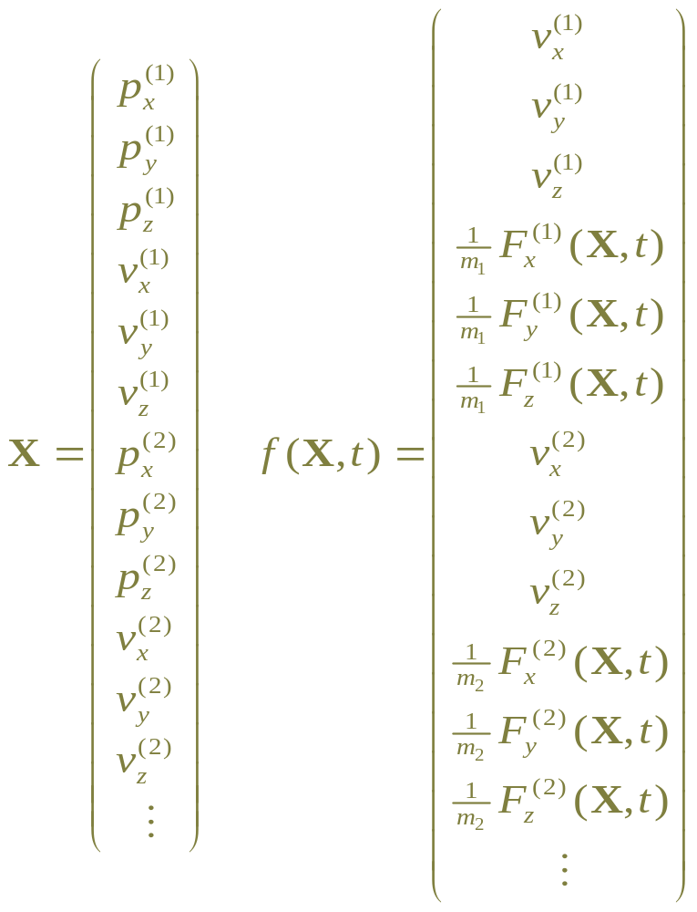
For a collection of 3D particles…

Slide 13
Still, a path through a field:
X(t) maybe path in multi-body phase space
For ODE, it’s an array of numbers.
X₀

Slide 14
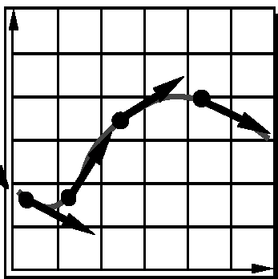
Intuitive solution: take steps
Current state X
Examine f(X,t) at (or near) current state
Take a step to new value of X
Most solvers do some form of this

Slide 15
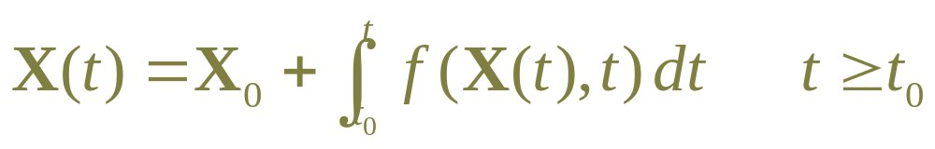
Aside: Integral equation
Note, differential equation:
is equivalent to integral equation:

Slide 16
Outline for today
Course business
Solving Ordinary Differential Equations
  Introduction
  Explicit Methods
  Adaptive step size
  Implicit methods
  Summary

Slide 17
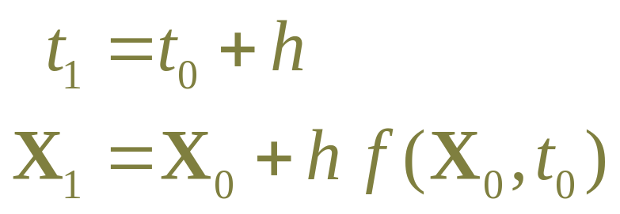
Euler’s method
Simplest and most intuitive.
Define step size h
Given X₀=X(t₀), take step:
Piecewise-linear approximation to the curve

Slide 18
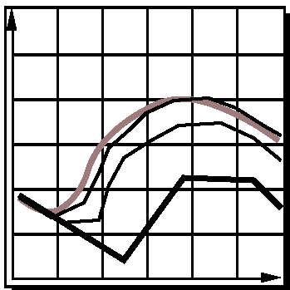
Step size controls accuracy
Smaller steps more closely follow curve
For animation, may need to take many small steps per frame

Slide 19
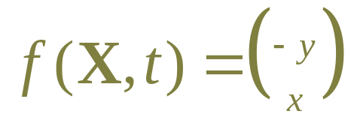
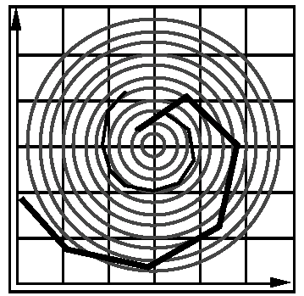
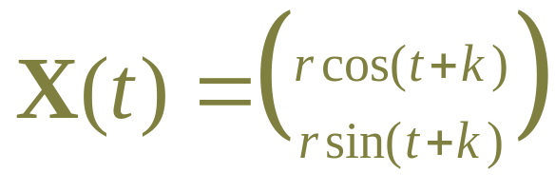
Euler’s method: inaccurate
Moves along tangent; can leave curve, e.g.:
Exact solution is circle:
Euler’s spirals outward
no matter how small h is

Slide 20
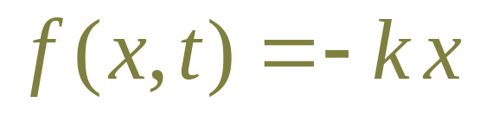
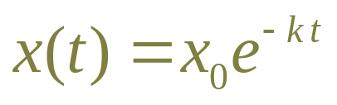
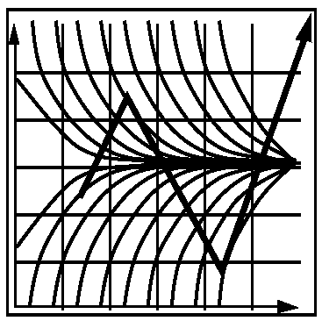
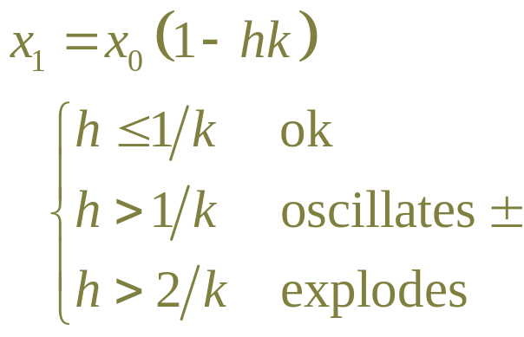
Euler’s method: unstable
Exact solution is decaying exponential:
Limited step size:
If k is big, h must be small

Slide 21
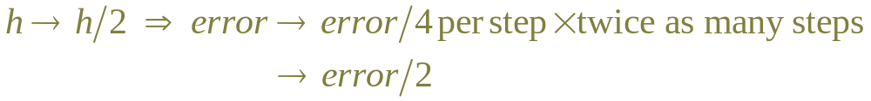
Analysis: Taylor series
Expand exact solution X(t)
Euler’s method approximates:
First-order method: Accuracy varies with h
To get 100x better accuracy need 100x more steps

Slide 22
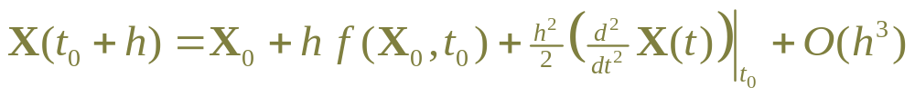
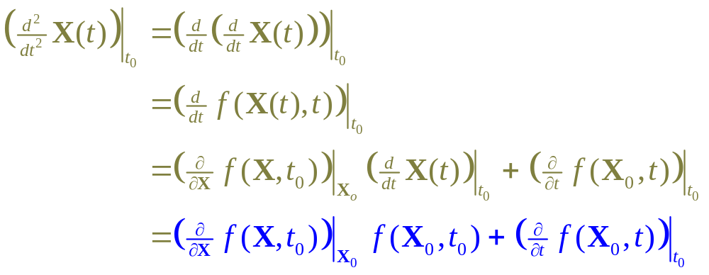
2nd-order methods
Want another term of Taylor expansion:
Differentiate:

Slide 23
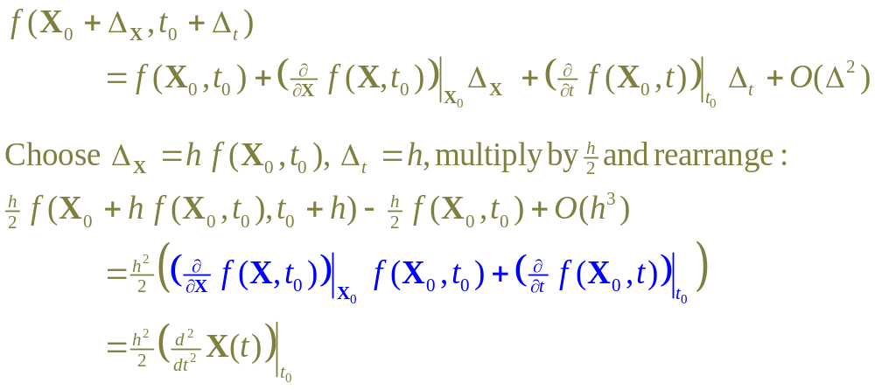
2nd-order method continued…
Don’t want to compute derivatives of f(X,t)
Instead, use Taylor expansion:

Slide 24
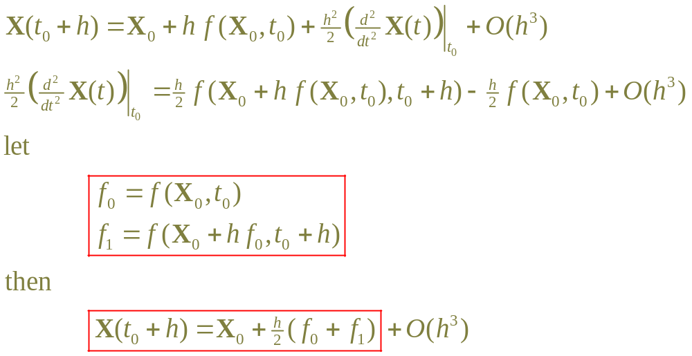
2nd-order methods continued…
Now combine these:
This is the trapeziod method,
AKA improved Euler’s method

Slide 25
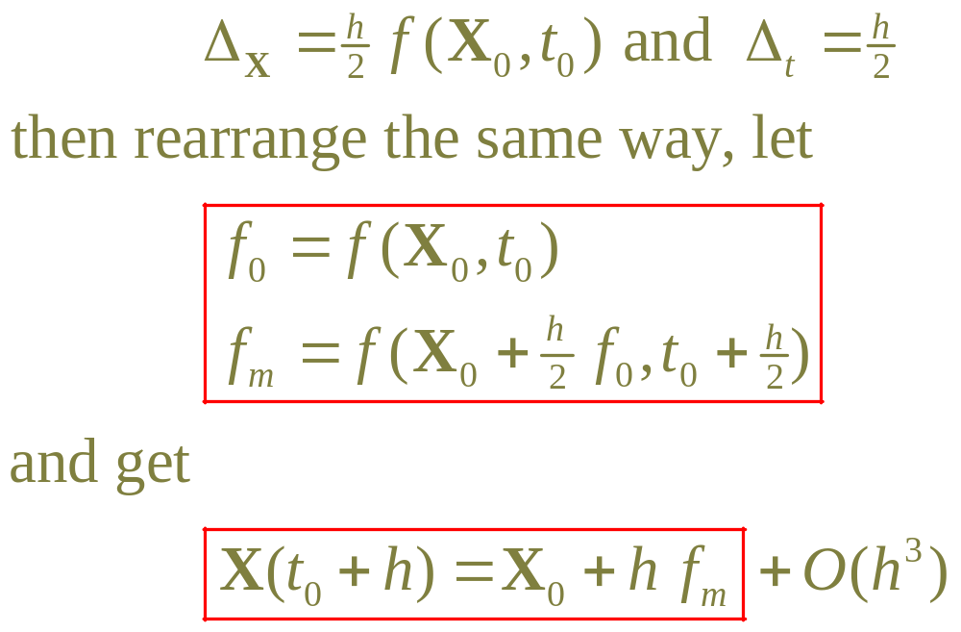
2nd-order methods continued…
Could also have chosen
This is the midpoint method

Slide 26
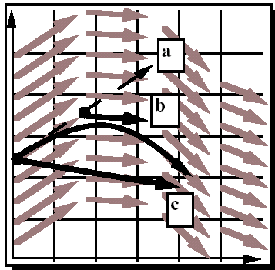
2nd-order methods
Midpoint:
½ Euler step
evaluate f_{m}
full step using f_{m}
Trapezoid:
Euler step
evaluate f₁
full step using f₁
average (a) and (c)
Midpoint method

Slide 27
Aside: Note about program state
For Euler’s method
  f(X,t) only called with values of X,t on the computed path.
  f(X,t) could just examine current state
  Easy to write program
For all other methods:
  Solver probes various values of X,t
  f(X,t) doesn’t examine or change current state
  Trickier to write program

Slide 28
Efficiency
often evaluating f(X,t) is expensive
2nd-order methods evaluate f(X,t) twice per step
Compared to Euler, for given accuracy:
  evaluates f take square root of the number of steps
  Effect is overall more efficient

Slide 29
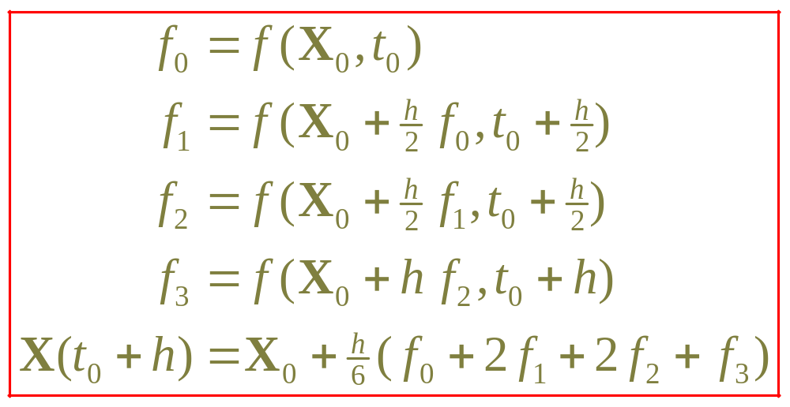
Runge-Kutta method
Follow same derivation for higher order
4th order:
This is what most people use most often

Slide 30
Outline for today
Course business
Solving Ordinary Differential Equations
  Introduction
  Explicit methods
  Adaptive step size
  Implicit methods
  Summary

Slide 31
Adaptive step size
How do you pick the step size?
Want large as possible given acceptable error.
Best step size might change along path
  “harder” and “easier” parts of the path
  decrease/increase step size as needed
Automatic adaptive step size control

Slide 32
Adaptive step size
Given h, take step and estimate error
  if error is too large, try again with smaller h
  if error is small, accept step and maybe increase h
Estimate error: compute X(t₀+h) two ways:
  compute X_{a} by taking one step using h
  compute X_{b} by taking two steps using h/2
  estimated error err = |X_{a} –X_{b}|

Slide 33
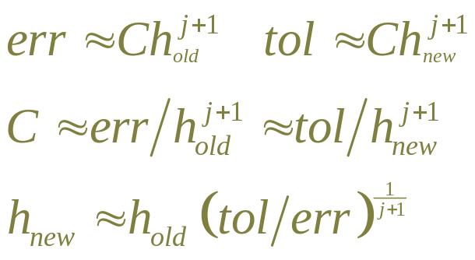



Choosing new step size
for j-order solver, error=O(h^{j+1})
given tolerance=tol
In practice:
  try for h a little below tol:
  don’t change too fast, e.g:
  have absolute bounds:

Slide 34
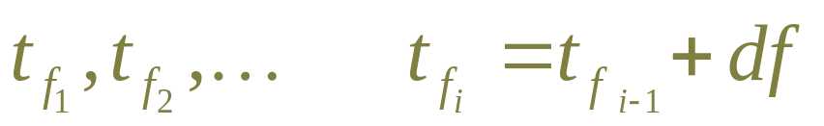
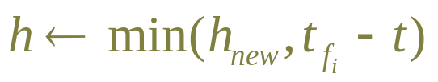
Step size for animation
Want values at regular frame times:
Can make sure not to step past next frame
  OK if h << df
Can step past frame, then interpolate back
  OK if h ~ df
  Need interpolation anyway when doing collisions

Slide 35
Outline for today
Course business
Solving Ordinary Differential Equations
  Introduction
  Explicit methods
  Adaptive step size
  Implicit methods
  Summary

Slide 36
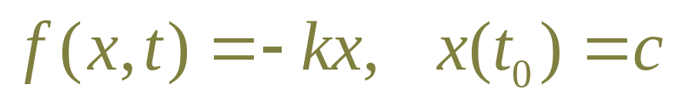
Implicit methods
Earlier example:
  Exponential decay from c down to 0
  The methods seen so far are all unstable
  for large enough k
  Adaptive step size:
    will not explode
    will choose very small steps

Slide 37
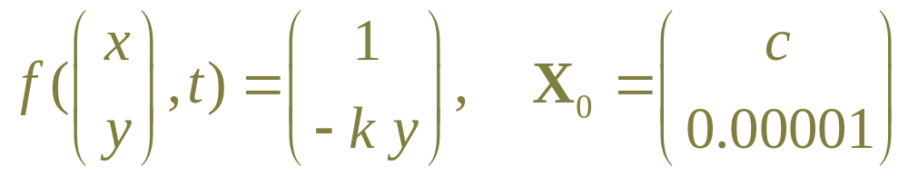
Implicit methods
Related example:
  A particle moving with constant velocity
  along the positive x-axis
  y is essentially 0—nothing happens
  but the explicit solvers need to take tiny steps:
  moves at the slowest time scale

Slide 38
Stiff ODEs
Both examples of stiff systems.
  No formal definition. large –k term, different variables moving at different scales, hard to solve.
  Often particle-spring systems with strong springs.
Instability when f(X,t) changes direction and is larger at the end of the step.
  Derivative at X₀ points towards X₀
  But derivative at X₁ isn’t coming from X₀!

Slide 39
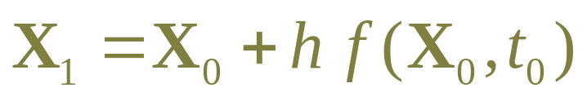
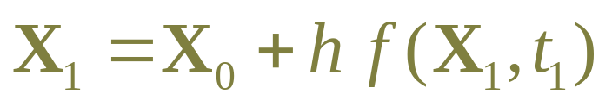
Implicit Euler’s method
Given X₀, t₀, h, t₁=t₀+h
Explicit Euler’s method:
Implicit Euler’s method:
  step uses the derivative at the end
  X₁ is defined by an implicit equation

Slide 40

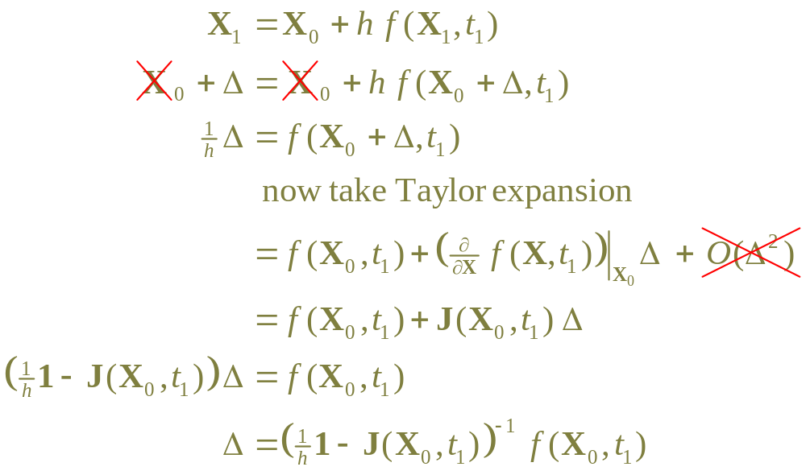
Implicit Euler’s, continued
Rewrite using

Slide 41
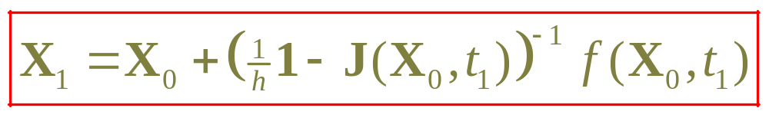
Implicit Euler’s, continued
Implicit Euler’s method:
  need J(X,t) in addition to f(X,t)
  must solve n x n matrix equation each step!
    often J is sparse, can be solved in O(n)
    often J is singular or ill-conditioned
  program is more complex
  but… it’s very stable!

Slide 42
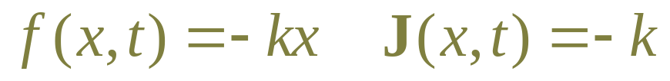
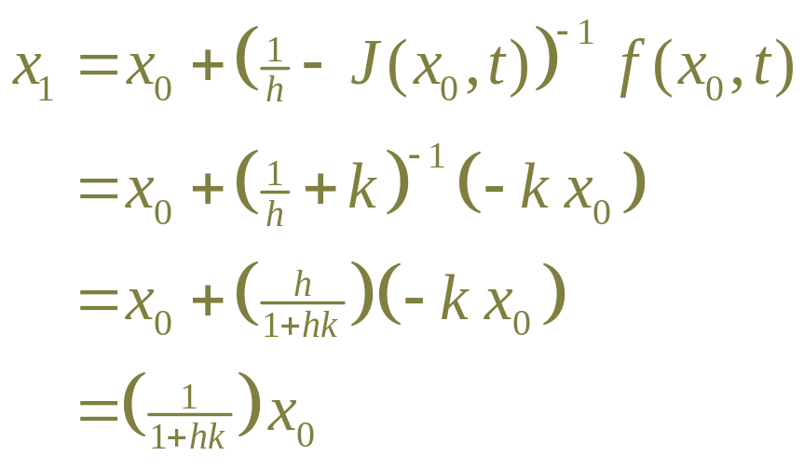
Stability of Implicit Euler’s
Consider exponential decay:
Using implicit Euler’s method:
  no limit on h in this case!
  can take arbitrarily large steps

Slide 43
Accuracy of Implicit Euler’s:
Same as explicit: not very accurate
Tends to “cut off corners”
  Circle example: path is inward spiral
  Attenuates high-frequency motion
  In physical simulations, dissipates energy.

Slide 44
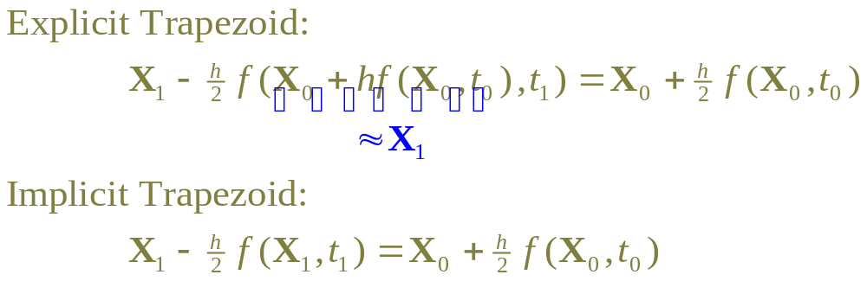
Implicit Trapezoid
  half-step forward from start and
  half-step back from end must
  meet in the middle.

Slide 45
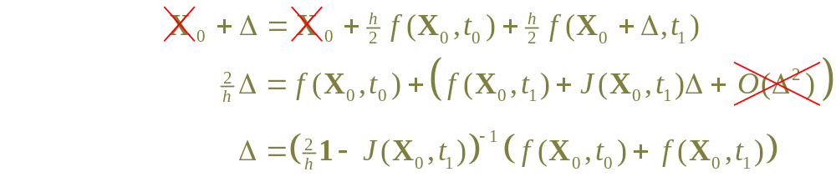
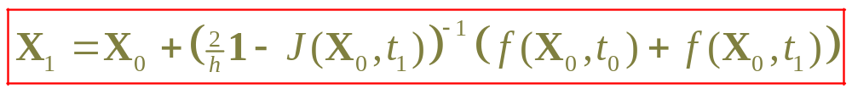
Implicit Trapezoid, continued:
Use Taylor expansion, same as for Euler’s:

Slide 46
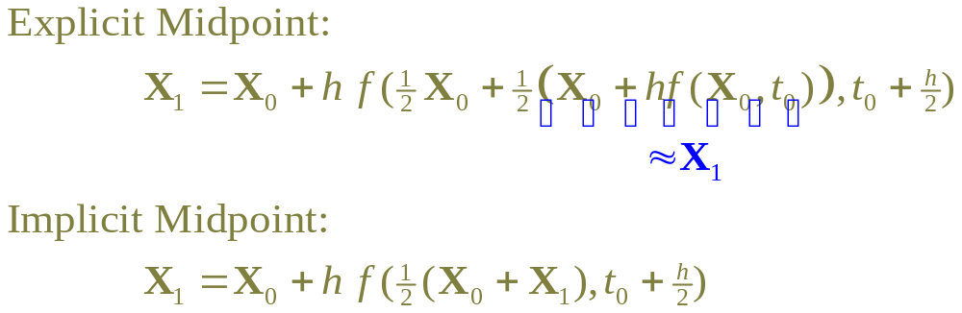
Implicit Midpoint
  the tangent at the midpoint of the start and end must reach from start to end.

Slide 47
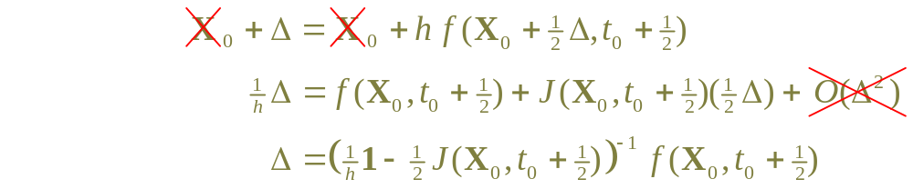
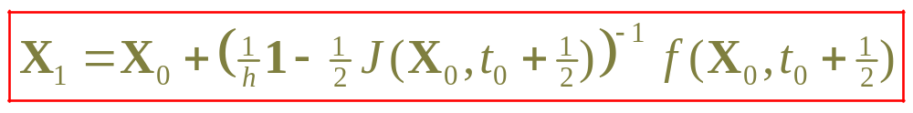
Implicit Midpoint, continued:
Use Taylor expansion again:

Slide 48
Outline for today
Course business
Solving Ordinary Differential Equations
  Introduction
  Explicit methods
  Adaptive step size
  Implicit methods
  Summary

Slide 49
Is there a solution?
The function f(X,t) must be smooth
  None of these solvers handle discontinuity
  Adaptive step size may drop to smallest h
Sometimes desired solution has discontinuity
  Rigid-body collisions have discontinuous v
  ODE solver can’t step across discontinuity.

Slide 50
Which solver to choose?
Many more kinds of ODE solvers
  predictor-corrector, boundary-value problems, semi-implicit, differential-algebraic equations, …
  Multi-step methods: keep history of previous values
  Adaptive-order methods
For hard problems, need to understand theory
  lots of theory!
Runge-Kutta (4th order) is a standard workhorse
Try to avoid stiff equations!
Often need to experiment and see what works

Slide 51
For animation…
Don’t need to be accurate, just look good.
Euler’s method w/fixed step size
  Always a bad idea.
  Unless it works for you!

