Slide 1
Computer Graphics
Animation Techniques
Simulation: Particle Systems,
Mass-Spring Systems, Rigid Bodies

Slide 2
Outline for today
Solving ODEs: Summary
Particle Systems
Mass-Spring Systems
Rigid Bodies

Slide 3
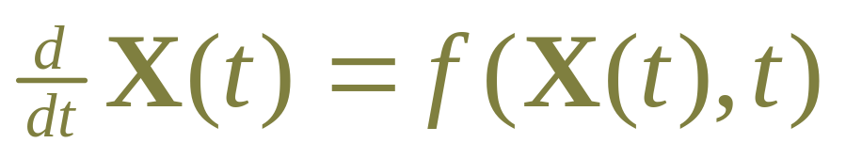
Numerical solutions to ODEs
Given a function f(X,t)
Given initial value X₀
Compute X(t)

Slide 4
Numerical solutions to ODEs
Explicit solvers:
  Euler’s method
  2nd order methods
  Runge-Kutta (4th order) most popular: often
  best accuracy with largest steps
  Need small steps for stiff equations

Slide 5
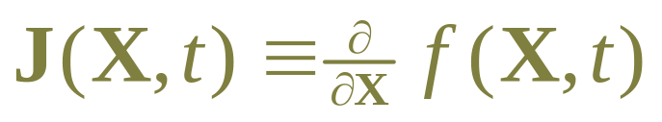
Numerical solutions to ODEs
Implicit methods:
  Implicit Euler, implicit 2nd order:
  Can handle stiff systems
  Solves matrix equation at each step
  Need also a function for Jacobian:

Slide 6
Adaptive Stepsize
Solver takes “one” step
  within error tolerance
  computes estimated step size h for next step
But you don’t know where it will end
We know we want the value at each frame

Slide 7
Solving to a specified time
Step up to (but not past) desired time t_{end}
  Use maximum step size:
    while (t < t_end) {
    hmax = min(HMAX,t_end-t);
    adaptiveStep();
    }
  if step was shortened due to hmax,
  retain previous h for next time
Other choice: step past and interpolate back

Slide 8
Making changes along the way
Not always a pure ODE:
  Sometimes discontinities in motion
  Sometimes add/remove items from simulation
Adjust state after every step
    while (t < t_end) {
    hmax = min(HMAX,t_end-t);
    adaptiveStep();
    X=odeProblem.adjustState(X,t)
    }
  Other choice: interpolate back to time of change
    Provide a function g(X) that is >0 normally, <0 if we passed
    Use root-finding in last step to get t such that g(X(t)) = 0

Slide 9
Outline for today
Solving ODEs: Summary
Particle Systems
Mass-Spring Systems
Rigid Bodies

Slide 10
What’s a particle system?
Collection of many small simple particles
Particle motion influenced by force fields
Particles created by generators
Particles often have lifetimes
Used for, e.g:
  sand, dust, smoke, sparks, flame, water, …

Slide 11
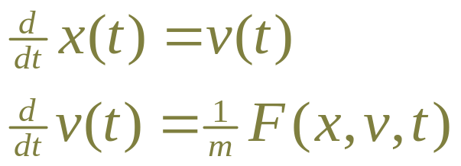
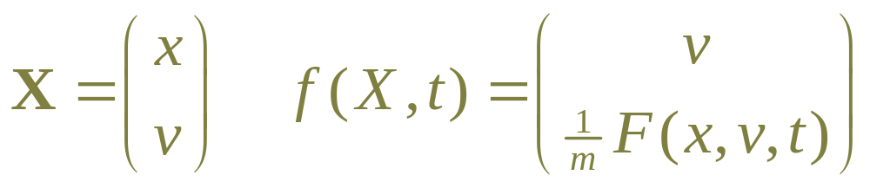
Particle motion
mass m, position x, velocity v
equations of motion:
ODE:

Slide 12
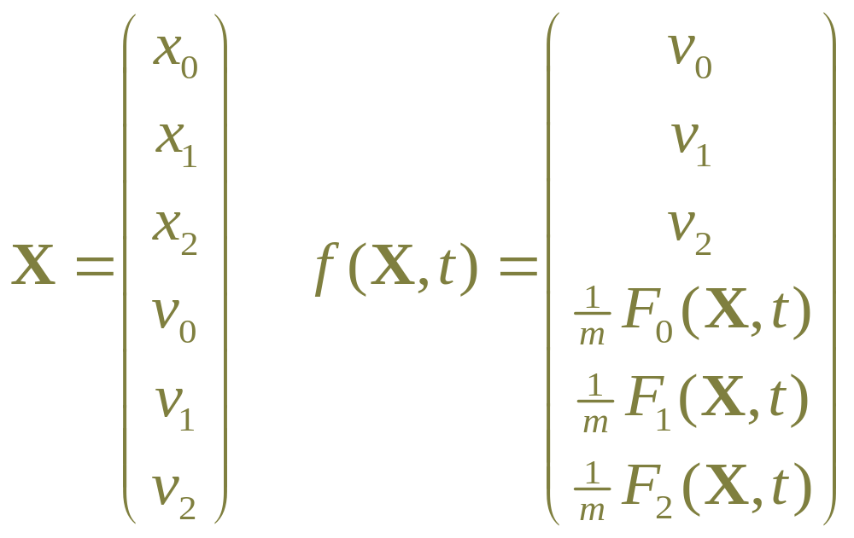
ODE in full:
In 3D we have a 6 dimension ODE

Slide 13
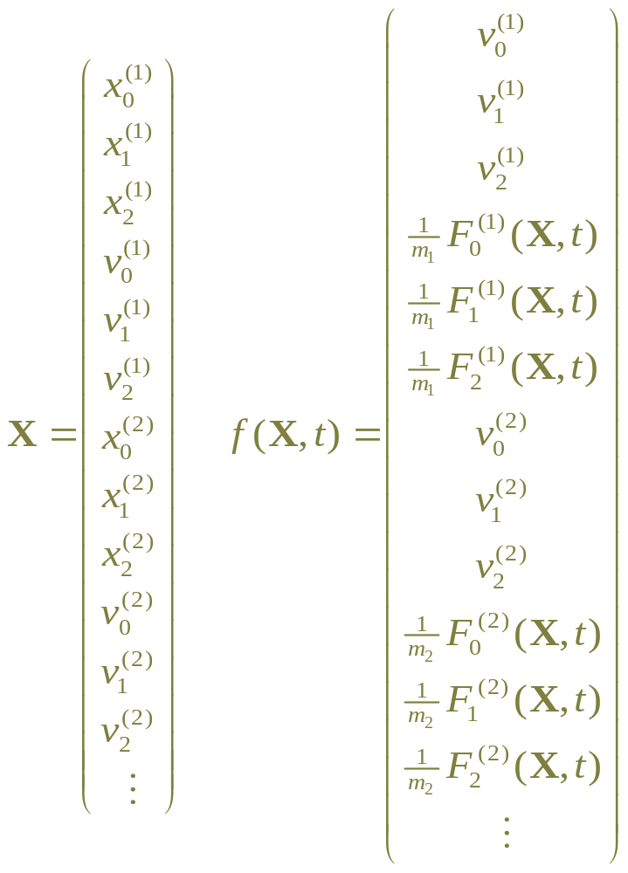
For a collection of 3D particles…

Slide 14
Particle implementation
Particle class
  mass m, position x, velocity v, force accumulator f
  index i into array X:
    X[i+0] ↔ x.x
    X[i+1] ↔ x.y
    X[i+2] ↔ v.x
    X[i+3] ↔ v.y
  derivative function computes
    F[i+0] ← v.x
    F[i+1] ← v.y
    F[i+2] ← f.x/m
    F[i+3] ← f.y/m
Global vector Particles keeps all particles

Slide 15
What is a force?
Force a class
  Computes force function for each particle p
  Adds computed force to total in p.f
Global vector Forces keeps all forces

Slide 16
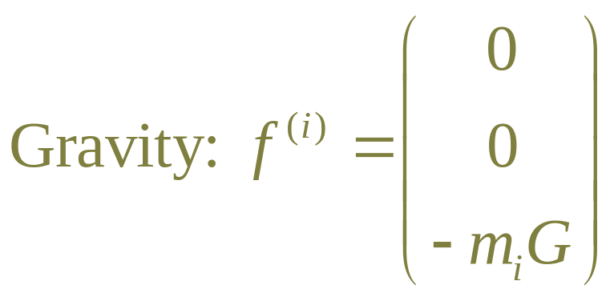
Forces: gravity
depends only on particle mass:
  f(X,t) = constant
for smoke, flame: make gravity point up!

Slide 17
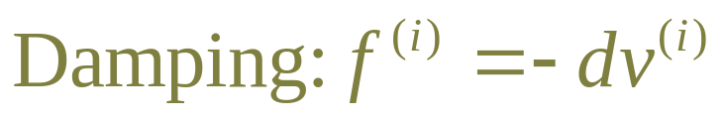
Forces: damping
force on particle i depends only on velocity of i
force opposes motion
removes energy, so system can settle
small amount of damping can stabilize solver
too much damping makes motion like in glue

Slide 18
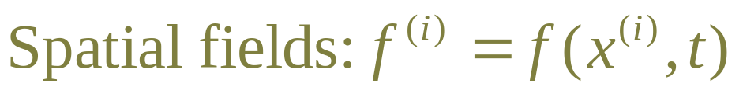
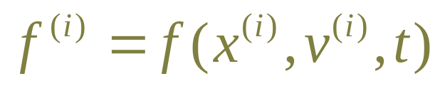
Forces: spatial fields
force on particle i depends only on position of i
arbitrary functions:
  wind
  attractors
  repulsers
  vortexes
can depend on time
note: these add energy, may need damping, so

Slide 19
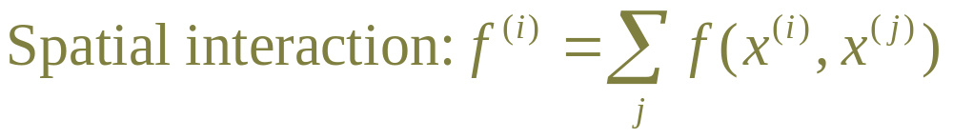
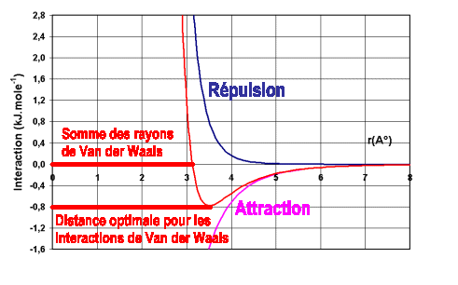
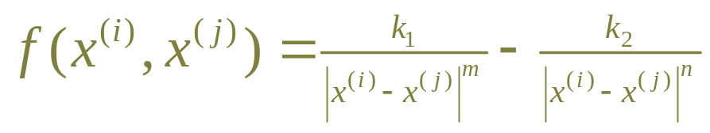
Forces: spatial interaction
e.g., approximate fluid: Lennard-Jones force:
O(N²) to test all pairs
  usually only local
  Use buckets to optimize

Slide 20
Computing f(X,t)
getDerivative(X,t)
for each p in Particles {
p.setState(X)
p.f = 0
}
for each f in Forces {
f.apply(t) // adds to each p.f
}
for each p in Particles {
p.computeDerivative(F)
}
return F

Slide 21
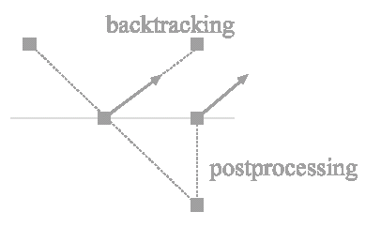
Collisions
Usually don’t test particle-particle collision
Test collision with environment, e.g. ground
Note: step overshoots collision
  Test for penetration
  back up or fixup

Slide 22
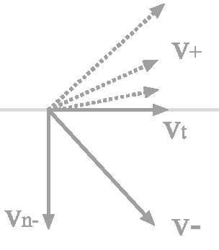
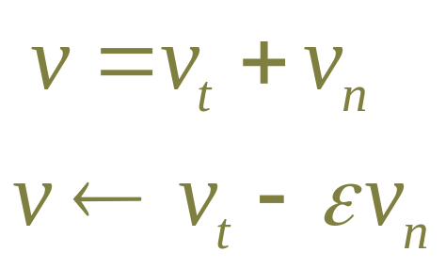
Handling collisions
tangential velocity v_{b} unchanged
normal velocity v_{n} reflects:
  coefficient of restitution
  change of velocity = -(1+є)v
  change of momentum Impulse = -m(1+є)v
  caution: if restitution=0 but
  force keeps pushing, can get stuck

Slide 23
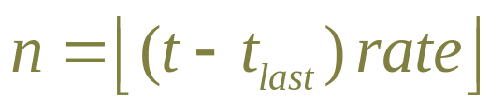
Where do particles come from?
Often created by generators (or “emitters”)
  can be attached to objects in the model
Given rate of creation: particles/second
  record t_{last} of last particle created
  create n particles. update t_{last} if n > 0
Create with (random) distribution of initial x and v
  if creating n > 1 particles at once, spread out on path

Slide 24
Particle lifetimes
Record time of “birth” for each particle
Specify lifetime
Use particle age to:
  remove particles from system when too old
  often, change color
  often, change transparency (old particles fade)
Sometimes also remove particles that are offscreen

Slide 25
Adjusting state at each step
Remember, solver does:
    while (t < t_end) {
    hmax = min(HMAX,t_end-t);
    adaptiveStep();
    X=odeProblem.adjustState(X,t)
    }
adjustState(X,t)
  remove dead or offscreen particles
  perform collisions
  generate new particles
  recompute particle indexes!

Slide 26
Particle systems in practice
Want very many particles 10000’s
Write special-purpose code, e.g.
  No Particle object, work directly in arrays
  Have fixed (max) number of particles
    Don’t create/destroy, just mark if in use
  Hard-wire most common forces (gravity, etc)
  Adjust only at frames
  Use fixed step size (whole frame?)
  Use simple solver

Slide 27
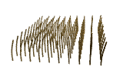
Modeling with particle systems
Can trace the path of particles, connect to form a model
Used sometimes for grass or hair:

Slide 28
Outline for today
Solving ODEs: Summary
Particle Systems
Mass-Spring Systems
Rigid Bodies

Slide 29
Mass-spring systems
Basically same as a particle system
Structured, rather than free form
Mass points part of model
  no generators, no lifetime, no aging
Use spring forces to connect masses
  all forces no longer apply to all points
  Each force object knows which points it acts on

Slide 30
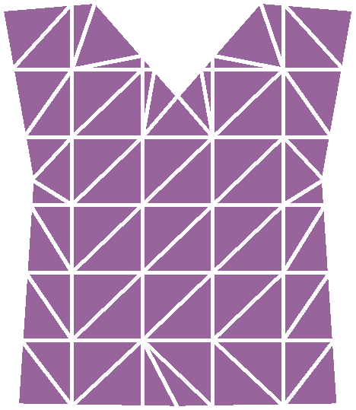
Mass spring systems
Connect points in 1D line:
  used for hair, springs, etc
Connect points in 2D mesh
  used for cloth
Connect points in 3D lattice:
  semi-rigid structures
  used for flesh/muscle motion
    e.g. Jurassic park dinosaurs

Slide 31
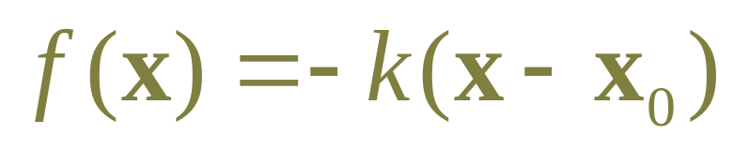
Spring to fixed point
Basic Hooke’s-law spring force:
  Attracts mass to point x₀
  Causes oscillation

Slide 32
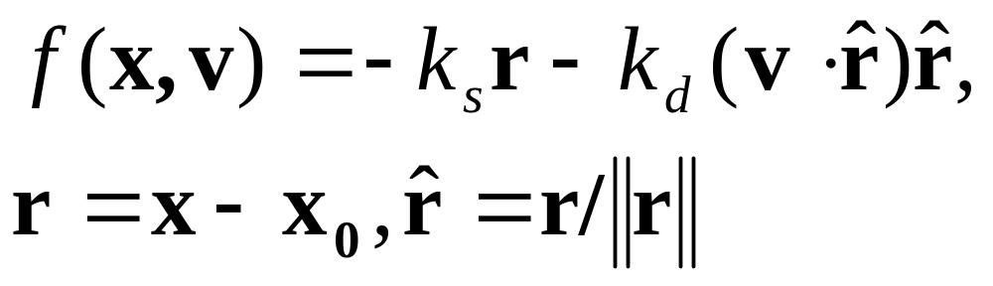
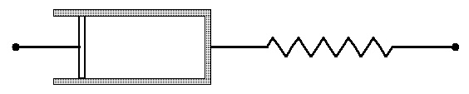
Damped spring
“Spring and dashpot”
  like a car suspension
  only damps motion in direction of spring

Slide 33
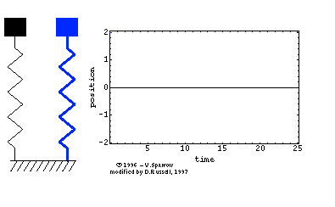
Damped spring
Relationship between k_{s} and k_{d} determines
  underdamping, critical damping, overdamping
  (in isolation)
Always want some damping.

Slide 34
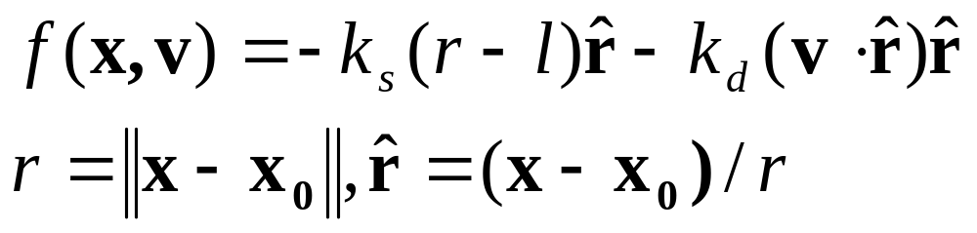
Spring with rest length
Pulls/pushes mass to radius l from x₀

Slide 35
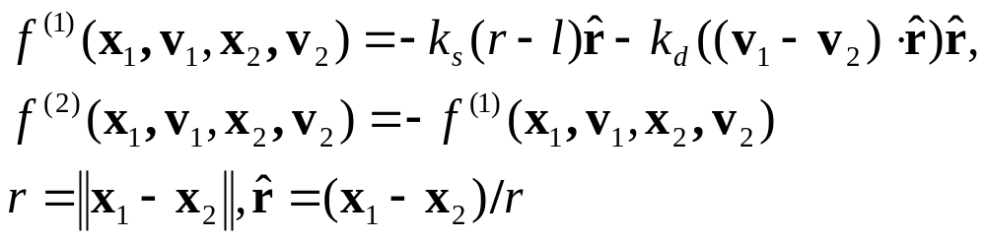
Spring between two points
Symmetric, equal-and-opposite forces
Only applies radially
Pulls/pushes mass to distance l apart

Slide 36
Constructions with springs
connect mass points to make objects
shapes can kink, shear, or collapse
add extra supports
can still be tricky to get desired behavior

Slide 37
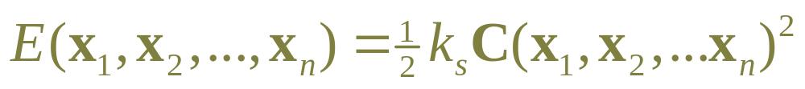
Design “generalized springs”
Usually based on behavior function.
Define a function C(x₁,x₂,…, x_{n})
  C=0 when behavior is correct
  in general C is a vector
  depends only on positions not on velocities
Define potential energy due to this behavior:
  E = 0 system is in desired state
  E > 0 system is deformed: “stress energy”

Slide 38
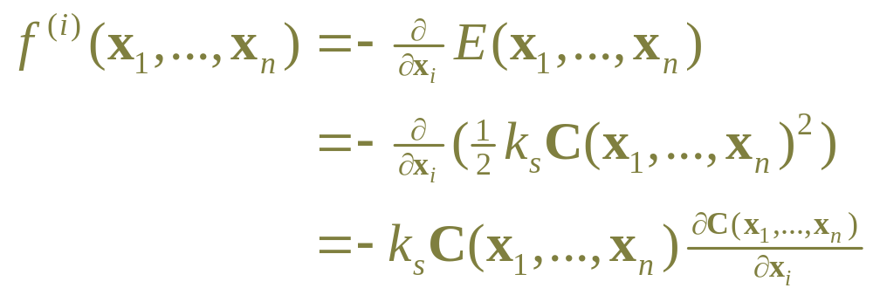
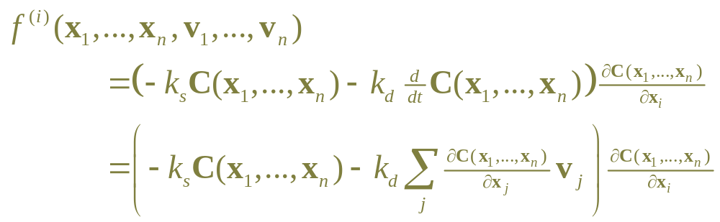
Force to reduce energy
Force due to potential energy is –gradient:
add damping:

Slide 39
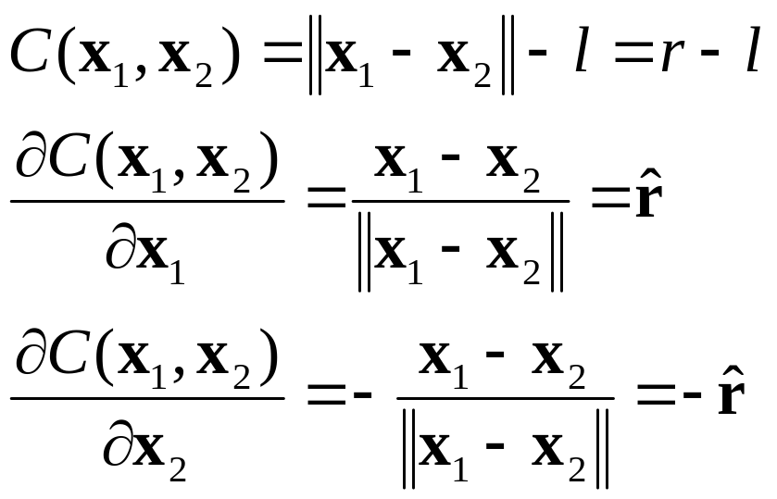
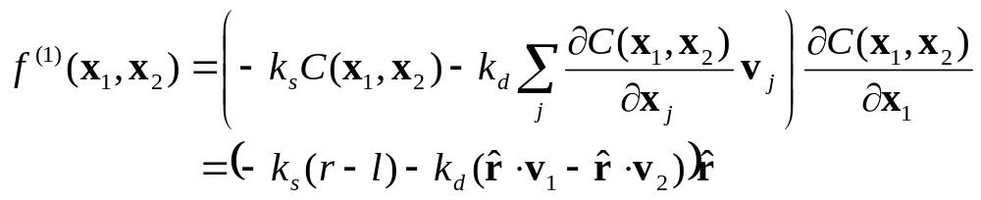
Example energy-based force
Derive standard spring:

Slide 40
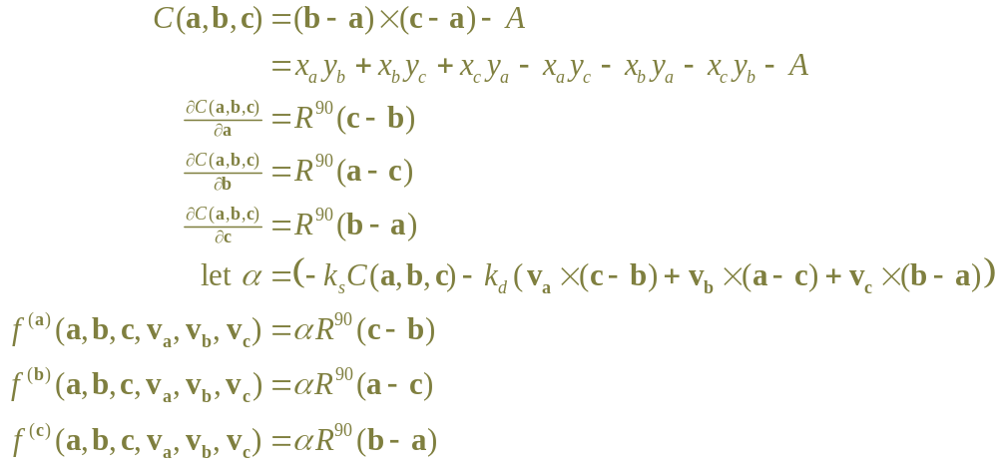
Example energy-based force
Maintain area of a triangle (2D):

Slide 41
Multiple springs
Each spring tries to achieve E=0
Competition between multiple forces
Result is compromise: when stable E≠0
To guarantee result, need constraints

Slide 42
Outline for today
Solving ODEs: Summary
Particle Systems
Mass-Spring Systems
Rigid Bodies

Slide 43
Rigid bodies
Same structure of program, just add a few terms…

Slide 44
Rigid body state
Same as points…
  m is the total mass
  x is the position of the center of mass
  v is the velocity of the center of mass
Plus new terms:
  I is the rotational inertia tensor (scalar in 2D)
  θ is the orientation (angle in 2D; messy in 3D)
  ω is the angular velocity (scalar in 2D; vector in 3D)
Body coordinates:
  origin at x, orientation θ relative to World
  for any shape, m and I completely describe response

Slide 45
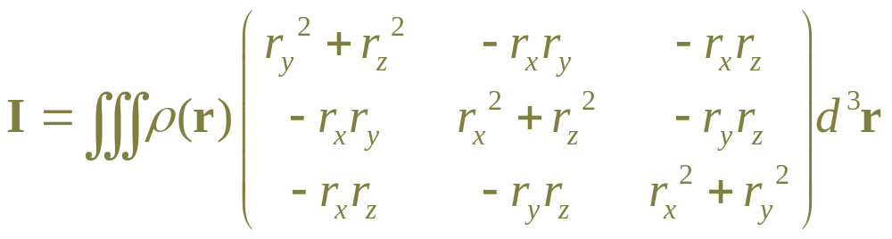
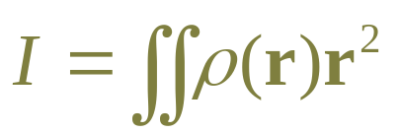
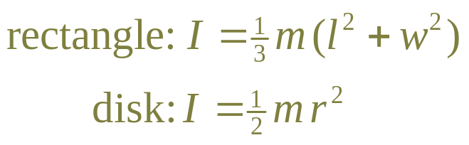
Inertia tensor
Inertia tensor describes mass distribution
  in 3D:
  in 2D:
  for mass density ρ(r), with r in body coordinates
Examples, with uniform density:

Slide 46
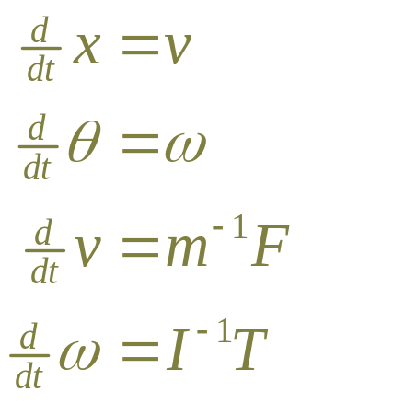
Rigid body equation of motion
Equation of motion has extra terms:
T is torque(转矩）

Slide 47
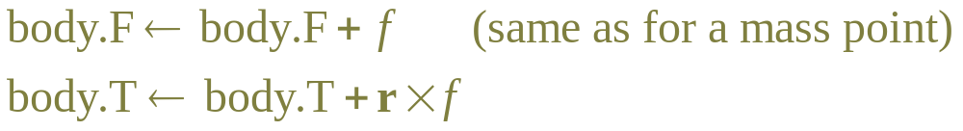
Torque
Each force f acts at a point on body
  r is vector from center of mass to point of action
Torque causes body to spin
  if force acts at center of mass, no torque (gravity)
  if force points towards center of mass, torque=0
  f at r and –f at –r give net torque but no net force

Slide 48
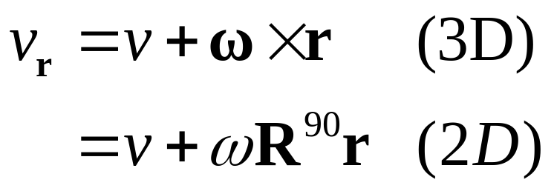
Velocity of a point
E.g. spring is attached at a point r
Damping depends on v_{r}

Slide 49
In the program:
Base class Body
Derived classes Masspoint, RigidBody
method getDimension()
  mass point returns 4, rigid body returns 6
method applyForce(f, r)
  mass point ignores r, just accumulates f
  rigid body accumulates f and r
method getVelocity(r)
  mass point ignores r returns v
  rigid body returns v + ω × r

Slide 50
Collisions
Collisions between two bodies
Need point of collision, and normal vector
  many algorithms…
For body-particle collision
  transform to body coordinates
  see if particle is inside body shape
  compute collision normal in body coordinates
  compute relative velocity in body coordinates
  compute impulse in body coordinates
  transform back to world and apply

Slide 51
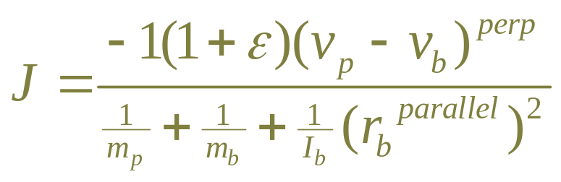
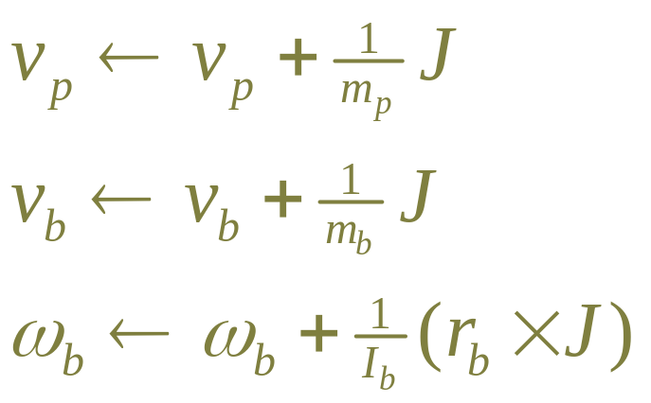
Collision: body and particle
Impulse J perpendicular, given by (2D):
apply using:

Slide 52
Program has…
Global vector Bodies
  all bodies: mass points, particles and rigid bodies
Global vector Particles
  just particles.
Global vector RigidBodies
  just rigid bodies.
Global vector Forces
  forces can act on any kind of body

