Slide 1
Image Processing
Filtering

Slide 2
Linear Filtering
About modifying pixels based on neighborhood. Local methods simplest.
Linear means linear combination of neighbors. Linear methods simplest.
Useful to:
  Integrate information over constant regions.
  Scale.
  Detect changes.
Fourier analysis.

Slide 3
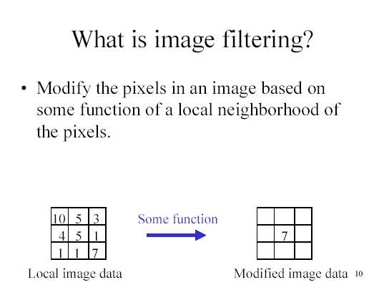

Slide 4
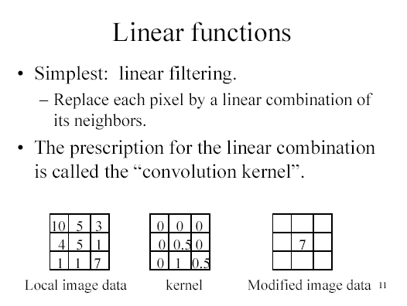

Slide 5
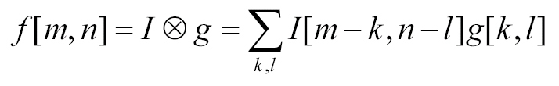
Convolution
Convolution kernel g, represented as matrix.
  it’s associative
Result is:

Slide 6
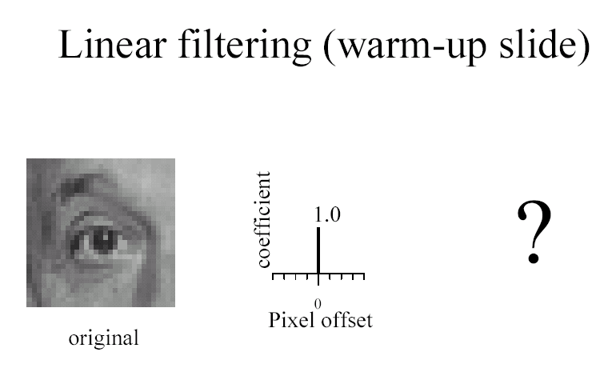

Slide 7
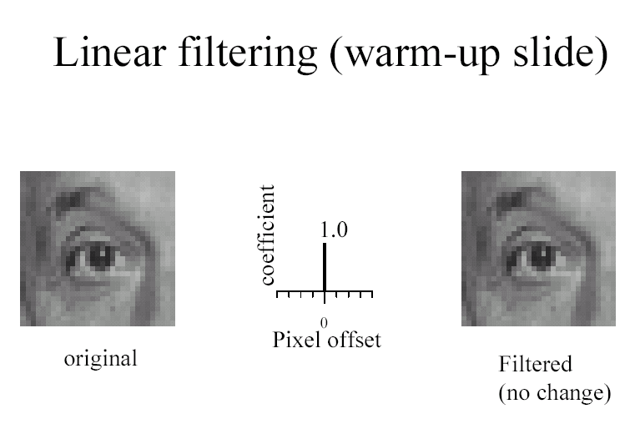

Slide 8
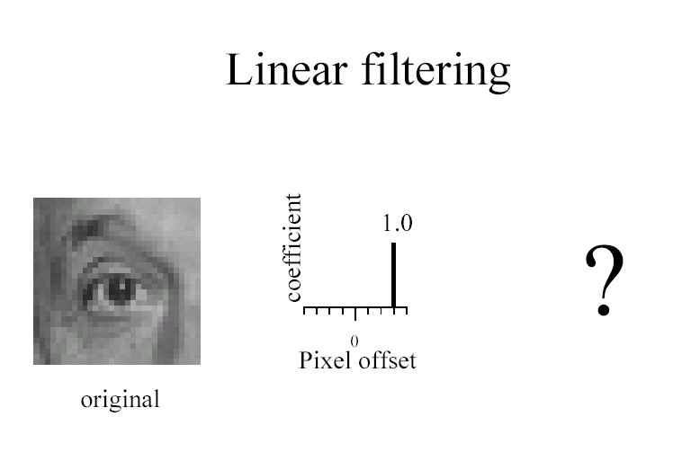

Slide 9
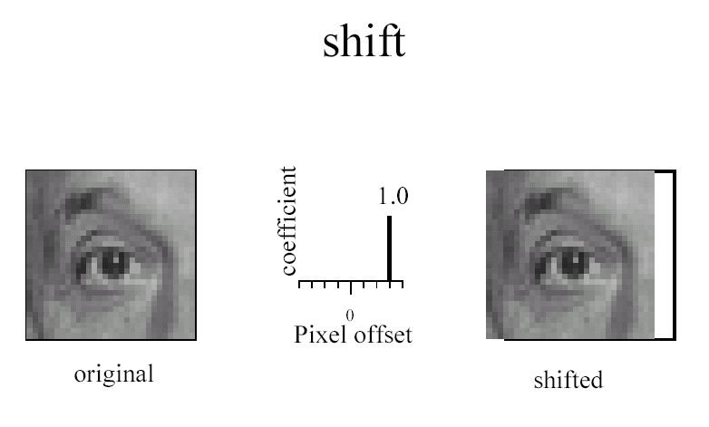

Slide 10
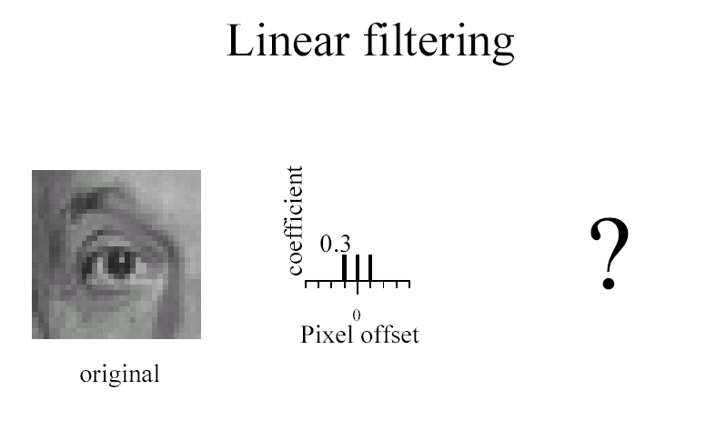

Slide 11
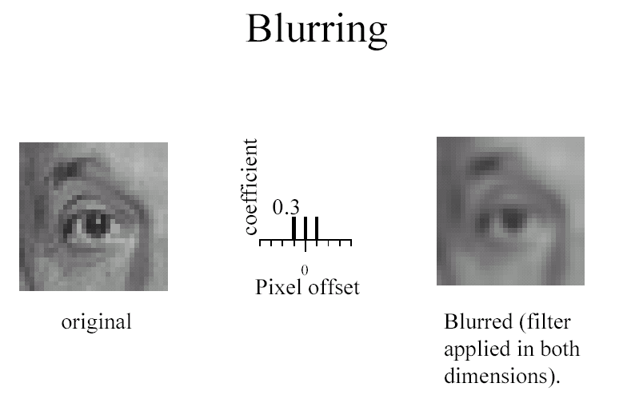

Slide 12
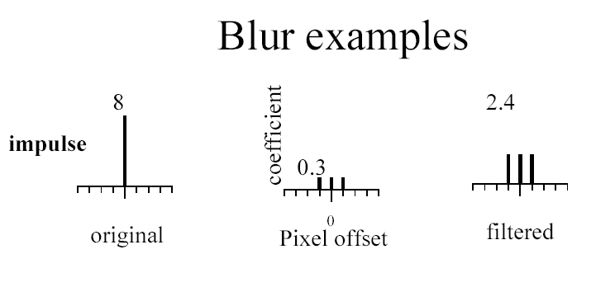

Slide 13
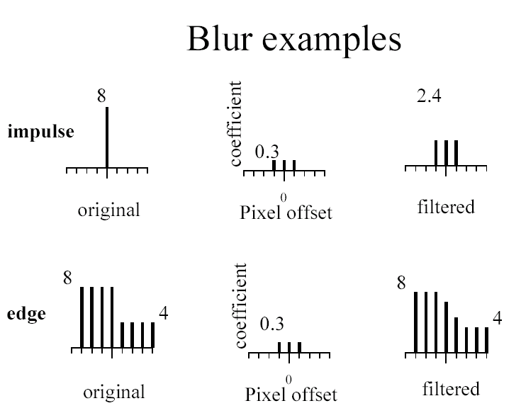

Slide 14
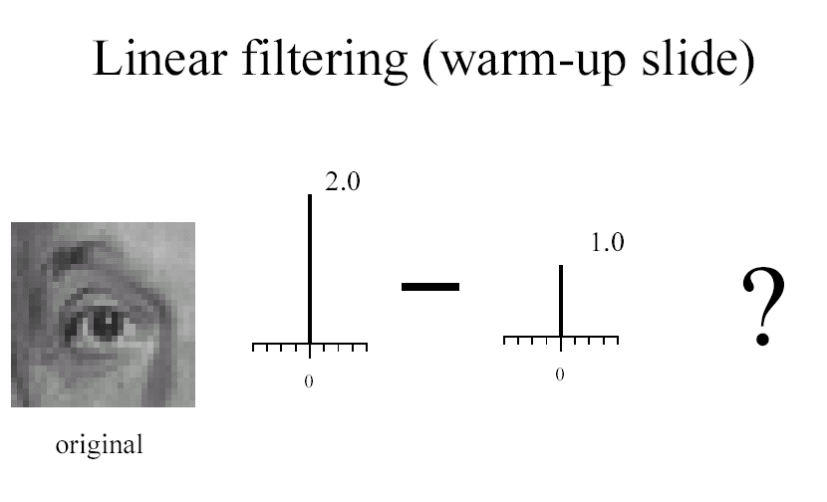

Slide 15
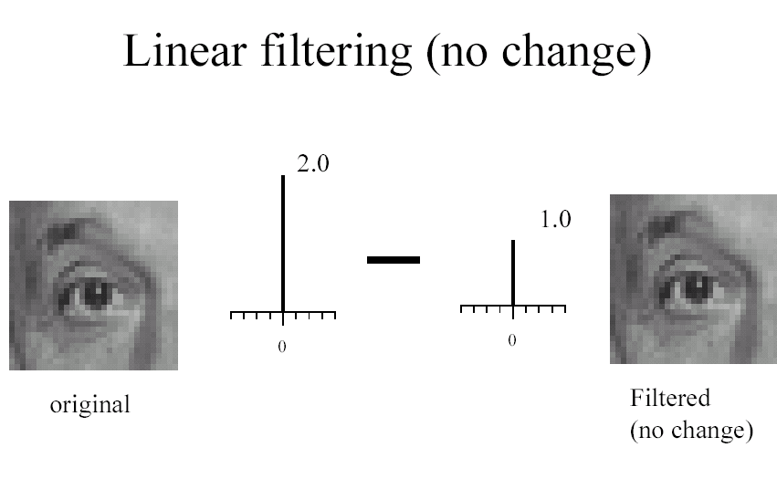

Slide 16
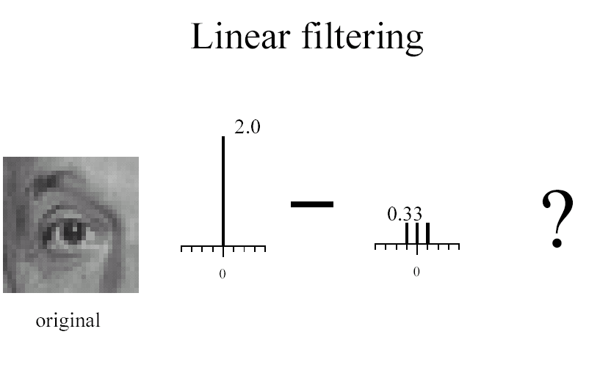

Slide 17
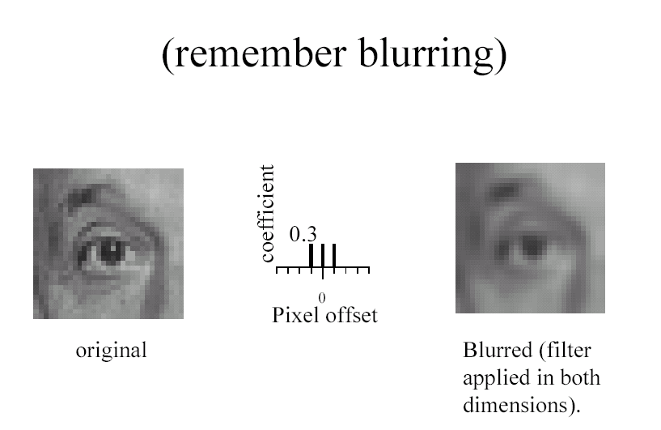

Slide 18
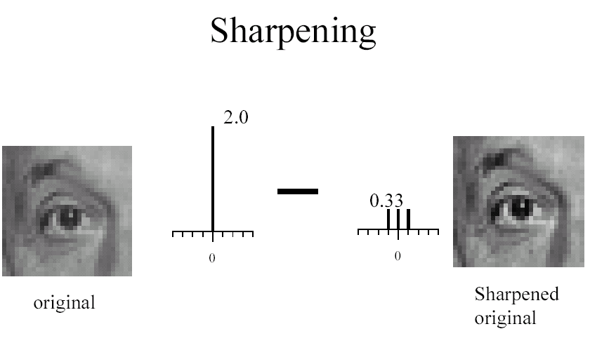

Slide 19
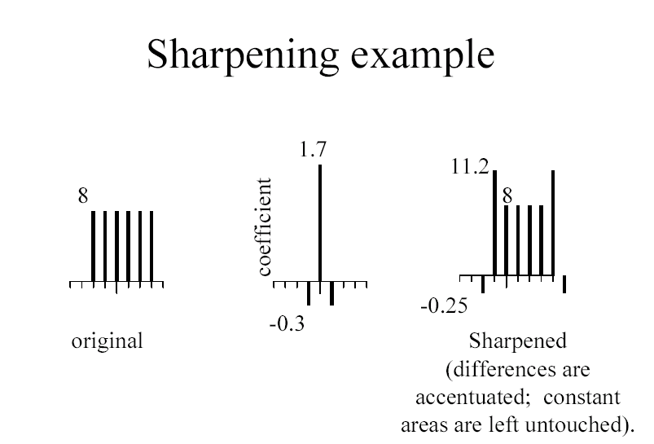

Slide 20
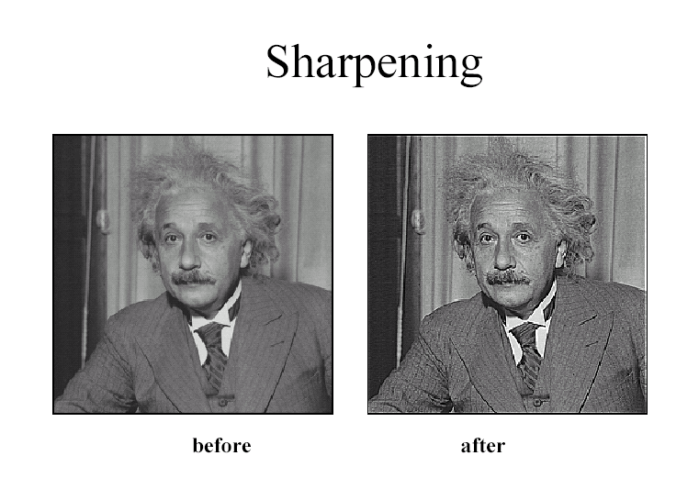

Slide 21
Filtering to reduce noise
Noise is what we’re not interested in.
  We’ll discuss simple, low-level noise today: Light fluctuations; Sensor noise; Quantization effects; Finite precision
  Not complex: shadows; extraneous objects.
A pixel’s neighborhood contains information about its intensity.
Averaging noise reduces its effect.

Slide 22
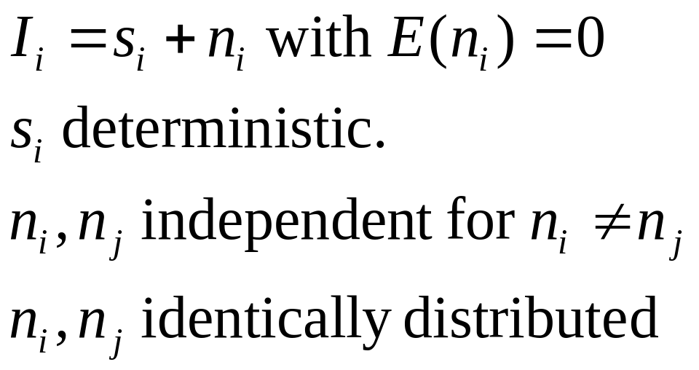
Additive noise
I = S + N. Noise doesn’t depend on signal.
We’ll consider:

Slide 23
Average Filter
Mask with positive entries, that sum 1.
Replaces each pixel with an average of its neighborhood.
If all weights are equal, it is called a BOX filter.
F
1
1
1
1
1
1
1/9
1
1
1

Slide 24
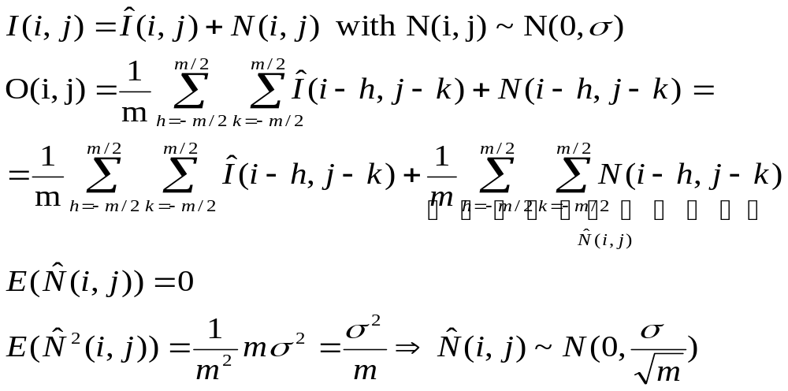
Does it reduce noise?
Intuitively, takes out small variations.
2
2
2

Slide 25
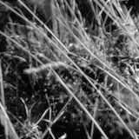
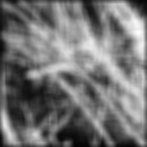
Example: Smoothing by Averaging

Slide 26
Average Filter
Add much weight to the center
Keep the contrast
F
1
1
1
1/10
1
2
1
1
1
1

Slide 27
Smoothing as Inference About the Signal
Neighborhood for averaging.
+
=
Nearby points tell more about the signal than distant ones.

Slide 28
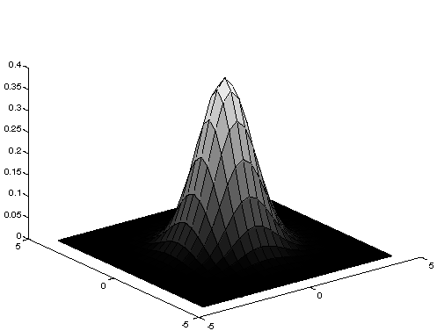
Gaussian Averaging
Rotationally symmetric.
Weights nearby pixels more than distant ones.
  This makes sense as probabalistic inference.
A Gaussian gives a good model of a fuzzy blob

Slide 29
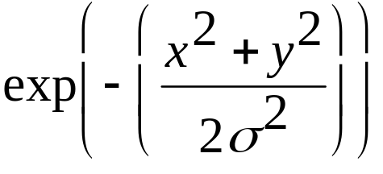
An Isotropic Gaussian
The picture shows a smoothing kernel proportional to
(which is a reasonable model of a circularly symmetric fuzzy blob)

Slide 30

Smoothing with a Gaussian

Slide 31
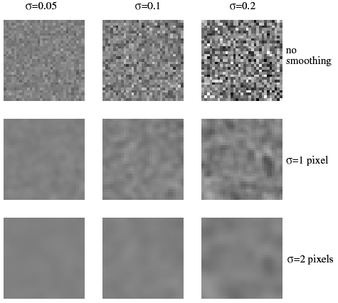
The effects of smoothing
Each row shows smoothing
with gaussians of different
width; each column shows
different realizations of
an image of gaussian noise.

Slide 32
Efficient Implementation
Both, the BOX filter and the Gaussian filter are separable:
  First convolve each row with a 1D filter
  Then convolve each column with a 1D filter.

Slide 33
Smoothing as Inference About the Signal: Non-linear Filters.
+
=
What’s the best neighborhood for inference?

Slide 34
Filtering to reduce noise: Lessons
Noise reduction is probabilistic inference.
Depends on knowledge of signal and noise.
In practice, simplicity and efficiency important.

Slide 35
Filtering and Signal
Smoothing also smooths signal.
Removes detail
This is good and bad:
- Bad: can’t remove noise w/out blurring shape.
- Good: captures large scale structure; allows subsampling.

Slide 36
Subsampling

Slide 37
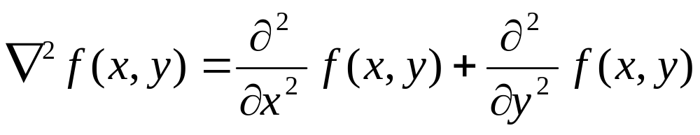
Enhance the Edge
Laplacian
0
-1
0
-1
-1
-1
-1
4
-1
-1
8
-1
0
-1
0
-1
-1
-1

