Slide 1
Image Processing
Edge Detection

Slide 2
Boundary Detection - Edges
Boundaries of objects
  Usually different materials/orientations, intensity changes.

Slide 3
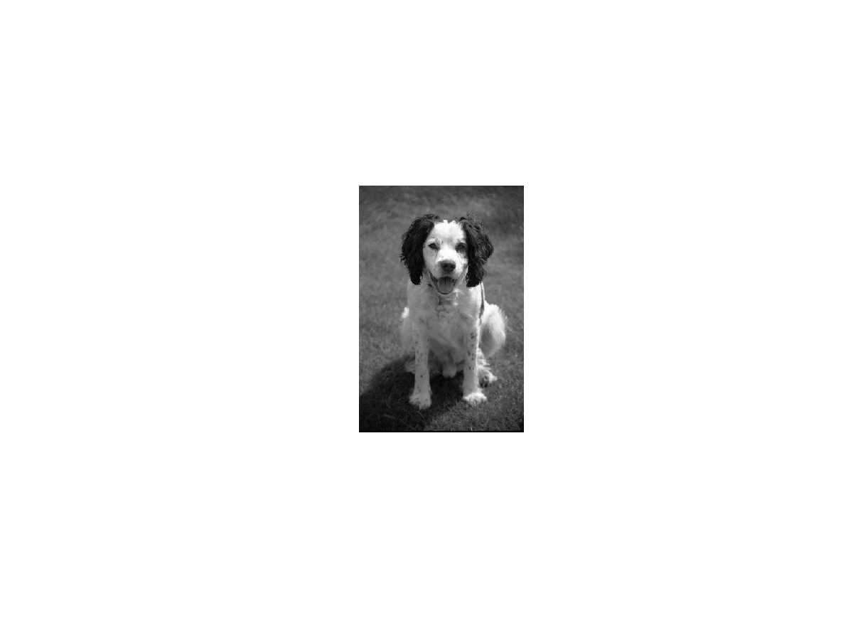

Slide 4
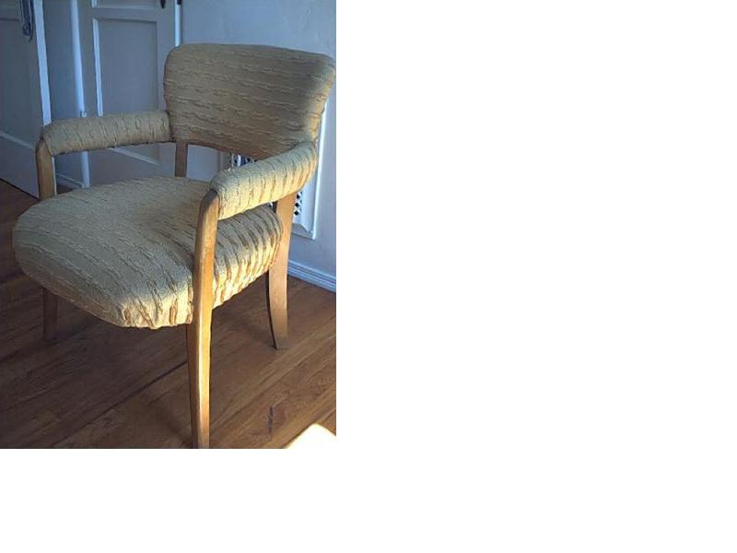
We also get:
Boundaries of surfaces

Slide 5
Boundaries of materials properties

Slide 6
Boundaries of lighting

Slide 7
Edge is Where Change Occurs
Change is measured by derivative in 1D
Biggest change, derivative has maximum magnitude
Or 2nd derivative is zero.

Slide 8
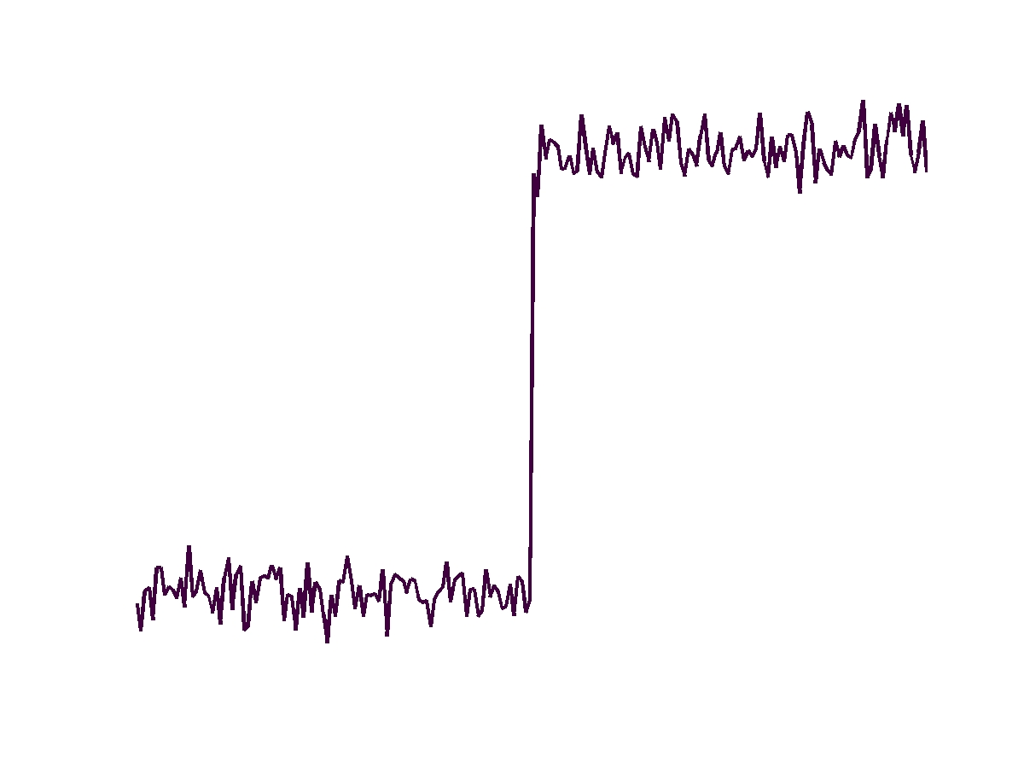
Noisy Step Edge
Gradient is high everywhere.
Must smooth before taking gradient.

Slide 9
Optimal Edge Detection: Canny
Assume:
  Linear filtering
  Additive iid Gaussian noise
Edge detector should have:
  Good Detection. Filter responds to edge, not noise.
  Good Localization: detected edge near true edge.
  Single Response: one per edge.

Slide 10
Optimal Edge Detection: Canny (continued)
Optimal Detector is approximately Derivative of Gaussian.
Detection/Localization trade-off
  More smoothing improves detection
  And hurts localization.
This is what you might guess from (detect change) + (remove noise)

Slide 11
So, 1D Edge Detection has steps:
Filter out noise: convolve with Gaussian
Take a derivative: convolve with [-1 0 1]
Find the peak: Two issues:
  Should be a local maximum.
  Should be sufficiently high.
We can combine 1 and 2.

Slide 12
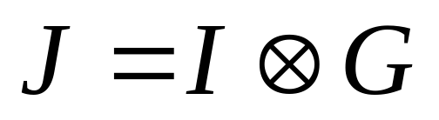
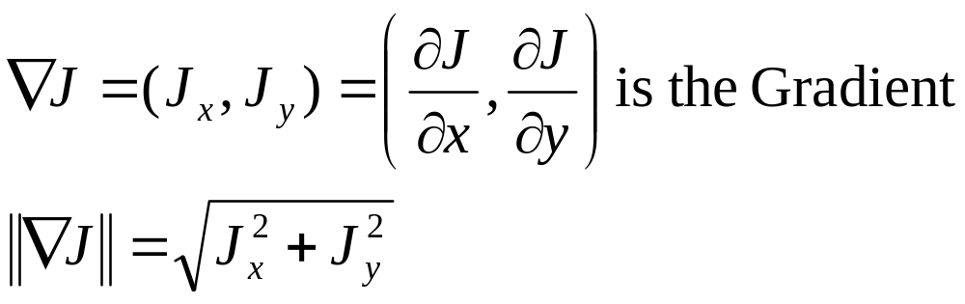
2D Edge Detection: Canny
Filter out noise
  Use a 2D Gaussian Filter.
Take a derivative
  Compute the magnitude of the gradient:

Slide 13
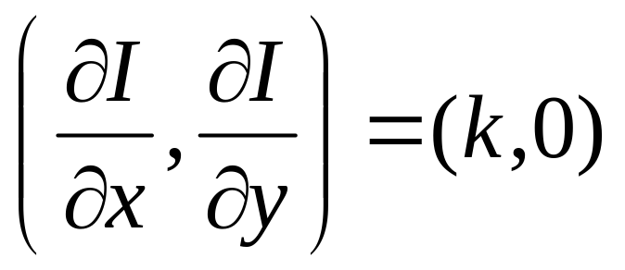
What is the gradient?
No Change
Change

Slide 14
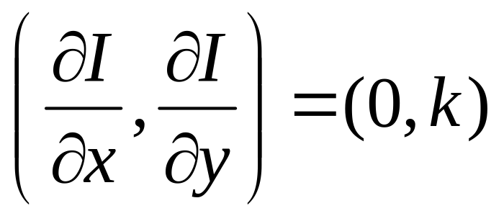
What is the gradient?
Change
No Change

Slide 15
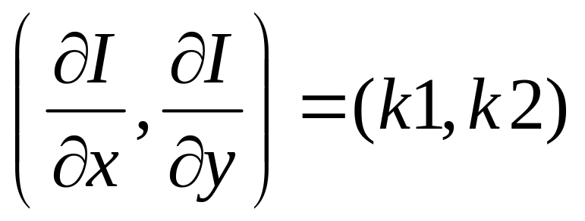
What is the gradient?
Less Change
Gradient direction is perpendicular to edge.
Gradient Magnitude measures edge strength.
Much Change

Slide 16
Smoothing and Differentiation
Need two derivatives, in x and y direction.
We can use a derivative of Gaussian filter
    because differentiation is convolution, and convolution is associative
Notes:
Important to point out that the derivative of gaussian kernels I’ve illustrated “look like” the effects
that they’re trying to identify.

Slide 17
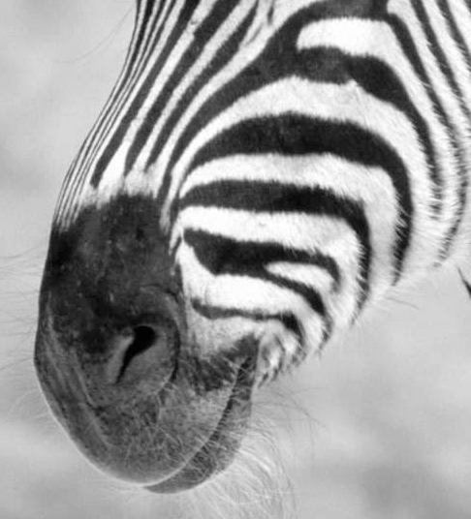
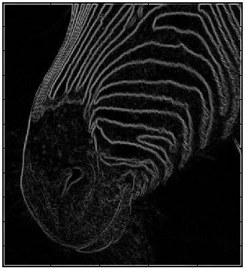
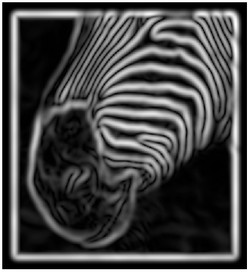
Scale
Smoothing
Eliminates noise edges.
Makes edges smoother.
Removes fine detail.
Notes:
Figures show gradient magnitude of zebra at two different scales

Slide 18
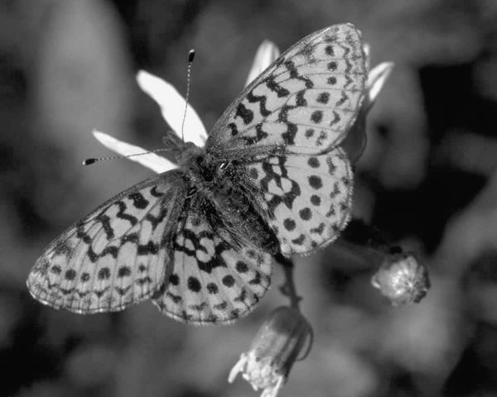

Slide 19
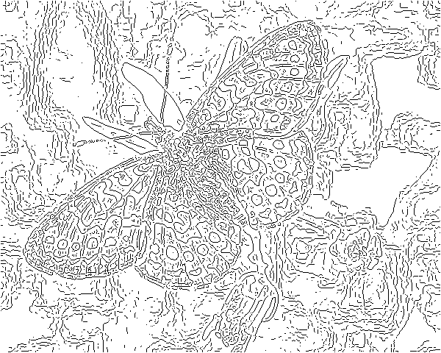
fine scale
high
threshold

Slide 20
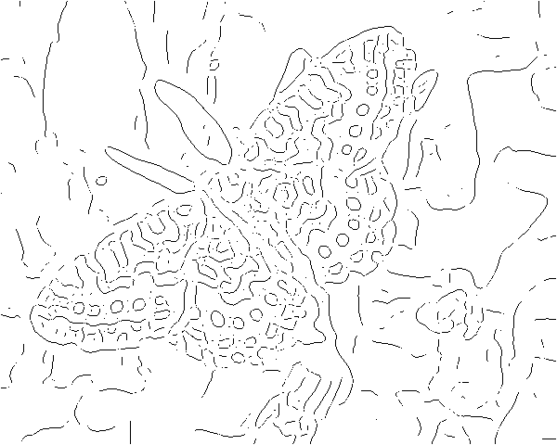
coarse
scale,
high
threshold

Slide 21
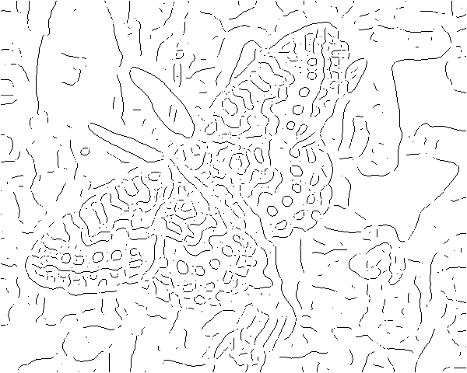
coarse
scale
low
threshold

Slide 22
Finding the Peak
1) The gradient magnitude is large along thick trail; how do we identify the significant points?
2) How do we link the relevant points up into curves?
Notes:
Figures show gradient magnitude of zebra at two different scales

Slide 23


We wish to mark points along the curve where the magnitude is biggest.
We can do this by looking for a maximum along a slice normal to the curve
(non-maximum suppression). These points should form a curve. There are
then two algorithmic issues: at which point is the maximum, and where is the
next one?

Slide 24


Non-maximum
suppression
At q, we have a maximum if the value is larger than those at both p and at r. Interpolate to get these values.
(Forsyth & Ponce)

Slide 25
Predicting
the next
edge point
Assume the marked point is an edge point. Then we construct the tangent to the edge curve (which is normal to the gradient at that point) and use this to predict the next points (here either r or s).

Slide 26
Hysteresis
Check that maximum value of gradient value is sufficiently large
  drop-outs? use hysteresis
    use a high threshold to start edge curves and a low threshold to continue them.

Slide 27
Why is Canny so Dominant
Still widely used after 20 years.
  Theory is nice (but end result same).
  Details good (magnitude of gradient).
  Hysteresis an important heuristic.
  Code was distributed.
  Perhaps this is about all you can do with linear filtering.

Slide 28
More edge detection methods will be introduced in the lecture on segmentation.

Slide 29
Corners
Why are they important?

Slide 30
Corners contain more edges than lines
A point on a line is hard to match.

Slide 31
Corners contain more edges than lines
A corner is easier

Slide 32
Edge Detectors Tend to Fail at Corners

Slide 33
Finding Corners
Intuition:
  Right at corner, gradient is ill defined.
  Near corner, gradient has two different values.

Slide 34
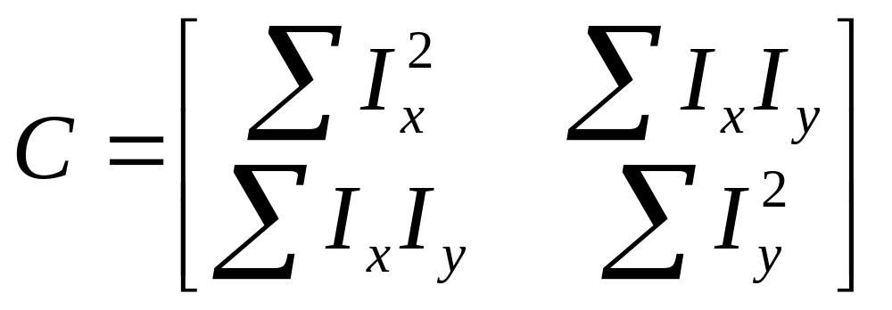
Formula for Finding Corners
We look at matrix:
Gradient with respect to x, times gradient with respect to y
Sum over a small region, the hypothetical corner
WHY THIS?
Matrix is symmetric

Slide 35
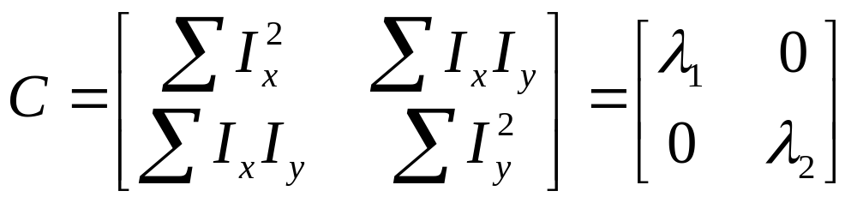
First, consider case where:
This means all gradients in neighborhood are:
(k,0) or (0, c) or (0, 0) (or off-diagonals cancel).
What is region like if:
λ1 = 0?
λ2 = 0?
λ1 = 0 and λ2 = 0?
λ1 > 0 and λ2 > 0?

Slide 36
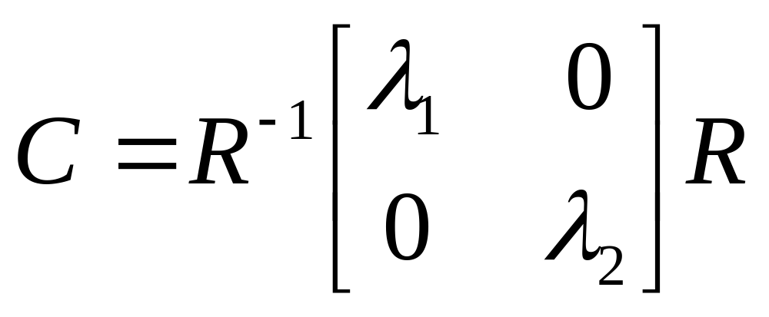
General Case:
From Linear Algebra we haven’t talked about it follows that since C is symmetric:
So every case is like one on last slide.

Slide 37
So, to detect corners
Filter image.
Compute magnitude of the gradient everywhere.
We construct C in a window.
Use Linear Algebra to find λ1 and λ2.
If they are both big, we have a corner.

Slide 38
Some Edge Operators
Directional Edge
-1
-1
-1
-1
0
1
-1
-1
0
0
1
1
0
0
0
-1
0
1
-1
0
1
-1
0
1
1
1
1
-1
0
1
0
1
1
-1
-1
0

Slide 39
Some Edge Operators
Kirsch
+5
+5
+5
-3
+5
+5
-3
-3
+5
-3
-3
-3
-3
0
-3
-3
0
+5
-3
0
+5
-3
0
+5
-3
-3
-3
-3
-3
-3
-3
-3
+5
-3
+5
+5

Slide 40
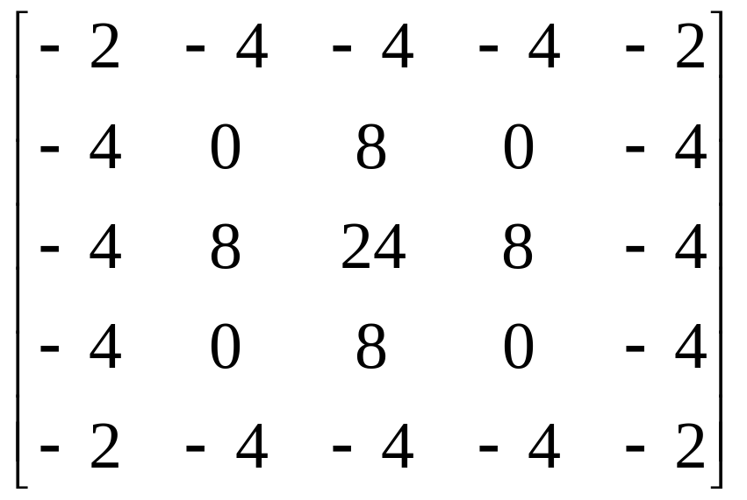
Some Edge Operators
LOG(Mexican Cap)

