Slide 1
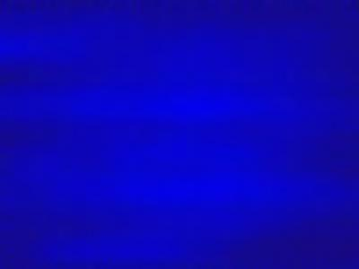
Computer Graphics
Lecture 2
Dithering, Halftoning, Sampling & Aliasing

Slide 2
Dithering and Halftoning
How to print a color picture on a black-white printer?
If you have just a 256 color screen, how can you display a true color picture with millions color?

Slide 3
Dithering and Halftoning
Trade spatial for intensity resolution
Thresholding
Random dither; Robert’s algorithm
Ordered dither
Error diffusion
Your eye will average over an area
  - Spatial Integration
Notes:
Dithering is examinable.

Slide 4
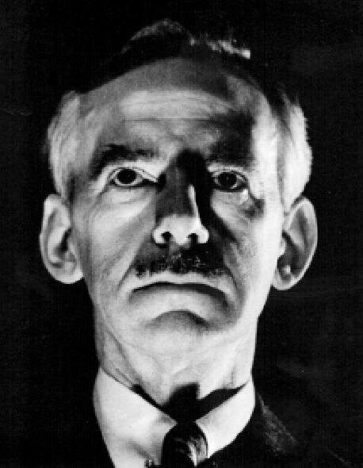
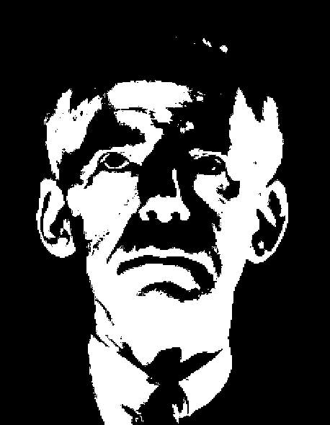
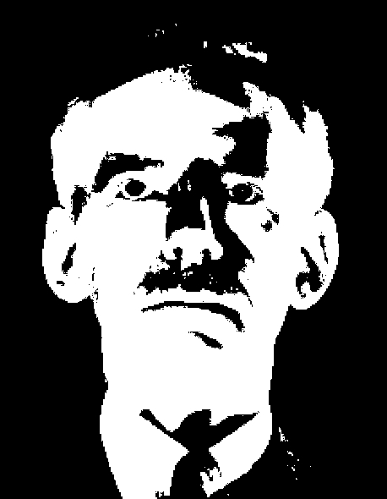

Thresholding.
Original image.
n = 0.5
Simple threshold.
n= 0.7
Errors are low spatial frequencies.

Slide 5

Robert’s Algorithm
First add noise
Then quantize
i
r + 1
1
Quantised to 1
Quantised to 0
0
r
x
Moves errors to higher spatial frequencies.
-> eye averages over an area.

Slide 6
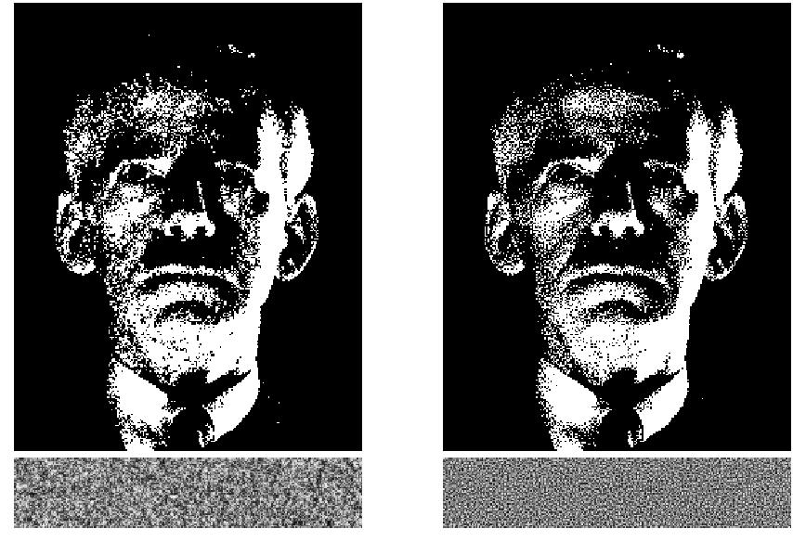
Robert’s Algorithm
Moves low frequency (average error) to high frequency
Pink(low), Blue (high), White(all) frequency noise
Pink
Blue

Slide 7
The trouble with noise.
Difficult to compute quickly.
Not reproducible.
Pre-compute pseudo-random function and store in table.
Small tiled patterns sufficient

Slide 8
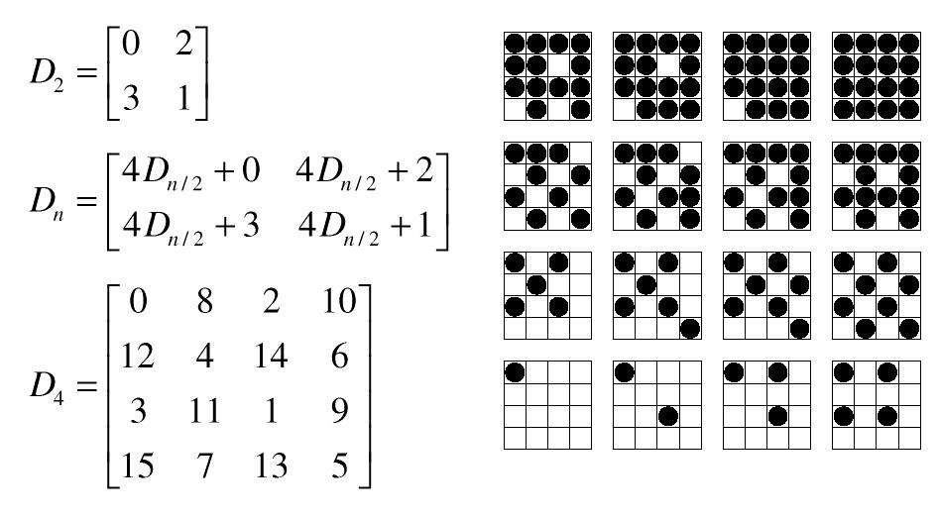
Ordered Dithering
Trade off spatial resolution for intensity resolution.
Use dither patterns.
Can be represented as a matrix.
Notes:
Ordered dither – not examinable.

Slide 9
A core algorithm
for(y=0; y<ny; y++)
for(x=0; x<nx; x++){
I=x mod n;
J=y mod n;
vq[x][y] = compare(v[x][y],D(I,J));
}

Slide 10
Bayer Ordered Dither Patterns

Slide 11
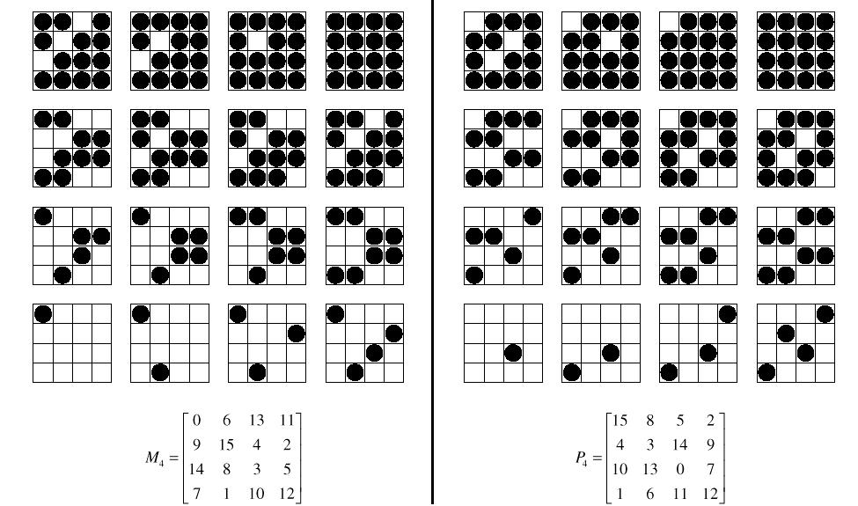
Other possibilities.

Slide 12
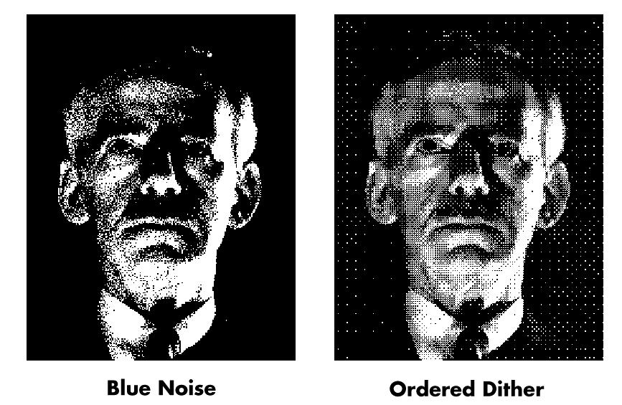
Comparison

Slide 13
Error Diffusion.
Idea: Quantize, then distribute error to neighbours
for(y=0; y<ny; y++)
for(x=0; x<nx; x++){
vq[x][y] = quantize(v[x][y]);
e = v[x][y] - vq[x][y];
i[x+1][y] += 3/8*e;
i[x][y+1] += 3/8*e;
i[x+1][y+1] += 1/4*e;
}
e
-3e/8
-3e/8
-e/4

Slide 14
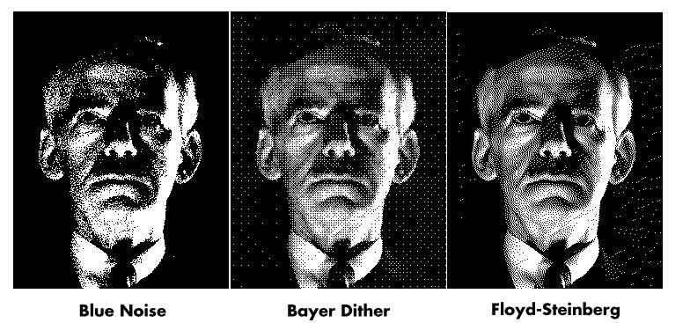
Comparison.

Slide 15
Sampling & Aliasing
Real world is continuous
The computer world is discrete
Mapping a continuous function to a discrete one is called sampling
Mapping a continuous variable to a discrete one is called quantizaion
To represent or render an image using a computer, we must both sample and quantize

Slide 16
Displays → Signal Reconstruction.
All physical displays recreate a continuous image from a discrete sampled image by using a finite sized source of light for each pixel.
Reconstruction
Discrete input values.
Continuous Light Output.

Slide 17
Recall: a pixel is a point…
It is NOT a box, disc or teeny wee light
It has no dimension
It occupies no area
It can have a coordinate
More than a point, it is a SAMPLE

Slide 18
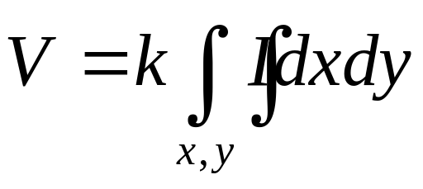
Imaging devices area sample.
Video camera : CCD array.
Regular array of imaging
sensors.
y
Intensity, I
Value sensed is an area integral over a pixel.
x

Slide 19
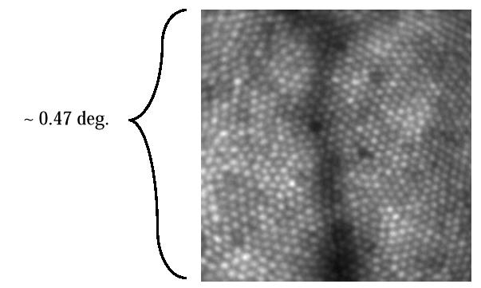
Imaging devices area sample.
The eye : photoreceptors
Film is similar : irregular
array of receptors.
J. Liang, D. R. Williams and D. Miller, "Supernormal vision
and high- resolution retinal imaging through adaptive optics,"
J. Opt. Soc. Am. A 14, 2884- 2892 (1997)

Slide 20
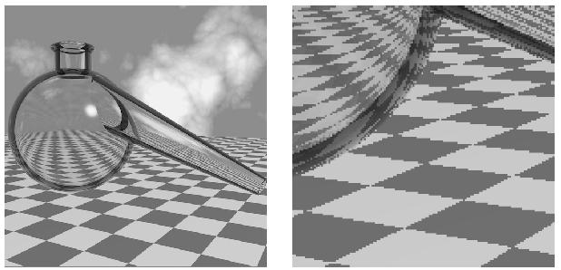
What’s different about computer graphics ?
Model of Scene.
- points
- lines
- 3D objects
- lighting etc
Point Sampling.
Query values of pixels
Frame Buffer

Slide 21
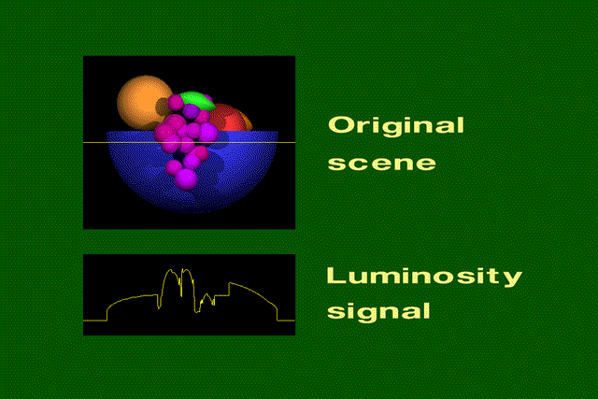
Continuous Luminosity signal
Slide © Rosalee Nerheim-Wolfe

Slide 22
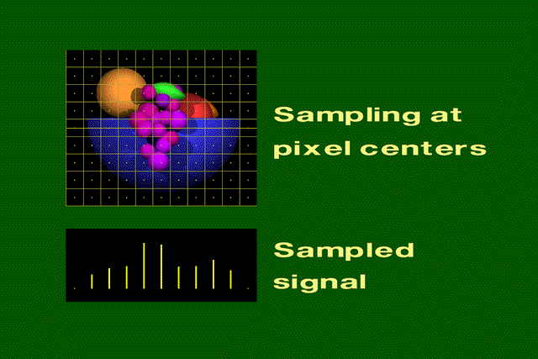
Sampled Luminosity
Slide © Rosalee Nerheim-Wolfe

Slide 23
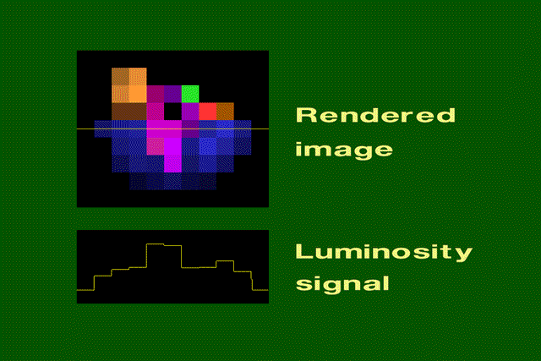
Reconstructed luminosity
Slide © Rosalee Nerheim-Wolfe

Slide 24
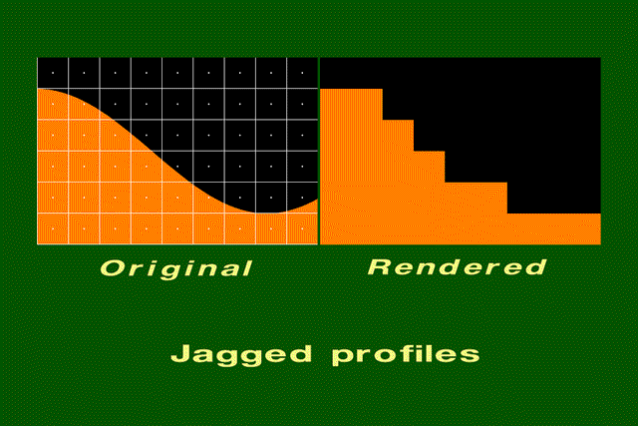
Reconstruction artefact
Slide © Rosalee Nerheim-Wolfe

Slide 25
Staircasing or Jaggies
The raster aliasing effect – removal is called antialiasing

Slide 26
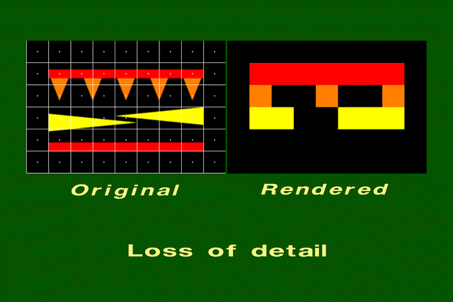
Can be a serious problem…
Slide © Rosalee Nerheim-Wolfe

Slide 27
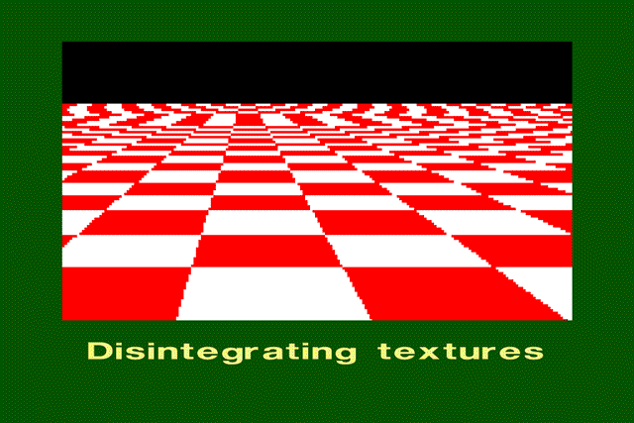
…very serious problem!
Slide © Rosalee Nerheim-Wolfe

Slide 28
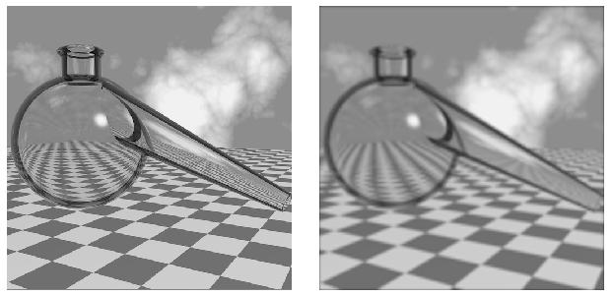
Blurring doesn’t work well.
Removed the jaggies, but also all the detail ! → Reduction in resolution
Notes:
Ineffectivenes of blurring – important.

Slide 29
Area sampling is costly
Computationally expensive.
Difficult to do analytically in a 3D environment
  Single sample is a ray in 3D - easy computation of intersections.
Area sample becomes a cone !
  Reflections difficult.
Is it an optimum solution ?

Slide 30
How is antialiasing done?
We need some mathematical tools to
  analyse the situation.
  find an optimum solution.
Tools we will use :
  Fourier transform.
  Convolution theory.
  Sampling theory.

Slide 31
Spectral Analysis / Fourier Transforms
Spectral representation treats the function as a weighted sum of sines and cosines
Every function has two representations
  Spatial (time) domain - normal representation
  Frequency domain - spectral representation
The Fourier transform converts between the spatial and frequency domains.

Slide 32
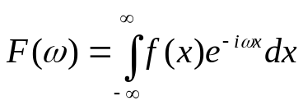
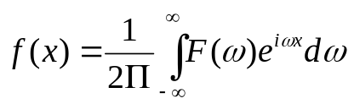

Spectral Analysis / Fourier Transforms
The Fourier transform converts between the spatial and frequency domain.
Note the Euler formula :
Real and imaginary components.
Forward and reverse transforms very similar.
  Reversal in sign of imaginary component, scale constant.
Spatial domain
Frequency domain.
Notes:
Don’t need to know this

Slide 33
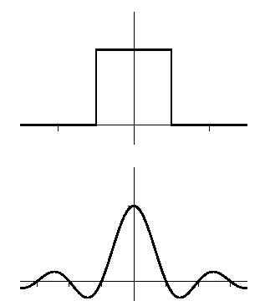
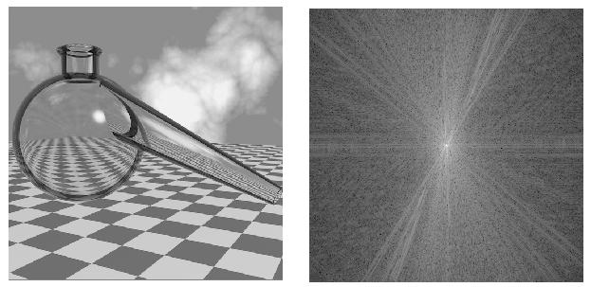
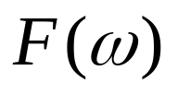
Fourier transform conventions.
We will use the ‘optical’ convention.
Note : spectral transform has
origin in centre, and is symmetrical
f(x)
Low frequencies in centre,
High frequencies at the edge. Note symmetry.
Notes:
Important to know the principle of the fourier transform and the transform of a boxcar function.

Slide 34
Robert’s algorithm
Pink Noise
Blue Noise

Slide 35
Noise spectra.
Pink Noise
f
Blue Noise
f
White Noise
f

Slide 36
Some important properties of Fourier transforms.
Finite function ⇔ Infinite function.
  eg. single sine wave ⇔ single point or ‘delta’ function.
Square or boxcar function - corresponds to 1 pixel.
1
Function called :
Square(x)
-1/2
+1/2

Slide 37
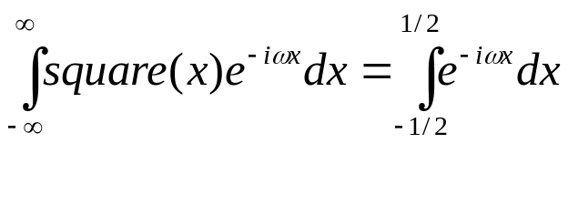
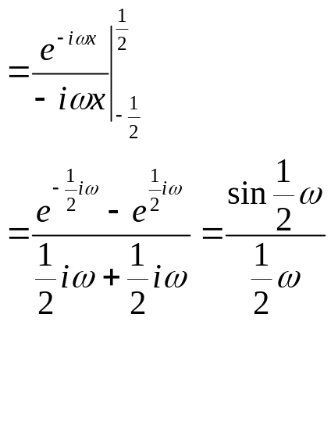
The ‘Sinc’ function.
= sinc f
Recall Euler’s formula :

Slide 38
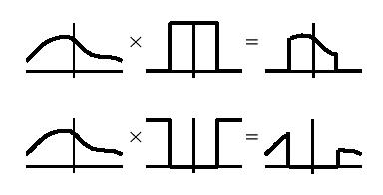
Filtering in the frequency domain
Frequency
domain
Image
Filter
Image
Fourier
Transform
Fourier
Transform
Lowpass filter
Highpass filter

Slide 39
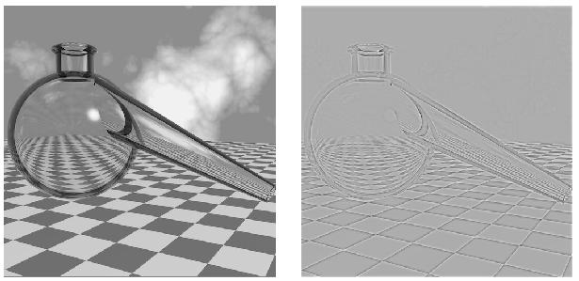
Filtering.
Low pass
High pass

Slide 40
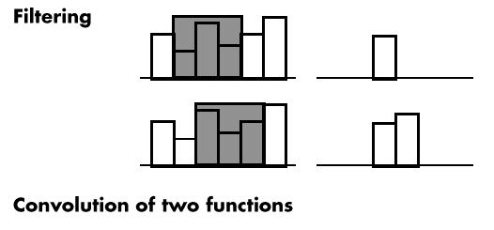
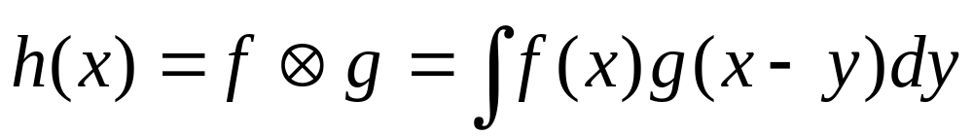
Filtering in the space domain
Blurring or averaging pixels together.
g(y)
Integrate
over y
Calculate integral of one function, f(x) by a sliding second function g(x-y).
Known as Convolution.
f(x)
h(x)
Increment
x

Slide 41
Convolution theorem.
Theorem: Multiplication in the frequency domain is equivalent to convolution in the space domain.
Symmetric Theorem: Multiplication in the space domain is equivalent to convolution in the frequency domain.
Notes:
Important to know the relationship between convolution and multiplication in the other domain.

Slide 42
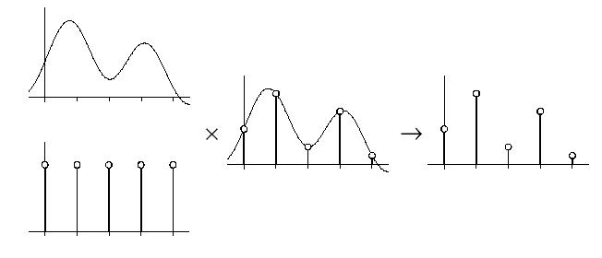
How can we represent sampling ?
Multiplication of the sample with a regular train of delta functions.

Slide 43
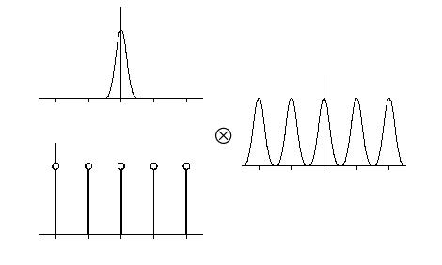
Sampling: Frequency domain.
Need Fourier transform of regular train of delta functions.
  - A regular train of delta functions - spacing is inversely proportional
So convolve with this function.
Multiple solutions at regularly increasing values of f

Slide 44
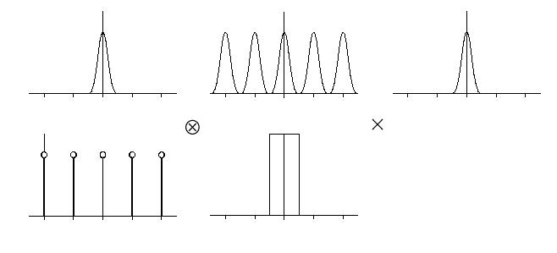
Reconstruction in frequency domain
Original signal.
Bandpass filter due to regular array of pixels.

Slide 45
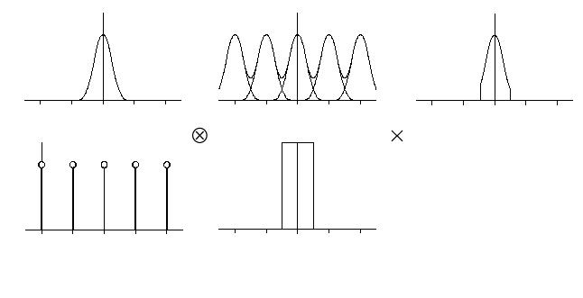
Undersampling leads to aliasing.
Samples are too close
together in f.
Spurious components :
Cause of aliasing.
Notes:
Don’t need to know this

Slide 46
The Sampling Theorem.
This result is known as the Sampling Theorem and is due to Claude Shannon who first discovered it in 1949
For a given bandlimited function, the rate at which it must be sampled is called the Nyquist Frequency
A signal can be reconstructed from its samples
without loss of information, if the original signal
has no frequencies above 1/2 the sampling frequency
Notes:
Do need to know this

Slide 47
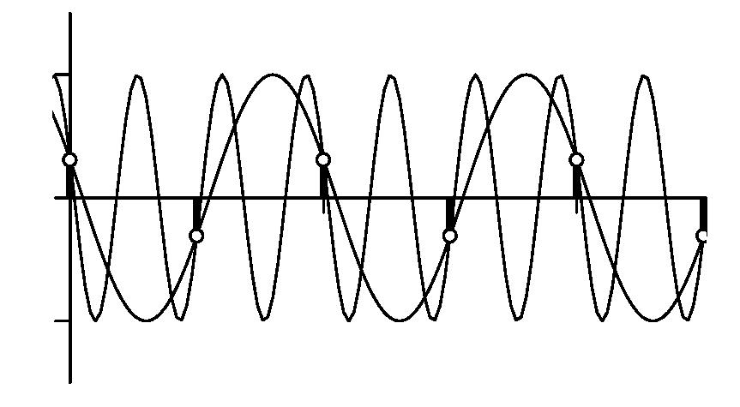
Aliasing in the space domain.
Original signal
Aliased result
Summary : Aliasing is the appearance of spurious signals when the frequency of the
input signal goes above the Nyquist limit.

Slide 48
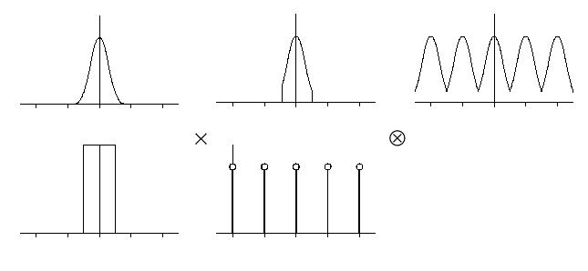
How do we remove aliasing ?
Perfect solution - prefilter with perfect bandpass filter.
No aliasing.
Aliased example
Perfect bandpass

Slide 49
How do we remove aliasing ?
Perfect solution - prefilter with perfect bandpass filter.
  Difficult/Impossible to do in frequency domain
Convolve with sinc function in space domain
  Optimal filter - better than area sampling.
  Sinc function is infinite !!
  Computationally expensive.

Slide 50
How do we remove aliasing ?
Cheaper solution : take multiple samples for each pixel and average them together → supersampling.
Can weight them towards the centre → weighted average sampling
Stochastic sampling
Removing aliasing is called antialiasing

